Slide 1
AQA
    AS Level
      Computer Science
      Paper 2
Boolean algebra
  Unit 4
  Hardware
  and software

Slide 2
Objectives
Be familiar with the use of Boolean identities and De Morgan’s laws to manipulate and simplify Boolean expressions
Write a Boolean expression for a given logic gate circuit, and vice versa

Slide 3
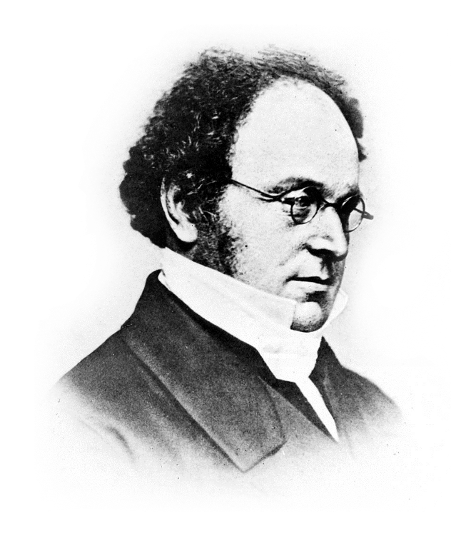
Augustus de Morgan (1806 - 71)
de Morgan was a mathematician and logician who formulated laws to simplify Boolean expressions
This had little practical use in his lifetime but became of major significance with the advent of computers

Slide 4
De Morgan’s laws
In the last lesson, it was stated that any Boolean function can be converted to one using only NAND functions
It is also true that any Boolean function can be converted to one using only NOR functions
  Using only one type of gate reduces manufacturing costs
  De Morgan would have been astonished that his work had such commercial significance!

Slide 5
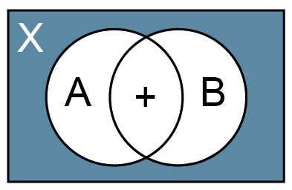
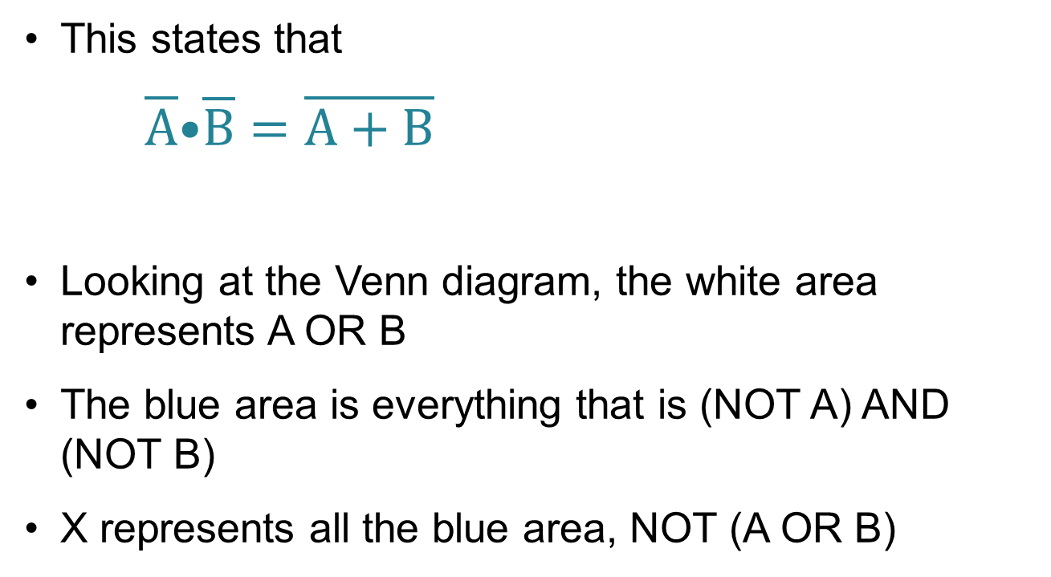
De Morgan’s first law
This states that
$\overline{A}\text{•}\overline{B}=\overline{A+B}$
Looking at the Venn diagram, the white area represents A OR B
The blue area is everything that is (NOT A) AND (NOT B)
X represents all the blue area, NOT (A OR B)

Slide 6

De Morgan’s first law
Complete the truth table to show that de Morgan’s Law is true, i.e. $\overline{A}\text{•}\overline{B}=\overline{A+B}$
A | B | A + B | A + B |  | A • B | B | A
0 | 0 |  |  |  |  |  | 1
0 | 1 |  |  |  |  |  | 1
1 | 0 |  |  |  |  |  | 0
1 | 1 |  |  |  |  |  | 0

Slide 7
De Morgan’s first law
Complete the truth table to show that de Morgan’s Law is true, i.e. $\overline{A}\text{•}\overline{B}=\overline{A+B}$
A | B | A + B | A + B |  | A • B | B | A
0 | 0 | 0 |  |  |  |  | 1
0 | 1 | 1 |  |  |  |  | 1
1 | 0 | 1 |  |  |  |  | 0
1 | 1 | 1 |  |  |  |  | 0

Slide 8
De Morgan’s first law
Complete the truth table to show that de Morgan’s Law is true, i.e. $\overline{A}\text{•}\overline{B}=\overline{A+B}$
A | B | A + B | A + B |  | A • B | B | A
0 | 0 | 0 | 1 |  |  |  | 1
0 | 1 | 1 | 0 |  |  |  | 1
1 | 0 | 1 | 0 |  |  |  | 0
1 | 1 | 1 | 0 |  |  |  | 0

Slide 9
De Morgan’s first law
Complete the truth table to show that de Morgan’s Law is true, i.e. $\overline{A}\text{•}\overline{B}=\overline{A+B}$
A | B | A + B | A + B |  | A • B | B | A
0 | 0 | 0 | 1 |  |  | 1 | 1
0 | 1 | 1 | 0 |  |  | 0 | 1
1 | 0 | 1 | 0 |  |  | 0 | 0
1 | 1 | 1 | 0 |  |  | 0 | 0

Slide 10
De Morgan’s first law
Complete the truth table to show that de Morgan’s Law is true, i.e. $\overline{A}\text{•}\overline{B}=\overline{A+B}$
A | B | A + B | A + B |  | A • B | B | A
0 | 0 | 0 | 1 |  | 1 | 1 | 1
0 | 1 | 1 | 0 |  | 0 | 0 | 1
1 | 0 | 1 | 0 |  | 0 | 1 | 0
1 | 1 | 1 | 0 |  | 0 | 0 | 0

Slide 11
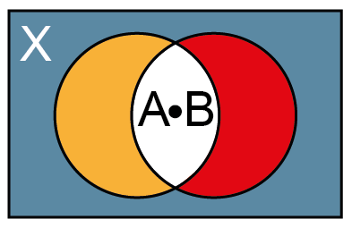
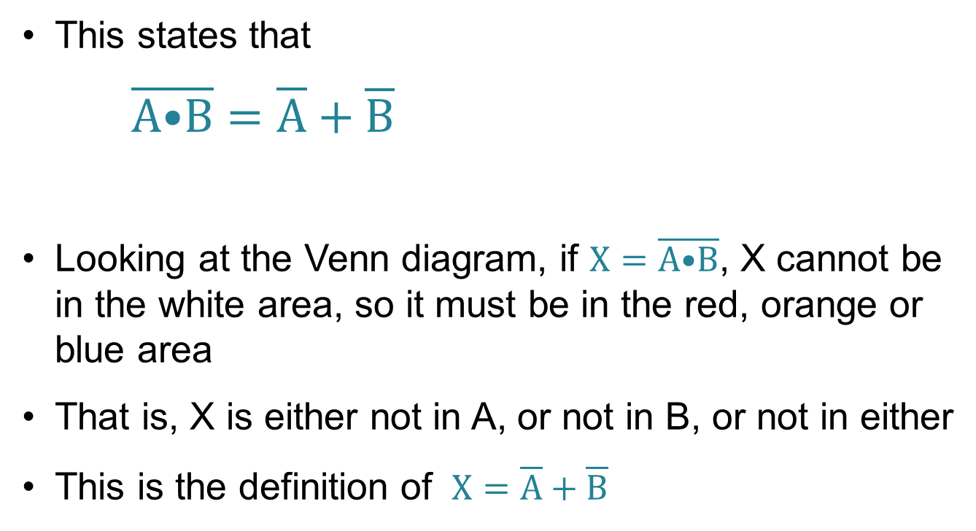
De Morgan’s second law
This states that
$\overline{A\text{•}B}=\overline{A}+\overline{B}$
Looking at the Venn diagram, if $X=\overline{A\text{•}B}$, X cannot be in the white area, so it must be in the red, orange or blue area
That is, X is either not in A, or not in B, or not in either
This is the definition of $X=\overline{A}+\overline{B}$

Slide 12

De Morgan’s second law
Complete the truth table to show that de Morgan’s Law is true, i.e. $\overline{\text{A}\text{•}B}=\overline{A}+\overline{B}$
A | B | A • B | A • B |  | A + B | B | A
0 | 0 |  |  |  |  |  | 1
0 | 1 |  |  |  |  |  | 1
1 | 0 |  |  |  |  |  | 0
1 | 1 |  |  |  |  |  | 0

Slide 13
De Morgan’s second law
Complete the truth table to show that de Morgan’s Law is true, i.e. $\overline{\text{A}\text{•}B}=\overline{A}+\overline{B}$
A | B | A • B | A • B |  | A + B | B | A
0 | 0 | 0 |  |  |  |  | 1
0 | 1 | 0 |  |  |  |  | 1
1 | 0 | 0 |  |  |  |  | 0
1 | 1 | 1 |  |  |  |  | 0

Slide 14
De Morgan’s second law
Complete the truth table to show that de Morgan’s Law is true, i.e. $\overline{\text{A}\text{•}B}=\overline{A}+\overline{B}$
A | B | A • B | A • B |  | A + B | B | A
0 | 0 | 0 | 1 |  |  |  | 1
0 | 1 | 0 | 1 |  |  |  | 1
1 | 0 | 0 | 1 |  |  |  | 0
1 | 1 | 1 | 0 |  |  |  | 0

Slide 15
De Morgan’s second law
Complete the truth table to show that de Morgan’s Law is true, i.e. $\overline{\text{A}\text{•}B}=\overline{A}+\overline{B}$
A | B | A • B | A • B |  | A + B | B | A
0 | 0 | 0 | 1 |  |  | 1 | 1
0 | 1 | 0 | 1 |  |  | 0 | 1
1 | 0 | 0 | 1 |  |  | 1 | 0
1 | 1 | 1 | 0 |  |  | 0 | 0

Slide 16
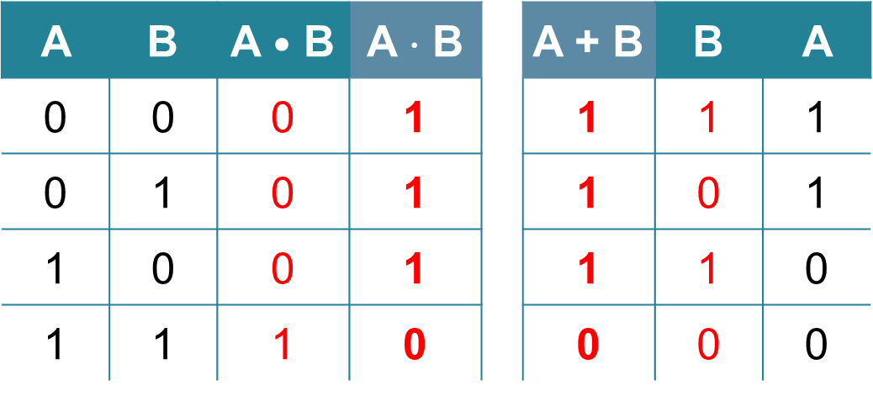
Proof!
Complete the truth table to show that de Morgan’s Law is true, i.e. $\overline{\text{A}\text{•}B}=\overline{A}+\overline{B}$
A | B | A $\text{•}$ B | A ⋅ B |  | A + B | B | A
0 | 0 | 0 | 1 |  | 1 | 1 | 1
0 | 1 | 0 | 1 |  | 1 | 0 | 1
1 | 0 | 0 | 1 |  | 1 | 1 | 0
1 | 1 | 1 | 0 |  | 0 | 0 | 0

Slide 17
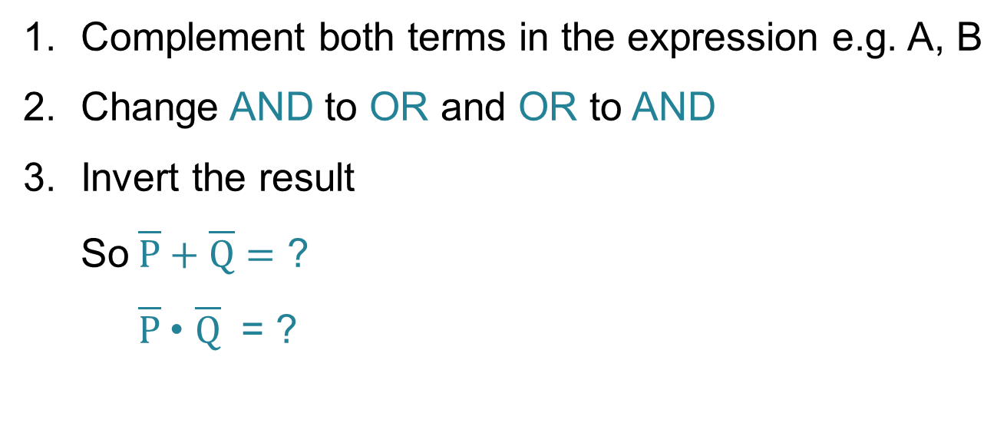
Implementing de Morgan’s laws
Complement both terms in the expression e.g. A, B
Change AND to OR and OR to AND
Invert the result
So $\overline{P}+\overline{Q}=$ ?
$\overline{P}$• $\overline{Q}$ = ?

Slide 18
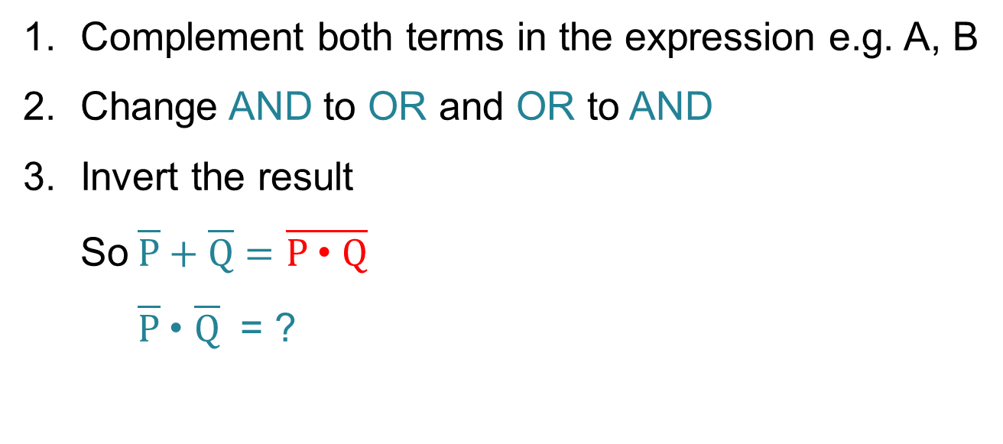
Implementing de Morgan’s laws
Complement both terms in the expression e.g. A, B
Change AND to OR and OR to AND
Invert the result
So $\overline{P}+\overline{Q}=$ $\overline{P \text{•} Q}$
$\overline{P}$• $\overline{Q}$ = ?

Slide 19
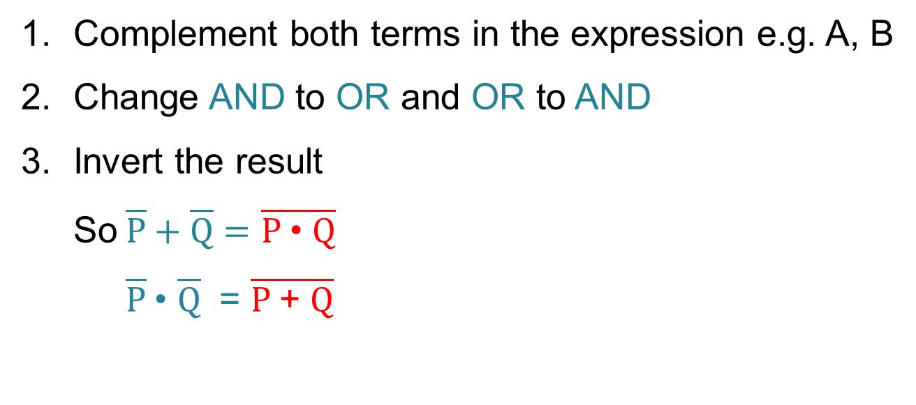
Implementing de Morgan’s laws
Complement both terms in the expression e.g. A, B
Change AND to OR and OR to AND
Invert the result
So $\overline{P}+\overline{Q}=$ $\overline{P \text{•} Q}$
$\overline{P}$• $\overline{Q}$ = $\overline{P \text{+} Q}$

Slide 20
Simplifying expressions
You need to be able to simplify given Boolean expressions
As well as de Morgan’s laws, there are several other “simplification rules” that will help you to do this
See if you can fill in the first column on the next slide – remember, X and Y can only be either TRUE or FALSE
1 = TRUE, 0 = FALSE

Slide 21
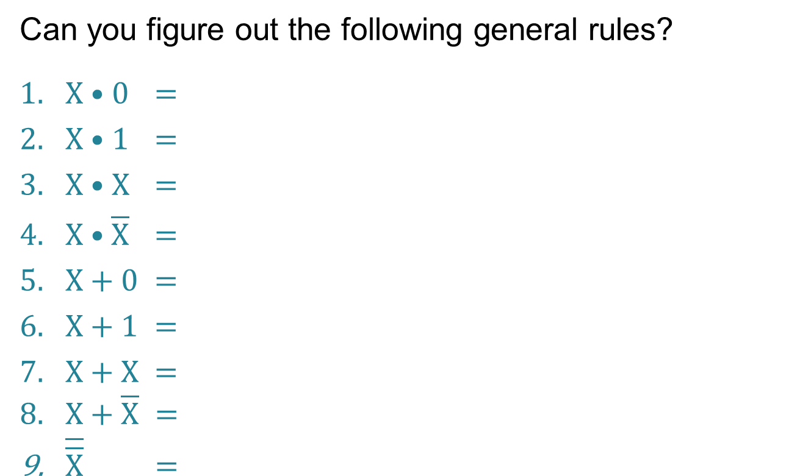
Simplifying expressions
Can you figure out the following general rules?
$X$• 0 =
X • 1 =
X • X =
$X \text{•}$ $\overline{X}$ =
X + 0 =
X + 1 =
X + X =
X + $\overline{X} =$
$\overline{\overline{X}} =$

Slide 22
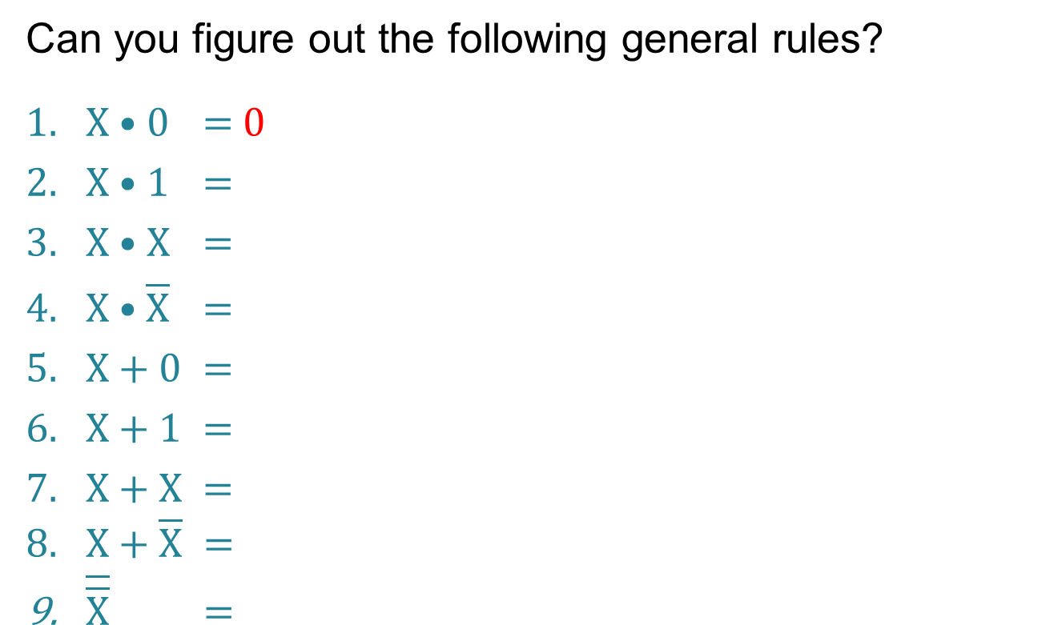
Simplifying expressions
Can you figure out the following general rules?
$X$• 0 = 0
X • 1 =
X • X =
$X \text{•}$ $\overline{X}$ =
X + 0 =
X + 1 =
X + X =
X + $\overline{X} =$
$\overline{\overline{X}} =$

Slide 23
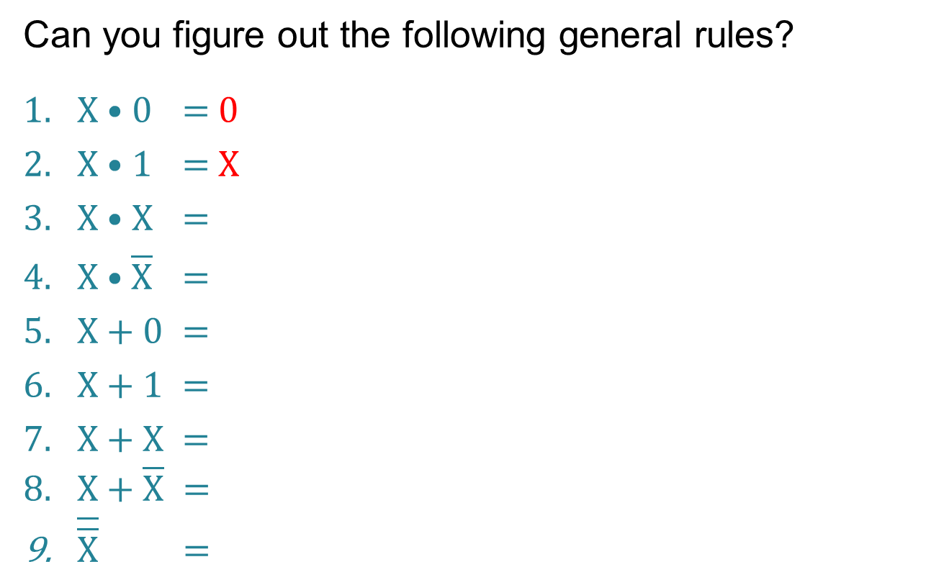
Simplifying expressions
Can you figure out the following general rules?
$X$• 0 = 0
X • 1 = X
X • X =
$X \text{•}$ $\overline{X}$ =
X + 0 =
X + 1 =
X + X =
X + $\overline{X} =$
$\overline{\overline{X}} =$

Slide 24
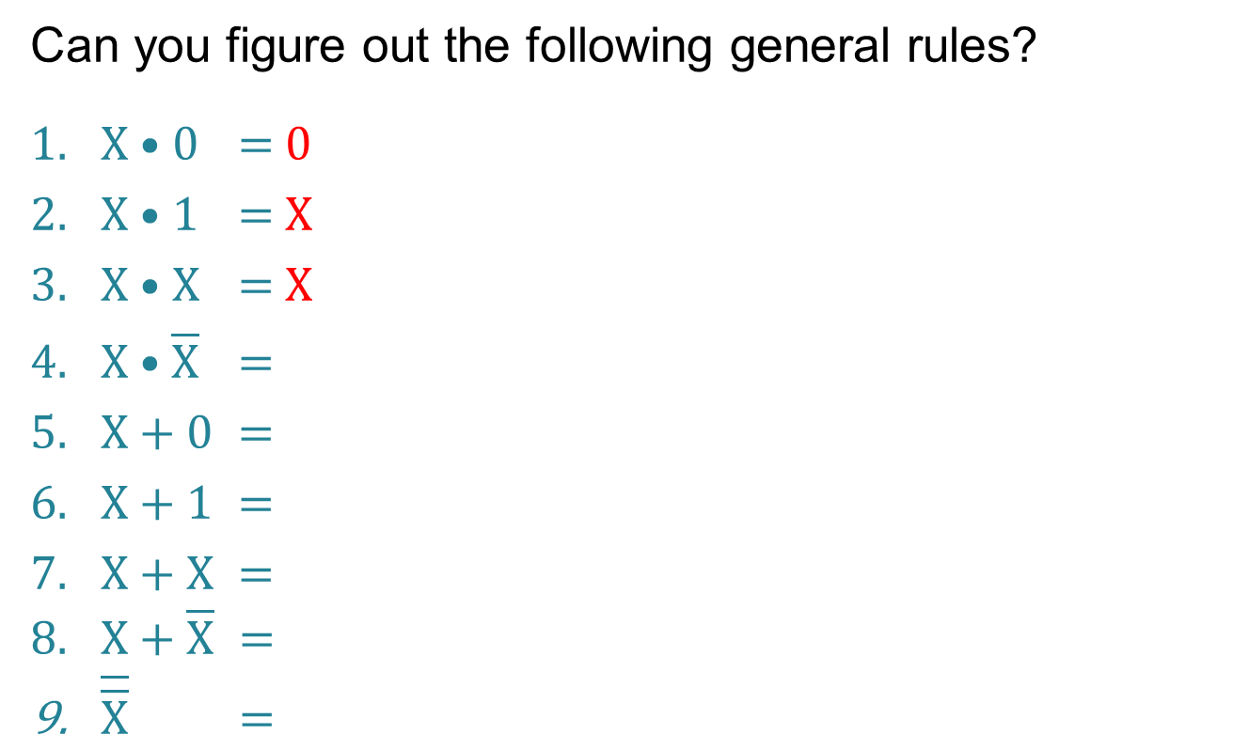
Simplifying expressions
Can you figure out the following general rules?
$X$• 0 = 0
X • 1 = X
X • X = X
$X \text{•}$ $\overline{X}$ =
X + 0 =
X + 1 =
X + X =
X + $\overline{X} =$
$\overline{\overline{X}} =$

Slide 25
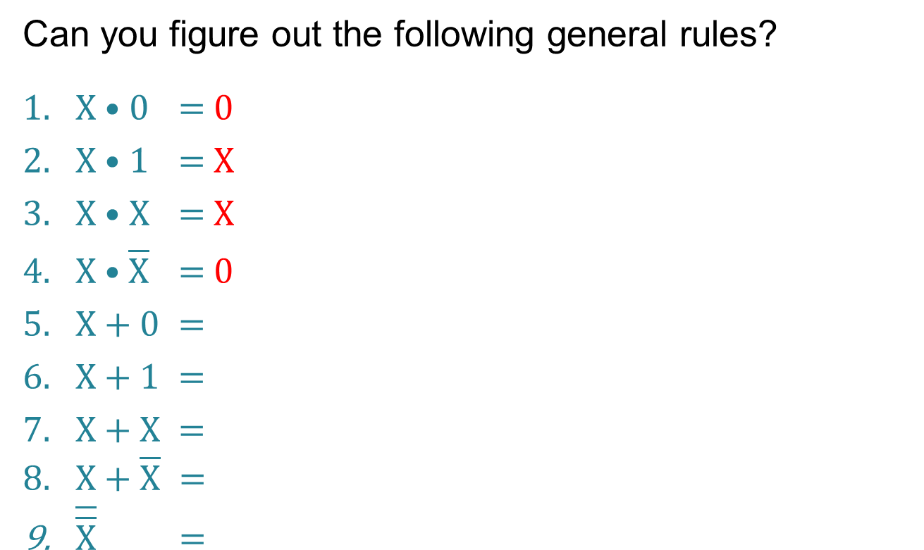
Simplifying expressions
Can you figure out the following general rules?
$X$• 0 = 0
X • 1 = X
X • X = X
$X \text{•}$ $\overline{X}$ = 0
X + 0 =
X + 1 =
X + X =
X + $\overline{X} =$
$\overline{\overline{X}} =$

Slide 26
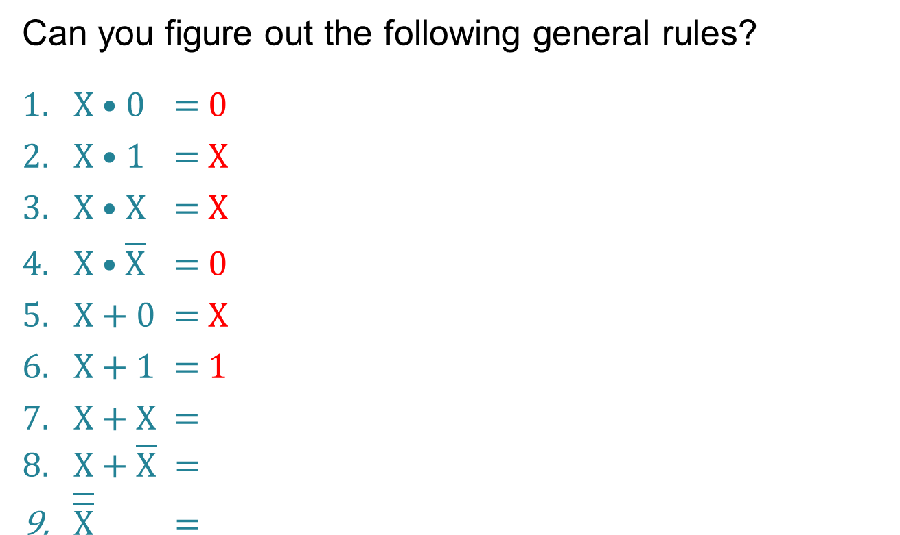
Simplifying expressions
Can you figure out the following general rules?
$X$• 0 = 0
X • 1 = X
X • X = X
$X \text{•}$ $\overline{X}$ = 0
X + 0 = X
X + 1 = 1
X + X =
X + $\overline{X} =$
$\overline{\overline{X}} =$

Slide 27
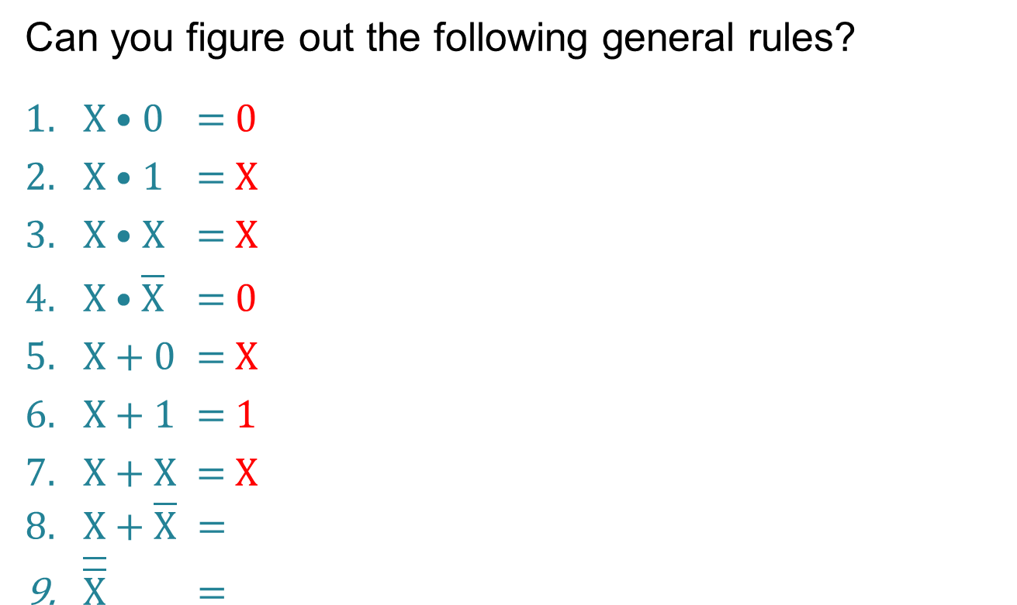
Simplifying expressions
Can you figure out the following general rules?
$X$• 0 = 0
X • 1 = X
X • X = X
$X \text{•}$ $\overline{X}$ = 0
X + 0 = X
X + 1 = 1
X + X = X
X + $\overline{X} =$
$\overline{\overline{X}} =$

Slide 28
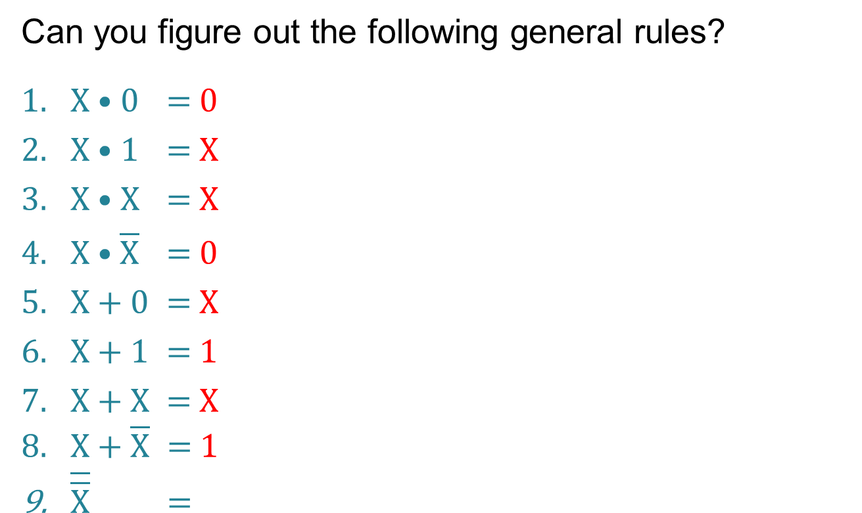
Simplifying expressions
Can you figure out the following general rules?
$X$• 0 = 0
X • 1 = X
X • X = X
$X \text{•}$ $\overline{X}$ = 0
X + 0 = X
X + 1 = 1
X + X = X
X + $\overline{X} =$ 1
$\overline{\overline{X}} =$

Slide 29
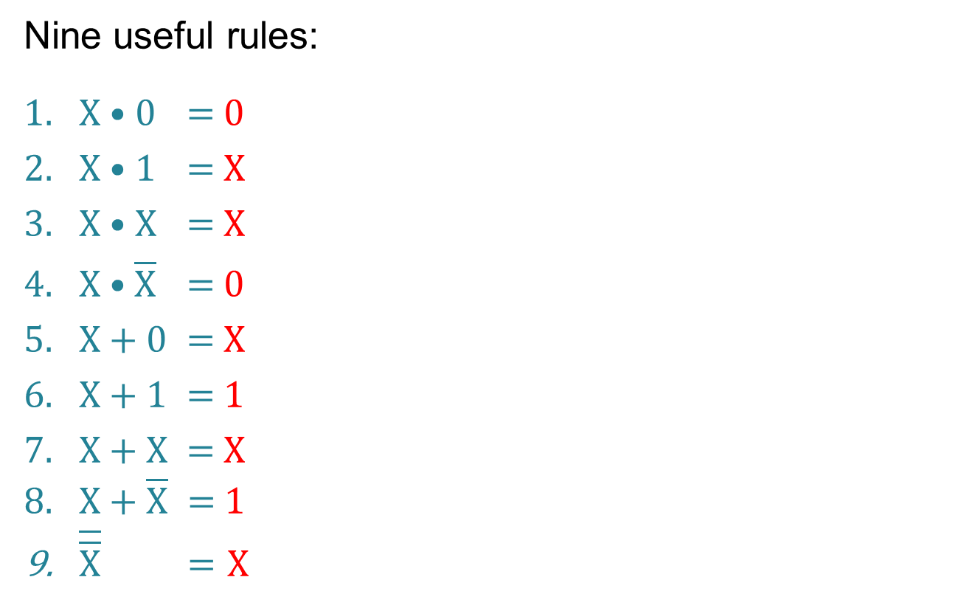
Simplifying expressions
Nine useful rules:
$X$• 0 = 0
X • 1 = X
X • X = X
$X \text{•}$ $\overline{X}$ = 0
X + 0 = X
X + 1 = 1
X + X = X
X + $\overline{X} =$ 1
$\overline{\overline{X}} =$ X

Slide 30
Some more rules
Commutative rule
X • Y = Y • X
X + Y = Y + X
Associative rule
X • (Y • Z) = (X • Y) • Z
X + (Y + Z) = (X + Y) + Z
Distributive rule
X • (Y + Z) = X • Y + X • Z
(X+ Y) (W + Z) = X • W + X • Z + Y • W + Y • Z

Slide 31
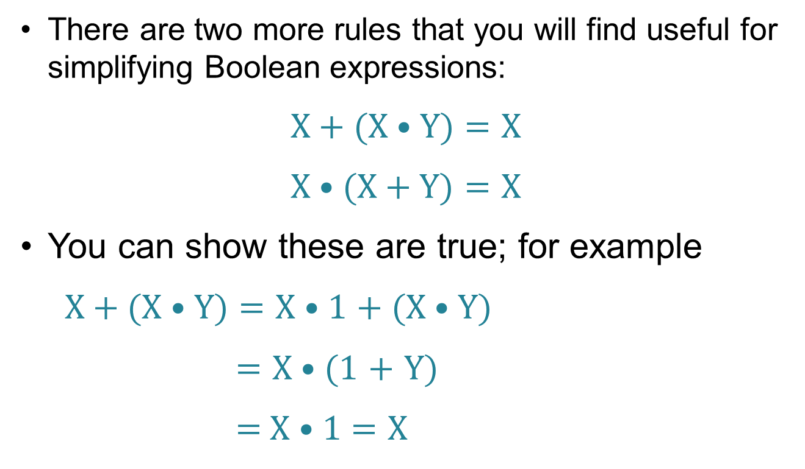
Absorption rules
There are two more rules that you will find useful for simplifying Boolean expressions:
$\text{X} \text{+} \text{(}\text{X} \text{•} \text{Y}\text{)}$ = $\text{X}$
$\text{X}\text{ • (}\text{X}\text{ + }\text{Y}\text{)}$ = $\text{X}$
You can show these are true; for example
$\text{X}\text{ + (}\text{X}\text{ • }\text{Y}\text{)}$ = $\text{X}\text{ • 1}$ $\text{+ (}\text{X}\text{ • }\text{Y}\text{)}$
= $\text{X}\text{ • (1}$ $\text{+}$ $\text{Y}\text{)}$
= $\text{X}\text{ • 1}$ = $\text{X}$

Slide 32
Worksheet 6
Now try the questions in Task 1 on Worksheet 6

Slide 33
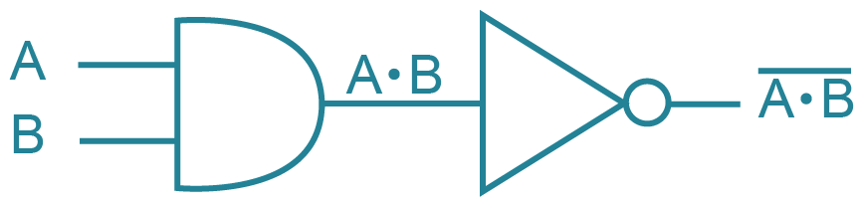
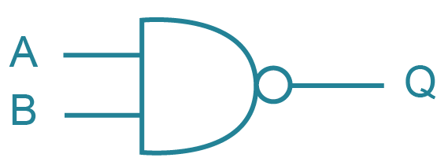
Logic diagrams using NAND
A NAND gate is equivalent to a combination of an AND gate and a NOT gate:
Is equivalent to:

Slide 34
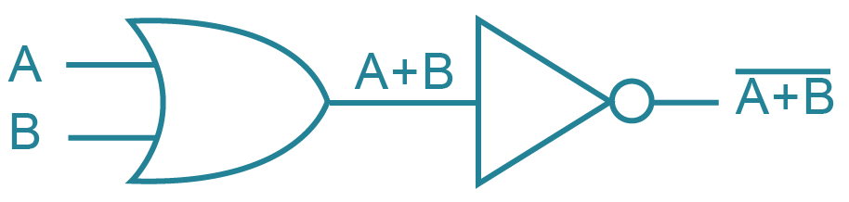
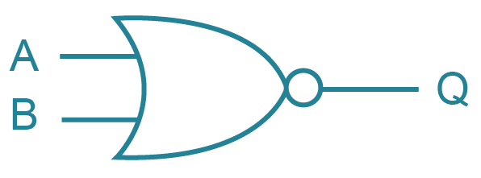
Drawing circuits using NOR
A NOR gate is equivalent to a combination of an OR gate and a NOT gate:
Is equivalent to:

Slide 35
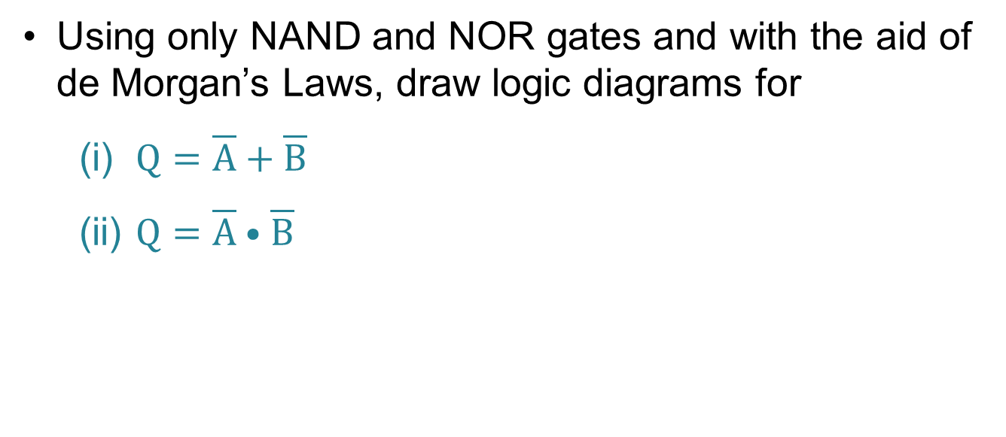
Using NAND and NOR gates
Using only NAND and NOR gates and with the aid of de Morgan’s Laws, draw logic diagrams for
(i) $Q=\overline{A}+\overline{B}$
(ii) $Q=\overline{A} \text{•} \overline{B}$

Slide 36
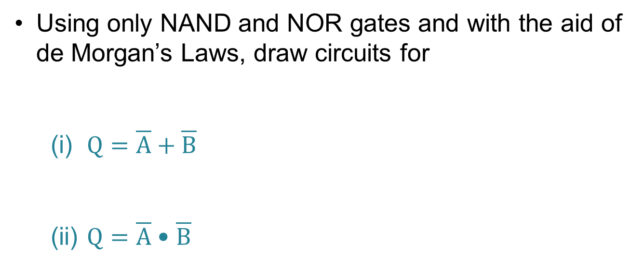
Using NAND and NOR gates
Using only NAND and NOR gates and with the aid of de Morgan’s Laws, draw circuits for
(i) $Q=\overline{A}+\overline{B}$
(ii) $Q=\overline{A} \text{•} \overline{B}$

Slide 37
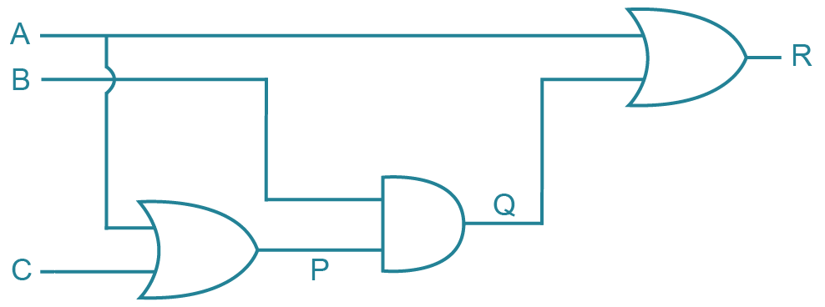
Writing expressions representing logic circuits
Given a logic circuit, we can break it down and find the Boolean expression that it represents
Label the output from each gate

Slide 38
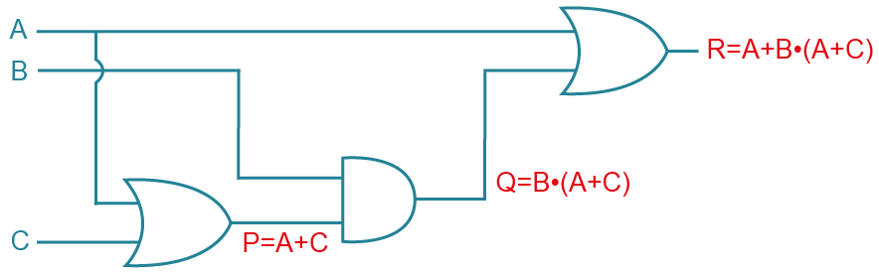
Writing expressions representing logic circuits
Given a logic circuit, we can break it down and find the Boolean expression that it represents
Label the output from each gate
Can you simplify R? How many gates are needed?

Slide 39
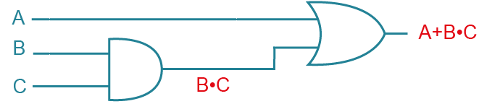

A simpler circuit
R = A + B $\text{•}$ (A + C)
= A + A $\text{•}$B + B $\text{•}$C (You could use the Absorption rule here…)
= A $\text{•}$ (1 + B) + B $\text{•}$C
= A + B $\text{•}$C

Slide 40
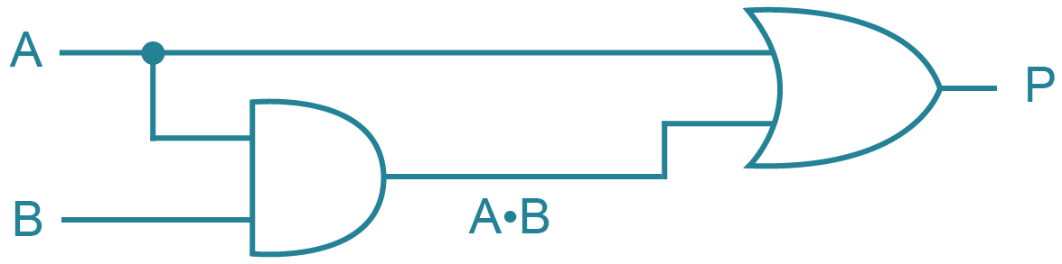
Worksheet 6
Now try the questions in Task 2
Here’s an extra one to start you off:
  Can you simplify this circuit?

Slide 41
Plenary
Boolean algebra seems tricky at first
It’s all a matter of lots and lots of practice
Try and familiarise yourself with de Morgan’s Laws and the other useful rules for simplifying expressions

