Slide 1
What is a market? What is marketing?
“A place where buyers and sellers meet”
“Marketing is the management process involved in identifying, anticipating and satisfying customer requirements profitably”
Notes:
Visual aids and then definition

Slide 2
Learning Objectives
Explain the purpose of marketing and its importance to different types of business organisation in different situations.
Explain what is meant by market orientation, product orientation and asset led marketing.
Explain what is meant by the marketing mix

Slide 3
The purpose of marketing
To satisfy customers
To identify consumer requirements
To anticipate consumer requirements
To compete effectively
To make profit

Slide 4
B2C or B2B
Consumer marketing: is where a business is marketing to consumers
Business to business marketing: where one business in engaged in marketing its products to another business

Slide 5
Market orientation
This is where a business continually identifies, reviews and analyses consumers’ needs
Flexible to changes in taste and fashion
Decisions based on market research
New products designed to meet customer needs
High cost to research the market
Unpredictability of the future

Slide 6
Product orientation
This is where a business focuses on the production process and the product itself
Focus on product development
Focus on good quality products
Changes in market structure will not be responded to
Fashion and taste are not accounted for
http://study.com/academy/lesson/production-orientation-definition-examples-quiz.html

Slide 7
Asset-led marketing
A business that is asset-led is responsive to the needs of the market.
However, it takes into account it own strengths and weaknesses when producing a product or service.
The business makes good quality products based on market needs
Maximises return from assets
Can be difficult, time consuming and expensive for businesses to establish its ‘core competencies’
Notes:
Sony Walkman video

Slide 8
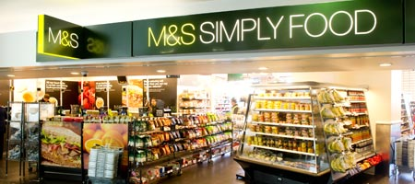
Market orientation
This is where a business continually identifies, reviews and analyses consumers’ needs
e.g. M&S, Costa, Proctor & Gamble, Coca-Cola

Slide 9
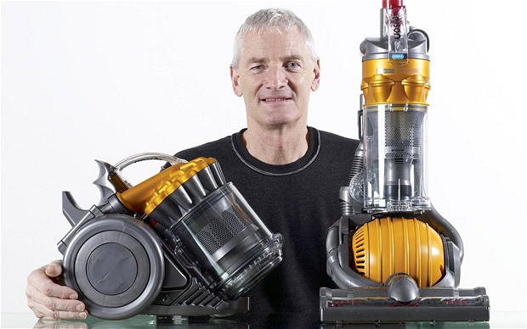
Product orientation
This is where a business focuses on the production process and the product itself
e.g. Dyson, Sony, McDonalds

Slide 10
Asset led marketing
A business that is asset-led is responsive to the needs of the market.
However, it takes into account it own strengths and weaknesses when producing a product or service.
E.g. Apple, Tesco
Complete page 2 of your workbook
Notes:
NEW Coke video

Slide 11
The marketing mix; the 4 Ps
Product
Price
Place
Promotion
Complete page 3 of worksheet

Slide 12
Activity 2 – page 2
Research each of the companies – decide whether they are market orientated, product orientated or asset led.
Use examples from their product portopilio and company information on their website to justify your decision
Now look at a business of your choice and do the same

Slide 13
Activity 4 – page 3
Investigate the marketing campaigns of one of the businesses from page 2, identifying the different aspects of the marketing mix (i.e. 4Ps) and orientation (e.g. market oriented, product oriented, asset-led).
Choose an organisation that has a large product portfolio. (eg. soft drinks, cars, insurance, banks electronic equipment such as phones and tablets).
Investigate the marketing campaigns of two of their products/services and make notes about their marketing strategy (e.g. Product (features, benefits, USP), Price, Promotion, Place)

Slide 14
Based on what you have learned today, define marketing using 5 words…

