Slide 1
P3 Design promotions that could be used to demonstrate personal selling skills

Slide 2
Assignment 19.3
You need to design two promotional activities or materials for different products/services at a chosen hospitality business.
Your promotions could relate to the hospitality businesses you have already studied for P1 and P2.
Your promotions should link to more than just one of the products and services offered at the businesses (so perhaps a group of products, a promotional event e.g. a wine tasting evening).
Your promotional material should be presented in the form of written material, i.e. a leaflet or a poster promoting specific products, a prepared sales pitch (PowerPoint), vouchers, press release etc.

Slide 3
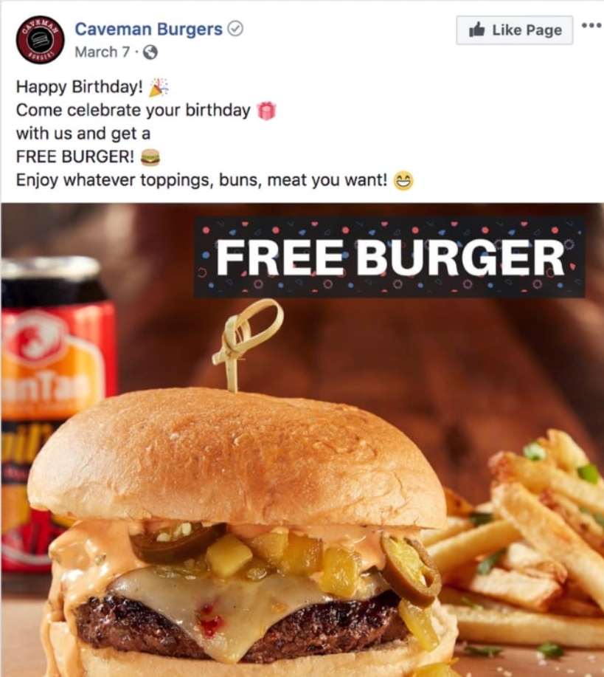
Promotional Methods
What about creating a social media marketing campaign?
Facebook
Twitter
Instagram

Slide 4
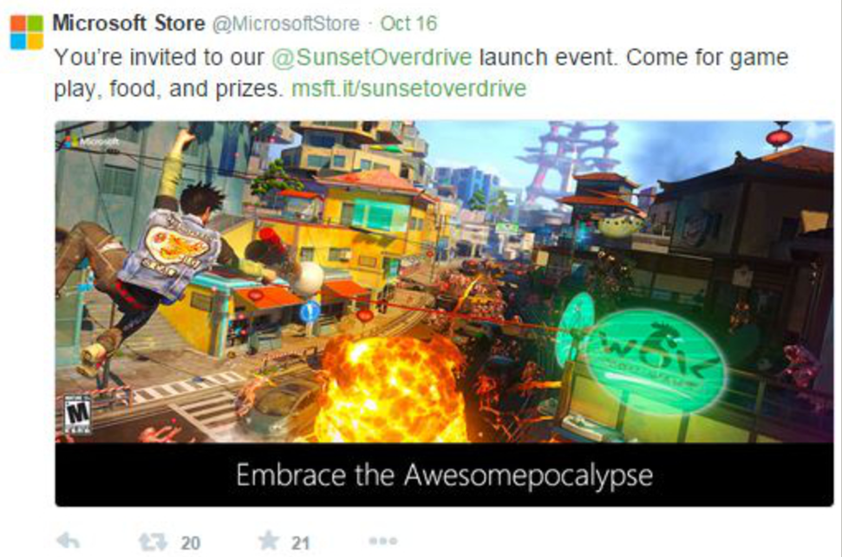

Slide 5
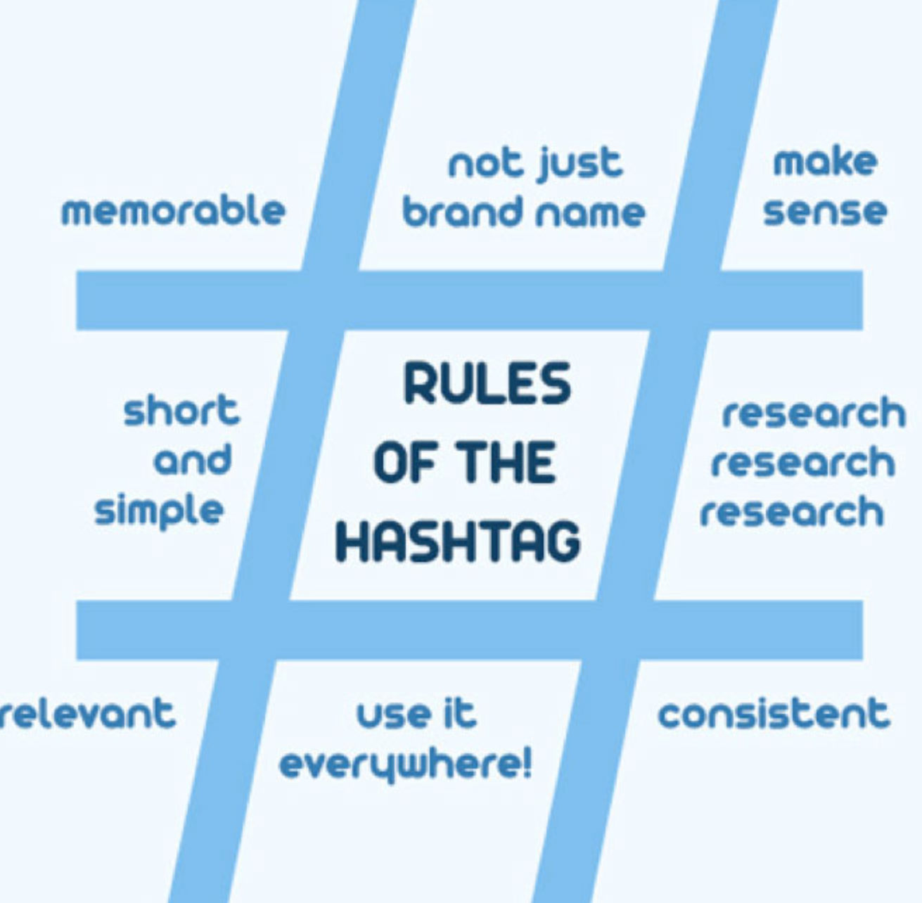

Slide 6
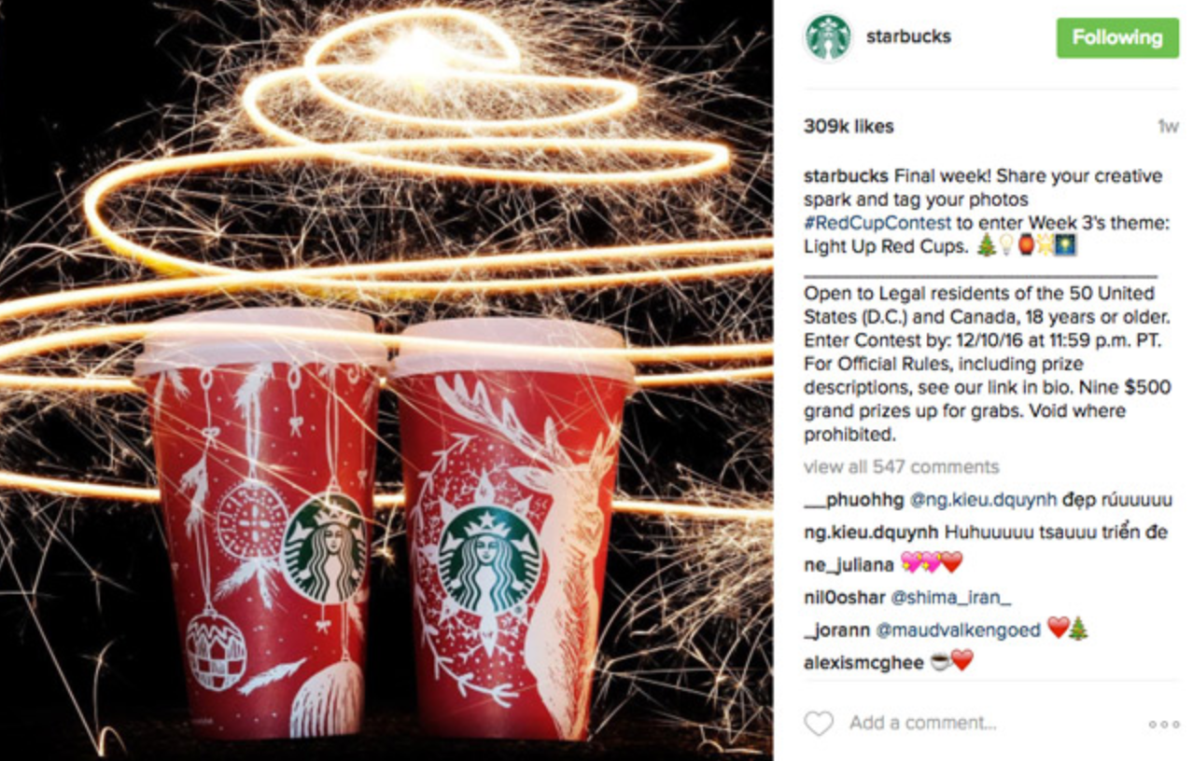

Slide 7
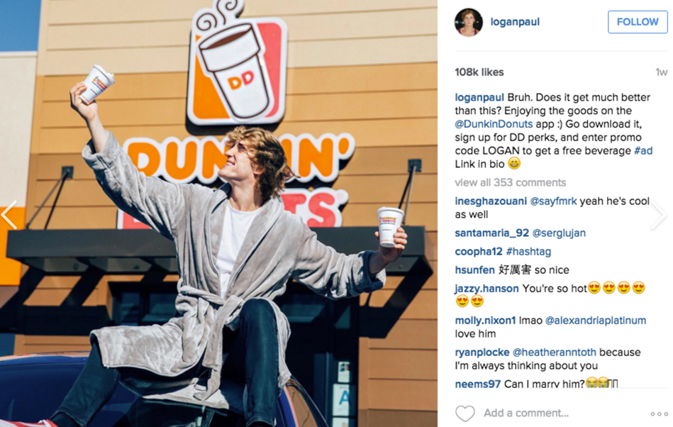

Slide 8
Other Methods
Posters
Leaflets
Prepared sales pitch
Vouchers
Press Release

Slide 9
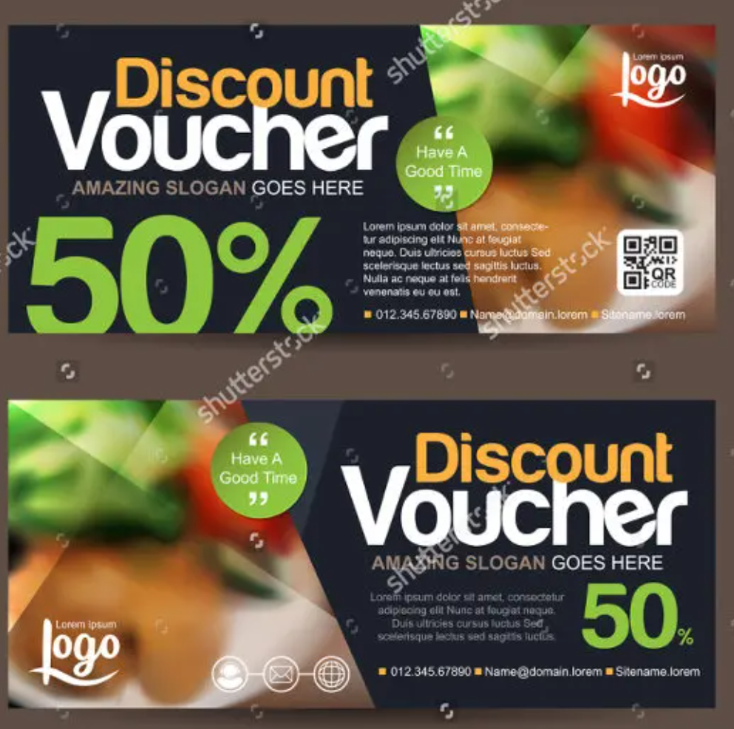

Slide 10
What to include?
Marketing an Event
Name and description of the event
Date and time
Location
Price and what it includes
How to buy tickets
Contact information
Relevant pictures to support the event
Marketing a product
Product name (description if needed)
What the offer is (e.g. discount offer, 2-4-1, free product with another purchase)
Where they can get the offer (online / instore or both??)
Terms and conditions of the offer
Contact information
Relevant pictures to support your offer

Slide 11
Task 19.3
Think carefully about the design of your material (AIDA?) and audience.
If you are choosing a promotional activity (event, merchandising, direct- marketing campaign) provide a written description of the activity along with evidence of any promotional literature that may accompany this (e.g. poster advertising a promotional event or a special offer/deal, a copy of a promotional e-mail).
Your promotional material/activity must link to an overall promotional strategy:
e.g. A hotel might have low occupancy at weekends because it is mainly used by business travellers, and so your promotional material/activity could form part of an overall strategy that might focus on encouraging business travellers to extend their stays.
e.g. Your poster may form part of an overall advertising campaign for new products/services, which includes TV, Radio and Magazine adverts.

Slide 12
Task 19.3
B) Each of your 2 promotion designs should be accompanied by a “Promotional Brief”:
A description/justification of the promotional method that you have designed.
An explanation of the aims and objectives of each method.
What are you trying to achieve with your promotion?
- Increase Sales?
- Attracting new customers? Gap in the market?
- Improving repeat business/customer loyalty?
- Competitive advantage?
- Improving/changing public image?
- Brand recognition?

Slide 13
Task 19.3
A description of the additional types of (personal) selling that could be used for promoting the chosen product/service.
- Upselling?
- Supporting promotional literature?
A summary type of customers at which it will be aimed (and how the material appeals to them).
A summary of costs that would be incurred.
A summary Resources required
An explanation of how your promotional material links to an overall promotional strategy (existing or new).
Deadline Monday 25th January

