Slide 1
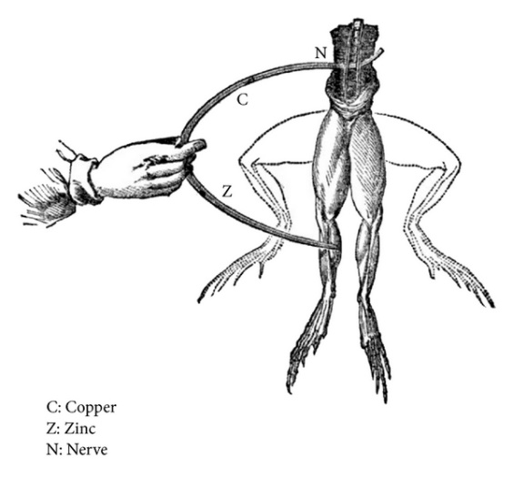
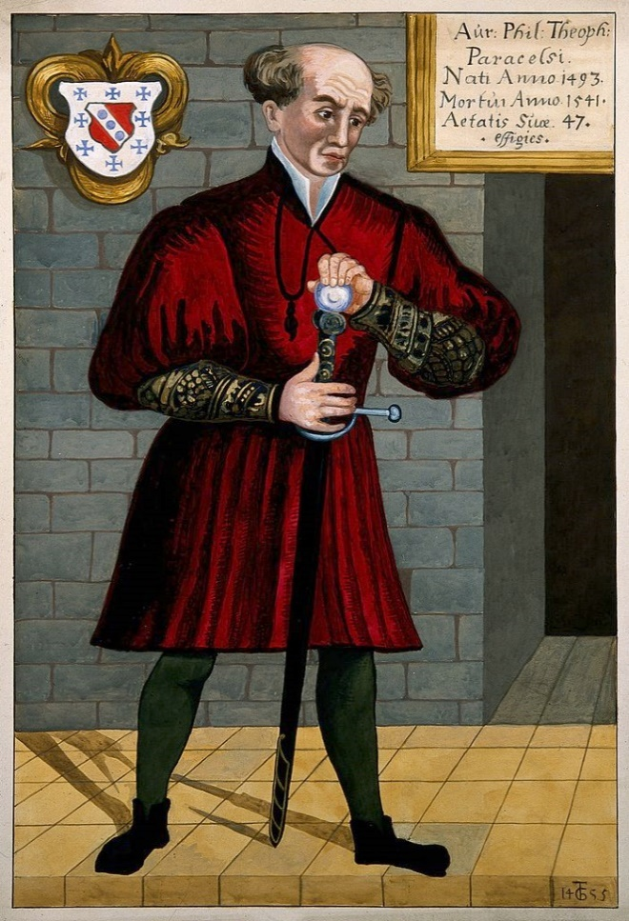
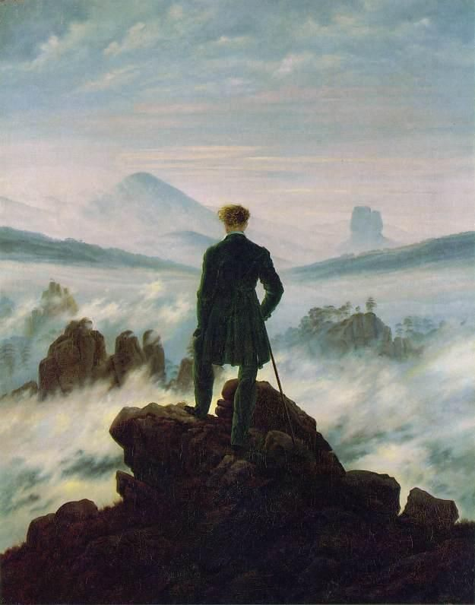
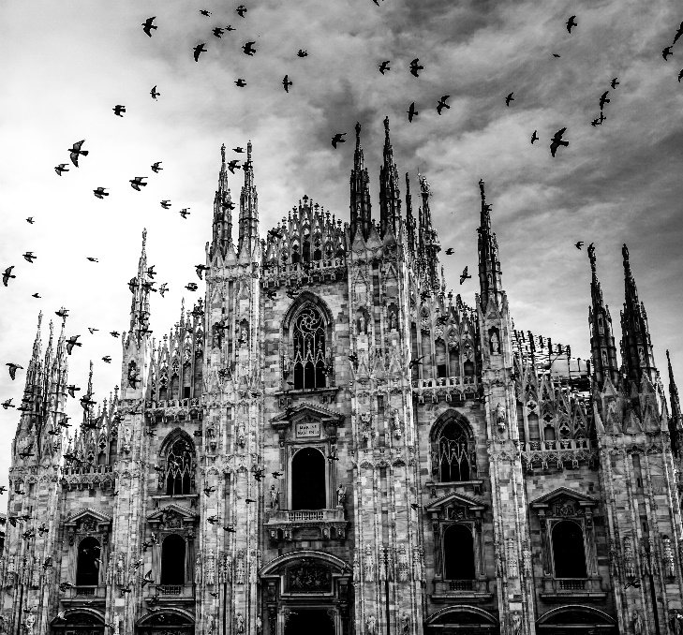
Frankenstein
Chapters 4- 5 - Context
Notes:
Introduction: aims and objectives – to revise the sentence types, to apply this knowledge to the text itself; to look at oppositions; to apply theory to practice in terms of analysing an extract from Chapter 5.

Slide 2
Chapter 4 p 51- p 53
Repeated sense of Victor's determination ("ardour" is repeated twice on p 51), to follow a "path of knowledge". This figurative language is repeated throughout this novel – often to signal Victor's unwillingness to follow a path that anyone else has ever used before.
Time passes quickly in this chapter ("Two years passed" p 51, "The summer months passed" p 56; "Winter, spring, and summer passed" p 57), perhaps reflecting Victor's disconnection from society, but also moving the plot forward to the moment of the creature's creation.
Similarities with the creature are to become clear: both make "rapid" progress (p 51), but the differences are that Victor's achievements are recognised by the university and by society (he procured "great esteem and admiration" p 52), while the creature's ability to learn how to speak and to read in multiple languages, are not recognised by anyone.
use of rhetorical questions ("Whence, I often asked myself, did the principle of life proceed?" (p 52) increase the sense of a monologue and of the spoken voice,
The gothic convention of juxtaposition of life and death: "To examine the causes of life, w must first have the recourse to death". ( p52) Here, Victor comments on the physical aspects of death (bodies as "food for the worm" p 52), rather than on any metaphysical or supernatural fear of it.
Motif of light and dark in the gothic description of the "corruption of death" on p 53. In the darkness "a sudden light broke in upon me" ( p 53) – the light of knowledge.
He reminds Walton and the reader that he is rational, in his direct address: "Remember, I am not recording the vision of a madman…" ( p 53) as he states that he became "capable of bestowing animation upon lifeless matter." (p 53)
He is insistent that this is a scientific rather than a supernatural event: "Not that, like a magic scene, it all opened upon me at once…" (p 53)

Slide 3
Chapter 4 p 54 - p 57
Metafictionality of the text as Victor directly addresses Walton and therefore the reader ("my friend" p 54), and draws attention to the telling of the story ("my story" p 54). He warns Walton about the dangers of knowledge (p 54) – and perhaps the didactic message also reaches the reader
His intention is clearly stated that he began to create a "human being" (p 54) – however, working on a such a small scale means that he has to work slower, and therefore he decides to create "the being of gigantic stature" – there is no understanding of the consequences of his actions.
Repeated motif of light and dark: "pour a torrent of light into our dark world" p 55
Juxtaposition of the natural ("the moon gazed on my midnight labours" p 55), and the unnatural ("I pursued nature to her hiding places" p 55)
He has separated himself from society – physically and emotionally: "In a solitary chamber, or rather cell…" p 55
Reminder that this narrative has an audience on p 57: "but I forget that I am moralising in the most interesting part of my tale, and your looks remind me to proceed." Shelley is building the tension, and drawing attention to the fact that the creature is about to appear in this text – the reader (like Walton) is waiting for his arrival.

Slide 4
Your task: analyse this passage in terms of setting, character, narrator, writing style, theme, use of figurative language Levi Jessie B Hannah Will
1 How can I describe my emotions at this catastrophe, or how delineate the wretch whom with such infinite pains and care I had endeavoured to form? His limbs were in proportion, and I had selected his features as beautiful. Beautiful! -- Great God! His yellow skin scarcely covered the work of muscles and arteries beneath; his hair was of a lustrous black, and flowing; his teeth of a pearly whiteness; but these luxuriances only formed a more horrid contrast with his watery eyes, that seemed almost of the same colour as the dun white sockets in which they were set, his shrivelled complexion and straight black lips.

Slide 5
Writing style: Long complex sentences are broken with minor, fragmented sentences to imply his state of panic and is unable to control his thoughts and keep them to himself, highlighted by the fact that a hyphen is used to interrupt one thought with another (" -Great God!) Foreshadows later erratic behaviour derived from panic, when he destroys the creature's Bride, he constructed for him in a rage-fuelled frenzy. ​Rhetorical question reminds us that there is an audience to this story.
Narrator: Victor is spectating and reflecting upon his creature - retrospective narration highlighting to Walton his mistakes. We see first-hand how rapidly his opinion changes​
Character: First appearance of the creature is entirely based on his monstrous looks to emphasise the shallowness of society unwilling to look past them and base a full judgement on them.​
Theme: The theme implied throughout this passage is one of gothic nature. This is portrayed through the language Victor uses to describe the creature. The fact he says his "watery eyes" had a "horrid contrast" suggests corpse imagery, a common gothic trope and is very fitting since he is essentially describing a cocktail of corpses. However, amidst the chaos and panic in Victor, he still succeeds in pointing out the creature's "teeth of a pearly whiteness", suggesting he can still see the beauty through the abomination he has created. This only emphasises the magnitude of Victor's ego as it still manages to somewhat usurp any rational horror he holds towards the creature. Introduces the theme of appearance and beauty through how the creature is viewed. ​
Figurative language: Uses positive language whilst the creature is motionless "lustrous" "pearly whiteness" until he realises the error of his ways. "Shrivelled complexion" - a link to new-born children but Victor is unwilling to father or even empathise with the creature. When he exclaims "Beautiful!" It is ironic as he only sees the science behind it and how he has been able to manipulate it.​
Setting: After a "dreary night of November" - Victor is aware of the recklessness of his work and must conceal it under the shadows of the night. Furthermore, winter and specifically the night time are generic conventions of the gothic genre and reflect the gloomy mood of the scene – this therefore fulfils a symbolic and analogical function. He has also just been working on the creature in the half-light which not only links to the theme of secrecy, but also suggests that when the candle burns out, the world will have to embrace destruction, as the light has run out. ​
How can I describe my emotions at this catastrophe, or how delineate the wretch whom with such infinite pains and care I had endeavoured to form? His limbs were in proportion, and I had selected his features as beautiful. Beautiful! -- Great God! His yellow skin scarcely covered the work of muscles and arteries beneath; his hair was of a lustrous black, and flowing; his teeth of a pearly whiteness; but these luxuriances only formed a more horrid contrast with his watery eyes, that seemed almost of the same colour as the dun white sockets in which they were set, his shrivelled complexion and straight black lips.

Slide 6
Your task: analyse this passage in terms of setting, character, narrator, writing style, theme, use of figurative language Katie Jessie G Ellie H Emily H
2 The different accidents of life are not so changeable as the feelings of human nature. I had worked hard for nearly two years, for the sole purpose of infusing life into an inanimate body. For this I had deprived myself of rest and health. I had desired it with an ardour that far exceeded moderation; but now that I had finished, the beauty of the dream vanished, and breathless horror and disgust filled my heart. Unable to endure the aspect of the being I had created, I rushed out of the room, continued a long time traversing my bed chamber, unable to compose my mind to sleep. At length lassitude succeeded to the tumult I had before endured; and I threw myself on the bed in my clothes, endeavouring to seek a few moments of forgetfulness. But it was in vain: I slept, indeed, but I was disturbed by the wildest dreams. I thought I saw Elizabeth, in the bloom of health, walking in the streets of Ingolstadt. Delighted and surprised, I embraced her; but as I imprinted the first kiss on her lips, they became livid with the hue of death; her features appeared to change, and I thought that I held the corpse of my dead mother in my arms; a shroud enveloped her form, and I saw the grave-worms crawling in the folds of the flannel. I started from my sleep with horror; a cold dew covered my forehead, my teeth chattered, and every limb became convulsed: when, by the dim and yellow light of the moon, as it forced its way through the window shutters, I beheld the wretch -- the miserable monster whom I had created. He held up the curtain of the bed and his eyes, if eyes they may be called, were fixed on me. His jaws opened, and he muttered some inarticulate sounds, while a grin wrinkled his cheeks. He might have spoken, but I did not hear; one hand was stretched out, seemingly to detain me, but I escaped, and rushed down stairs. I took refuge in the courtyard belonging to the house which I inhabited; where I remained during the rest of the night, walking up and down in the greatest agitation, listening attentively, catching and fearing each sound as if it were to announce the approach of the demoniacal corpse to which I had so miserably given life

Slide 7
Your task: analyse this passage in terms of setting, character, narrator, writing style, theme, use of figurative language Darcy Sabrina Ellie L Eve
3 Oh! no mortal could support the horror of that countenance. A mummy again endued with animation could not be so hideous as that wretch. I had gazed on him while unfinished he was ugly then; but when those muscles and joints were rendered capable of motion, it became a thing such as even Dante could not have conceived.
I passed the night wretchedly. Sometimes my pulse beat so quickly and hardly that I felt the palpitation of every artery; at others, I nearly sank to the ground through languor and extreme weakness. Mingled with this horror, I felt the bitterness of disappointment; dreams that had been my food and pleasant rest for so long a space were now become a hell to me; and the change was so rapid, the overthrow so complete!
Morning, dismal and wet, at length dawned, and discovered to my sleepless and aching eyes the church of Ingolstadt, white steeple and clock, which indicated the sixth hour. The porter opened the gates of the court, which had that night been my asylum, and I issued into the streets, pacing them with quick steps, as if I sought to avoid the wretch whom I feared every turning of the street would present to my view. I did not dare return to the apartment which I inhabited, but felt impelled to hurry on, although drenched by the rain which poured from a black and comfortless sky.
I continued walking in this manner for some time, endeavouring, by bodily exercise, to ease the load that weighed upon my mind. I traversed the streets, without any clear conception of where I was, or what I was doing. My heart palpitated in the sickness of fear; and I hurried on with irregular steps, not daring to look about me:-
"Like one who, on a lonely road, Doth walk in fear and dread, And, having once turned round, walks on, And turns no more his head; Because he knows a frightful fiend Doth close behind him tread." *
Writing style: Use of exclamative ("Oh!") to create the sense of the spoken voice
Setting: the morning is "dismal and wet" – fulfilling an analogical function, and reflecting Victor's mood. The "white steeple" could be seen to represent the morality of Christianity that he has turned from. The "gates" are one image of the repeated images of entrapment that run through this novel, as Victor feels trapped by his guilt.
Lexical clusters of body parts, not only of the creature ("muscles" "joints"), but also of Victor ("artery" "mind" "heart"), linking the two together in life.
Intertextual reference to "Ancient Mariner": both Victor and the Mariner are doomed to live with guilt, and to tell their story for ever.

Slide 12
Your task: analyse this passage in terms of setting, character, narrator, writing style, theme, use of figurative language Ella Harry Sasha Luke
4 I trembled excessively; I could not endure to think of, and far less to allude to, the occurrences of the preceding night. I walked with a quick pace, and we soon arrived at my college. I then reflected, and the thought made me shiver, that the creature whom I had left in my apartment might still be there, alive, and walking about. I dreaded to behold this monster; but I feared still more that Henry should see him. Entreating him, therefore, to remain a few minutes at the bottom of the stairs, I darted up towards my own room. My hand was already on the lock of the door before I recollected myself I then paused; and a cold shivering came over me. I threw the door forcibly open, as children are accustomed to do when they expect a spectre to stand in waiting for them on the other side; but nothing appeared. I stepped fearfully in: the apartment was empty; and my bedroom was also freed from its hideous guest. I could hardly believe that so great a good fortune could have befallen me; but when I became assured that my enemy had indeed fled, I clapped my hands for joy, and ran down to Clerval.
We ascended into my room, and the servant presently brought breakfast; but I was unable to contain myself It was not joy only that possessed me; I felt my flesh tingle with excess of sensitiveness, and my pulse beat rapidly. I was unable to remain for a single instant in the same place; I jumped over the chairs, clapped my hands, and laughed aloud. Clerval at first attributed my unusual spirits to joy on his arrival; but when he observed me more attentively he saw a wildness in my eyes for which he could not account; and my loud, unrestrained, heartless laughter frightened and astonished him.
"My dear Victor," cried he, "what, for God's sake, is the matter? Do not laugh in that manner. How ill you are! What is the cause of all this?"
"Do not ask me," cried I, putting my hands before my eyes for I thought I saw the dreaded spectre glide into the room; "he can tell. -- Oh, save me! save me!" I imagined that the monster seized me; I struggled furiously, and fell down in a fit.

Slide 13
Your task: analyse this passage in terms of setting, character, narrator, writing style, theme, use of figurative language Emily S Max Ruqia
5 By very slow degrees, and with frequent relapses that alarmed and grieved my friend, I recovered. I remember the first time I became capable of observing outward objects with any kind of pleasure, I perceived that the fallen leaves had disappeared, and that the young buds were shooting forth from the trees that shaded my window. It was a divine spring; and the season contributed greatly to my convalescence. I felt also sentiments of joy and affection revive in my bosom; my gloom disappeared, and in a short time I became as cheerful as before I was attacked by the fatal passion.
"Dearest Clerval," exclaimed I, "how kind, how very good you are to me. This whole winter, instead of being spent in study, as you promised yourself, has been consumed in my sick room. How shall I ever repay you? I feel the greatest remorse for the disappointment of which I have been the occasion; but you will forgive me."
"You will repay me entirely if you do not discompose yourself, but get well as fast as you can; and since you appear in such good spirits, I may speak to you on one subject, may I not?"
I trembled. One subject! what could it be? Could he allude to an object on whom I dared not even think?

Slide 14
Match the ideas from text to text
Rejection of the clones who relinquish their lives for the sake of their creators | The alienated/marginalised creation has a voice.
Defining the clones as the “other”- fixing a boundary between the human and the creation | Rejection of creature, who, regardless, grieves his creator’s death (“Oh, Frankenstein! Generous and self-devoted being!”)
Search for meaning and identity through self-expression (clones raised to seek validity in their creations) | Metaphorical/emotional/spiritual restrictions (formed by the institution)
Telling of a story, awareness of a reader (Margaret etc) | Metaphorical/emotional/spiritual restrictions (formed by the institution)
The alienated/marginalised creation has a voice. | Search for meaning and identity through creation (“It was with these feelings that I began the creation of a human being”. Chapter 4)
Metaphorical/emotional/spiritual restrictions (Victor trapped by guilt) | Marginalisation and mistreatment of clones by society.
Defining the clones as the “other”- fixing a boundary between the human and the creation | Moment of creature’s realisation of his appearance (the pool where “I became fully convinced that I was in reality the monster that I am”)
Old v new world (Chapter 22 of NLMG) | Contemporary discussion about over-reaching ambition usurping the role of God and women etc.
Contemporary debate about the ethics of cloning and stem cell research | Telling of a story, awareness of a reader (implied reader)
Defining the creature as the “other” (“daemon”/”devil”/ “animal”) – fixing a boundary between the human and the creation | Marginalisation and mistreatment of creature by society.
Moment of the clones’ realisation of their difference. (the mirror that suddenly “shows you something else, something troubling and strange”) | Ancient v modern science (Chapter 3 Frankenstein)

Slide 15
Your matches might look something like this:
Frankenstein
Ancient v modern science (Chapter 3 Frankenstein)
Contemporary discussion about over-reaching ambition usurping the role of God and women etc.
Telling of a story, awareness of a reader (Margaret etc)
Metaphorical/emotional/spiritual restrictions (Victor trapped by guilt)
Marginalisation and mistreatment of creature by society.
Moment of creature’s realisation of his appearance (the pool where “I became fully convinced that I was in reality the monster that I am”)
Defining the creature as the “other” (“daemon”/”devil”/ “animal”) – fixing a boundary between the human and the creation
Search for meaning and identity through creation (“It was with these feelings that I began the creation of a human being”. Chapter 4)
The focus on the role of nurture, without which the creature is monstrous (“I was benevolent and good; misery made me a fiend.”)
Remoteness of creation (Scotland) v
The alienated/marginalised creation has a voice.
Metaphorical/emotional/spiritual restrictions (Victor trapped by guilt)
Never Let Me Go
Old v new world (Chapter 22 of NLMG)
Contemporary debate about the ethics of cloning and stem cell research
Telling of a story, awareness of a reader (implied reader/donor)
Metaphorical/emotional/spiritual restrictions (formed by the institution)
Marginalisation and mistreatment of clones by society.
Moment of the clones’ realisation of their difference. (the mirror that suddenly “shows you something else, something troubling and strange”)
Defining the clones as the “other”- fixing a boundary between the human and the creation
Search for meaning and identity through self-expression (clones raised to seek validity in their creations)
The focus on the role of nurture: the attempts to prove the soul of the clones, who are educated humanely. v
Remoteness of creation (Scotland)
The alienated/marginalised creation has a voice.
Metaphorical/emotional/spiritual restrictions (formed by the institution)

Slide 16
Your Task
Read the information on the slide you have been allocated
Summarise it in no more than three sentences.
Decide on two ways in which you could tie it to the text.
You will then present your findings to the class, using the extract/s you have been given to illustrate either Romanticism, Ancient Science, Galvanism or the Gothic.

Slide 17
Ancient Science
Parcelsus: (1493-1541) – argued that human life could be created through alchemy, and believed in the long sought after elixir vitae as a means of indefinitely prolonging life free from disease.
Agrippa (1486-1535) was a mystic and alchemist. He wrote books that argued that magic existed, and that it could be studied and used by devout Christians, as it was derived from God, not the Devil.
Victor lists the prominent scientists Agrippa, Parcelsus and Magus as being part of his boyhood reading material. The dismissals by Victor's father and Krempe serve to point towards the distance the late eighteenth century saw between these mystics and the modern experimental chemistry.

Slide 18
Ancient Science
In this house I chanced to find a volume of the works of Cornelius Agrippa. I opened it with apathy; the theory which he attempts to demonstrate and the wonderful facts which he relates soon changed this feeling into enthusiasm. A new light seemed to dawn upon my mind, and bounding with joy, I communicated my discovery to my father. My father looked carelessly at the title page of my book and said, "Ah! Cornelius Agrippa! My dear Victor, do not waste your time upon this; it is sad trash."
If, instead of this remark, my father had taken the pains to explain to me that the principles of Agrippa had been entirely exploded and that a modern system of science had been introduced which possessed much greater powers than the ancient, because the powers of the latter were chimerical, while those of the former were real and practical, under such circumstances I should certainly have thrown Agrippa aside and have contented my imagination, warmed as it was, by returning with greater ardour to my former studies. It is even possible that the train of my ideas would never have received the fatal impulse that led to my ruin. But the cursory glance my father had taken of my volume by no means assured me that he was acquainted with its contents, and I continued to read with the greatest avidity. When I returned home my first care was to procure the whole works of this author, and afterwards of Paracelsus and Albertus Magnus. I read and studied the wild fancies of these writers with delight; they appeared to me treasures known to few besides myself. I have described myself as always having been imbued with a fervent longing to penetrate the secrets of nature. …. My father was not scientific, and I was left to struggle with a child's blindness, added to a student's thirst for knowledge. Under the guidance of my new preceptors I entered with the greatest diligence into the search of the philosopher's stone and the elixir of life; but the latter soon obtained my undivided attention. Wealth was an inferior object, but what glory would attend the discovery if I could banish disease from the human frame and render man invulnerable to any but a violent death! Nor were these my only visions. The raising of ghosts or devils was a promise liberally accorded by my favourite authors, the fulfilment of which I most eagerly sought; and if my incantations were always unsuccessful, I attributed the failure rather to my own inexperience and mistake than to a want of skill or fidelity in my instructors.

Slide 19
Romanticism
An attitude or intellectual orientation that characterised many works in Western civilisation over a period of the late 18th to the mid 19th century.
It rejected: the order, calm, harmony, balance and rationality that typified Classicism (the movement that preceded it). It reacted against 18th century rationalism.
It embraced: the individual, the subjective, the irrational, the imaginative, the personal, the emotional, the visionary.
Attitudes:
appreciation of the beauties of nature
exaltation of emotion over reason, and of the senses over intellect
a turning in on the self and a heightened examination of human personality, its moods and mental potential
preoccupation with the genius, the hero, with a focus on his passions and inner struggles
view of the artist as the individual creator, whose creative spirit is more important than strict adherence to formal rules and traditional procedures
emphasis on imagination as a gateway to transcendent experience and truth
a predilection for the exotic, the remote, the mysterious, the occult, the monstrous, the diseased and even the satanic

Slide 20
Romanticism
Elizabeth was of a calmer and more concentrated disposition; but, with all my ardour, I was capable of a more intense application and was more deeply smitten with the thirst for knowledge. She busied herself with following the aerial creations of the poets; and in the majestic and wondrous scenes which surrounded our Swiss home—the sublime shapes of the mountains, the changes of the seasons, tempest and calm, the silence of winter, and the life and turbulence of our Alpine summers—she found ample scope for admiration and delight. While my companion contemplated with a serious and satisfied spirit the magnificent appearances of things, I delighted in investigating their causes. The world was to me a secret which I desired to divine. Chapter 2
Henry Clerval was the son of a merchant of Geneva. He was a boy of singular talent and fancy. He loved enterprise, hardship, and even danger for its own sake. He was deeply read in books of chivalry and romance. He composed heroic songs and began to write many a tale of enchantment and knightly adventure. He tried to make us act plays and to enter into masquerades, in which the characters were drawn from the heroes of Roncesvalles, of the Round Table of King Arthur, and the chivalrous train who shed their blood to redeem the holy sepulchre from the hands of the infidels. Chapter 2
Notes:
Each group jigsaws and then feeds back to the relevant slide

Slide 21
The Gothic
Definition: a genre or mode of literature that combines horror, death, and romance. It originated in England in the second half of the 18th century and was prevalent in the 19th century.
Elements:
dark settings: dungeons, crypts, labyrinths, winding stairs and low lighting such as a candle being the only source of light, shadows, the moonlight etc
Extreme landscapes such as rugged mountains, large forsts or cold, icy wastes with extreme weathers
Death, decay, darkness and madness
A passion-driven, wilful villain-hero or villain
A heroine with a tendency to faint and a need to be rescued
A hero whose true identity is revealed by the end of the text
Horrifying events or the threat of such happenings: gloom, mystery, suspense, the dramatic, macabre and sensational, magic and the supernatural.
Evil deeds leading to the downfall of a character.

Slide 22
The Gothic
To examine the causes of life, we must first have recourse to death. I became acquainted with the science of anatomy, but this was not sufficient; I must also observe the natural decay and corruption of the human body. In my education my father had taken the greatest precautions that my mind should be impressed with no supernatural horrors. I do not ever remember to have trembled at a tale of superstition or to have feared the apparition of a spirit. Darkness had no effect upon my fancy, and a churchyard was to me merely the receptacle of bodies deprived of life, which, from being the seat of beauty and strength, had become food for the worm. Now I was led to examine the cause and progress of this decay and forced to spend days and nights in vaults and charnel-houses. My attention was fixed upon every object the most insupportable to the delicacy of the human feelings. I saw how the fine form of man was degraded and wasted; I beheld the corruption of death succeed to the blooming cheek of life; I saw how the worm inherited the wonders of the eye and brain. I paused, examining and analysing all the minutiae of causation, as exemplified in the change from life to death, and death to life, until from the midst of this darkness a sudden light broke in upon me—a light so brilliant and wondrous, yet so simple, that while I became dizzy with the immensity of the prospect which it illustrated, I was surprised that among so many men of genius who had directed their inquiries towards the same science, that I alone should be reserved to discover so astonishing a secret. Chapter 4

Slide 23
Galvanism
Definition: the effect of the application of electric current pulses through body tissues that causes muscle contraction.
Late in the 18th century Luigi Galvani found that frog’s legs twitched as if alive when struck by a spark of electricity. He believed that this form of electricity, which he called "animal electricity" was a form of energy that was still being held in the animal's issue. Today, it is referred to as Electrophysiology and scientists are aware that it is not in fact an electrical fluid streaming from the brain that makes the animal twitch, but instead the effect of joining two metals and their electrical charges. In her 1831 Preface to the novel, Mary Shelley mentions ‘galvanism’ as an influence upon her story: "I saw the pale student of unhallowed arts kneeling beside the thing he had put together. I saw the hideous phantasm of a man stretched out, and then, on the working of some powerful engine, show signs of life, and stir with an uneasy, half vital motion.

Slide 24
Galvanism
When I was about fifteen years old we had retired to our house near Belrive, when we witnessed a most violent and terrible thunderstorm. It advanced from behind the mountains of Jura, and the thunder burst at once with frightful loudness from various quarters of the heavens. I remained, while the storm lasted, watching its progress with curiosity and delight. As I stood at the door, on a sudden I beheld a stream of fire issue from an old and beautiful oak which stood about twenty yards from our house; and so soon as the dazzling light vanished, the oak had disappeared, and nothing remained but a blasted stump. When we visited it the next morning, we found the tree shattered in a singular manner. It was not splintered by the shock, but entirely reduced to thin ribbons of wood. I never beheld anything so utterly destroyed.
Before this I was not unacquainted with the more obvious laws of electricity. On this occasion a man of great research in natural philosophy was with us, and excited by this catastrophe, he entered on the explanation of a theory which he had formed on the subject of electricity and galvanism, which was at once new and astonishing to me. All that he said threw greatly into the shade Cornelius Agrippa, Albertus Magnus, and Paracelsus, the lords of my imagination; but by some fatality the overthrow of these men disinclined me to pursue my accustomed studies. Chapter 3
"The ancient teachers of this science," said he, "promised impossibilities and performed nothing. The modern masters promise very little; they know that metals cannot be transmuted and that the elixir of life is a chimera but these philosophers, whose hands seem only made to dabble in dirt, and their eyes to pore over the microscope or crucible, have indeed performed miracles. They penetrate into the recesses of nature and show how she works in her hiding-places. They ascend into the heavens; they have discovered how the blood circulates, and the nature of the air we breathe. They have acquired new and almost unlimited powers; they can command the thunders of heaven, mimic the earthquake, and even mock the invisible world with its own shadows." Chapter 3

Slide 25
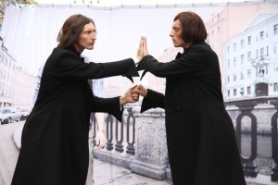
Read on to Chapter Seven
Our focus will be on:
Women
Role of Henry
The sublime
The double
Social Criticism

