Slide 1
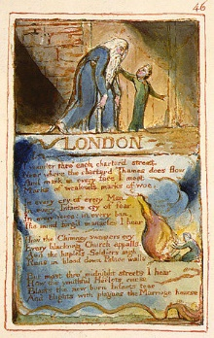
Blake Week 2
Tabulation, Stylistics and Rhythm
"London" and "Garden of Love"

Slide 2
London
I wander thro' each charter'd street,
Near where the charter'd Thames does flow.
And mark in every face I meet
Marks of weakness, marks of woe.
In every cry of every Man,
In every Infants cry of fear,
In every voice: in every ban,
The mind-forg'd manacles I hear
How the Chimney-sweepers cry
Every blackning Church appalls,
And the hapless Soldiers sigh
Runs in blood down Palace walls
But most thro' midnight streets I hear
How the youthful Harlots curse
Blasts the new-born Infants tear
And blights with plagues the Marriage hearse

Slide 3
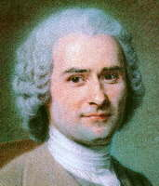
Revising the poem: what you remember….
“Man is born free, but everywhere he is in chains”
Jean Rousseau (1712 – 1778)
Notes:
Each student has a hand out – they should cut and stick the points onto the poem, in preparation for a piece of analysis on the poem.

Slide 4
A tabulation of "London"

Slide 5
What do you notice about the tabulation?
Open Class |  |  |  |  | Closed class
Line | Main verbs | Nouns | Adverbs | Adjectives | Prepositions, conjunctions, determiners, pronouns
1 | wander | street |  | charter’d | I thro’ each
2 | does flow | Thames |  | charter’d | near where the
3 | meet mark | face |  |  | and in every I
4 |  | woe Marks marks weakness |  |  | of of
5 |  | cry Man |  |  | in every of every
6 |  | Infants cry fear |  |  | in every of
7 |  | voice ban |  |  | in every in every
8 | hear | manacles |  | mind-forged | the I
9 |  | Chimney-sweeper’s cry |  |  | How the
10 |  | Church |  | blackning | Every
11 |  | Soldiers sigh |  | hapless | and the
12 | runs | blood palace walls |  |  | in down
13 | hear | streets |  | midnight | but most thro’ I
14 | curse | Harlots |  | youthful | How the
15 | Blasts | Infants tear |  | new-born | the
16 | blights | plagues Marriage hearse |  |  | and with the
Verb shift from "wander" and "flow" (natural and unforced) to "curse" "blasts" "blights" (aggressive and destructive). Indicating the increasing perception of the narrator.
Repetition of adjective "charter'd" to create the sense of man's attempt to control the city – contrasting to the river that continues to "flow" through it – unaffected by man.
Shift in verbs from focus on inanimate objects ("street" "Thames") to the human "face" "man" "Infants cry" etc) – again, showing how the narrator's perception shifts.
Repetition of "every" (x7) suggesting the way in which this control is pervasive
Noun shift from the visual ("face" "street" etc) to the aural ("cry" (x2) "voice" "sigh") creating the impression of the narrator's senses being overwhelmed. Seen also in the verbs ("mark" in line 3 contrast to "hear" in line 8, repeated in line 13.

Slide 6
Context: French Revolution happened five years before this poem was written.
Context: This poem was written at the time of the Industrial Revolution – a time of childhood labour, workhouses, and increasing urbanisation and mechanisation.
Context: This poem illustrates all the qualities of experience (appears in the Songs of Experience): industrialisation, loss of innocence, repression, fear, woe, evil, corruption etc
Lexis: “Chartered” means to map out, or to control
Lexis: “Appalls” is polysemic: it means to turn pale, but also to shock, and also be covered by a pall (a funeral cloth)
Lexis: “Marks” is also polysemic: it means to notice, but also to make a mark. The plural shifts to a noun word class.
Lexis: “Blackening” works both literally and figuratively: it is a literal blackening of smoke from the increasing urbanisation of London, and it is also a metaphor, recognising the evil of the church, who employed children as young as four years old.
Form: Fragmentary sense of London: sounds and sights, but captured in a very tight form (four four line stanzas of equal line length – perhaps reflecting the restriction)
Tone: This is a social commentary on the inequality of society; on the corruption of the church, on the institution over the individual, and on the evil of child labour.
Rhyme and rhythm: Iambic tetrametre, broken in line 11 - arguably the most important line of the poem: about the restriction of the human mind.
Lexis: “Harlot” and "plagues" echo Biblical lexis: reminder of God’s word
Rhyme and rhythm: Repetition of sound in “fear” “Hear” “hear” “tear” to foreground the suffering evident in these negative nouns and verbs
I wander thro' each charter'd street,
Near where the charter'd Thames does flow.
And mark in every face I meet
Marks of weakness, marks of woe.
In every cry of every Man,
In every Infants cry of fear,
In every voice: in every ban,
The mind-forg'd manacles I hear
How the Chimney-sweepers cry
Every blackning Church appalls,
And the hapless Soldiers sigh
Runs in blood down Palace walls
But most thro' midnight streets I hear
How the youthful Harlots curse
Blasts the new-born Infants tear
And blights with plagues the Marriage hearse

Slide 7
Debate: each group has to provide three quotes from the poem to "prove" that their reading is the most accurate.
The importance of this poem is that it shows the power of industrialisation
The importance is that it shows the power of nature over man
The importance of this poem is that it shows the power of the institution over the individual. Ideas and outlook are imposed on us by external authority. There is little freedom of thought (Rousseau)
Notes:
Each pair to argue for one of these – using evidence from the poem to support their argument.

Slide 8
Poetry
F orm and structure
L exis and syntax
I magery and symbolism
R hyme and rhythm
T one and voice
Notes:
Revision of what they need to be thinking about in terms of analysing the poetry. Each student has a hand out – they should cut and stick the points onto the poem, in preparation for a piece of analysis on the poem.

Slide 9
What you could include….
Form: following a particular form? (sonnet, villanelle, ballad, ode etc.) Stanza form (tercet, quatrain, couplet etc.) Structure: the development of the poem. The turning point. Repetitions. Contrasts.
Lexis: repetitions of words, contrasts of words, low frequency, high frequency etc. Stylistic analysis: patterns made and broken. Syntax: interrogative, declarative, exclamatory sentences, complex or simple sentences. Repetition of syntactical constructions – syntactical parallelism or deviation
Imagery and symbolism: metaphors, similes, symbols and motifs, personification, semantic fields, onomatopoeia etc.
Rhyme: regular rhyme, half rhymes, repeated rhymes, break in rhymes. Rhythm: iambic, spondaic, dactylic, anapaestic, contrasts or break in rhythm.
Tone and voice: elements of the spoken voice seen in idiomatic expressions, for example, use of the first person narrator, repeated traits of the language etc.
Notes:
Use this as reference while writing a 20 minute response to “How does Blake represent industrialisation in this poem?”

Slide 10
Your task: to tabulate one of these poems
Look at the data, and make a note of four or five findings – things you have noticed about the language.
What is the significance of your findings?
How does the language help to create the meaning of the poem?
Your data will be used for revision purposes.

Slide 11
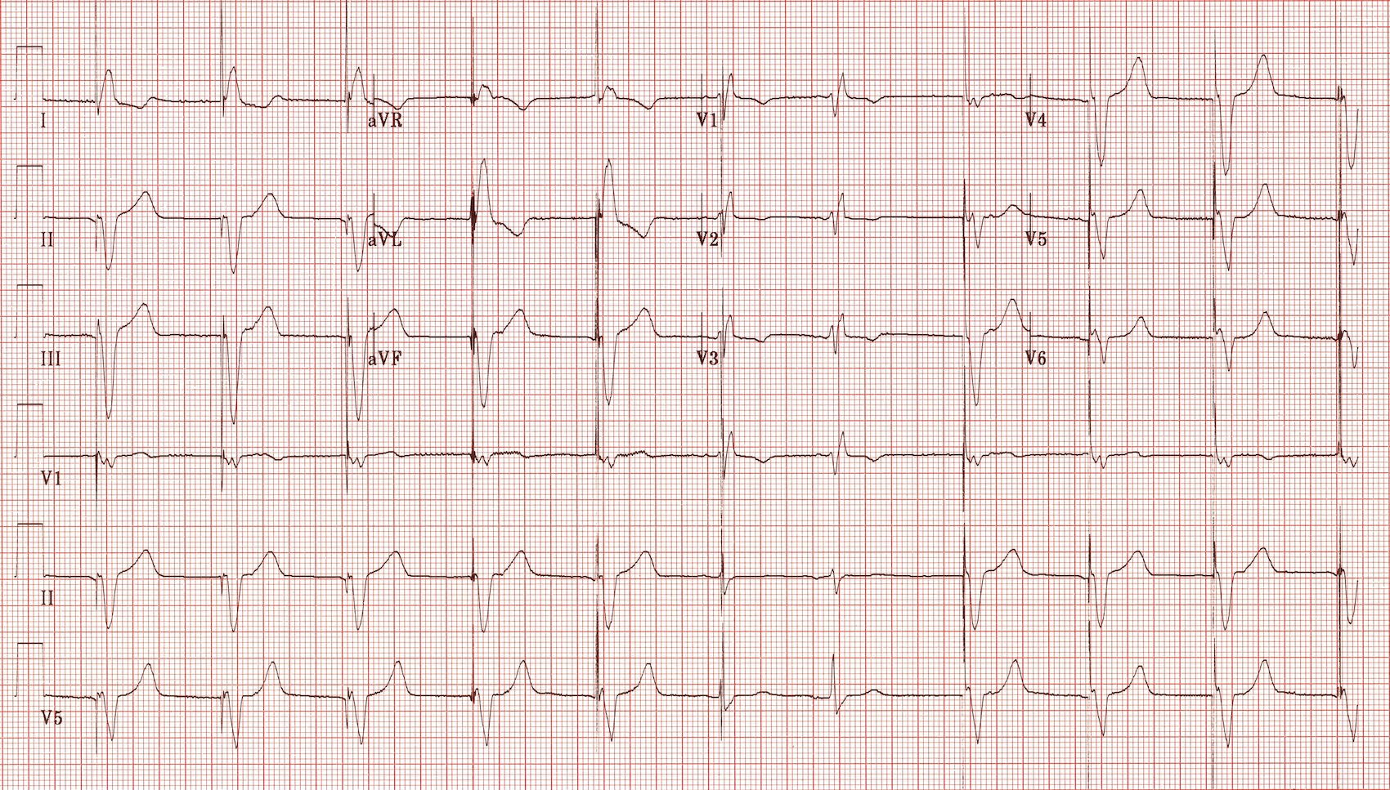
Blake through Rhythm
Notes:
Aims and objectives. Introduction. Idea of metre in poetry: what does it mean? How can we remember the different terms? What effect does each have? Applying it to a poem, and using it to inform the way in which we understand the poem (5 mins)

Slide 12
So what does metre mean?
Definition: It is the basic rhythmic structure of a verse or lines in verse. There are many terms for all the different rhythms.
How to find your metre: read the line of poetry out aloud, and decide which words you would naturally stress.
Importantly, you want to look at obvious breaks or contrasts in rhythm in a poem, and work out how the metre helps to create meaning.
Notes:
Open up the discussion to ascertain what the students already know about metre. Compare their responses on white boards, to the definition on the PowerPoint slide. Stress that the relevance is what mood the metre creates, and whether the writer breaks a metrical rhythm in a poem. (10 mins)

Slide 13
Where would you put the stresses here? Mark unstressed as x and stressed as /
So long as men can breathe, or eyes can see,
So long lives this, and this gives life to thee.
I think I’d like to have a cup of tea
Notes:
Work in a pair to decide (on a white board) what the stress pattern is. Mark it down as x for unstressed and / for stressed. 5 mins

Slide 14
If you marked the stressed (/) and the unstressed (X) – it might look something like this.
× / × / × / × / × /
So long as men can breathe, or eyes can see,
× / × / × / × / × /
So long lives this, and this gives life to thee.
Notes:
Compare to this slide: discussion about whether they agree. Discussion about whether anyone can give a name to this metre. 5 mins

Slide 15
Which sounds more upbeat? In pairs, read both out aloud. One person note down which words the other person stresses.
Slow Spondee stalks; strong foot!
With a leap and a bound the swift Anapests throng
Notes:
In pairs to try and decide where the stresses lie in these two lines. Which one sounds more solemn, which more upbeat? Do the class agree?

Slide 16
Some terms for you:
Dactyl - / x x
Picture yourself in a boat on a river with tangerine trees and marmalade skies
And its “opposite”:
Anapest x x /
Trochee / x
Twinkle twinkle little star
And its opposite:
Iamb x /
Spondee / /

Slide 17
Find a single word that will help you to remember these terms. Try and use their qualities to decide on your word
Dactyl - / x x (song-like)
Anapest x x / (comic)
Trochee / x (down beat)
Iamb x / (rhythm closest to that of conversation)
Spondee / / (solemn)
Notes:
Ask the class to arrive at a mnemonic by which they will be able to remember the term and the quality that the metre typically embues in a poem.

Slide 18
My Suggestions…
Dactyl - / x x musical
Anapest x x / oh what fun
Trochee / x trouble
Iamb x / I talk
Spondee / / grave march

Slide 19
What do you notice about the change in rhythm in this 12 line poem?
First two lines: x /x x /x x /
X /x x /x x /
Middle line: X / / / x / x x /
Last two lines: x / x / / x / x x /
x / x x / x / x x /
Notes:
Look at the rhythm of “Garden of Love”: work in pairs to reach conclusion, then discuss their ideas: on board.

Slide 20
Looking at “The Garden of Love”
Regular, anapaestic rhythm in the first two stanzas, suggesting the past, happy associations the person had with The Garden of Love (“play”, “green”, “flowers”)
Deviation in rhythm in quote from The Bible: spondaic rhythm foregrounding the serious nature of the imperative.
Deviation in the rhythm in the last two lines: confirmation of the way in which the priests, as symbols of established religion and of the adult world, have taken over from the childlike freedom that still echoes in the first verse.
Notes:
How does their knowledge of the rhythm feed their understanding of this poem?

Slide 21
Connecting the poems: “Explore how Blake presents industrialisation in “London”, making links with one or two other poems of your choice.

Slide 22
Individually: write your response to this question
Explore how William Blake presents industrialisation in “London” and make connections with one or two other poems from your collection.
You should consider Blake’s use of poetic and stylistic techniques and significant literary or other relevant contexts.
NB This is a Closed Text Exam
Notes:
Plan for 5 minutes. Decide what poem they would use for comparison. Poems on board. Complete their response.

