Slide 1
Marketing
Reflect on last weeks learning:
What are the features of a successful product?
Product L2: Product Life Cycle

Slide 2
Learning Objectives
Explain what is meant by the product life cycle
Explain the stages in the product life cycle
Explain what is meant by an extension strategy
Construct and label a product life cycle diagram including extension strategies
Evaluate the impact of extension strategies on a business.

Slide 3
Product Life Cycle – What is it?
The product life cycle is a theoretical model which represents the stages in the life of a product and the sales that are achieved at each stage.
The product life cycle measure the change in sales of the product that occurs over time (sales are not constant)
Every product has a life cycle.
There are variations in levels of demand.
The amount of competition varies.

Slide 4
Product Life Cycle – Stages
(Development)
Introduction
Growth
Maturity
Saturation
Decline (Extension strategies)
Theory can be applied to a:
Product category
Style
Brand or model
Each stage of the Cycle has an implication for:
(a) Net cash flow, (b) Profit and (c) Marketing strategy
Notes:
Starter

Slide 5
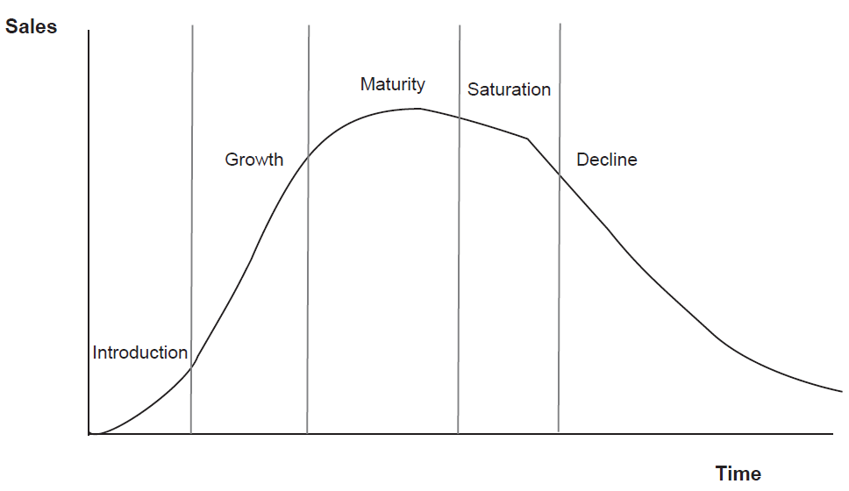
Product Life Cycle – Stages
Notes:
Starter

Slide 6
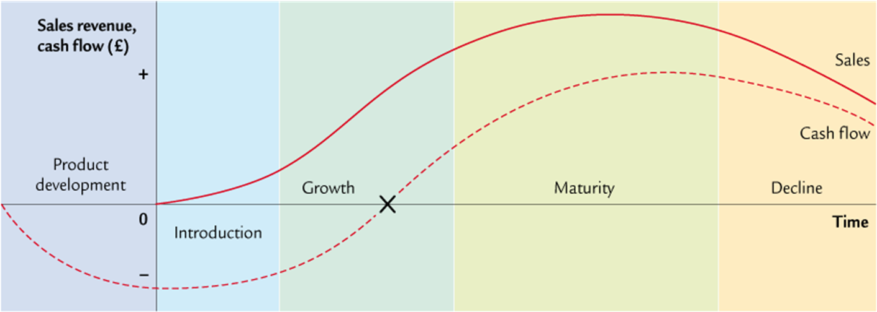
Product Life Cycle – Stages
Notes:
Starter

Slide 7
Development stage
Product is being researched and designed
If an idea is considered worth pursuing a prototype is made.
Large number of products never progress beyond this stage and will fail.
Costs will be high in this stage.

Slide 8
Introduction stage
Product is new to the market
Few consumers know of its existence
Prices can be high
Sales may be restricted to early adopters
Profits are low, because development costs have to be repaid and advertising expenditure can be high

Slide 9
Growth stage
Product has become more widely known and consumed
Advertising is used to establish and strengthen the brand and develop image for product
Profits start to grow
Advertising expenditure may still be high
Prices fall as competitors enter the market

Slide 10
Maturity stage
Product range may be extended
Competition will increase and must be responded to
Advertising is used to reinforce image
Sales are at their peak
Profits should be high
Businesses will try and make the product stay in the maturity stage for as long as possible to maximise profits. To do this they will need to use extension strategies

Slide 11
Saturation stage
Very few new customers gained.
Businesses should try to reduce their costs, so that prices can be more flexible.
Market for the product is full.
Profits may start to decline.

Slide 12
Decline stage
Sales may fall fast
Product range may be reduced and business will concentrate on core products
Advertising costs will be reduced.
Attempts will be made to mop-up what is left of potential market.
Overall profits will fall.
Price is likely to fall.

Slide 13
Alternative product life cycles
‘Straw on fire’ life cycle:
Product quickly moves through all the stage.
During this time sales can be very high.
Products with this type of life cycle will only dominate the market for a short period (e.g. fads or crazes like loom bands)
‘Extended’ life cycle
Demonstrates that some products remain in the marketplace for a long time.
Stay in maturity and avoid decline
E.g. Coca Cola
‘Straw on Fire’ life cycle
Sales
What would the product life cycle of a washing machine look like?
Time (years)
1
2
3
4
5
6
7

Slide 14
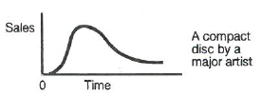
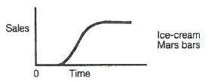
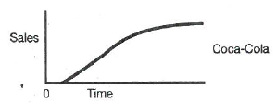
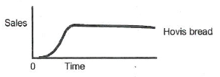
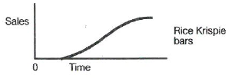
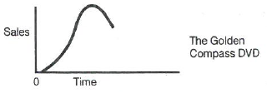
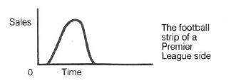
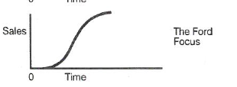

Slide 15
Activities
Use the lesson slides, the exam board notes and the scanned text book page to complete the “L1 Product Life Cycle table” identifying what happens at each stage of the PLC
What is happening to sales/revenue at each stage?
Are costs high/low/increasing/decreasing?
What marketing activities will be taking place – why?
Etc
30 – 40 minutes
Complete Question 2 on page 82 of scanned text book page
15 minutes

Slide 16
Watch me!
https://www.youtube.com/watch?v=ob5KWs3I3aY

