Slide 1
Starter Activity
(Without looking at your notes…)
What are the stages of the product life cycle?
At what stage does cash flow become positive?
At what stage is the product most profitable?

Slide 2
Learning Objectives
Explain what is meant by the product life cycle
Explain the stages in the product life cycle
Explain what is meant by an extension strategy
Construct and label a product life cycle diagram including extension strategies
Evaluate the impact of extension strategies on a business.

Slide 3
Extension strategies
The main focus of the product life cycle is to keep products at their peak: that is, in the maturity stage.
This is achieved through extension strategies
extension strategies: methods used to lengthen the life cycle of a product by preventing or delaying it from reaching the decline stage of the product life cycle.

Slide 4
Extension strategies
Could include:
Repositioning the product in the market place
Relaunching the product, aiming at a different segment (e.g. promoting the healthy aspects of consuming the product)
Using the ‘now with’ policy
Some other ideas....
Finding new markets for existing products (e.g. sports clothing as fashion)
Developing a wider product range
Gearing the product towards specific target markets
Changing the appearance, format or packaging
Encouraging people to use the product more frequently (e.g. cereal)
Changing the ingredients/components
Updating designs (e.g. car manufacturers / games consoles)

Slide 5
Extending the life cycle
Sales
Introduction
Growth
Maturity
Decline
Time
Saturation

Slide 6
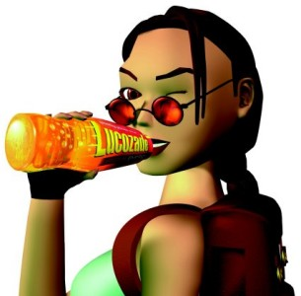
Extension Strategies
Find new uses for the products

Slide 7
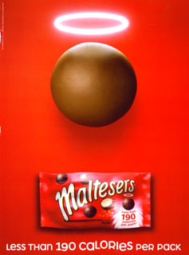
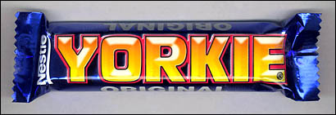
Aiming the product towards specific target markets

Slide 8
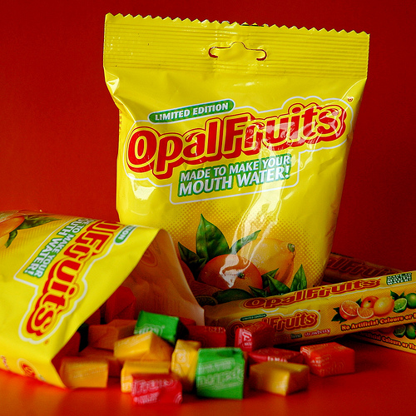
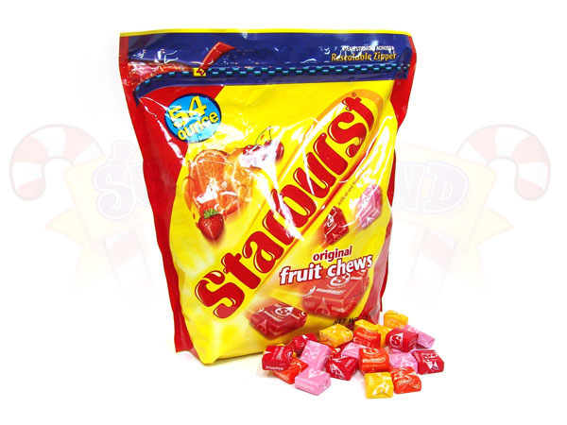
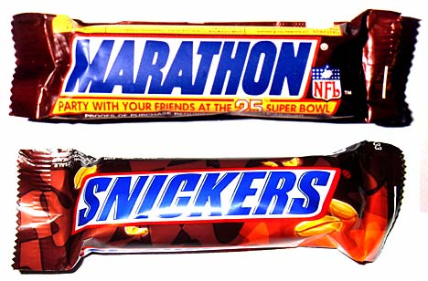
Changing appearance or packaging

Slide 9
Extending the Product Life Cycle
Consider any / all of the following: Change price. Change promotion. Change product – restyle. Change distribution – online. Develop ne market segments. Find new uses for the product. Re-position the product.
Product culls: Elimination of the non-profitable products that have no other use (e.g. key customer requires them). Weak products take management time and may be create negative cash flow.
Product Life Cycle is short if: The rate of technological change is rapid. There is a high degree of innovation in the market. Customers’ tastes are changing rapidly. The product is a fashion item. The product is badly marketed.

Slide 10
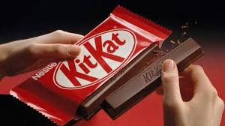
Activities
1. Use the section on Extension Strategies in the scanned text book pages (page 81) to make notes on the different extension strategies a business may use
2. Read the Kit Kat case study on page 84 and answer the questions. Make sure your use correct terminology in your answers.
15 – 20 minutes
30 - 40 minutes

Slide 11
Summary
3-2-1
List 3 different extension strategies
Describe 2 of the strategies.
Explain, using an example, how 1 strategy could prolong the life of a particular product.

Slide 12
50/50
https://www.youtube.com/watch?v=_26E6QR_hmU

