Slide 1
AQA
    A Level
      Computer Science
      Paper 2
Structure of the Internet
  Unit 10
  The Internet

Slide 2
Objectives
Understand the structure of the Internet
Describe the term ‘Uniform Resource Locator’ (URL) in the context of networking
Explain the terms ‘domain name’ and ‘IP address’
Describe how domain names are organised
Understand the purpose and function of the Domain Name Server (DNS) system
Explain the service provided by Internet registries and why they are needed

Slide 3
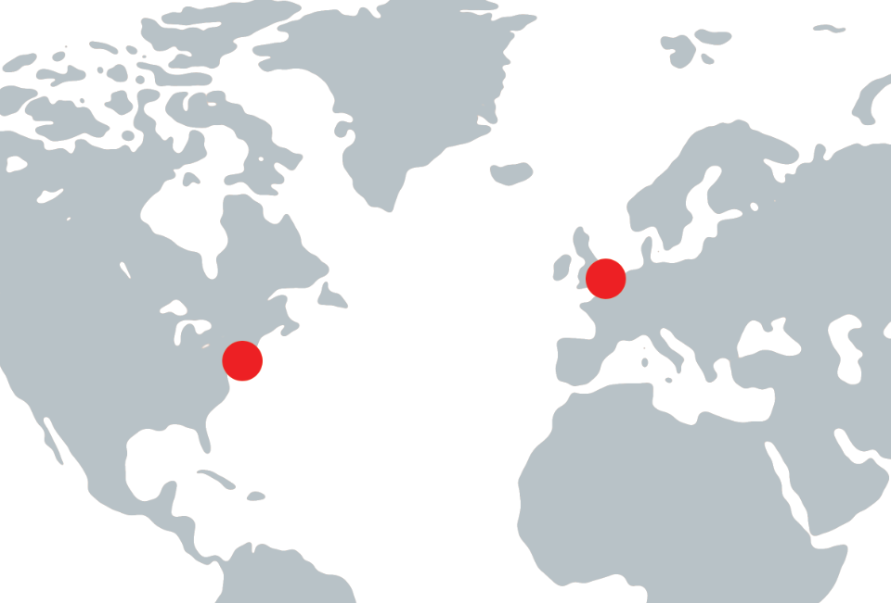
Starter
You access a website hosted in New York for a School called Hill Top from a computer in London
How does your request get there and back?
  How can the school in New York be distinguished from a school with the same name in the UK?

Slide 4
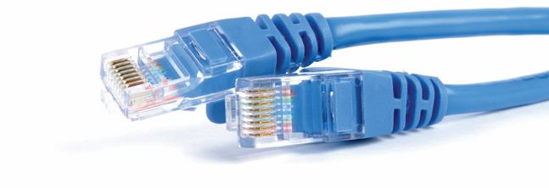
Connecting computers worldwide
Computers communicate with each other using networks
The largest public network in the world is called the Internet but it is similar in concept to a network you would find at home

Slide 5

The Internet
The Internet is a network of Inter-connected Networks
The World Wide Web is a collection of resources accessed via the Internet
  The Internet can also be used to transmit data without using the web – how?

Slide 6

Directing traffic
Similar to a road network, data traffic is directed to any location if the destination address is known

Slide 7
Structure of the Internet
The main part of the Internet is known as the backbone
This is a set of dedicated connections that connect several large networks at various points on the globe
Each of these points are then connected to other regional networks usually, controlled by Internet Service Providers (ISPs)
  Which ISP do you use?
An ISP provides access to individual end-users

Slide 8
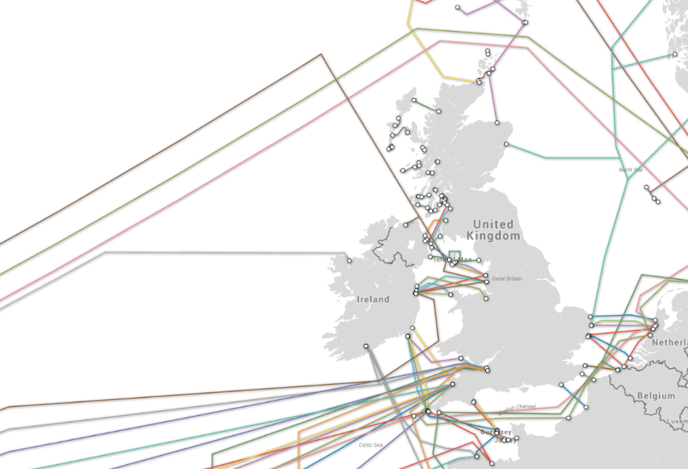
Internet backbone in Europe
What happens:
  when data are sent from Belgium to New York?
  to the same data if all backbone connections from France to the USA are disconnected?
  if one connection is damaged across the English Channel?
  if both backbone connections
  to the far north of
  Scotland are damaged?

Slide 9
Internet addresses
Each device on a network needs to be uniquely identified so that data can be sent to the correct destination much like an address on a letter
  The Internet Protocol addressing system is used
14.132.250.10

Slide 10
IP addressing
IP Version 4 (IPv4) addresses are made up of four octet values (numerical values described by 8 bits) separated by a full-stop
  14.132.250.10 and 230.197.1.192 for example
  This provides only 4.3 billion addresses for 6 billion people
How many devices do you use personally?
  There are no longer enough IPv4 addresses available so Version 6 (IPv6) is used to extend this enough for 340,282,366,920,938,463,463,374,607,431,768,211,456 separate addresses

Slide 11
Fully Qualified Domain Names
An FDQN can be broken down into constituent parts including a host name, and the domain name itself
  bbc.co.uk is the domain name
  www. specifies the host
  www.bbc.co.uk is therefore the Fully Qualified Domain Name

Slide 12
Uniform Resource Locator
URLs are used to specify the means of accessing a resource and its location across a network
The protocol and the domain name of the resource together form the URL
For example:
  http:// specifies that the resource requires http (a web page)
  www.bbc.co.uk/index.html is the fully qualified domain name and the name of the resource to be accessed (index.html)
  The URL is a combination of these http://www.bbc.co.uk/index.html

Slide 13
Domain Name System (DNS)
DNS servers are dedicated computers with an index of domain names and their corresponding IP addresses
  When a computer queries a DNS server for a domain name, the server returns an IP address that the computer can use to send a message to it
  Why do we not use IP addresses directly in a browser?
Typing google.co.uk into a browser causes it to make a DNS request to return an IP address
www.google.co.uk → 216.58.209.99

Slide 14
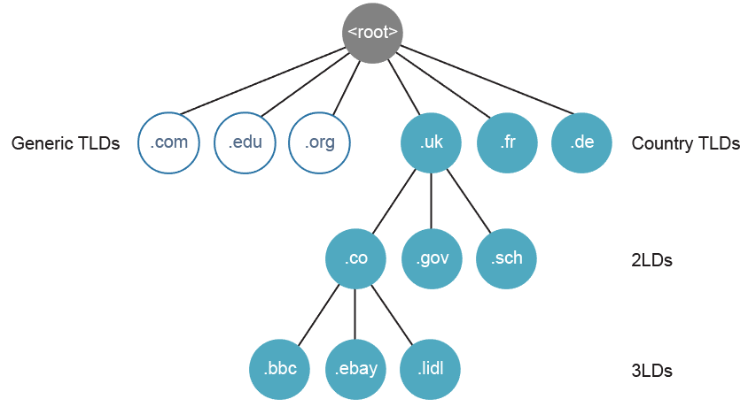
Domain Name System
There are several DNS servers that work together to catalogue every web domain name
  These are segmented into geographical groupings or levels
  When the IP address of a given domain is not known, a query is referred to a related domain server that could know

Slide 15
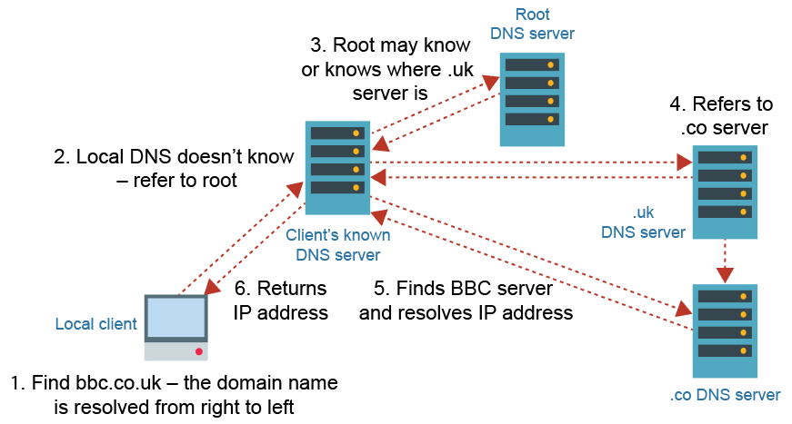
Resolving an IP address

Slide 16
Resolving an IP address
Suppose that a client has no cached record of an
IP address for www.google.co.uk
  It sends a DNS query for that domain to its specified
  DNS server
If the DNS server does not have a record for that domain, it:
  either recursively handles the request so that it can eventually deliver an IP address (or a “DNS address could not be found” error message), or
  refers to a DNS server authoritative for example, .uk and follows this, and subsequent referrals, to successively lower-level DNS servers

Slide 17
Worksheet 1
Complete Tasks 1 and 2
Try typing 216.58.213.174 into the address bar of your browser
  What happens?

Slide 18
Internet registries
The Internet Assigned Numbers Authority (IANA) has the global responsibility for IP addresses and domain names
  IANA delegates responsibility for allocating IP addresses to five Internet Registries
  Domain name registration is delegated to many Domain Registrars
Domain names must be unique
  Why can abcde.com and abcde.co.uk both be allowed as unique examples?

Slide 19
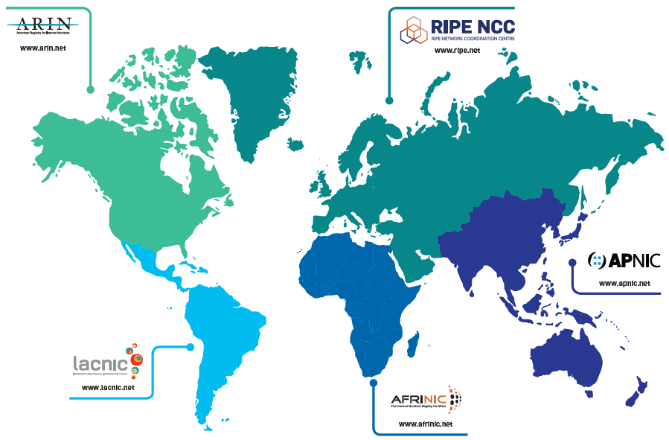
Internet Registries

Slide 20
Purchasing a domain name
Available domain names are issued by Internet registrars
Use www.1and1.co.uk/domaincheck to check prices of domain names in the following Top Level Domains (TLDs)
  .com
  .uk
  .net
  .org

Slide 21
Worksheet 1
Complete Worksheet Task 3

Slide 22
Plenary
Match the terms to their correct definitions:
Uniform Resource Locator |  | Set of four numbers identifying a resource on a network
IP address |  | Organisations that control the allocation of domain names and IP addresses
Domain Name System |  | A method by which hosts on a network can be identified by name based on groupings of addresses
Internet registry |  | The combination of the protocol and fully qualified domain name of a resource

Slide 23
Plenary Answers
Match the terms to their correct definitions:
Uniform Resource Locator |  | Set of four numbers identifying a resource on a network
IP address |  | Organisations that control the allocation of domain names and IP addresses
Domain Name System |  | A method by which hosts on a network can be identified by name based on groupings of addresses
Internet registry |  | The combination of the protocol and fully qualified domain name of a resource

