Slide 1
AQA
    A Level
      Computer Science
      Paper 2
Internet security
  Unit 10
  The Internet

Slide 2
Objectives
Understand how a firewall works
Explain symmetric and asymmetric encryption and key exchange
Explain how digital signatures and certificates are obtained and used
Discuss worms, Trojans and viruses and the vulnerabilities that they exploit
Discuss how improved code quality, monitoring and protection can be used against such threats

Slide 3

Starter
A file is being transferred from Chile to India
  What risks are involved in sending confidential information within the file?

Slide 4

Castle security
How can you get in or out of a castle?
  What can you do to stop people entering or leaving?

Slide 5
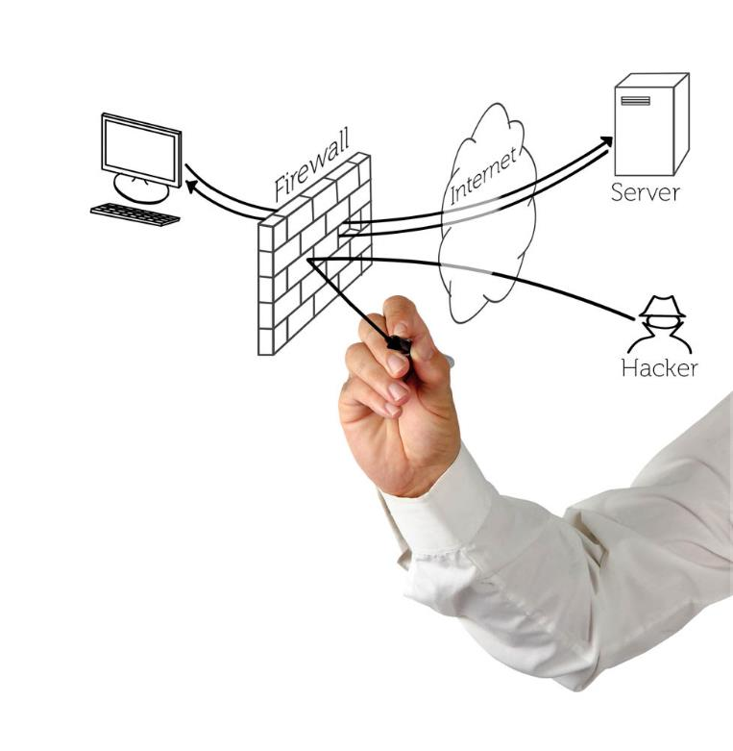
Firewall
The entrance to a network can be protected in the same way
  A firewall is either software or hardware that controls access to and from a network
  Numbered doors called ports are opened so that only certain traffic is allowed to pass through

Slide 6
Packet filtering
Packets of data are inspected by the firewall to check which port they are attempting to access
Different network protocols use different port numbers for example, HTTP traffic, used to transfer web page data, uses port 80 or 8080
If this traffic is to be allowed through, the port must be opened for the duration of the connection, otherwise the firewall will automatically reject it
  Why are ports not left open by default?

Slide 7
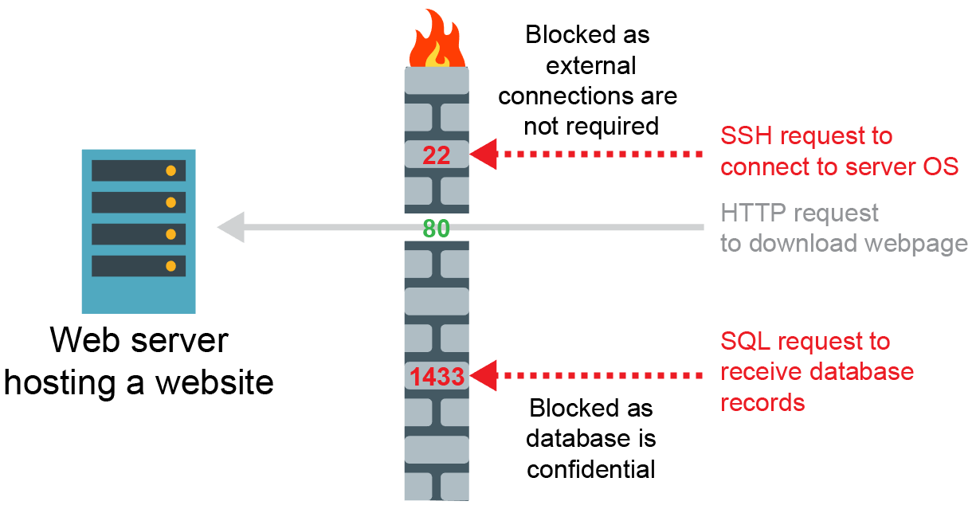
Blocking communications

Slide 8

Stateful inspection
Rather than relying on port numbers and IP addresses to determine passage, stateful inspection examines the payload of a packet before allowing access and remembers actions for future decisions
  When data are expected from a destination they are allowed through as the details of the ‘conversation’ are maintained by the firewall

Slide 9
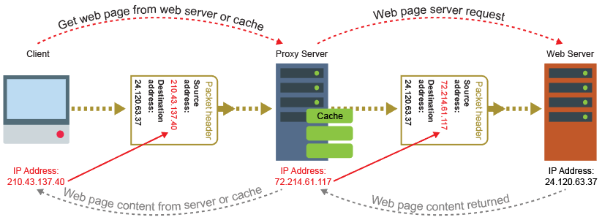
Proxy servers
‘Proxy’ means ‘on behalf of’
  A proxy server makes a web request on behalf of your own computer, hiding the true request IP addresses from the recipient

Slide 10
Functions of a proxy server
A proxy server:
  Enables anonymous surfing
  Can be used to filter undesirable online content
  Logs user data with their requests
  Provides a cache of previously visited sites to speed access
What happens if the website has been updated since the cached version?

Slide 11
Protocols and ports
Complete Task 1

Slide 12
Encryption
The act of encoding a plaintext message so that it cannot be deciphered unless you have a numerical key to decrypt it
  If the message is intercepted it cannot be understood
  If the key can be intercepted, the encryption process is rendered useless

Slide 13
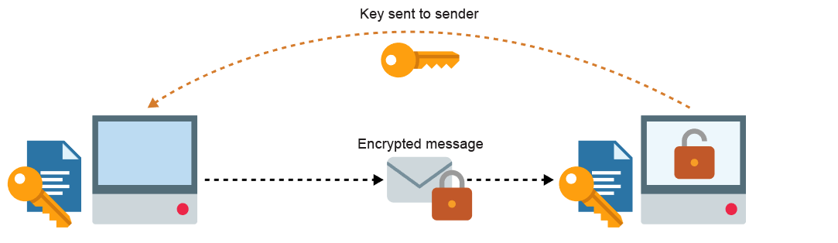
Symmetric encryption
Symmetric encryption uses the same key to encrypt and then decrypt the data being transferred
  The key has to be transferred between the communicating devices so that they both understand how to pass messages

Slide 14
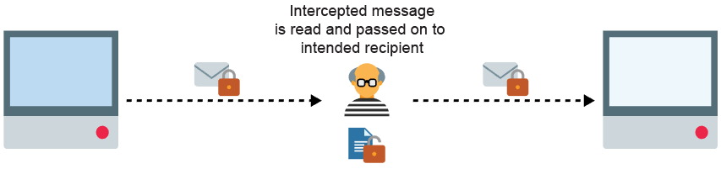
Man in the middle attack
Once they have the key, all that is required is for an attacker is to sit in the middle of the conversation and pretend to be the other party

Slide 15
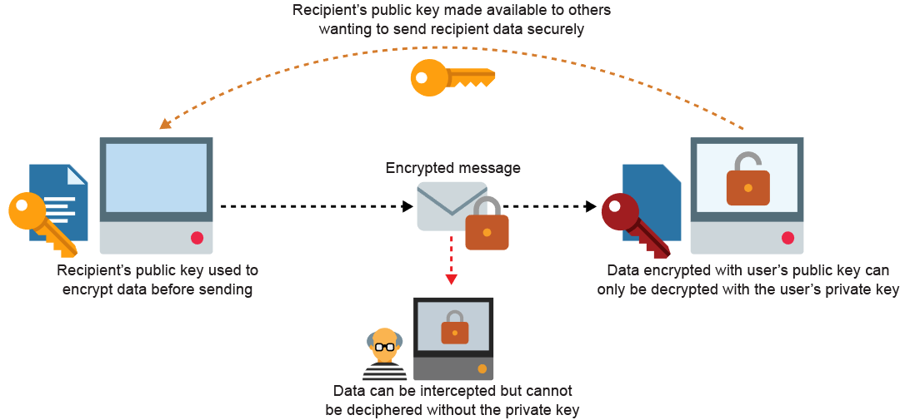
Asymmetric encryption
Uses two separate, but related keys

Slide 16
Symmetric encryption
A relatively fast form of encryption
Key exchange – the communicating devices have to transfer the key between them so that they both understand how to pass messages
  Home and small office Wi-Fi networks usually use a Pre-Shared Key (PSK)
  How can the devices share a private key securely if they are distant from each other?

Slide 17
Asymmetric encryption
Also known as private/public key encryption
Used to initiate TLS connections
Slower than symmetric encryption, so a secure communication session often uses ‘hybrid encryption’
  The beginning of the session uses asymmetric encryption to share a private key for symmetric encryption
  Symmetric encryption speeds up the rest of the
  secure session

Slide 18
Digital signatures
In order to verify the integrity of a message, the sender can add a digital signature to a message
The sender creates the digital signature by:
  irreversibly reducing the unencrypted message to produce
  a hash
  encrypting the hash using their private key
The sender bundles the digital signature with the message and encrypts the bundle using the recipient's public key

Slide 19
Digital signatures
The recipient of a digitally-signed, encrypted message:
  uses their private key to decrypt the bundle of digital signature and message
  uses the sender’s public key to decrypt the signature – how does this prove the owner of the public key signed the message?
  compares the hash received in the decrypted signature with their own hash of the received message – if the hashes match, this verifies the integrity of the message

Slide 20
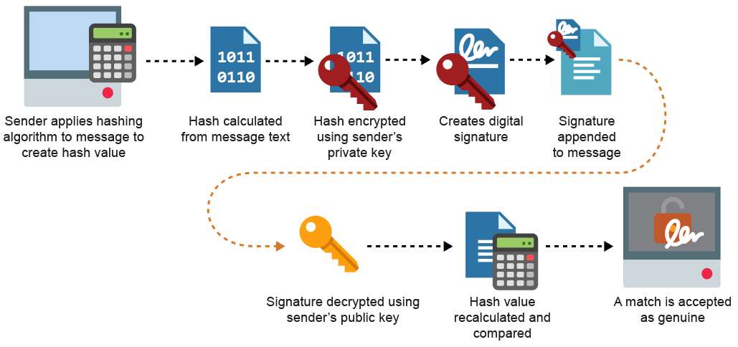
Digital signatures
As a signature can only be decrypted by the sender’s public key the signature can be considered genuine and unaltered

Slide 21
Digital signatures
A digital signature verifies the integrity of a message’s content
How does the recipient know that the owner of the public key used to decrypt the signature is really the person or organisation that claims to have sent it?
  Once a message arrives from a supposed sender, the receiver can get the certificate that belongs to the supposed sender from a certificate server

Slide 22
Digital certificates
When the sender digitally signs a message, they also send their digital certificate
A trusted company known as a Certificate Authority (CA) provides this, which includes:
  a serial number
  name of the CA
  expiry date
  subject (name of the holder)
  subject’s public key
  CA’s digital signature of the certificate to verify the certificate’s origin and integrity

Slide 23
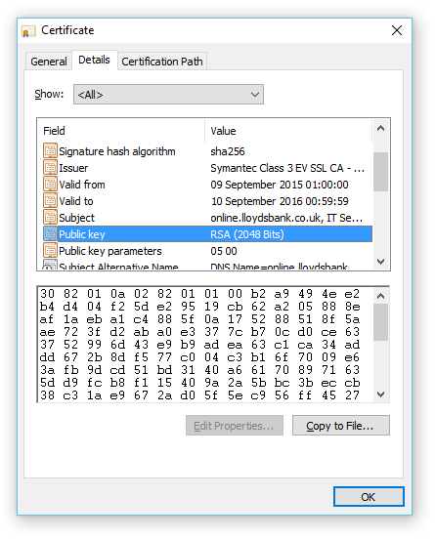
Digital certificates
Used to verify the identity of the owner of each public key and to obtain the key itself
Also used by websites that use HTTPS
  Click the browser’s padlock icon
  What if the Subject field of a website’s certificate only shows the website’s domain name without the name and location of the organisation?

Slide 24
Worksheet 3
Complete Task 2

Slide 25

Malicious software
Malware annoys users or damages their data
Worms and viruses self-replicate
A virus infects (embeds itself in) other programs or data files
A virus needs a user to help it spread
  It is commonly found in email attachments with Macros

Slide 26

Worms
A worm is a standalone program that does not require a user to run it in order for it to spread
  Worms exploit vulnerabilities in the destination system and spread automatically

Slide 27

Trojans
Trojans are malicious pieces of software that masquerade as something seemingly innocuous or useful
  They cannot self-replicate
  Often they serve to open up back doors in your computer to the Internet so that the processing power, Internet bandwidth and data can be exploited remotely

Slide 28
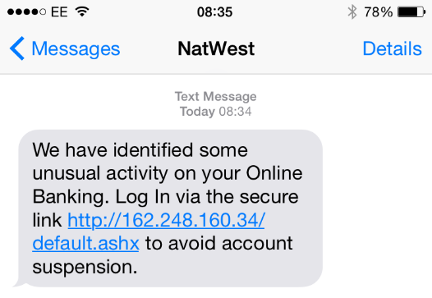
Phishing
Phishing is using email to manipulate a victim into visiting a fake website and giving away personal information
  Who are most susceptible to such messages?
  What are the consequences of clicking on such a link?

Slide 29
Code quality
Improving code quality, together with monitoring attempts to gain unauthorised access and protection can significantly reduce threats from malware
Measures include:
  Guarding against buffer overflow attack
  Guarding against SQL injection attack
  Use of strong passwords for login credentials
  Two-factor authentication
  Use of access rights (file system permissions)

Slide 30

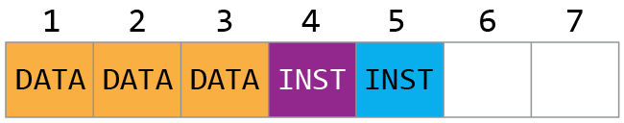
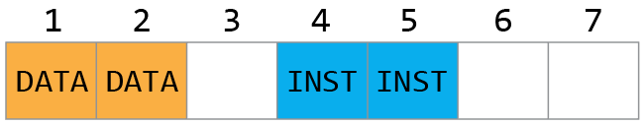
Buffer overflow
Buffer overflow occurs when a program accidentally writes data to a location too small to handle it
  As a result the overflowed data (written to location #3 below) may end up in a neighbouring instruction space
  Malware can deliberately cause and manipulate overflow data which may then be read as a malicious ‘instruction’

Slide 31

SQL injection
A malicious user can enter SQL commands via online database forms to change the processing
  Imagine the following SQL for a banking web form below:
  "SELECT * FROM Customer WHERE CustID = " + txtBoxCustID;
  This will produce the following SQL to display the correct account details, then delete the bank’s entire accounts data
  SELECT * FROM Customer WHERE CustID = 21104710;
  DROP TABLE Accounts;

Slide 32
Monitoring
Monitoring can protect against the threat of hacking, which can introduce malware
These can be used to protect against the threat of malware and hacking
  Packet sniffers
  User access logs

Slide 33
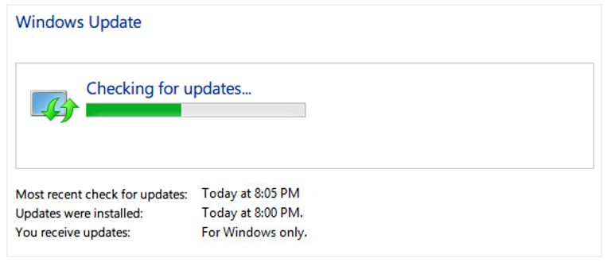
Protection
Up-to-date patches to the operating system and application programs reduce vulnerabilities in
the system
Up-to-date anti-malware (“anti-virus”) software can prevent the spread of infection

Slide 34
Worksheet slide
Complete Task 3

