Slide 1
AQA
    A Level
      Computer Science
      Paper 2
TCP/IP, standard application layer protocols
  Unit 10
  The Internet

Slide 2
Objectives
Describe the roles of the four layers in the TCP/IP protocol stack
Describe the role of sockets in the TCP/IP stack
Be familiar with MAC addresses
Explain and differentiate between the common protocols and the well‐known ports they use
Be familiar with transferring files using FTP as an anonymous and non‐anonymous user
Know how Secure Shell (SSH) is used for remote management including the use of application level protocols for sending and retrieving email
Explain the role of an email server in sending and retrieving email
Explain the role of a web server in serving up web pages in text form
Understand the role of a web browser in retrieving web pages and web page resources and rendering these accordingly

Slide 3



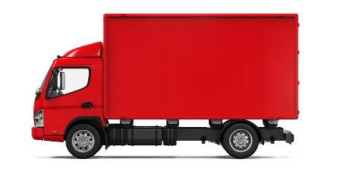
Starter
How does a consignment of goods reach
its destination?
  What processes might it undergo before being shipped?

Slide 4
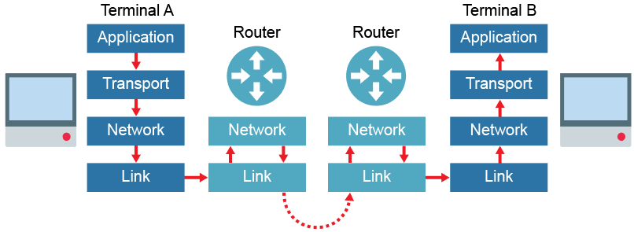
TCP/IP protocol stack
The TCP/IP stack is a set of rules used in turn, to format a message so it can be sent over a network
  Each layer provides a specific function within the transmission of the message

Slide 5
TCP/IP protocol stack
TCP/IP uses four connected layers to allow network communication to take place
Each layer wraps the packets with its own header data:
  Application Layer
  Transport Layer
  Network Layer
  Link Layer

Slide 6
Application Layer
Used to provide services for applications that want to communicate across a network, often the Internet
  Uses high-level protocols that set an agreed standard between the communicating end-points
  For example, SMTP (for e-mail), FTP (for file transfer) and HTTP (for web browsing)
  Does not actually determine how the data is transmitted, rather specifies the rules of what should be sent

Slide 7

Sending data
A web page is requested by a client computer
  As part of the web page, the following .png web image is to be requested from a web server by the client browser using the HTTP protocol:

Slide 8
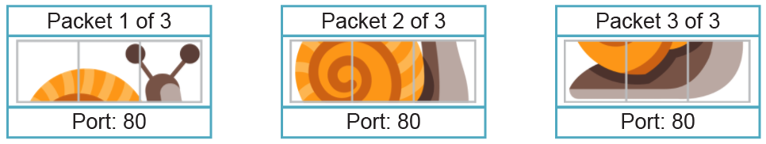
Transport Layer
Uses the Transmission Control Protocol (TCP) to establish an end‐to‐end connection with the recipient computer
  Splits data into packets and numbers them sequentially
  Adds the port number to be used based on HTTP protocol
  At the receiving end this layer confirms that packets have been received and requests any missing packets be resent

Slide 9
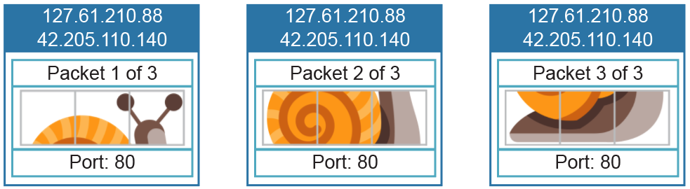
Network Layer
Uses the Internet Protocol (IP) to address packets with the source and destination IP addresses
  A router forwards each packet towards an endpoint called a socket, defined by the combination of IP address and port number: 42.205.110.140:80
  Each router uses a routing table to instruct the next hop

Slide 10
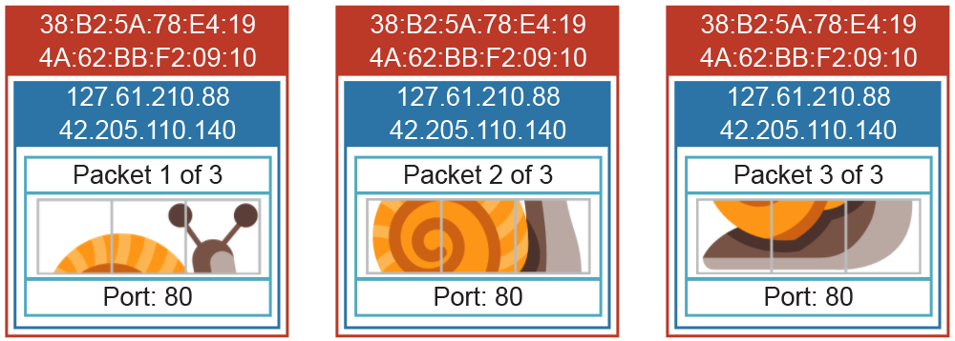
Link Layer
The link layer operates across a physical connection
  Adds the MAC address of the physical NIC that packets should be sent to based on the destination IP address
  MAC addresses change with each hop

Slide 11
Receiving data
At the destination, the message is passed back up through the layers
  The Link Layer removes the MAC address from each packet and passes it to the Network Layer
  The Network Layer removes the IP address from each packet and passes it to the Transport Layer
  The Transport Layer removes the port number from each packet, reassembles the packets in the correct order and passes them to the Application Layer
  The Application Layer presents the image data for the user in a browser

Slide 12
Media Access Control (MAC) addresses
A MAC address uniquely identifies a physical device with a Network Interface Card (NIC)
4B:24:A2:73:0E:F1
  This may be the destination computer, or a router in transit
  Packets move up and down the lower layers of the stack as they hop across routers, changing their source and destination MAC addresses as they go
  What is the initial destination MAC address of a packet leaving the source computer?

Slide 13
Port numbers
A port is used to alert a specific application to deal with data sent to a computer
  These are used by protocols to specify what data is
  being sent
  The combination of an IP address and a port number, separated by a colon, is known as a socket e.g. 42.205.110.140:80

Slide 14
Well-known port numbers
The following common application level protocols use standard ports:
Server port number | Protocol
20 | File Transfer Protocol (FTP) DATA
21 | File Transfer Protocol (FTP) CONTROL
22 | Secure Shell (SSH) Remote login
23 | Telnet (unencrypted) Remote login
25 | Simple Mail Transfer Protocol (SMTP)
80 and 8080 | HyperText Transfer Protocol (HTTP)
110 | Post Office Protocol v3 (POP3)
143 | Internet Mail Access Protocol (IMAP)
443 | HyperText Transfer Protocol Secure (HTTPS)

Slide 15
Transferring files with FTP
File Transfer Protocol is an application level protocol used to move files across a network
  FTP uses the client server model with separate data and control channels operating on ports 20 and 21
Usernames and passwords are frequently used to protect access to files and to identify users
  Access can also be provided anonymously where any user can access the FTP site

Slide 16
Worksheet
Complete Task 1

Slide 17
Secure Shell
Secure Shell (SSH) is an encrypted protocol that allows secure communication between nodes across a network
  SSH uses public key encryption to protect the data in communication and is commonly used for remote management of servers and other computers

Slide 18
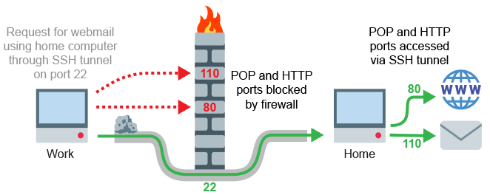
Secure Shell tunnelling
SSH can be used to create a tunnel through
a network
  This tunnel can be used to pass through data that might otherwise be blocked

Slide 19
Sending and receiving email
Mail servers are dedicated computers that are responsible for storing email, providing access to clients and providing services to send emails
They use three protocols:
  SMTP: Used to send emails and forward them between mail servers to their destination
  POP3: Downloads email stored on a remote server to a local client (removed after download)
  IMAP: Manages emails on a sever so multiple clients can access the same email account in synchronicity

Slide 20
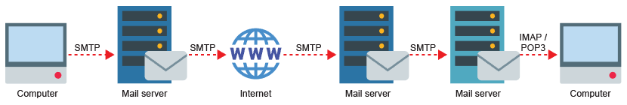
Email protocol comparison
IMAP holds mail on the server so that multiple devices can access all mail
POP downloads mail to a local device and removes it from the server
  What happens if you log in to access mail using a second device with POP or IMAP?

Slide 21

Web page construction
Web pages are written in HTML, CSS and JavaScript
  <!DOCTYPE html>
  <html>
  <head>
  <title>The Tully Monster
  </title>
  <style>
  body {font-family: arial;}
  </style>
  </head>
  <body>
  <h1>The Tully Monster</h1>
  <p>300 million years old</p>
  <img src="TullyMonster.png">
  </body>
  </html>

Slide 22
Web servers
Dedicated computers that host websites and provide resources on request
  HTML, CSS and JavaScript are separated and broken down into their constituent parts e.g. <HEAD> and <BODY>
  These text elements are further broken down and rendered on the client browser according to a standard hierarchical model
  Other page resources such images, videos or scripts are subsequently downloaded as the page is rendered

Slide 23
Worksheet
Complete Tasks 2 and 3

Slide 24
Plenary
Explain how a company’s internal HTML web page is transmitted across an Ethernet network connection using TCP/IP
  Remember to explain in terms of the 4 layers of the TCP/IP protocol stack

