Slide 1
Business Functions: Marketing
Reflect on learning from last lesson: what is an extension strategy, give one example
Managing the Product Portfolio / The Boston Matrix
Notes:
Getting started: read through the Boston matrix theory note and highlight key points

Slide 2
Learning Objectives
Be able to….
Define product portfolio and product portfolio analysis.
Describe the purpose of the Boston Matrix and the meaning of each component.
Explain the limitations of the Boston Matrix.

Slide 3
Key terms
Product portfolio: the range of products or brands provided by a business.
Product analysis: The study of the range of products with a view to deciding whether new products should be developed / old products withdrawn.
The Boston Matrix: a tool of product portfolio analysis that classifies products according to the market share of the product and the rate of growth of the market in which the product is sold.

Slide 4
Product Portfolio Analysis
Very few firms rely on one product
In a multi-product firm (e.g. Kellogg’s), the range of products is its product portfolio
Firms plan their product range to spread their risks
If one product has low sales, it may be supported by other, more successful products
An example of the way in which a business can carry out product portfolio analysis is the Boston matrix.

Slide 5
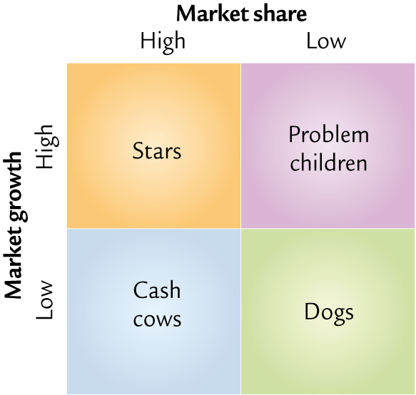
The Boston Matrix
What does the Boston Matrix do? It compares a products market share with the rate of market growth.
What then? Each quarter of the matrix is given a name to characterise the business's attitude to products occupying one of the quadrants.
Is this important? Yes, this categorisation will help decide the marketing strategy.
Notes:
Developed by the Boston Consulting Group in the 1950’s
The Boston Matrix is designed to show how a firms products are performing in relation to growth in the size of the market.

Slide 6
The Boston Matrix
A product with a high market share is clearly in a strong competitive situation.
A product in a high growth market should have opportunities for future growth
Notes:
Developed by the Boston Consulting Group in the 1950’s
The Boston Matrix is designed to show how a firms products are performing in relation to growth in the size of the market.

Slide 7
How to use the matrix
Use it to:
judge how to manage individual products and the product range
recognise the importance of using successful, profitable products, to fund development of stars
analyse if the portfolio meets company objectives.
Ideally firms do not want products in each part of the matrix

Slide 8
Star
High market growth, high market share - A brand leader in the category
- Huge potential
- May have been expensive to develop
- They should also generate a large amount of cash / worth spending money to promote.
Market Share
High
Low
- Consider the extent of their product life cycle in decision making.
High
Market growth
Low
Notes:
Frequently roughly in balance on net cash flow.
However if needed, attempts through marketing and product development should be made to hold market share, because the rewards will be a Cash Cow if market share is kept as the market growth slows and matures.

Slide 9
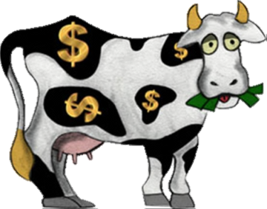
Cash Cow
Low market growth, high market share
Cheap to promote
Generate large amounts of cash – use for further R&D?
Costs of developing and promoting have largely gone
Need to monitor their performance – the long term?
At the maturity stage of the product life cycle?
Market Share
High
Low
High
Market growth
Low
Notes:
Use cash flow from cash cow to support stars

Slide 10
Problem Child
High growth, Low Market Share
- Have the worst cash flow characteristics of any of the 4 types, because marketing costs and R&D costs are high
Positive cash flows are low due to
the low market share.
Market Share
High
Low
- Problem Children can absorb greater amounts of cash and later, as the market growth stops become a Dog.
High
Market growth
Low
Notes:
-Decide whether to invest heavily (to increase market share), or to generate cash, sell the product off or stop investing and take what ever cash can be generated, before the product ‘dies’

Slide 11
Dogs
Low market growth, Low market share
- Costs of development are likely to have been paid back long ago and marketing costs can be low.
However, firms should minimise the number of dogs in a portfolio because they do
not have long term futures.
Market Share
High
Low
- Dogs can deliver strong positive cash flow, and if they do not then decide to liquidate. - Can exist for a long time in niche markets
High
Market growth
Low
Notes:
Not always unprofitable

Slide 12
Product Portfolio Analysis - Conclusion
Ideally a firm will want a portfolio of cash cows and stars
However, in the long term these products may decline, so new products with a low market share but in high growth markets will be ideal replacements
The Boston Matrix is just a generalisation. Cash cows can lose money and dogs can be very profitable in the right circumstances
Overall the Boston Matrix says relatively little about a PRODUCT and should not be used without reference to other factors, such as profitability

Slide 13
Product Portfolio Analysis - Conclusion
Other factors that should be considered:
The exact meanings of high and low market share.
The exact meanings of high and low market growth.
The size of the market.
The definition of the market.
How profitable is the product?
Consumer opinions and loyalty.

Slide 14
Benefits | Drawbacks
Simply to use and explain | Too simplistic (relative market share and growth are too narrow when measuring competitive strengths of the firm)
Helps firms decide a strategy (strengths and market opportunities) | It is only a snapshot of the current position
Has been successfully used by firms | Based on a series of assumptions
Relatively easy to construct (as market growth and share data is readily available) | The definition of “market” can be a problem
Clear guidance is provided for the management of each of the 4 categories in terms of approach to investment and support | Some of the terminology of the four quadrants might be misleading
Important model for allocating resources to the right areas

Slide 15
Class Activities
Use the lesson slides and the exam board note (on GOL) to make brief notes on the Boston Matrix. You should include:
- Purpose of the matrix
- Brief description of each segment of the Matrix
- Benefits and drawback of using the Matrix
2. Complete the Boston Matrix worksheet. Choose one of the companies from those listed below and carry out research into their product portfolio.
You should allocate at least 8 of their products to the correct category in the matrix and answer the questions
- Kelloggs
- Apple
- Cadbury

Slide 16
HW: Past paper question

Slide 17
