Slide 1
Product Life Cycle and Cash flow

Slide 2
Product Life Cycle: What is it?
Every product has a life cycle.
During this period sales are not constant
There are variations in levels of demand
The amount of competition varies

Slide 3
Five stages of the product life cycle
Introduction
Growth
Maturity
Saturation
Decline

Slide 4
THE PRODUCT LIFE CYCLE AND CASH FLOW

Slide 5
Introduction stage
Product is new to the market
Few potential customers
Prices can be high
Sales may be restricted to early adopters
Profits are low, because development costs have to be repaid and advertising expenditure can be high

Slide 6
Growth
Product has become more widely known and consumed
Marketing is used to establish and strengthen the brand and develop image for product
Profits start to grow
Advertising expenditure may still be high
Prices fall as competitors enter the market

Slide 7
Maturity
Product range may be extended
Competition will increase and have to be responded to
Advertising is used to reinforce image
Sales are at their peak
Profits should be high

Slide 8
Saturation
Very few customers are gained
Replacement purchases are the trend
Firms try to reduce their costs, so that pricing strategies become more flexible
Brand image needs to be maintained or it can be repositioned to capture new markets, or market niches, but quality must be maintained
Profits may start to fall

Slide 9
Decline
Sales may fall fast and as a result range sold is likely to be reduced with firms concentrating on core products
Advertising costs will be reduced
Attempts will be made to mop-up what is left of potential market
Each product sold should be profitable as development costs will have been paid back at an earlier stage
Total profits will start to fall
Price will fall

Slide 10
Drawing a product life cycle
Plot the following products on the stage of the life cycle you think they are at:
Amazon Alexa
Football strip of a premier league side
Hovis bread
Ford Focus
Coca Cola
Complete the Kit Kat article textbook p80

Slide 11
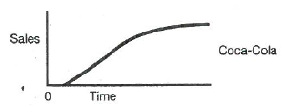
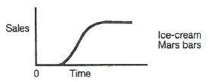
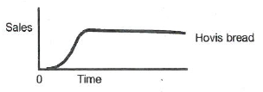
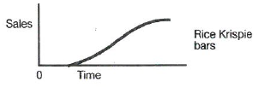
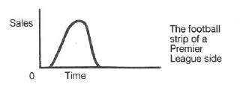
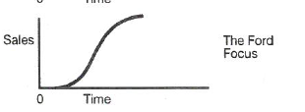

Slide 12
Product Portfolio Analysis and Management
All firms with a long-term view will have a mix of products available for sale and at different stages of the life cycle.
Example
Mondeo have 7 different versions – this is known as
product depth

Slide 13
Cash Flow and the Product Life Cycle
Developing new products is expensive, even existing products have costs attached, such as advertising or distribution.
All of these costs affect cash flow and for most products we can estimate cash flow against different stages of the product life cycle

