Slide 1
Decisions about the marketing mix

Slide 2
Learning Objectives
Understand the importance of global marketing and global brands
Explain how the marketing mix will differ in different contexts
Evaluate the marketing mix in different contexts

Slide 3
Explain how the marketing mix will differ in different contexts
Local vs national vs global
Perfect competition vs monopolistic competition vs oligopoly
Goods vs services
Niche vs mass markets
B2B vs B2C

Slide 4
Understand the importance of global marketing and global brands
What is a brand?
It is a name, term, sign, symbol, design or any other feature that allows consumers to identify the goods and services of a business and to differentiate them form those of competitors.
EXAMPLES: McDonald’s ‘golden arches’; Nike ‘swoosh’; Adidas three stripes; Virgin font

Slide 5
Understand the importance of global marketing and global brands
What are the reasons for branding?
CREATE CUSTOMER LOYALTY: A barrier to entry for competitors
DIFFERENTIATE THE PRODUCT: Gives a clear product identity when there is similarity in design
PRICING FLEXIBILITY: Creates price inelastic demand. Customers pay higher prices
TRUST: Customers re-purchase because they trust the product
BRAND IMAGE: To attract customers through the ‘classic’ or ‘quirky’ positioning

Slide 6
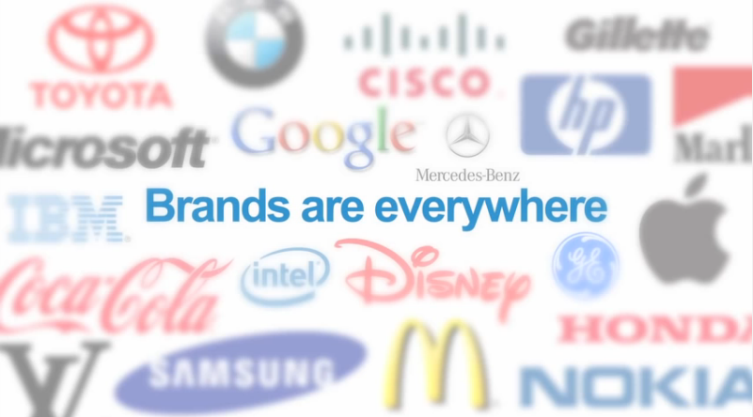
Impact of branding
Notes:
https://www.youtube.com/watch?v=JKIAOZZritk

Slide 7
Understand the importance of global marketing and global brands
Why might businesses market their products internationally?:
PROFIT: Prices may be higher, costs lower and markets less competitive
SPREAD RISK: Less vulnerable to changes in the economic conditions in one market
EXTEND PLC: Products that maybe in decline in one market can be re-launched in a new one
LEGAL: There maybe fewer restrictions on labour, environmental issues and products such as alcohol, tobacco, pharmaceuticals

Slide 8
Understand the importance of global marketing and global brands
Why are global brands considered ‘gold dust’ to a business?
BENEFITS: Economies of scale; marketing, operational, managerial, financial
RE-PURCHASE: Wherever customers travel the brand can be purchased
E.g. a Big Mac is a Big Mac no matter where you are in the world!

Slide 9
Understand the importance of global marketing and global brands
Why the overseas market is different?
POLITICAL : Instability can result in investments being ‘written off’, e.g. Zimbabwe, Russia
CULTURAL : Understand differences in language, colour, body shape, gender and ‘bribes’
LEGISLATION: Differences in product labelling and safety, environment impact, advertising
ECONOMIC : GDP, average income, distribution of income, taxation
SOCIAL: Demographics, role of women, educational attainment, religion, attitudes
BUSINESS PRACTICE: Whether to customise products to the market, accounting practices, transportation networks, media opportunities, market structures and competitors

Slide 10
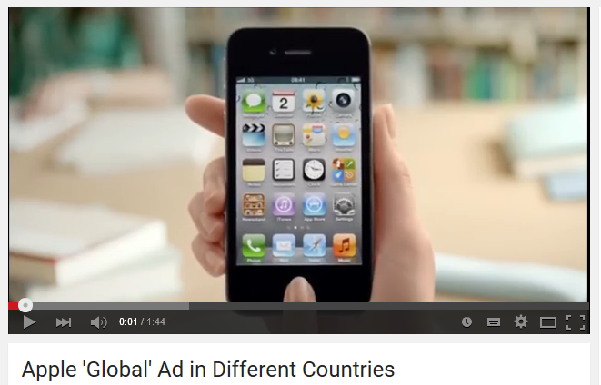
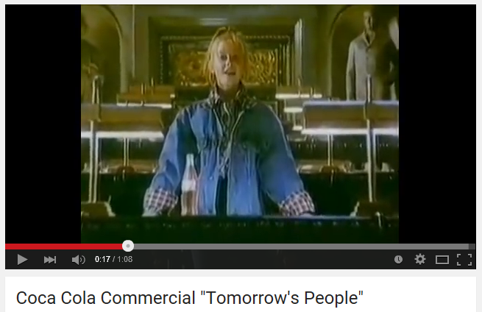
Understand the importance of global marketing and global brands
Notes:
Videos to demonstrate same advertising in different countries
Apple - https://www.youtube.com/watch?v=MoE9XxXUatA
Coca Cola – link takes you to page where can play the different versions from around the world (same ad apart from the opening child)
https://www.youtube.com/results?q=coca+cola+tomorrow%27s+people+around+the+world

Slide 11

Glocalisation

Slide 12
Activity - Evaluate the marketing mix in different contexts
Research Activity:
Identify 1 global brands.
Analyse how their marketing varies from one country to another (relate specifically to the 4Ps in the marketing mix)
Explain the reasons for this.
Investigate the problems each business is likely to have when involved in global marketing.

Slide 13
Plenary
How might the marketing mix be adapted to meet the different needs of consumers in the global marketplace?
  Using your knowledge from the lesson and your research, make three points to answer the question above

Slide 14
Homework Activity - Evaluate the marketing mix in different contexts
Note taking:
Branding
What is a brand (page 119)
Reasons for branding (page 121)
Branding in a global market and problems with branding (page 122)
International marketing
The importance of international marketing (page 159)
Why the overseas market is different (page 159 – 160)
Methods of entering overseas markets (160 – 161)

