Slide 1
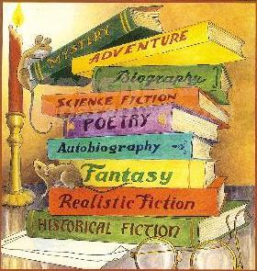
Week 8 Frankenstein and Never Let Me Go
Genre busting or embracing?

Slide 2
Your Presentations:
To create a single page document for your allocated chapter: on which you should
Outline the main events of your chapter
List the key features of your chapter in terms of character, theme, writing style, tone, setting, narrative voice etc.
List the connections you see with Never Let Me Go
Volume 2 Chapter 111 p 105 - Jessie B Luke R Ruqia
Volume 2 Chapter 1V p 113 - Levi Max Hannah Emily S
Volume 2 Chapter V p 119 - Will Katie Jessie G Eve
Volume 2 Chapter V1 p 125 - Ellie H Sasha Harry Darcy
Volume 2 Chapter V11 p 130 - Emily H Sabrina Ellie L Ella

Slide 4
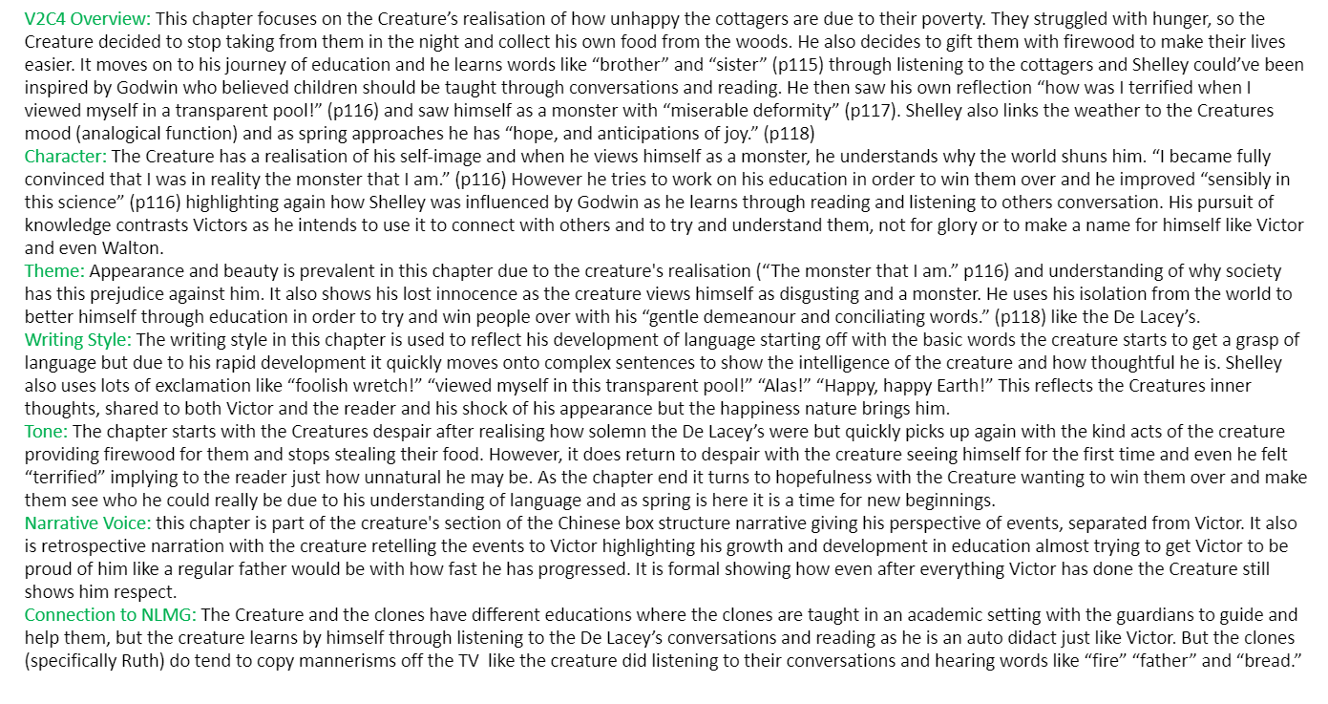

Slide 5
Chapter summary -volume 2 CHAPTER VII-
Ella, ellie, darcy and sabs

Slide 6
STORYLINE OVERVIEW
While foraging for wood in the forest one evening, the creature stumbles across an abandoned leather satchel containing a few books.
The creature finds and reads three books: Milton's Paradise Lost, Plutarch's Lives and Goethe's The Sorrows of Young Werther; unaware that the books are fictional, he reads it as history and relates it to his own situation. Now being able to read, the creature reads Victor's journal of the months leading up to his creation.
Victor's description of the creature's appearance increases his sense of loneliness and self-disgust, but with his newfound eloquence he introduces himself to old De Lacey, whose blindness protects him from being immediately repelled by the creature's appearance. They begin to talk, but when Agatha, Felix and Safie return, the creature is forced to flee.
KEY FEATURES OF THE CHAPTER
The creature is advancing psychologically, now being able to read and speak fluently just like the cottagers.
He is starting to grasp human relations and interactions, having profiled each cottager in the previous chapter and now analysing and planning to approach one of them.
Establishes that his appearance is vastly different to a normal human, so opts to try and talk to the blind member of the family (De Lacey ) as his appearance will not be the first impression.
Has first 'normal' encounter and conversation with De Lacey before being caught and told to leave by Felix.
Chapter is in first person perspective of the creature, set in and around the cottage/ hovel – Shelley enables the reader to sympathise with the creature rather than the critical, hyperbolic accounts of Victor regarding the Creature

Slide 7
THE CREATURE’S MOTIVES...
This is quite a while before the creature gives up on humanity. What he has read, together with his close observations of the de Laceys, has convinced him of the existence of human virtue, and he aspires to what is best in people.
These feelings are part of what Mary Shelley is saying about human development and social education. Left to himself, the creature is innocent, benevolent and trusting, and he retains these and other positive qualities, in spite of having read about and witnessed much less worthy behaviour.
He hopes that, because de Lacey is blind he will have an unbiased reception, and this proves to be the case. It is only when the sighted members of the family arrive that he is attacked and forced to flee.
LINKS TO NEVER LET ME GO:
Never Let Me Go also displays the first interaction between clones and humans in the real world, when Ruth sees her 'possible' when they go into town. Although Ruth doesn’t actually talk to her possible: both the clones and the creature observe the human behaviour from a distance, showing their interest in humans in general and their analysis of them.
Also, the creature adapts humanist behaviours by watching the cottagers from a hole in their wall, almost like 'watching tv' , just as the clones watch tv shows and reciprocate the behaviours shown (most predominantly shown by Ruth and Tommy).
Never Let Me Go also displays how the clones would easily believe stories they were told, just like how the creature believes everything he read in the books, this simply showing that they know no better as they have not been taught to (they are very naïve).

Slide 8
KEY THEMES
Role of Women = The De Lacey’s defy the stereotype at the time, as they are a family who according to critics, “shares work and responsibility equally between male and female in an atmosphere of rational companionship”
Dangerous Knowledge = “They produced in me an infinity of new images and feelings, that sometimes raised me to ecstasy, but more frequently sunk me into the lowest dejection” (p 130)
KEY QUOTES
The possession of these treasures gave me extreme delight; I now continually studied and exercised my mind upon these histories, whilst my friends were employed in their ordinary occupations. (p 130)
Many times I considered Satan as the fitter emblem of my condition; for often, like him, when I viewed the bliss of my protectors, the bitter gall of envy rose within me. (p 132)
Could they turn from their door one, however monstrous, who solicited their compassion and friendship? (p 133)
I, like the archfiend, bore a hell within me, and finding myself unsympathised with, wished to tear up the trees, spread havoc and destruction around me, and then to have sat down and enjoyed the ruin. (Chapter VIII p 138)

Slide 9
Volume 2 Chapters 8-9, Volume 3 Chapters 1-2
Volume 2, Chapter 8 : The creature murders William, and frames Justine for the murder. The creature demands that Victor should make him a female companion.
Volume 2, Chapter 9: Victor agrees to create a female creature, and returns to Geneva.
Volume 3 Chapter 1 Victor finally agrees to marry Elizabeth and prepares to leave for the Orkneys, where he will create the female creature. Clerval plans to follow him.
Volume 3, Chapter 2 Victor hires a hut in the Orkneys and begins to create the second creature.
Notes:
Overview of Volume 2 Chapters 8 to Volume 3 Chapter 3 – with prompts on slides 20 mins

Slide 10
Volume 2, Chapter 8
Character (p 138): I, like the archfiend, bore a hell within me.. repetition of the creature’s alignment with Satan.
Doubling (p 138) I declared ever-lasting war against the species link to Victor p 95 avenge the deaths of William and Justine Seen again on p 141 “I resolved to fly far from the scenes of my misfortunes” (see, for example, p97 I suddenly left home…) Victor “determined to go without a guide” p 100, the creature has no guide (“nor could I ask information from single human being” p 141)
Setting: (p 140) “fierce wind” signalling lack of control and desire for revenge – analogical function. (link to Never Let Me Go and Tommy’s final tantrum)
Education (p 141): I did not know the names of the towns that I was to pass through (p 141): his education is limited to the immediate (comparable to the partial education of the clones)

Slide 11
Volume 2, Chapter 8
Setting (p 141) : sun became heatless… the surface of the earth was hard and chill (Ch 16): possibly symbolising the lack of compassion the creature experiences
Lexical repetitions of “revenge” eg p 143 “eternal hatred and vengeance to all mankind” “deep and deadly revenge” – structurally building tension for the murder of William
epithets (p 144): of William: “monster” “wretch” – emulates Victor’s language – society’s values (p144) the creature refers to his “victim”- signalling a change of perception: “I too can create desolation” (p 144) referring to himself as a “fiend” (p145)
Isolation (p148) : I am alone and miserable ref Walton on p 19 “I bitterly feel the want of a friend. I have no one near me…” structural repetitions foreground the similarities between Walton, Victor and the Creature

Slide 12
Volume 2, Chapter 9
Doubling “rage of anger” p 140 v “rage that burned within me” p 147 – continual signals through lexical choice to show how similar the two have become
Destruction: p 147 “tear me to pieces” to be repeated “tore to pieces” p171 – foreshadowing the destruction of the female creature. p 148 – the creature vows to “work at” Victor’s destruction – structurally echoing Victor’s vow to “pursue and destroy the being to whom I gave existence” p 215
Character p 148: the power of the creature is reflected in the use of imperatives (p 148) “Make” “let” “let”
Setting p 151: lexical repetition of “darkness” on p 151 – reflecting Victor’s despair.

Slide 13
Volume 3, Chapter 1
Alienation p155: “I took refuge in the most perfect solitude”: both creature and Victor are alienated. Separated from family – both creating and destroying. Clerval as a foil: “He was a being formed in the “very poetry of nature” (Ch 18)
Doubling p 157: I must… let the monster depart with his mate, before I allow myself to enjoy the delight of a union…: parallel of Victor and creature finding a female
Context p 157: “deadly weight yet hanging around my neck” – reference to “The Ancient Mariner”
Character p 159: Clerval as foil “how great was the contrast between us” – “a being formed in the very poetry of nature” p 161 – sympathetically portrayed by Shelley as representative of the Romantic sensibility. (ref. p 163 Victor sees Clerval as “an image of my former self” – uncorrupted by an overreaching ambition that usurped God and nature.)
Voice p 162: sense of audience: “I will proceed with my tale” – structural marker to build tension.

Slide 14
Volume 3, Chapter 2
doubling pp 165-167 - reference to the progress through Britain, echoes the constant sense of movement of the creature
Setting p 168 “remote spot of Scotland” – separation from society – beyond the moral boundaries of society – forced to the margins
Structural p 168-169“I toiled day and night to complete my work” (p 169) v accomplishment of my toils (p 58) secret toil (p 55) “immersed in a solitude” (p 168) v “in a solitary chamber” (p 55); “filthy process” (p 168) v “filthy creation” (p 55) – direct parallel between the two scenes of creation, one of which ends in destruction
doubling (p 168) of Victor’s existence in Scotland (p168: “ungazed at… pittance of food” and the creature’s existence.
Voice and structure: Creature’s tale: Chs 10-17 Victor’s voice: Chs 18 -24 Walton’s letters conclude the novel

Slide 15
Volume 3 Chapters 3-6
Volume 3 Chapter 3: Victor starts work on the female creature, but has second thoughts. He sees the creature at the window of his lab and destroys the work in progress. The creature vows that he will take revenge and that he will be with Victor on his wedding night. Following a suggestion by Clerval, Victor packs up his instruments, rows out into the sea, and dumps them; the winds are too strong and he can't get back to shore. He contemplates death, but gets blown back to land, only to be greeting by some townspeople who accuse him of murder.
Volume 3 Chapter 4: Victor is imprisoned, and, when shown the body, he realises it is Henry Clerval, with the black marks of the creature’s hands around his neck. In shock, Victor falls into convulsions and suffers a long illness. His father visits him and stays with him until the court. Having nothing but circumstantial evidence, the court finds him innocent of Henry’s murder. After his release, Victor departs with his father for Geneva.
Volume 3 Chapter 5: Victor and his father leave for home. The letter he receives from Elizabeth reminds him of the creature's threat. Victor tells Elizabeth that he has a terrible secret that he can only reveal to her after they are married. After the wedding, Victor and Elizabeth depart for a family cottage to spend the night.
Volume 3 Chapter 6: Victor tells Elizabeth to retire for the night, and then he hears Elizabeth scream and realizes that it was never his death that the creature had been intending this night. Victor returns home and tells his father the news. Shocked by the tragedy his father dies a few days later. Victor finally breaks his secrecy and tries to convince a magistrate in Geneva that an unnatural creature is responsible for the death of Elizabeth, but the magistrate does not believe him. Victor resolves to devote the rest of his life to finding and destroying the creature.

Slide 16
Frankenstein and Never Let Me Go
Genre busting or embracing?

Slide 17
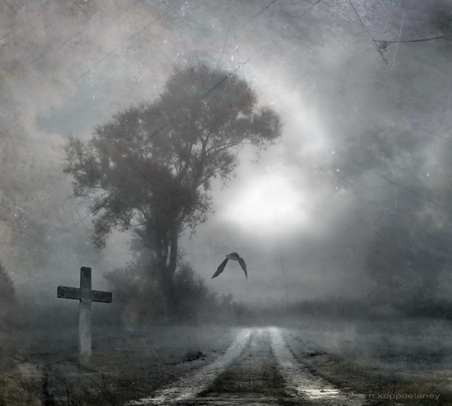
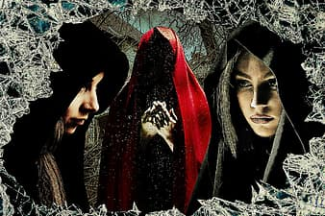
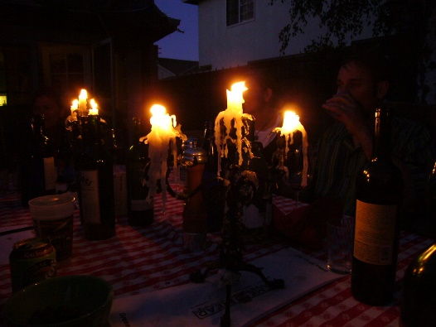
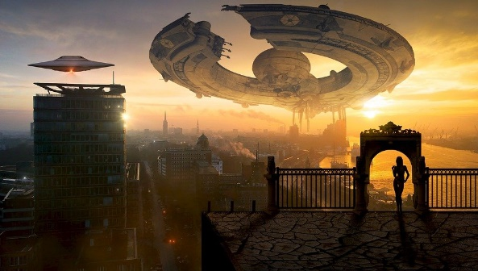
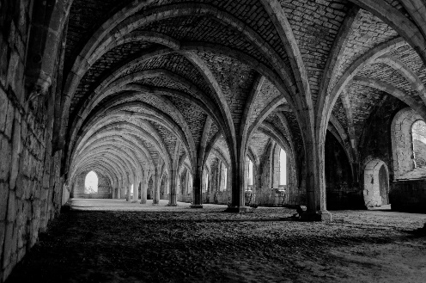
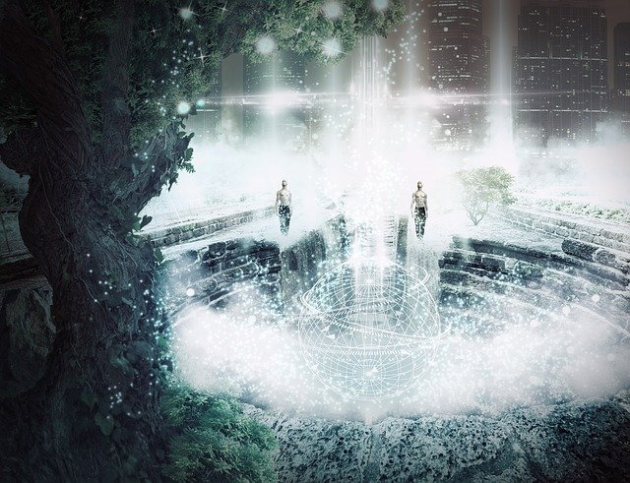
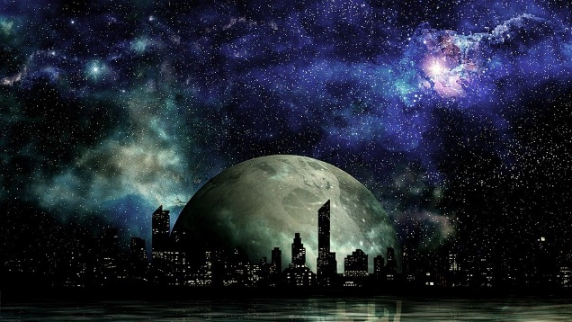
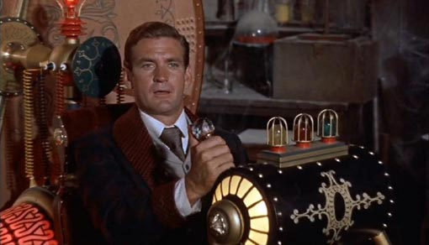
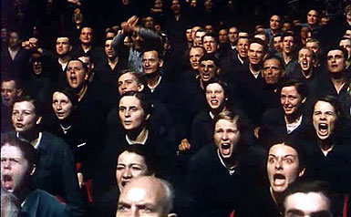
What genres do these represent? What "ingredients" do each have in them?

Slide 18
What you might have noticed:
Gothic:
death, ruins, castles, cellars, darkness, supernatural, candles, mystery
Science Fiction:
other worlds, new technology, alien life, disturbance of the natural order

Slide 19
Feature | Never Let Me Go | Frankenstein
Psychology of horror/terror/mystery/dread | Yes? No? Maybe? | Yes? No? Maybe?
the improbable made possible.
the fiction of revolutions. Revolutions in time, space, medicine, travel, and thought
Omens, portents, visions
Represents an effect of technology, as a disturbance in the natural order, that has not yet been experienced
Heightened emotion, extremes and oppositions, sublime
concerns itself with scientific or technological change, and it usually involves matters whose importance is greater than the individual or the community; often civilization or the race itself is in danger.
Distressed heroine
a literature of 'what if?'
references to the supernatural
Dark mysterious setting
explanation lies in science rather than the supernatural
the setting differs from our own world (e.g. by the invention of new technology, through contact with aliens, by having a different history, etc.),
the themes of madness and death

Slide 20
Science Fiction | Gothic
Represents an effect of technology, as a disturbance in the natural order, that has not yet been experienced | Psychology of horror/terror/mystery/dread
the improbable made possible. | Omens, portents, visions
the fiction of revolutions. Revolutions in time, space, medicine, travel, and thought | Heightened emotion, extremes and oppositions, sublime
concerns itself with scientific or technological change, and it usually involves matters whose importance is greater than the individual or the community; often civilization or the race itself is in danger. | Distressed heroine
a literature of 'what if?' | the themes of madness and death
the setting differs from our own world (e.g. by the invention of new technology, through contact with aliens, by having a different history, etc.), | Dark mysterious setting
explanation lies in science rather than the supernatural | references to the supernatural

Slide 21
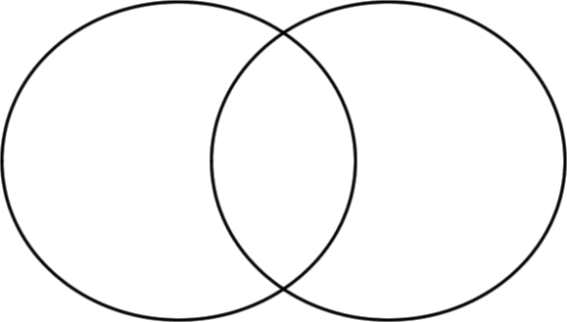
What characteristics do these texts share?
Frankenstein
Never Let Me Go
references to the supernatural
explanation lies in science rather than the supernatural
Distressed heroine
the improbable made possible.
Heightened emotion, extremes and oppositions, sublime
the themes of madness and death
the fiction of revolutions. Revolutions in time, space, medicine, travel, and thought
the setting differs from our own world (e.g. by the invention of new technology, through contact with aliens, by having a different history, etc.),
Represents an effect of technology, as a disturbance in the natural order, that has not yet been experienced
Dark mysterious setting
a literature of 'what if?'
Omens, portents, visions
concerns itself with scientific or technological change, and it usually involves matters whose importance is greater than the individual or the community; often civilization or the race itself is in danger.

Slide 22
Conclusion: blending of science fiction and gothic
The element of “what if?” in both: the exploration of a disruption of the natural order
Some of the settings are different from our own: to distance the reader from his/her own society, perhaps, and therefore enable the reader to judge more objectively
The improbable made possible: both texts juxtapose a recognisable world (the domestic/Norfolk) with the strange (recovery centres/creation of creature) – a warning?

Slide 23
Gothic Science Fiction?
Combines the Gothic genre with an investigation into the transgressions of scientific inquiry.
Not just a story about ghosts or monsters, but rather an insight into the consequences of technological or scientific research.
A morally irresponsible science with dire costs is the basis of a vast number of science fiction novels.
The focus of Mary Shelley’s insight into scientific overreaching is that the yearning for knowledge, even when expressed through a scientist leads only to tragedy and breaches boundaries that are forbidden and better left untouched. Science, steeped in the Romantic need to transcend society, when seen in the harsh reality that Shelley invokes, fails to bring any good into the world, or to add enlightenment.

