Slide 1
Introduction to Human Resources (HR) & Changing working practices

Slide 2
What does HR actually do?
Notes:
Click on picture for link to YOUTUBE videoclip
WHOLE GROUP DISCUSSION ON WHAT HR DO

Slide 3
What does HR actually do?
Match the workforce to the needs of the business
Minimise labour costs
Make effective use of the workforce
Maintain good employer/employee relations
Planning workforce needs of the business – current and future
Recruiting and selecting suitable employees for the business
Training and appraising existing staff
Strategic decisions on policy, structure and culture
Complying with workplace legislation
Payroll and admin
Notes:
Objectives and functions

Slide 4
Learning Objectives
Explain the functions of the human resource department
Explain what is meant by ‘flexible workforce’, and explain a variety of flexible working methods
Explain the impact of new technology on working practices

Slide 5
The HR department?
Many businesses will have a dedicated HR Manager, and larger organisations will have a HR department
Smaller businesses are unlikely to have a dedicated HR person/team, but will still have to carry out human resource functions
In the chat: Consider small and large businesses. What are the similarities and differences in their human resource functions?

Slide 6
Watch!
https://www.youtube.com/watch?v=EaMOQzgMMIQ

Slide 7
A job for life?
Full time
Permanent status
Specific skills
One career path
Final salary pension
Flexibility of working
Transferable skills
Career change
Lifelong learning
New technologies

Slide 8
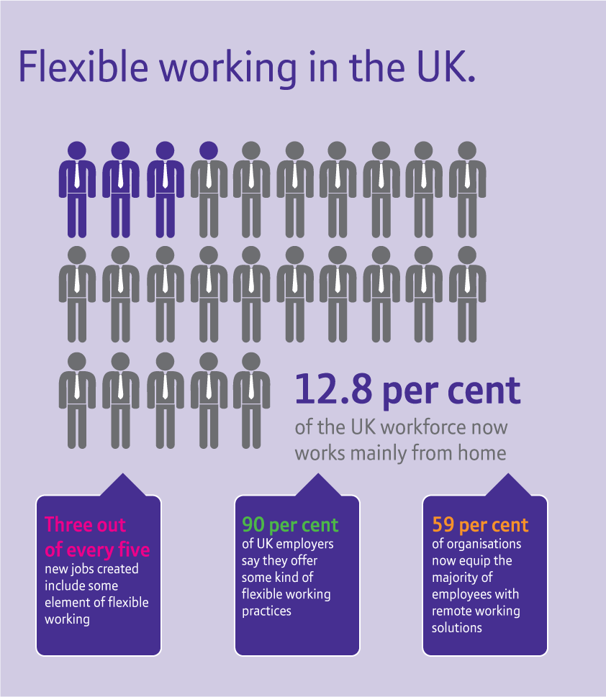
Flexible working methods
Flexible hours
Home working (or teleworking)
Part time working
Temporary working
Job sharing
Multi-skilling
Zero-hours contracts
Hot-desking

Slide 9
How flexible working can benefit the business (the employer)
Cost-effectiveness and efficiency
Ability to attract a higher level of skills
More job satisfaction
Reduced levels of sickness absence
Greater continuity
Increased customer satisfaction and loyalty
Improved competitiveness

Slide 10
How flexible working can benefit the employees
The main benefit of working flexibly for your employees is that it gives them the chance to fit other commitments and activities around work and make better use of their free time.
Working from home may allow them to feel more in control of their workload
Staggered working hours may help them avoid the stress of commuting at peak times

Slide 11
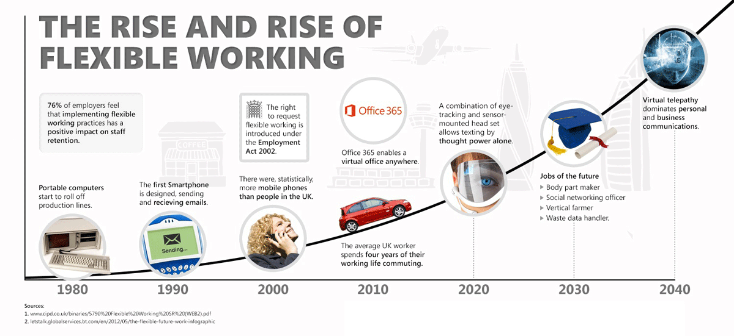
What is the impact of technology?
Notes:
Recruitment – online adverts, online applications, video conference interviews, applicant data analysis
Training – virtual classrooms - online training for homeworkers / remote locations, online tests – high volumes, geographic spread, lower costs, flexible timing
Data Storage and Retrieval – employee data, employment forms (e.g. holidays)
Appraisals – capture performance data (for some roles), measure performance standards, online appraisal system
http://smallbusiness.chron.com/technology-impact-hr-practices-37912.html

Slide 12
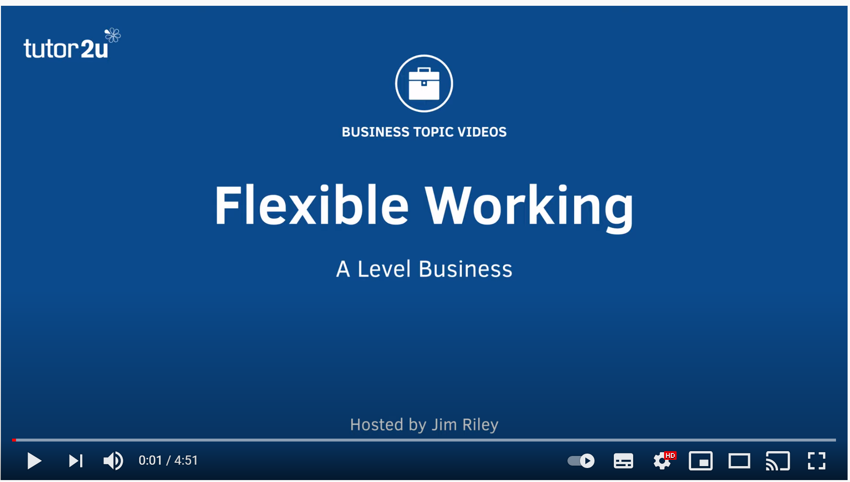
Watch!
https://www.youtube.com/watch?v=t-5-Mze079M

Slide 13
Activity
Use the exam board notes, lesson slides and scanned textbook pages on flexible working methods to help you complete the questions and table in the workbook.
Answer the past paper questions, using full exam technique and demonstrating the skills required.

