Slide 1
Business Functions
People: Workforce Planning

Slide 2
Learning Objectives
Explain what is meant by workforce planning
Evaluate the impact and importance to a business of having the correct numbers of employees with appropriate skills and experience.

Slide 3
Workforce Planning
Definition:
“The method by which a business forecasts how many and what type of employees it needs now and in the future, and matches up the right type of employees to the needs of the business”
At its simplest its about trying to predict the future demand for different types of staff and seeking to match this with their supply.
It means ensuring that there are will be the right number of workers, with the right skills, doing the right jobs, at the right time at the right cost.

Slide 4
Workforce Planning Why is it required?
Business aims change over time, new products are created and require workers with new skills.
Labour market trends have implications for recruitment and retention of staff.
Population trends require businesses to adapt their products and working practices to get and retain workers with the required skills.
Technological change affects products throughout their life cycle, and these changes often require workers with new skills.

Slide 5
Workforce planning
Skills gaps and shortages
Skills gaps - occur when employers believe that their members of their existing workforce need additional skills in order to meet changing demands.
Skills shortages – occur when employers cannot find enough appropriate people to fill vacant positions in their workforce.

Slide 6
Overcoming labour shortages
Outsourcing
Introducing training programmes/ retraining existing staff
Increasing mechanisation/automation thus reducing the need for staff
Offering better terms and conditions of employment
Rescheduling work or increasing overtime

Slide 7
Stages of workforce planning
Analysing current employees
Forecasting workforce requirements
Short term
e.g. sick pay, maternity leave
Medium/Long term
e.g. meeting future growth, expansion overseas

Slide 8
Components of a workforce plan
How many? (full time / part time?)
What skills?
When needed?
Where needed?
Achieving targets?
The plans should identify what changes to staffing will be needed – do they need to increase or decrease staffing? This can be done in a number of ways:
- train existing staff
- Redeploy staff
- Recruit staff from outside
- Voluntary and compulsory redundancy
- Early retirement
- Natural wastage
Increase staffing
Decrease staffing

Slide 9
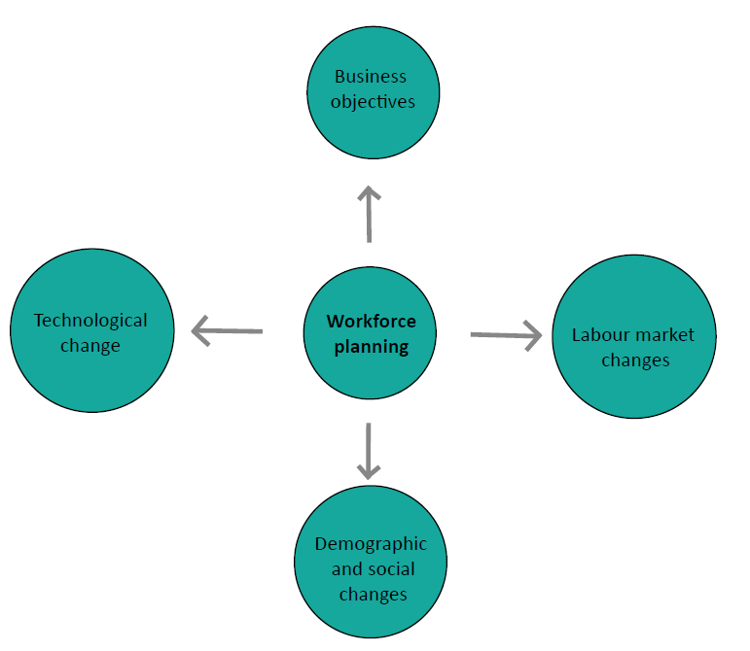
Factors affecting workforce planning

Slide 10
Workforce Planning
ADVANTAGES
The business aims are more likely to be achieved if the correct workforce resources are available.
Planning ahead can save cash – training rather than recruiting talent, and saving on redundancy payments.
Staff motivation may benefit if there are new opportunities and the future of the business is felt to be more secure.
DISADVANTAGES
Any plan is only as good as its assumptions, and planning years ahead with accuracy is difficult.
There is an opportunity cost of the time and cost of this exercise. Could it be spent better ? e.g. R & D
Competitors can ‘steal’ the trained workforce and ‘waste’ the cash invested in them.
Technology could invalidate the product plans and require a re-think of the worker talents required.
Notes:
Q1, p431 HJR

Slide 11
Problems of ineffective workforce planning
Recruitment and selection difficulties
Inadequately trained employees
Morale and motivation problems
High levels of labour turnover and absenteeism
Redundancies

Slide 12
Internal supply of labour
Internal promotional opportunities
Training and development
Changing employment conditions
Retirement and staff turnover
Legal requirements

Slide 13
External supply of labour
Local Factors
Availability/cost housing e.g. expensive in London and rural areas difficult to attract affordable labour
Ease/availability of transport e.g. if they can drive, parking, congestion charges
Local unemployment rates

Slide 14
External supply of labour
National factors
Government legislation: employment, training, subsidies
Skills available – how distributed
Flexible working – norm? e.g. working at home
Trends in pop. E.g. aging population in UK – impact on workforce?
National unemployment rates

Slide 15
Activity
Use the lesson slides, the exam board notes and the scanned text book pages to help you answer the questions in the workforce planning workbook
Read the Barclays article in the workbook and answer the question on the page after the article, referencing info in the article to support you explanation.
45 minutes –
1 hour

