Slide 1
Comp2: People
Recruitment and selection

Slide 2
Learning Objectives
Explain what is meant by the recruitment process
Explain what is meant by internal and external recruitment
Explain what is mean by job analysis, job description and person specification
Evaluate appropriate methods of selecting different types of employees for different types of jobs including interviews, work trials, testing, selection exercises and telephone interviews

Slide 3
Recruitment and Selection
Vacancies in a business can arise for a number of reasons:
Expansion
Retirement of existing workers
Workers leaving for a new job elsewhere
Promotion
Maternity leave.
Notes:
Starter

Slide 4
Recruitment and selection
The HR function specialises in recruitment and selection.
The recruitment process starts when a business needs a new employee. It continues until the most suitable person is selected and appointed.
Effective recruitment and selection can lead to lower labour turnover, lower costs, improved productivity and highly motivated employees.

Slide 5
Recruitment and selection
The usual stages involved in recruitment are:
Completing job analysis
Writing a job description and a person specification
Advertising the vacancy
Shortlisting applicants
Interviewing applicant
Appointing the successful candidate

Slide 6
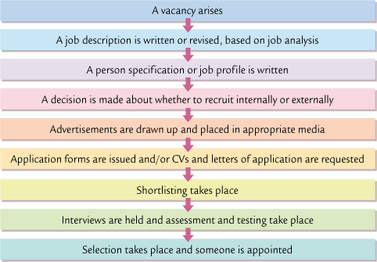
Recruitment

Slide 7
Internal recruitment =
selecting someone from within the business.
Notice board
Intranet
Company newsletter
Advantages
The employees abilities are already known
Internal promotion is motivating for workforce
Quicker recruitment and selection process
Shorter induction period
Less expensive
Reduces the risk of employing the wrong person
Disadvantages
Limited range of applicants
Internal promotion usually creates another vacancy
Lack of fresh ideas coming in to the business

Slide 8
External recruitment =
selecting someone from outside the business.
Employment Agencies, Head hunters
Advertising in the media (e.g. local / national papers)
Job centres, Careers Service
Advantages
Larger choice of well qualified applicants
Brings in new ways of thinking
Overcomes conflicts that may occur if one staff member is promoted over another
Can help a business understand how others operate
Disadvantages
Can be costly
Can be time consuming to those involved
May upset internal employees
May take on someone good at interview but not at the job
Notes:
Which methods would be most suitable to find semi skilled workers / skilled workers / management?

Slide 9
Job Analysis generates the person specification and job description
What is the job title?
Do we need to change the job role?
Do we want a full-time or part-time employee?
What qualifications will the person need?
What characteristics are we looking for?

Slide 10
Job Description
Person Specification
Job title
Who the employee will be responsible to
List of all the tasks they will undertake in their work
Essential qualifications
Essential characteristics
Desirable qualifications
Desirable characteristics
Notes:
15 minutes

Slide 11
Job advertisement
The advertisement should include a mixture of the job description and person specification
An outline of the requirements for the job
The necessary and desirable criteria for job applicants.
The nature of the organisation activities
The job location
The reward package
The job tenure (whether it is temporary or permanent)
Details of how to apply

Slide 13
Information Required by a Firm (CV)
Personal details
Education and qualifications
Work experience
Posts of responsibility
Other interests
Name and contact details of TWO referees

Slide 14
Short-Listing
This involves reviewing the application forms / CVs against the criteria set out and creating a list of a small number of suitable applicants.
Read the letter of application and CV
“Grade” the application (eg A, B, C or marks out of 10)
Decide which applications are the best and why
References are also collected at this stage.
Applicants are contacted.

Slide 15
Methods of selection
Interviews are the most popular selection methods. They can be formal or informal / one to one or panel.
The interviewer can assess:
- oral communication skills
- physical appearance
- personal attributes
The interviewee can asses - physical working conditions
- future prospects
- the working atmosphere
Notes:
Stone Age Job Interview: https://www.youtube.com/watch?v=zOH_PZqDxF8&feature=related

Slide 16
Objectives of a Job Interview
To find out if the person is able to do the job well
To find out if the person will “fit” in the organisation
An interviewer must:
Treat all applicants fairly
Try and find out as much as possible about the applicant

Slide 17
Other methods of selection
Other selection procedures include
Telephone interviews
Work trial
Aptitude and attainment tests
Psychometric or personality tests
Assessment centres

Slide 18
Legal Constraints
Which laws do the HR function have to ensure they abide by during the recruitment and selection process?
The Equality Act
GDPR (data protection)
National Minimum wage
Right to work in the UK

Slide 19
Benefits of effective recruitment and selection
lower labour turnover
lower costs
improved productivity
highly motivated employees.

Slide 20
Activity
Use the lesson slides, the exam board notes and the text book pages to complete the Recruitment Workbook

