Slide 1
Unit 21 P3
Prepare two draft written proposals to present to the client for the brief that you have chosen, identifying different themes and options for each one.

Slide 2
Task 2b)
Prepare two draft written proposals to present to the client for the brief that you have chosen, identifying different themes and options for each one (P3). This should be in the form of a concept file for each of your event proposals, with graphic imagery.
Each proposal/concept file should cover:
1. A range of ideas and themes to meet the client needs
2. Details of suitable event venues
3. The venue’s appearance for the event e.g. layout, decorations
4. Materials that will be required, with details of possible suppliers and contractors
5. An outline of the event’s marketing strategy e.g. promotions, ticketing and sales
6. How you will ensure health and safety e.g. risk assessments, crowd control
7. Liaison with third parties, such as police, catering, fire, first aid, etc.
8. Examples of the methods which would be used for evaluation and feedback
9. Cash flow forecast, showing a breakdown of estimated expenditure and demonstrating how you aim to keep within the budget.

Slide 3
Your 2 Concept Files:
A “concept file” is a visually stimulating method to present the details of each proposal to your client.
These should be presented in an appropriate way to give to the client (power point presentation, word document, poster etc) so that they can form a mental picture of the event to help decide on the final plans.
Use of images, font, colours, themes, ideas etc. that will help the client visualise the event (and help them to choose their proposal).
Be creative.

Slide 4
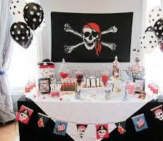
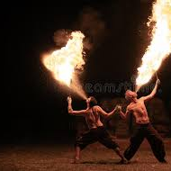
1. Ideas and Themes:
Suggested theme?
Why is this appropriate for the event/client/guests/time of year?
How will this theme be linked/communicated throughout the event?
Dress code?
Decorations?
Food?
Entertainment?
Use images etc. to give examples of how the theme could be represented.

Slide 5
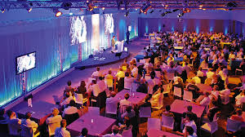
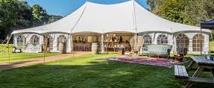
2. Suitable Event Venues
Which type of venue that you are considering and why?
Then, for each proposal, provide details of the specific venue that you plan to use (this could be the same for both proposals). Include:
Name, location (map), transport links.
Services provided by this venue (included in the cost?).
Costs?
Justify why is this a good venue to use for the client’s event.
Don’t forget to use images.

Slide 6
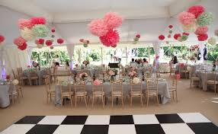
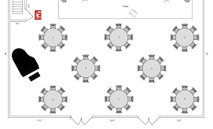
3. Venue Appearance
How will the venue be decorated?
How does this links to the theme?
Different areas of the venue? (Floor plan?)
Colours/decorations/props/flowers/lighting/table dressings/signage etc.
Costs?
Justify why these ideas are appropriate for the client’s event.
Use images.

Slide 7
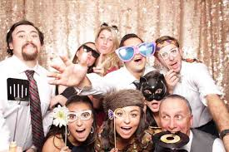
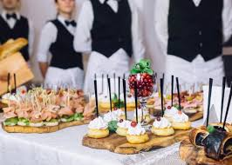
4. Sourcing Suitable Materials, Suppliers and Contractors.
Who will supply:
Decorations/props?
Furniture?
Food/Drink? Waiting staff?
Entertainment?
Security?
Stage/Marquee providers?
Other necessary equipment providers?
Costs for each?
Use Images.

Slide 8
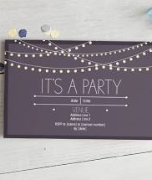
5. Identifying Marketing Strategies
How/where will the event be promoted? (Posters/websites/social media?)
Ticketing/Invitations?
Discuss the design - Link to the theme?
Include images.
Timings?
Costs?

Slide 9
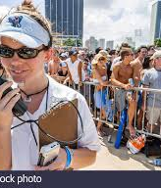
6. Health & Safety
Any Legal requirements.
A Risk Assessment will be needed before the event - What needs to be considered for this? (summarise the main hazards).
What will staff training involve?
Will there be plans (EAPs) in place for Fire, Bomb-scare, lost child etc.
Security?
Staff communication methods?
Costs?

Slide 10
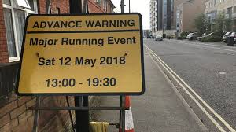
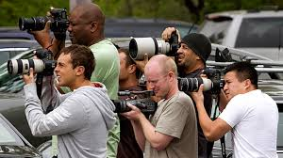
7. Third Parties.
Discuss the other organisations need to be involved in the event… such as:
Police? Fire Service?
The Council
First Aid?
Licensing Authorities?
The media?

Slide 11
8. Evaluation & Feedback.
How will feedback from guests be recorded/collected? (So that the client can measure the success of their event?)
Examples?
Feedback forms/surveys for customers.
Discussion with the client.
Financial performance (level of profits? Break-even?).
Costs?

Slide 12
9. Cash Flow
Produce a break down of the costings and the income for the proposal, to show the client how their budget will be managed/spent.
Income?
Client budget, ticket sales, sponsorship, investors, grants, loans, fund-raising.
Costs?
Venue, decorations, catering, equipment, entertainment, marketing, security, licence, additional staff etc.
Optional extras?

Slide 13
INCOME (MONEY RECEIVED):
SOURCE | £
TOTAL CASH AVAILABLE
EXPENDITURE (COSTS):
ITEM | PAYMENT TO (e.g. NAME OF SUPPLIER, CONTRACTOR ETC.) | £
TOTAL COSTS | -

