Slide 1
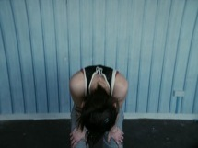
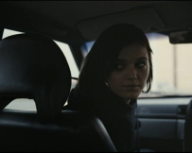
Fish Tank - narrative
Opening sequence
Closing sequence
Text box
Text box
Text box

