Slide 1
Organisational Structures
What is an ‘organisational structure’?

Slide 2
Learning Objectives
Explain what is meant by organisational design
Understand what is meant by authority, responsibility, chain of command, span of control, delegation, hierarchy, centralisation and decentralisation, empowerment and delayering.
Explain the characteristics of different organisation structures including hierarchical (flat and tall) and matrix structures.

Slide 3
Key terms
To answer questions on the topic of organisational structures you must be able to make accurate use of these keywords
Delayering
Span of control
Responsibility
Authority
Hierarchy
Organisational structure
Chain of command
Centralisation / Decentralisation

Slide 4
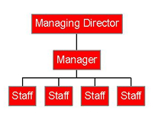
Organisational Structures:
the way in which a business is organised
Hierarchy: the order or levels of management of a business, from the lowest to the highest type
‘Tall’ type Organisational Structure
‘Flat’ type Organisational Structure

Slide 5
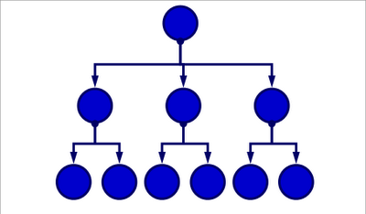
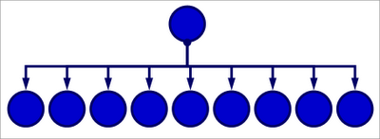
Span of control
How many people directly controlled by a manager

Slide 6
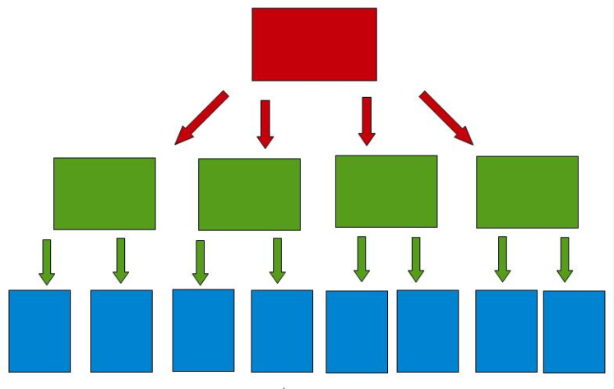
Chain of Command
The way authority and power are passed down in a business

Slide 7
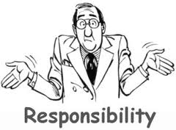
Authority and responsibility, is there a difference?
A manager can delegate authority to a subordinate.
However, responsibility must remain with the manager
MD
Manager
Employee
Employee
Manager
Employee

Slide 8
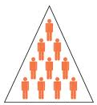
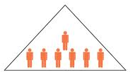
Delayering
The levels of an organisation are called layers. Delayering is removing layers of management from the hierarchy of an organisation

Slide 9
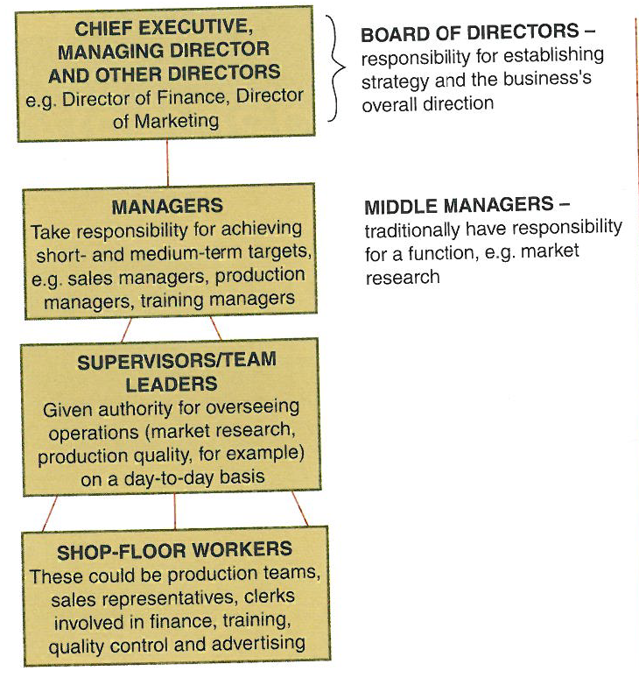
Communication in an organisation
Communication can pass down, up and across an organisation; for example between managers .
How much communication takes place will depend on the leadership style

Slide 10
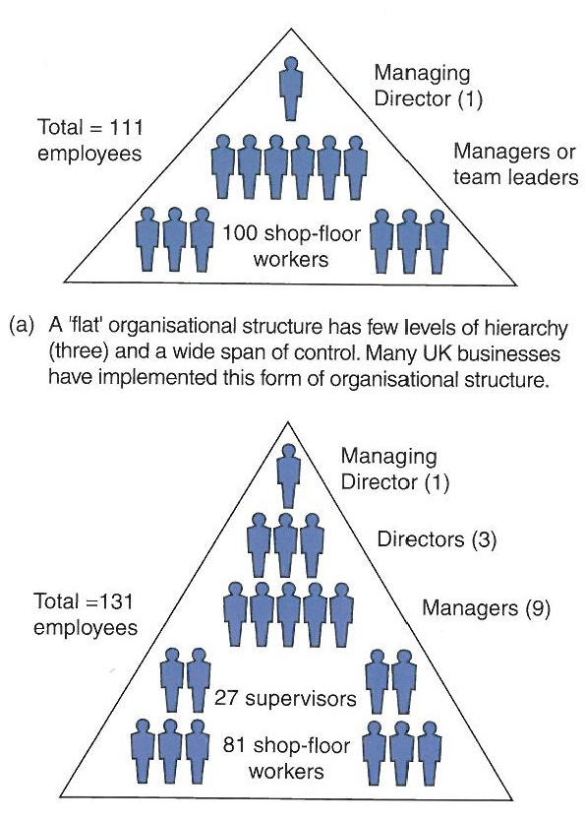
Communication in an organisation
A ‘flat’ organisational structure has few levels of hierarchy (3) and a wide span of control. Many UK businesses implemented this form of structure , e.g. retail, transport
A traditional ‘tall’ structure with 5 layers of hierarchy and a narrow span of control, e.g.; manufacturing

Slide 11
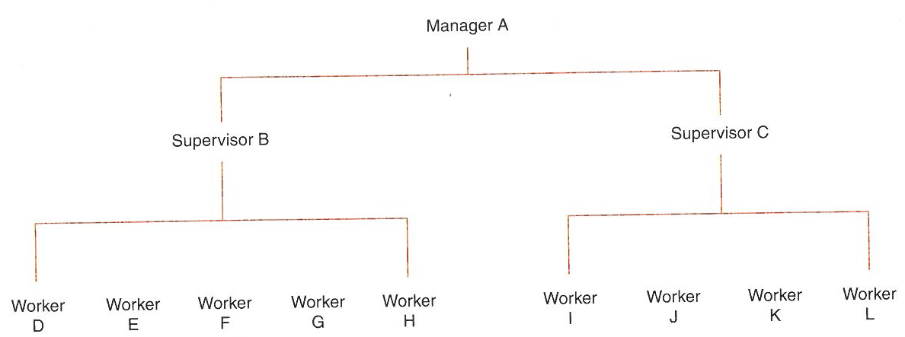
Span of control: an example
How many employees are in the span of control of Manager A?
Notes:
Manager A has a span of control of two. This is because the two supervisors B and C are the only employees directly responsible to this person. Supervisor B has the widest span of control – five workers are responsible to this person

Slide 12
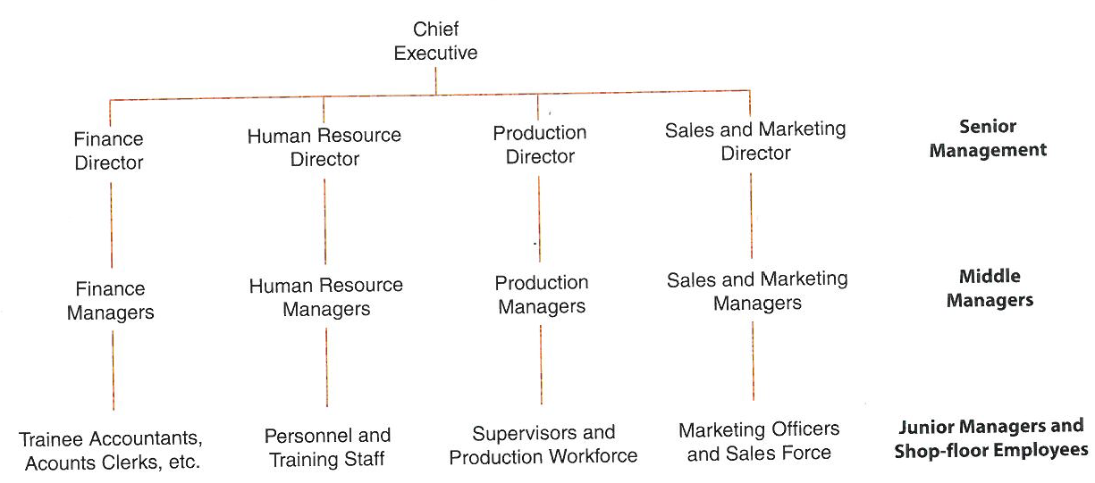
Functional organisation
A ‘traditional’ organisation structure organised around the 4 business functions, with communication typically down and up the organisation, and seldom across, which can be a disadvantage. However, it does promote ‘excellence’ within the functional areas which is an advantage.

Slide 13
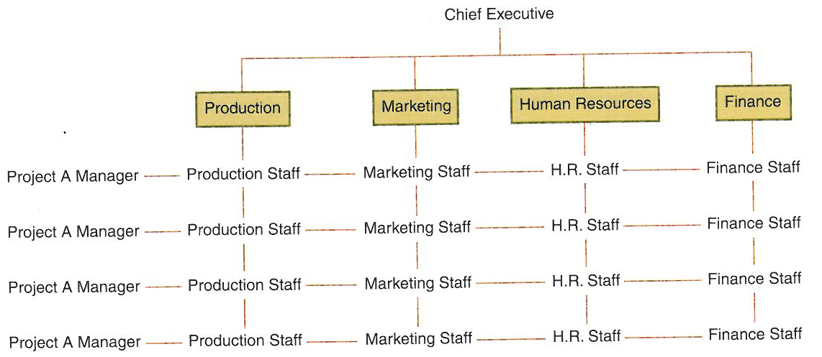
Matrix organisation
Matrix organisations are task orientated . Through combining a vertical chain of command operated through departments and horizontal organisation by project / product teams it aims to overcome the problems of a functional organisation

Slide 14
Activities
Use the exam board notes as well as the text book pages to help you complete the Lesson 1 activities on pages 1, 2 and 3 of the workbook.

