Slide 1
Starter Activity – Match the key term with the correct definition
 | Term | Definition
1 | Authority | A) The way authority and power are passed down in a business
2 | Responsibility | B) Authority to pass down from superior to subordinate
3 | Chain of command | C) To give official authority to employees to make decisions and control over their own activities
4 | Span of control | D) The right to command a situation, a task or an activity
5 | Delegation | E) The order or levels of management of a business from the lowest to the highest
6 | Hierarchy | F) A type of business organisation where decision making is pushed down the chain of command and away from the top or core of the business
7 | Centralisation | G) The number of subordinates working under a superior
8 | Decentralisation | H) Being accountable and required to justify an action
9 | Empowerment | I) Removing layers of management from the hierarchy of an organisation
10 | Delayering | J) A type of business organisation where major decisions are made at the top or core of the business and then passed down the chain of command

Slide 2
Learning Objectives (L2)
Explain the advantages and disadvantages of changing organisational structures and delayering.
Evaluate the choice between empowerment and control of the workforce.
Evaluate the appropriateness of different organisational structures to a business and its stakeholders

Slide 3
Factors determining type of organisational structure
Internal
Growth of the business. Perhaps from an entrepreneurial to a matrix to manage better
Nature of the product. E.g. creative functions tend to short spans of control, where as production functions to wide spans of control
Skills of the workforce. More highly skilled perhaps less supervision and vice versa
Culture of the organisation. Contrast a ‘Google’ with the ‘Police’
Objectives of the business. A matrix may suit a growth objective, but an entrepreneurial may suit an excellence objective
External
Competitive industry. A focus on cost control; outsourcing, delayering, wide spans of control
Technology. E.g. computers, bio science industries in which firms respond with matrix organisations that can make and break and not get ‘stuck’ in hierarchies

Slide 4
Centralisation vs decentralisation
Centralisation and decentralisation refer to the extent to which authority is delegated in a business.
Complete centralisation: subordinates have not authority at all.
Complete decentralisation: means subordinates would have all the authority to take decisions.

Slide 5
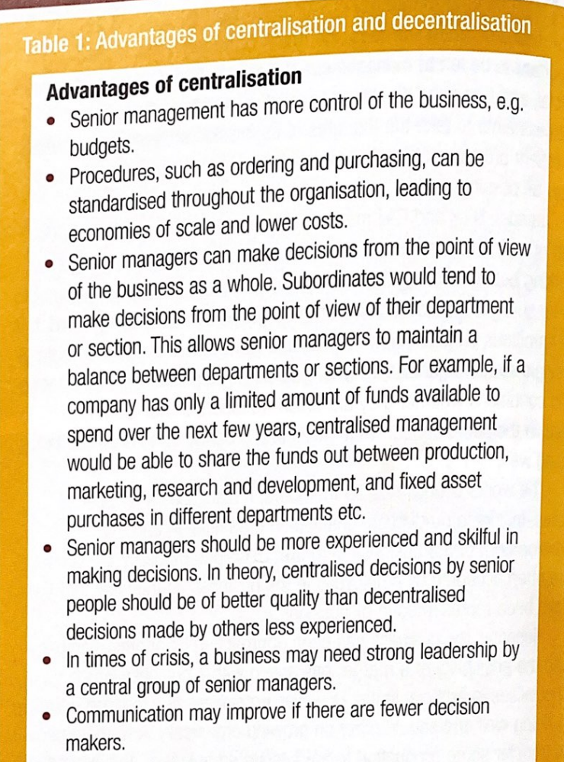
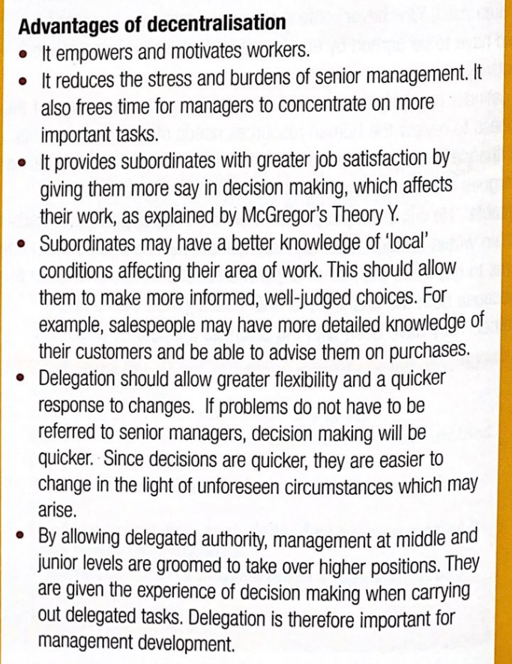

Slide 6
Delayering
Advantages | Disadvantages
Reduces costs (middle managers) | Valuable knowledge and experience could be lost
Can improve responsiveness and decision making | Morale and motivation may suffer
Can motivate employees lower down in the business | Some businesses use delayering as an excuse
Improved communication | Extensive and expensive training may be required
Can produce good ideas from a new perspective (due to delegation) | Can lead to unmanageable workloads and high levels of stress

Slide 7
Empowerment vs control of workforce
Delegated decision making can be more successful if employees are empowered.
Empowerment of employees involves many aspects:
Recognising employees are capable of doing more than they have in the past
Making employees feel trusted
Giving employees control of decision making
Recognising employees achievements

Slide 8
Empowerment vs control of workforce
However, empowerment is sometimes criticised as simply a means of cutting costs and removing layers from the business
Passing decision making down the hierarchy might allow a company to make managers redundant. Remaining employees are given more work to do but for the same pay.
Some businesses argue that they want to empower workers but in practice they are unable to do this. For example, a manager may feel insecure about subordinates making decision that might affect their position in the business. Feeling they make the wrong decision.
A further problem is the costs involved to the business, such as costs of training employees

Slide 9
Organisational structures
Every structure has its advantages and disadvantages – but, there is not a ‘perfect’ solution forever
Over time, as firms grow or shrink and change their products, the structure may have to change – and people usually react poorly to change, - so expect profit to deteriorate in the short-term
A successful organisational structure is one that helps the firm achieve its objectives

Slide 10
Activity
Complete the rest of the pages in your Organisational Design workbook.
You will need to use the ‘Organisational Structures Readings’ pdf on GOL to answer the questions on pages 4, 5 and 6
Carefully read the past paper questions and use paragraph structure / exam technique taught in lessons (you will have a little more time to finish these off in Friday’s lesson)

