Slide 1
AQA
    AS Level
      Computer Science
Writing and interpreting algorithms
  Unit 2
  Problem solving
  and theory of computation

Slide 2
Objectives
To understand the term ‘algorithm’
To learn how to write and interpret algorithms using pseudocode

Slide 3
Computational algorithms
What is an algorithm?
Give some examples of computational algorithms
There are thousands of real-world problems to be solved using different algorithms; some of them still unsolved!

Slide 4
Problems solved by algorithms
Routing problems:
  Routing packets of data around the Internet by the shortest route
  Finding the shortest route for a salesman to cover his territory
Timetabling commercial aircraft crews so that they do not exceed their permitted flight hours
Searching information on the Internet or from a database
Encrypting communications so that they cannot be hacked
Sorting large amounts of data
Writing a compiler program to translate a high level language to machine code

Slide 5

What are the properties of a good algorithm?
Discuss in pairs and come up with a list

Slide 6
A good algorithm:
has clear and precisely stated steps that produce the correct output for any set of valid inputs
should allow for invalid inputs
must always terminate at some point
should execute efficiently, in as few steps as possible
should be designed in such a way that other people will be able to understand it and modify it if necessary

Slide 7
Tools for designing algorithms
Hierarchy charts – useful for identifying the major task, and breaking these down into subtasks
Flowcharts – useful for getting down initial ideas for individual subroutines
Pseudocode – will translate easily into program code

Slide 8
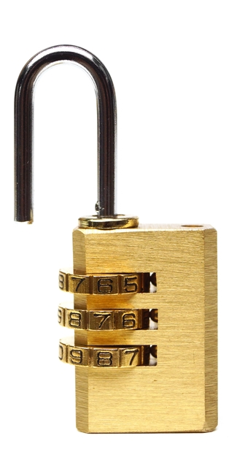
Worksheet 3
Try Task 1 on Worksheet 3

Slide 9
Sorting algorithms
Sorting is a very common operation in data processing
There are many different sorting algorithms, from very simple ones which execute very slowly, (e.g. an insertion sort) to more complex ones which execute very fast (e.g. merge sort)
On a given computer, a fast sort algorithm may sort ten million numbers in say 20 minutes, whereas an inefficient algorithm may take more than a month to sort the same data

Slide 10

Insertion sort
The insertion sort is an efficient algorithm for sorting a small number of elements
It works in the same way you might sort a deck of playing cards
  Start with all the cards face down
  Pick up each card in turn and insert it into the correct place in the deck

Slide 11
How the Insertion sort works
Suppose we have six numbers to sort
The pink card is the card you pick up each time
Insert it in the right place, and pick up another
(a)
7 | 4 | 6 | 8 | 1 | 5
(b)
4 | 7 | 6 | 8 | 1 | 5
(c)
4 | 6 | 7 | 8 | 1 | 5
(d)
4 | 6 | 7 | 8 | 1 | 5
(e)
1 | 4 | 6 | 7 | 8 | 5
(f)
1 | 4 | 5 | 6 | 7 | 8

Slide 12
Insertion sort algorithm
card = [7, 4, 6, 8, 1, 5]
# assume first card is card[0]
FOR j = 1 to 5
thisCard = card(j)
i = j – 1
WHILE i >= 0 and card[i] > nextCard
card[i + 1] = card[i]
i = i - 1
ENDWHILE
card[i + 1] = thisCard
ENDFOR

Slide 13

Bubble sort
This is a useful sort when there are only a small number of items to be sorted
To sort an array of n items, n-1 passes are made through the array, with each item being compared with the adjacent item and swapped if necessary

Slide 14
Bubble sort algorithm
#sorts an array a[0..n-1] of n items
REPEAT
FOR count = 0 to n-2
IF a[count] > a[count + 1] THEN
swap the items
ENDIF
ENDFOR
n = n-1
UNTIL n = 1
Trace through the algorithm for a[7,4,6,8,1,5]
Write the code for the line “swap the items”

Slide 15

Worksheet 3
Now try Task 2 on the worksheet

Slide 16
Searching algorithms
Two of the most common searching algorithms are the linear search and the binary search
The linear search starts at the beginning of the list and examines every item
The binary search uses the “divide and conquer” strategy to halve the search area each time an item is examined
  It can only be used if the items are in sorted order

Slide 17
Binary search algorithm
found = false
REPEAT
middle = int((low + high)/2)
IF list(middle) = x THEN
found = TRUE
ELSE
IF list(middle) > x THEN
high = middle – 1
ELSE
low = middle + 1
ENDIF
UNTIL found = TRUE

Slide 18
Try it out!
Ask a partner to think of a number between 1 and 100
For each guess you make, your partner will tell you whether you are too high, too low or on the button
How many guesses will you need?
How many if the number is between 1 and 1024?
How many guesses, on average, using a sequential search?

Slide 19
Plenary
Hierarchy charts and pseudocode are useful tools for designing algorithms
Sorting and searching and two very common operations in data processing, and efficient algorithms can greatly reduce execution times
Practise designing and tracing through algorithms, two vital skills for computer scientists

