Slide 1
Global Systems and Global Governance Analysis and assessment of the geographical consequences of global governance.
Learning Objectives:
How globalisation can benefit world development
The negative impacts of globalisation on societies
The negative impacts of globalisation on physical environments
Key terms:
Globalisation (Social, Economic, Environmental, Political)
‘Flows’ (goods, services, products, information, capital)
Sustainability
Anti-globalisation

Slide 2
Benefits of Globalisation

Slide 3
Costs of Globalisation

Slide 4
Answer the following question:
Summarise what are seen as the main ‘costs’ of globalisation. (4 marks)

Slide 5
Globalisation Critique
Task:
Read the Tutor2u ‘Globalisation: a critique’ CC and answer the following questions:

Slide 6
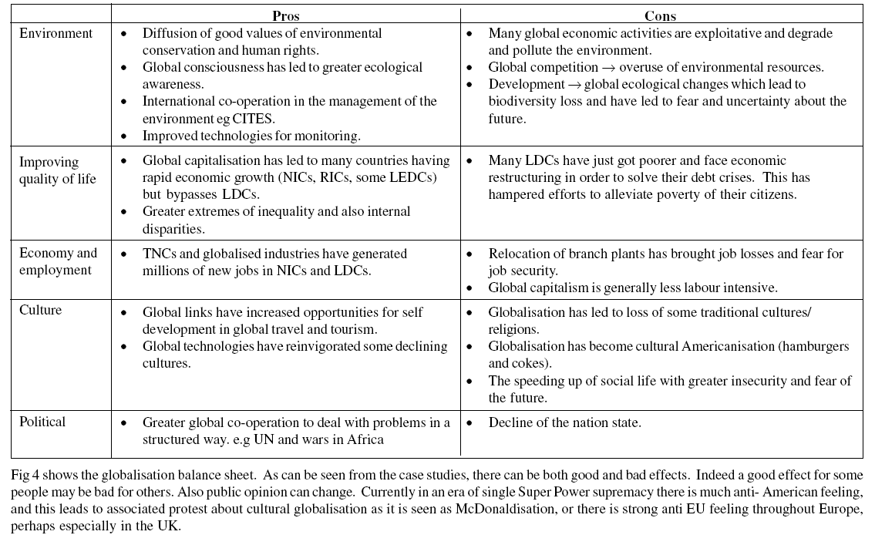

Slide 8
“Globalisation has created more costs than benefits”. To what extent do you agree with this statement? (20 marks)
Break down the question – what is it asking you to do?
What is Globalisation? What are the costs of Globalisation? What are the benefits of Globalisation?
Assessing will mean that you make a judgement as to whether Globalisation has created more costs than benefits.
What case study example/examples could you use?
Brainstorm as many costs and benefits as you can think of
What case study evidence/examples can you use in your answers?
Now complete a plan using the PEEL structure.

Slide 9
Tips on marking the answers
AO1
K & U knowledge and understanding of place(s) and environments
C & P knowledge and understanding of key concepts and processes
S & T awareness of scale and temporal change
AO2
A & E analysis and evaluation in the application of knowledge and understanding (arguments that support your viewpoint)
Links – links between knowledge and understanding to the application of knowledge and understanding in different contexts (other viewpoints – interested parties)
Conc – evaluative conclusion that is applied to the context of the question

