Slide 1
Management

Slide 2
Learning objectives
Explain what is meant by management
Explain the functions and roles of management
Explain the advantages and disadvantages of management by objectives (MBO)
Explain D. McGregor’s theory X and theory Y
Evaluate the importance of management to a business and its stakeholders

Slide 3

Leadership and management
The main difference between leaders and managers is that
leaders have people follow them
managers have people who work for them
A successful business owner needs to be both a strong leader and manager to get their team on board to follow them towards their vision of success
https://www.theguardian.com/careers/difference-between-leadership-management
Notes:
Kotter
Management is a set of processes that keep an organisation functioning. They make it work today – they make it hit this quarter's numbers. The processes are about planning, budgeting, staffing, clarifying jobs, measuring performance, and problem-solving when results did not go to plan."
Leadership is very different. "It is about aligning people to the vision, that means buy-in and communication, motivation and inspiration.“
Churchill is a great example of a leader, but he is not manager. "He is not beloved because he made the bureaucracy function.“
Leadership differs from management in a sense that:
While managers lay down the structure and delegates authority and responsibility, leaders provides direction by developing the organizational vision and communicating it to the employees and inspiring them to achieve it.
While management includes focus on planning, organizing, staffing, directing and controlling; leadership is mainly a part of directing function of management. Leaders focus on listening, building relationships, teamwork, inspiring, motivating and persuading the followers.
While a leader gets his authority from his followers, a manager gets his authority by virtue of his position in the organization.
While managers follow the organization’s policies and procedure, the leaders follow their own instinct.
Management is more of science as the managers are exact, planned, standard, logical and more of mind. Leadership, on the other hand, is an art. In an organization, if the managers are required, then leaders are a must/essential.
While management deals with the technical dimension in an organization or the job content; leadership deals with the people aspect in an organization.
While management measures/evaluates people by their name, past records, present performance; leadership sees and evaluates individuals as having potential for things that can’t be measured, i.e., it deals with future and the performance of people if their potential is fully extracted.
If management is reactive, leadership is proactive.
Management is based more on written communication, while leadership is based more on verbal communication.
The organizations which are over managed and under-led do not perform up to the benchmark. Leadership accompanied by management sets a new direction and makes efficient use of resources to achieve it. Both leadership and management are essential for individual as well as organizational success.

Slide 4
Leadership and management
Management is a set of processes that keep an organisation functioning.
They make it work today – they make it hit this quarter's numbers. The processes are about planning, budgeting, staffing, clarifying jobs, measuring performance, and problem-solving when results did not go to plan.“
Leadership is very different.
‘It is about aligning people to the vision, which means buy-in and communication, motivation and inspiration’
(Kotter Leadership & Management Theory 1990)
Notes:
Kotter
Management is a set of processes that keep an organisation functioning. They make it work today – they make it hit this quarter's numbers. The processes are about planning, budgeting, staffing, clarifying jobs, measuring performance, and problem-solving when results did not go to plan."
Leadership is very different. "It is about aligning people to the vision, that means buy-in and communication, motivation and inspiration.“
Churchill is a great example of a leader, but he is not manager. "He is not beloved because he made the bureaucracy function.“
Leadership differs from management in a sense that:
While managers lay down the structure and delegates authority and responsibility, leaders provides direction by developing the organizational vision and communicating it to the employees and inspiring them to achieve it.
While management includes focus on planning, organizing, staffing, directing and controlling; leadership is mainly a part of directing function of management. Leaders focus on listening, building relationships, teamwork, inspiring, motivating and persuading the followers.
While a leader gets his authority from his followers, a manager gets his authority by virtue of his position in the organization.
While managers follow the organization’s policies and procedure, the leaders follow their own instinct.
Management is more of science as the managers are exact, planned, standard, logical and more of mind. Leadership, on the other hand, is an art.
In an organization, if the managers are required, then leaders are a must/essential.
While management deals with the technical dimension in an organization or the job content; leadership deals with the people aspect in an organization.
While management measures/evaluates people by their name, past records, present performance; leadership sees and evaluates individuals as having potential for things that can’t be measured, i.e., it deals with future and the performance of people if their potential is fully extracted.
If management is reactive, leadership is proactive.
Management is based more on written communication, while leadership is based more on verbal communication.
The organizations which are over managed and under-led do not perform up to the benchmark.
Leadership accompanied by management sets a new direction and makes efficient use of resources to achieve it.
Both leadership and management are essential for individual as well as organizational success.

Slide 5
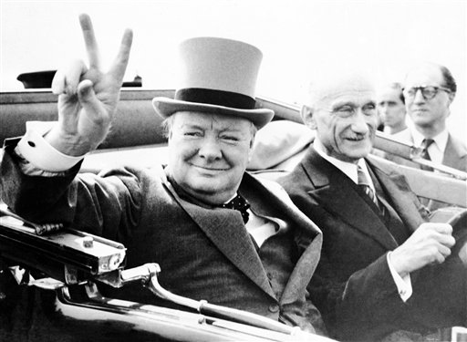
Leadership and management
Churchill is a great example of a leader, but he is not a manager.
He is not beloved because he made the bureaucracy function
Notes:
Kotter
Management is a set of processes that keep an organisation functioning. They make it work today – they make it hit this quarter's numbers. The processes are about planning, budgeting, staffing, clarifying jobs, measuring performance, and problem-solving when results did not go to plan."
Leadership is very different. "It is about aligning people to the vision, that means buy-in and communication, motivation and inspiration.“
Churchill is a great example of a leader, but he is not manager. "He is not beloved because he made the bureaucracy function.“
Leadership differs from management in a sense that:
While managers lay down the structure and delegates authority and responsibility, leaders provides direction by developing the organizational vision and communicating it to the employees and inspiring them to achieve it.
While management includes focus on planning, organizing, staffing, directing and controlling; leadership is mainly a part of directing function of management. Leaders focus on listening, building relationships, teamwork, inspiring, motivating and persuading the followers.
While a leader gets his authority from his followers, a manager gets his authority by virtue of his position in the organization.
While managers follow the organization’s policies and procedure, the leaders follow their own instinct.
Management is more of science as the managers are exact, planned, standard, logical and more of mind. Leadership, on the other hand, is an art.
In an organization, if the managers are required, then leaders are a must/essential.
While management deals with the technical dimension in an organization or the job content; leadership deals with the people aspect in an organization.
While management measures/evaluates people by their name, past records, present performance; leadership sees and evaluates individuals as having potential for things that can’t be measured, i.e., it deals with future and the performance of people if their potential is fully extracted.
If management is reactive, leadership is proactive.
Management is based more on written communication, while leadership is based more on verbal communication.
The organizations which are over managed and under-led do not perform up to the benchmark.
Leadership accompanied by management sets a new direction and makes efficient use of resources to achieve it.
Both leadership and management are essential for individual as well as organizational success.

Slide 6
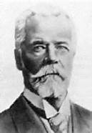
Fayol - The Functions of Management
  Planning
  Organising
  Commanding
  Co-ordinating
  Controlling
Do you think this is still relevant today?
Henri Fayol (1916)

Slide 7
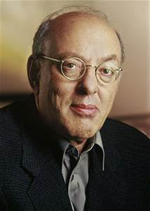
Mintzberg - Managerial Roles
Henry Mintzberg (1980s) said in addition to the FUNCTIONS of management, the manager should also fulfil certain ROLES:
  Interpersonal Roles – The manager as a figurehead, representing the business.
  Information Roles – The manager communicates at a level that subordinates might not be able to due to structural constraints or contact the manager might have.
  Decision Making Roles – Mintzberg advocates fluid decision making rather than meticulous forward-planning. He thought planning should be ongoing rather than systematic and that communication should be verbal rather than formal / written.

Slide 8

Activity
Answer Question 1 on page 396 of Hall, Jones and Raffo.

Slide 9
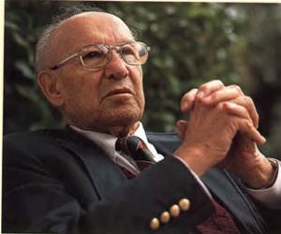
The Functions of Management according to Drucker
  Setting Objectives
  Organising work
  Motivating employees and communicating information to them
  Job measurement (checking that tasks have been performed and objectives met)
  Developing people (including training)
Peter Drucker (1955)

Slide 10
Management by Objectives (MBO)
Peter Drucker (1955)
  In the same paper as Drucker presented his ideas on the Functions of management, he further developed the first point (from the previous slide)
  His clarification on this is called Management by Objectives (MBO)

Slide 12
Advantages of MBO

Slide 13
Disadvantages of MBO

Slide 14
McGregor’s Theory X and Y
Theory X | Theory Y
Workers are motivated by money | Workers have many different needs which motivate them
Workers are lazy and dislike work | Workers can enjoy work
Workers are selfish, ignore the needs of organisations, avoid responsibility and lack ambition | If motivated, workers can organise themselves and take responsibility
Workers need to be controlled and directed by management | Management should create a situation where workers can show creativity and apply their job knowledge

Slide 15
Activity
Use the exam board notes and the scanned text book pages to help you complete the “Management Workbook” answering all questions

