Slide 1
Management recap
According to Fayol (1916), what are the functions of management?
What is Drucker’s (1955) management philosophy?
What are the characteristics of Theory X and Theory Y Managers?
What are the character traits of effective managers?

Slide 2
Leadership

Slide 3
Learning Objectives
Explain what is meant by leadership
Explain the different types of leadership styles (autocratic, democratic, paternalistic, bureaucratic and laissez-faire)
Explain leadership theories (including Fiedler (1976) and Wright and Taylor (1984)

Slide 4
Leaders
May perform similar functions to manager but they also need to inspire and motivate the workforce
They devise long term strategy
Consider challenges facing the business and how to overcome them
Managers direct and control the workforce to follow the principles and values established by the leaders

Slide 5
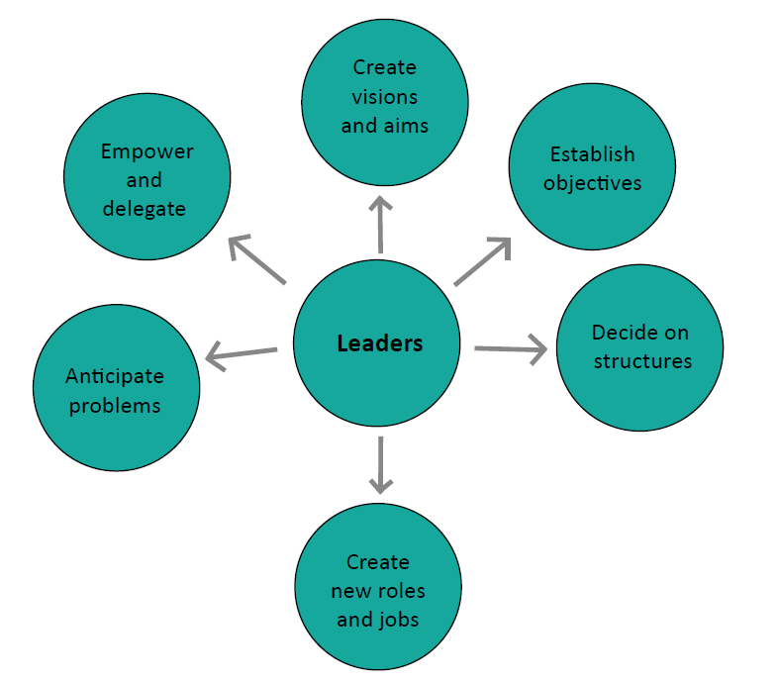
Leaders
Being a good leader involves getting people to understand and believe in your vision to work with you and achieve your goals

Slide 6
What are ‘leadership styles’?
Perhaps a culture within an organisation?
How do leaders treat their staff?
How do they try to get them to perform?
Do they
Encourage
Give orders
Treat staff with respect
Check up on staff
Talk with staff

Slide 7
Leadership Styles
Leadership styles are the way in which functions or leadership are carried out or the way that the leader behaves.
Autocratic (authoritarian) – The bossy boss
Paternalistic – The parental figure
Democratic – The consensus approach
Bureaucratic – The procedures approach
Laissez-faire – The arm’s length approach
Question:
What influences the choice of leadership style?
Do you think you can really choose your leadership style?

Slide 8
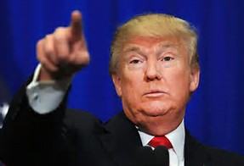
Autocratic(Authoritarian)
Manager as ‘the boss’
Takes decisions
Gives orders – communication is top-down and one-way
Has systems to follow “This is how we do things here.”
Use of rewards and penalties
Very little delegation
McGregor Theory X approach

Slide 9
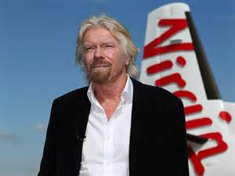
Paternalistic
the ‘parental figure’ at the head of the ‘family’
Manager still ‘the boss’
Still takes decision and may give orders
More likely to talk with staff
Be on good terms with them
‘Looks after’ staff, feels a sense of responsibility for them
Probably most common in small to medium sized companies
Softer version of autocratic

Slide 10
Democratic
Managers involve staff
Consult
Delegate
Empower
Give responsibility
Set up systems to ensure staff input
But still have responsibility for final decisions

Slide 11
Bureaucratic
Focus on specialisation of jobs and departments
Stick rigidly to job descriptions to the point that it might hamper worker progress
Thrive in hierarchies
Workers know exactly what to do / what is expected of them
Encourages co-operation as workers know what is expected of them
Very inflexible: discourages innovation and ability to change

Slide 12
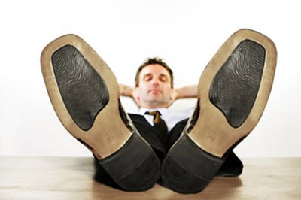
Laissez-faire
Has little input into the day-to-day decision making
Consciously delegates power
Gives employees freedom to do what they think is best
Effective when staff are ready and willing to take on responsibility

Slide 13
Watch!
https://www.youtube.com/watch?v=-GoPgcTs1iI
https://www.youtube.com/watch?v=BuRJR4xfO_0

Slide 14
Factors affecting leadership style
Personal values
Type of organisation systems (size, structure)
Manager’s experience
Effectiveness of teams
Confidence in and groups subordinates
Skills and experience
Feelings of security of subordinates
Nature of the business
Pressure (time, costs) problems

Slide 15
What are the benefits of good leadership?
Much as for our motivation theory
⇨ Involves and motivates staff
⇨ Staff work more efficiently
⇨ Staff turnover might fall
⇨ Productivity may rise
⇨ Unit costs might fall
⇨ Quality might rise
⇨ Company becomes more competitive
⇨ Sales might increase
⇨ Profits might rise

Slide 16
Which leadership style is best?
Many alternative forms & styles
Right leader for the right situation
–Autocratic makes more sense when business is in trouble (e.g. rapid turnaround)
– Autocratic would be inappropriate where performance highly dependent on effective team-working & decentralised operation
Stage of business: start-up v established & complex

Slide 17
Leadership Models
F. Fielder (1976): CONTINGENCY MODEL
Fielder thought leadership is the most important contributor to business success
But that you need to know what type of leader you are to find a role that is suitable. E.g. an effective leader in a solicitor’s practice might not be effective as a leader in the army.
He said the effectiveness of a business or team is dependent (or contingent) upon 2 factors:
PERSONALITY (which affects leadership style)
the amount of control and influence which the SITUATION provides.

Slide 18
Leadership Models
Fielder asked leaders to complete a questionnaire to find out who would be their Least Preferred Co-worker (LPC).
A high LPC score = RELATIONSHIP leader. These people tend to like co-workers even if they are difficult and unpleasant. Good leaders in non-stressful situations.
A low LPC score = TASK ORIENTED leader. These people see co-workers in a negative way. They focus on getting the job done regardless. Good leaders in extreme situations.
Fielder thought leadership style was inherent and can’t be changed.

Slide 19
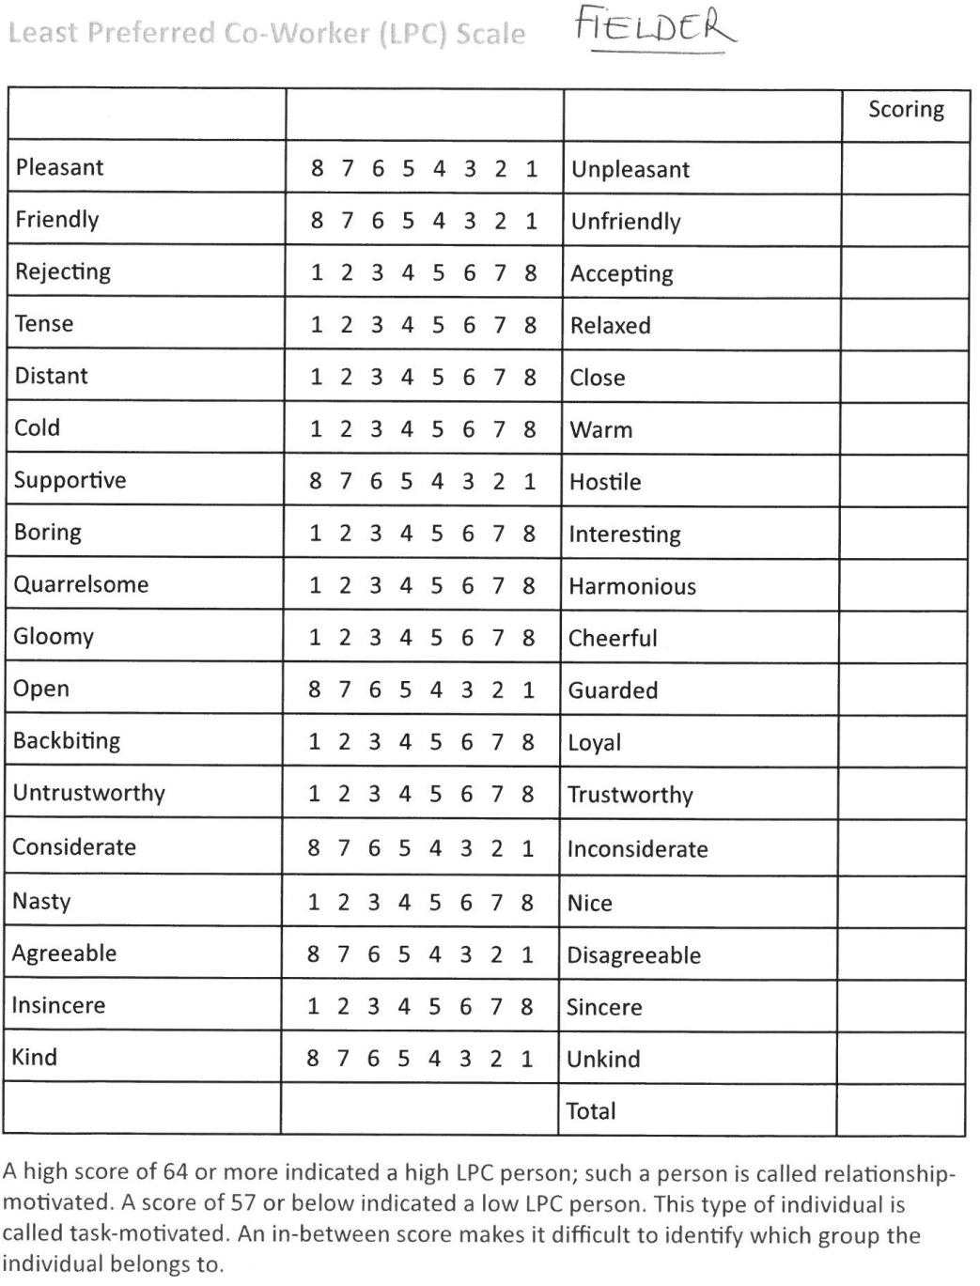

Slide 20
Leadership Models
P. Wright and D. Taylor (1984)
Wright and Taylor believed leaders CAN change. They developed a theory that focused on this.
They believed education can improve how leaders INTERACT WITH SUBORDINATES and change leaders’ LEADERSHIP SKILLS
They thought good leadership is a product of ability and motivation.
They believed in encouragement rather than punishment
They devised a checklist to improve work performance
They intended the checklist to be a starting point for discussion and thought rather than a simple list of solutions.

Slide 21
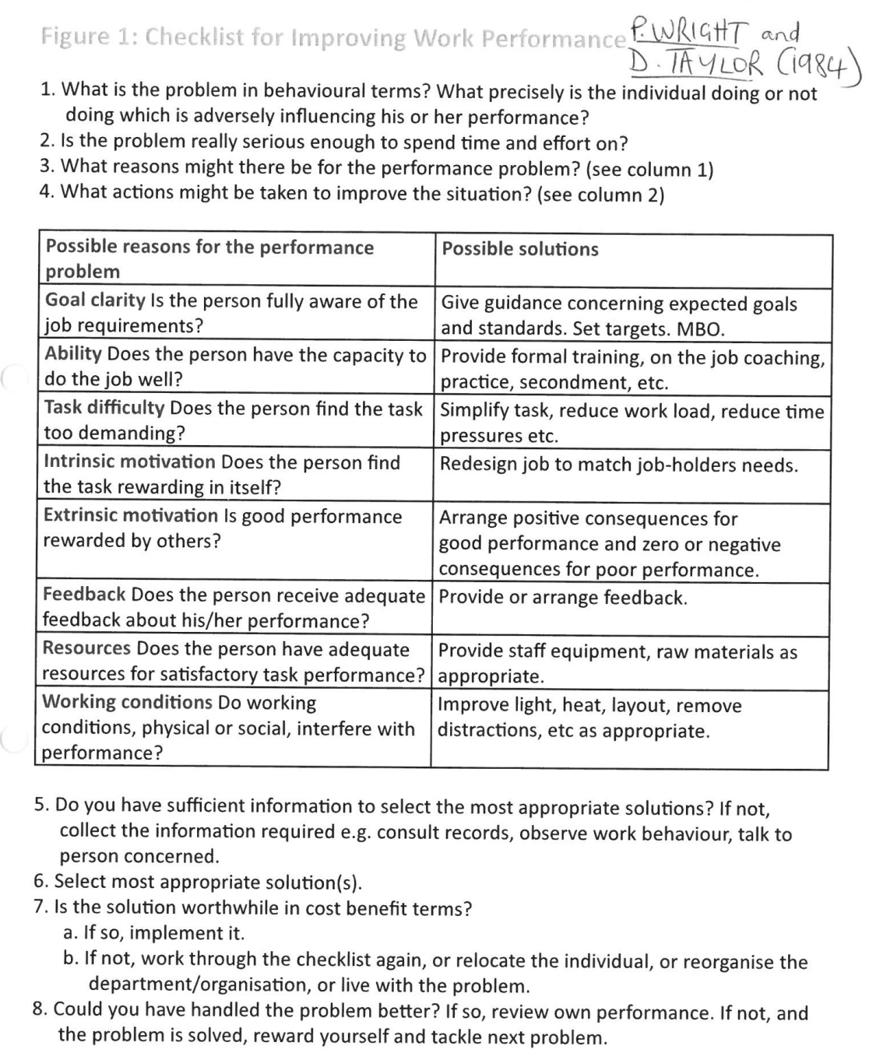

Slide 22
Activities
Use the lesson slides and the exam board notes to complete the Leadership workbook.
See next slide for past paper question help
This work will be due by 4pm on Friday 26th March on Teams.

Slide 23
Past Paper question
Carefully read the ‘All change at Cross Roads Transport Limited’ past paper question
Highlight / annotate anything you think is relevant to leadership (e.g. characteristics of leader / impact on staff).
Your answer should include 4 key points with analysis and evaluation – make links with evidence in the case study
For example: Impact is normally negative – demotivation – reduced productivity - "staff do what they have to and little more” – delivery drivers and fitters have been employed for long time suggesting the style does not negatively impact them as much as others

Slide 24
Plenary
Leadership and change management
Question:
In times of organisational change – e.g. growth, which style of leadership is going to be the most effective and why?
Which is the best style in times of crisis? Why?

