Slide 1
Refresh your memory!
Which type of leader do the following statements reflect: authoritarian, paternalistic, democratic, laissez-faire.
I like to get to know my staff and look after them. I will listen to them but ultimately all decisions are mine
I give the orders around here. I have systems in place and I like everyone to use them. I am not here to make friends.
c) I am happy for my staff to do what they think is best. I don’t mind taking a back seat in the day to day decisions.
d) I like to consult my staff before making decisions. If they have shown they are responsible I am happy to delegate tasks and responsibilities

Slide 2
Employer/employee relationships
Employment is a two way relationship….
You have 2 minutes to come up with a list of:
Responsibilities employers have to employees
Responsibilities employees have to employers

Slide 3
Learning Objectives
Explain what is meant by employer/employee relationships
Explain the duties and rights of employers and employees including contract of employment, health and safety, minimum wage and dismissal
Explain what is meant by equal opportunities
Evaluate the impact of equal opportunities on employers and employees

Slide 4
Employer/employee relations
Definition: the communications that occur between representatives of employees and employers
Discussions typically cover the following areas such as
Pay
Working hours
Working environment
Health and safety
Production targets

Slide 5
The importance of employee/employer relations
It helps with
Competitiveness
Productivity
Motivation of workforce
Managing change
Achieving objectives

Slide 6
Barriers to effective relations
Attitudes
Too many intermediaries
Information overload
Hierarchy

Slide 7
key employment concepts
Minimum wage
Equal opportunities
Trade unions
Industrial action
Works Councils, Staff Associations
CBI and other
ACAS (advice, conciliation, arbitration)

Slide 8
Contract of Employment
Employees must be provided with a written contract within 12 weeks of starting employment
Employment contract states:
Pay
Holiday entitlement
Pension rights
Disciplinary procedures
Length of notice period

Slide 9
Health & Safety Responsibilities
Employers
Provide a safe working environment
Provide a suitable level of training to perform job
Employees
Have a responsibility to take reasonable care by ensuring they abide by health and safety rules
e.g. wearing a hard hat on building sites
What is the minimum wage?

Slide 10
Minimum wage
Effects on Employees
7-8% of the workforce
Pressure to maintain wage differentials
For the lowest paid, the minimum wage has allowed a move away from poverty
Examples of jobs/industries that have benefitted most?
Effects on Employers
Increase in wage costs has led to the closure of many care homes – why?
Discouraged investment in the UK by foreign companies – why?
Small, labour intensive industries most affected
Impact on productivity?

Slide 11
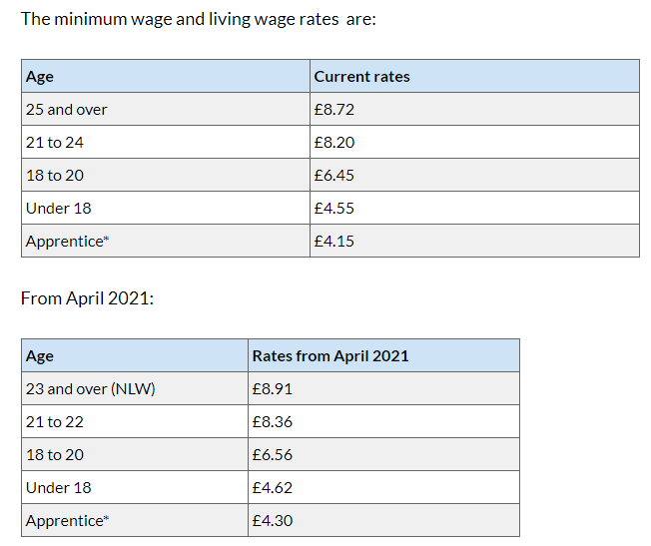

Slide 12
Equal Opportunities
Definition: giving everyone the same chance
UK legislation helps to promote this….
The Equality Act 2010 identifies 9 ‘protected characteristics’

Slide 13
THE EQUALITY ACT 2010 PROTECTED CHARACTERISTICS
Age
Disability
Gender Reassignment
Marriage and Civil Partnership
Pregnancy and Maternity
Race
Religion or belief (or lack of)
Sex
Sexual Orientation

Slide 14
Discrimination
Definition: choosing one candidate rather than another
Discrimination occurs in recruitment, training, promotion, setting wages and salaries
Some discrimination is legal, other discrimination is not
Think of a business example of
i) legal and
ii) illegal discrimination?

Slide 15
Positive Action
When an employer takes steps to help or encourage certain groups of people with different needs, or who are disadvantaged in some way (e.g. placing adverts visible to under-represented groups)
Positive Action is lawful under the Equality Act 2010
Positive Discrimination is unlawful
Notes:
https://www.theguardian.com/fashion/2012/apr/28/abercrombie-fitch-savile-row

Slide 16
Why does employee/employer relationships matter to business?
Productivity
Competitiveness
Motivation of workforce
Costs
Training costs
Employment tribunal claims

Slide 17
What does this mean for businesses?
Recruitment
Job adverts
Job descriptions
Interviews and selection tests
Training and promotion opportunities
Wages and benefits
Redundancy and dismissal

Slide 18
Activity
Read through the notes highlighting key info. (stop at Trade Unions)
Use your notes and the resources on Godalming Online (the CAB employee rights link) to help you complete the ‘employer/employee relations workbook.
Extension: Carry out research online to find two examples of poor employee/er relationships (re: minimum wage / health and safety / discrimination)

Slide 19
Plenary
‘The introduction of the National Minimum Wage has had more benefits than drawbacks’
Discuss this statement

