Slide 1
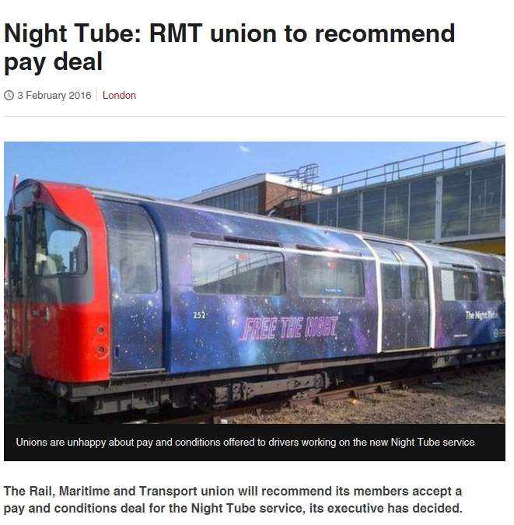
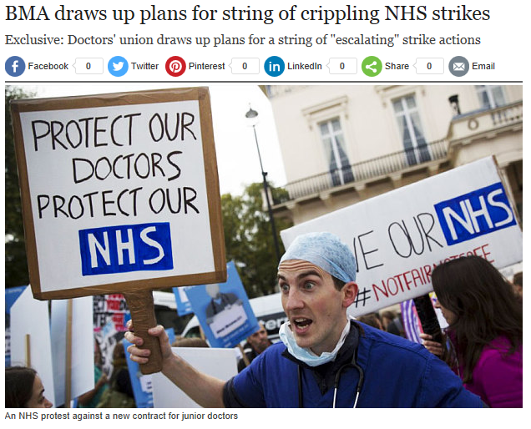
Employee/Employer Relationships Trade Unions
What is the purpose of a trade union?
Notes:
http://www.bbc.co.uk/news/uk-england-35484773
http://www.telegraph.co.uk/news/nhs/12167190/BMA-draws-up-plans-for-string-of-crippling-NHS-strikes.html

Slide 2
Learning Objectives
Explain the role of trade unions including collective bargaining and their advantages and disadvantages.
Explain what is meant by employer and employee conflict, including trade disputes and industrial action.
Explain the resolution of disputes including negotiation, consultation and the role of ACAS
Evaluate the impact of employer/employee relations, conflict and resolution on a business and its stakeholders

Slide 3
Employee representation
“informing, consulting and involving employees in the decision making process”
Trade unions
“An organisation representing the interests and goals of working people”

Slide 4
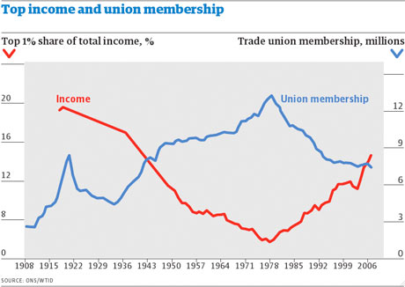
Decline in Trade Unions
1979 membership = 13 million
2000 membership = 8 million
Loss of trade union power during Thatcher's reign
Notes:
30% of union need to vote
Picketing
Union assets

Slide 5
What is a Trade Union?
Definition = organisation of workers which exist to promote the interests of their members
The role of a trade union
Collective bargaining
Attaining job security
Achieving safe working conditions
Protecting members interests from discrimination, unfair dismissal, H&S issues, legal advice, training, financial advice
Act as a pressure group to influence the behaviour of in general (as well as government and law)
Responsible for industrial action (negotiate with employers for the most favourable conditions)
What have the unions done for us TUC video - https://www.youtube.com/watch?v=lrjySOFLXgg
Collective bargaining = a method of determining conditions of work and terms of employment through negotiations between employers and employee representatives
Notes:
VIDEO: What have the unions done for us TUC video - https://www.youtube.com/watch?v=lrjySOFLXgg

Slide 6
Advantages and disadvantages of trade union membership
Advantages | Disadvantages
Can lead to workers achieving higher rewards or better working conditions | Decision making process can be slowed down (can be a problem in times of crisis)
Workers can feel more valued which can lead to greater motivation (leading to higher output, less absenteeism/turnover) | It can be expensive and time consuming
Can increase the ability of employees to contribute effectively to the business (sharing of ideas, easier decision making) | It may lead to conflict (resulting in industrial action)
Employers may be more sympathetic to the needs of employees | Some employees will pursue their own interests at the expense of the business
Can help a business to develop a common culture and meet objectives | Can encourage employees to believe they have more power than they actually have

Slide 7
Why do people join unions?
“Collective bargaining”
Representation
Negotiation of pay and working conditions
Ensure high standards of H&S
Benefit from a wide range of other services e.g. legal
Support development of equal opportunities policies
Why do employers like trade unions?
Collective bargaining assists employers
Help ensure that agreements are complied with by workers
Able to take a longer term view than individuals
Q1: For what reasons would employer/employee disputes arise?
Q2: What happens if the TU and the employer cannot agree?

Slide 8
Employee/Employer Relationships The Role of ACAS
What do you think happens if employers and employee representatives cannot meet an agreement after consultation and negotiation?

Slide 9
Advisory Conciliation and Arbitration Service (ACAS)
Sometimes an outside body is called in to arbitrate during employer/employee negotiations
Established in 1975
Independent source of expertise in preventing or settling industrial disputes
70,000 individual cases per year.
Can be accessed by organisations, unions, individuals.
Provide expert and unbiased conciliation or mediation.
Their role is provide advice, conciliation services and arbitration services

Slide 10
Advisory Conciliation and Arbitration Service (ACAS)
Settling disputes
Sometimes an outside body is called in to settle disputes during employer and employee negotiations
ACAS only gets involved when it is invited by both sides
Roles of ACAS
Advisory: clarify issues on complicated employment law
Conciliation: an independent ACAS conciliator discusses the disputed workplace issue with both parties
Arbitration: in impartial ACAS advisor is asked to make a decision on a dispute

Slide 11
Helping to resolve industrial Disputes
With conciliation, ACAS play more of a mediation role. They will try to help the employer/ee avoid industrial action.
Non-binding = involves a 3rd party, parties can accept or not.
Arbitration- settlement of dispute.
Both parties agree to be bound by the decision. Arbitration Act 1950 and 1996
Binding = parties have to take the award.
Key Term: Conciliation
Resolving individual or collective disputes, a neutral 3rd party encourages continued negotiations and postponement of industrial action, also called mediation.
Key term: Arbitration
Where both sides in a dispute agree to an independent party making a judgement about how a dispute can be resolved

Slide 12
Activities
Use the lesson slides, the exam board notes and the scanned text book pages to help you complete the Trade Unions workbook

