Slide 1
Quality standards
Week 6 ( 12th - 16th October)
Past Paper June 2018 Strines Stoves (TQM)
Unit 6
Learning Aim F1

Slide 2
Quality standards
These are approved certificates of meeting a quality management standard
Accreditation can be sought for products or services
Meeting the standard shows that the organisation has achieved a level of quality
The following organisations produce documents that provide requirements, specifications, guidelines or characteristics that can be used consistently to ensure that materials, products, processes and services are fit for their purpose.
Notes:
https://www.iso.org/files/live/sites/isoorg/files/archive/pdf/en/pub100080.pdf
This International Standard describes fundamentals of quality management systems, which form the subject of the ISO 9000 family, and defines related terms.
This International Standard is applicable to the following:
organizations seeking advantage through the implementation of a quality management system;
organizations seeking confidence from their suppliers that their product requirements will be satisfied;
users of the products;
those concerned with a mutual understanding of the terminology used in quality management (e.g. suppliers, customers, regulators);
those internal or external to the organization who assess the quality management system or audit it for conformity with the requirements of ISO 9001 (e.g. auditors, regulators, certification/registration bodies);
those internal or external to the organization who give advice or training on the quality management system appropriate to that organization;
developers of related standards.

Slide 3


Investors in People (IIP) is the standard for people management.
Based on a tested framework and a rigorous process of assessment, this standard defines what it takes to lead, support and manage people
https://www.youtube.com/watch?time_continue=175&v=oY6dgc7jkjU&feature=emb_logo
BSI - the British Standards Institute, develops and publishes British Standards
ISO - the International Organization for Standardization, develops and publishes International Standards
ISO 9000 is a set of international standards on quality management and quality assurance developed to help companies effectively document the quality system elements to be implemented to maintain an efficient quality system.
BSI Kitemark™ is a recognised symbol of quality and safety.
Notes:
(BS 7850-1:1992) long obsolete but still on the spec..

Slide 4
Leaders and managers set standards for their organisations to..
Continually improve, streamline operations and reduce costs
Win more business and compete in tenders
Satisfy more customers
Be more resilient and build a sustainable business
Show strong corporate governance
Work effectively with stakeholders and the supply chain
Notes:
https://www.iso.org/files/live/sites/isoorg/files/archive/pdf/en/pub100080.pdf
This International Standard describes fundamentals of quality management systems, which form the subject of the ISO 9000 family, and defines related terms.
This International Standard is applicable to the following:
organizations seeking advantage through the implementation of a quality management system;
organizations seeking confidence from their suppliers that their product requirements will be satisfied;
users of the products;
those concerned with a mutual understanding of the terminology used in quality management (e.g. suppliers, customers, regulators);
those internal or external to the organization who assess the quality management system or audit it for conformity with the requirements of ISO 9001 (e.g. auditors, regulators, certification/registration bodies);
those internal or external to the organization who give advice or training on the quality management system appropriate to that organization;
developers of related standards.

Slide 5
Developing a quality culture, importance & Benefits
Week 5 5th October)
Past Paper June 2018 Strines Stoves (TQM)
Unit 6
Learning Aim F2-4

Slide 6
Developing a quality culture
Setting quality standards.
Managerial commitment and staff buy-in.
Quality circles.
Partnership working with suppliers and customers.
Transparent and open communication.

Slide 7
Total quality management (Tqm)
TOTAL management, staff, suppliers, customers
QUALITY speed of service, consistency, innovation
MANAGEMENT improving processes and monitoring continually to make improvements however small at every stage of the process from beginning to end
Notes:
For Total Quality Management to work, managers have to be committed and all the staff have to be involved
Managers need to listen to their staff and value their input or the system fails
Consultation (asking the workforce for their opinion before making a decision) needs to be genuine
Obviously, not all decisions will involve all staff, TQM is about improving processes and making informed decisions

Slide 8
Key principles of TQM
Produce quality work the first time
Focus on the customer
Have a strategic approach to improvement
Improve continuously
Encourage mutual respect and teamwork
Notes:
For Total Quality Management to work, managers have to be committed and all the staff have to be involved
Managers need to listen to their staff and value their input or the system fails
Consultation (asking the workforce for their opinion before making a decision) needs to be genuine
Obviously, not all decisions will involve all staff, TQM is about improving processes and making informed decisions

Slide 9
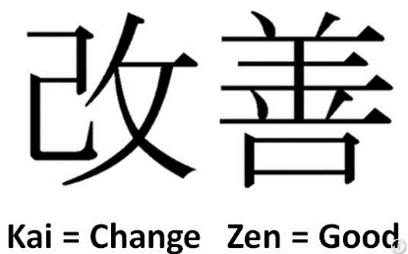
Kaizen (continuous improvement)
Involves a firm consulting their employees to improve the ways in which they produce products or services
Small but continuous improvements to quality, design and waste reduction
Management and workers must be committed to the process
Benefits include better labour relations, motivation and increased productivity and competitiveness

Slide 10
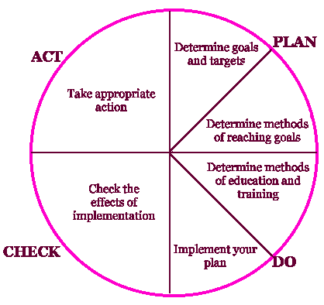
Quality Circles
A quality circle is a group of workers who meet regularly to identify, analyse and solve work-related problems.
Normally small in size, the group is usually led by a supervisor or manager and presents its solutions to management
Where possible, workers implement the solutions themselves in order to improve the performance of the organization and motivate employees.
Notes:
http://www.bbc.co.uk/bitesize/higher/history/
Quality circles were at their most popular during the 1980s, but continue to exist in the form of Kaizen groups and similar worker participation schemes.

Slide 11
Zero Defects, Quality Assurance, Quality Control,
Zero defects is where defects are not acceptable and that everyone should "do things right the first time“
Quality Assurance is a system or process to prevent mistakes from happening
Quality Control is a check to make sure that substandard goods are not issued
https://www.bbc.co.uk/bitesize/guides/z763f4j/video

Slide 12
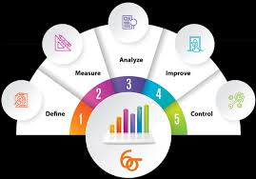
6 sigma quality control
An approach (introduced at Motorola in the 1980’s) to identify and eliminate the causes of defects, and therefore reduce costs:
Define the system
Measure key aspects of the current process and collect relevant data
Analyse the data to find key causes.
Improve or optimise the current process
Control the future process

Slide 13
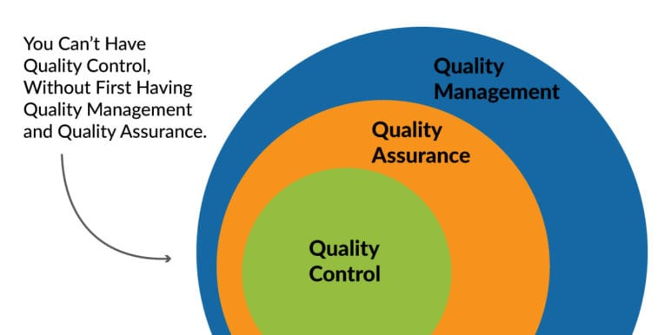

Slide 14
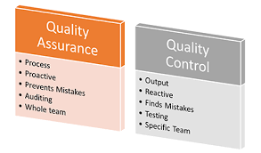

Slide 15

To maintain quality products and a quality service a good relationship is needed with suppliers and customers
Price, quality and service are required from suppliers and expected by customers
Transparent and open communication is essential
JIT (Just in Time) ordering system (relies on good relationship with suppliers)
Inside the BMW Mini Factory http://estream.godalming.ac.uk/View.aspx?ID=880~3D~mOKLCd

Slide 16
BENEFITS OF QUALITY OUTPUT
https://www.youtube.com/watch?v=KkUvJ2Ui3As
Quality culture and motivation gains
Zero defects, improved efficiency and profitability
Lower costs can allow lower prices thus leading to more competitiveness
Customer & supplier engagement and satisfaction
Consistent high quality can lead to a well known brand image and higher prices can be charged

Slide 17
Activity 1 (Past Paper June 2018 Strines Stoves)
With reference to the Set Task information, you are to prepare a report for Chris North to present to the Board of Directors at SS Ltd.
1
Your report should show understanding of quality management and its importance to SS Ltd
2
Make recommendations about the appropriate techniques or tools that SS Ltd could use for quality management
3

Slide 18
Activity 2 (Past Paper June 2018 Strines Stoves)
With reference to the Set Task information, you are to prepare a presentation for Chris North to present to the Board of Directors at SS Ltd.
1
The presentation should show understanding of how the current management approach is affecting the development of a quality culture at SS Ltd
2
Make recommendations about how SS Ltd could achieve a quality management standard
3

