Slide 1
Film Studies An introduction to film analysis
Narrative

Slide 2
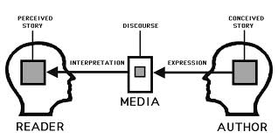
Narrative
Shots are linked in film and television to do one thing, tell a story. The process of producing a story is referred to as narrative. This can be divided into two parts:

Slide 3
The Plot:
What happens. This is the story of the programme or advert, just like studying a novel, you will pick up on events and characters and development.

Slide 4
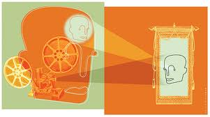
Discourse or Narration:
How the story is told. You may get a story told from one perspective or from many. You may find that you as a viewer are put in a strange position when watching the action.

Slide 5
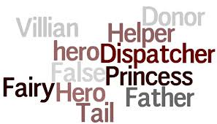
Narrative Theory
PROPP claimed that stories and their structures are determined by the role of characters. He studied a wide range of Russian folk stories and identified 8 key roles:

Slide 6
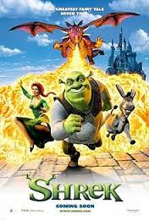
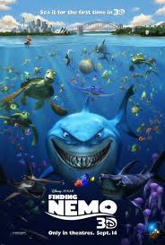
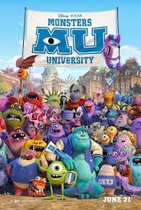
Character roles/stock characters
the villain – opposes the hero
the donor (provider) – helps the hero by providing a magic object
the helper – gives support to the hero
the princess – the reward for the hero and needs to be protected from the villain
the princess’ father
the dispatcher – send the hero on his way
the hero – seeks something
the false hero – falsely assuming the role of the hero

Slide 7
Universal structure
In terms of narrative driven by character type, Propp can be seen to have been influential in identifying a “universal” structure that can be applied to virtually all stories and in particular classic Hollywood cinema.

Slide 8
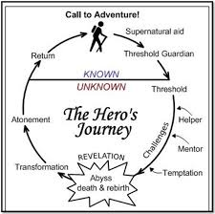
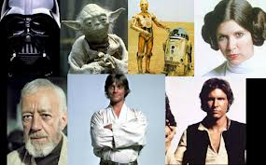
TASK 1
In pairs, take a popular mainstream film and draw up parallel links between Propp’s character roles and the characters/themes in the film.
Some could be two separate Propp roles.
Props character could be animal or mineral!
Are there any that do not fit? Why?
Try to think of three films that do not fit the pattern.

Slide 9
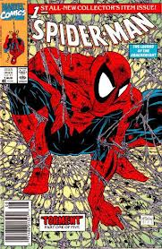
Tzvetan Todorov
Tzvetan Todorov, in his book The Fantastic
outlines several stages that a plot works through:
A state of equilibrium
A disruption of the equilibrium
A recognition of the disruption
Attempt to repair the disruption
Restatement of the (new) equilibrium

Slide 10
Levi Strauss' Theory of Binary Opposites
Levi Strauss, a French anthropologist in the 1900s, proposed a theory of 'binary opposites' which entails that the majority of narratives contain opposing main characters and themes.
These binary opposites help to thicken the plot and further the narrative; and introduce contrast. For example, in a superhero film this could be good vs. evil, in a horror film this could be human vs. supernatural, and in a comedy this could be young vs. old.
In Slumdog Millionaire:
Jamal Vs Salim
Poverty Vs Wealth
Happiness Vs loneliness
India Vs West

Slide 11
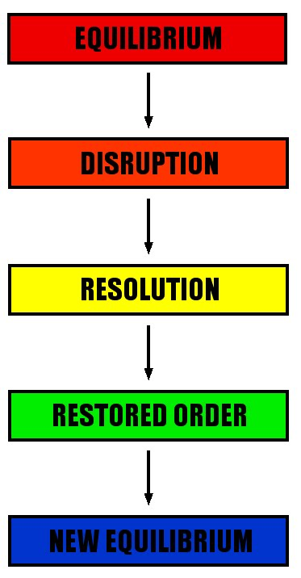
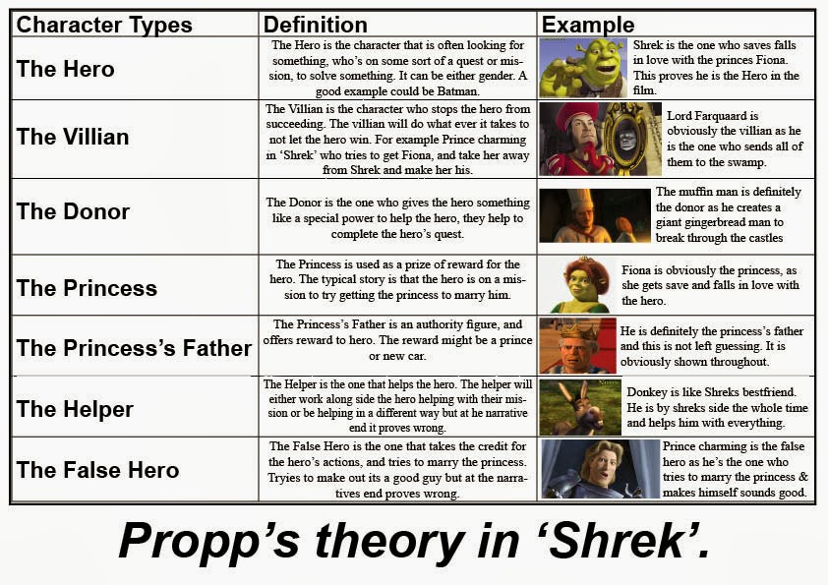
Task 2
In small groups you must come up with a film idea which will appeal to your age group and applies Todorov’s & Propp’s narrative theory.
The class will then vote for which films should be commissioned.
Add as much detail to your pitch as possible including:
a title,
a tagline,
actors,
director,
genre,
location,
Themes . . .

