Slide 1
Lettuce (growing in a farmers field)
What type of industry is this (hint: there are 3 types of industry)
How is lettuce transformed into what we buy in supermarkets?
What is added value?

Slide 2
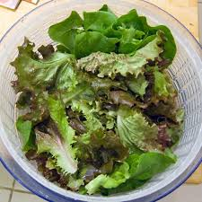
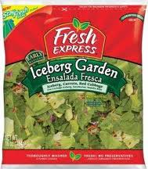
Inputs cost 15p
Process washing and bagging
Price £1.20
Added value £1.05 (not profit).

Slide 3
Learning Objectives
Understand the nature of operations management in different types of business organisations
Explain what is meant by added value
Calculate added value
Explain ways of increasing added value
Evaluate the importance of added value to a business and its stakeholders

Slide 4
Operations Management
Operations Management definition:
Producing the right amount of a good or service, at the right time, of the right quality and at the right cost to meet customer expectations

Slide 5
In summary this means . . .
Operations management is about “productive efficiency”:
Transforming resources into goods and services more efficiently than rivals. This means constantly trying to reduce the costs of the resources used to produce each unit of the goods or service.

Slide 6
What are the 4 factors of production?
How would you define production?

Slide 7
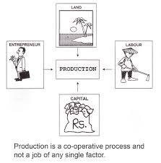
Production takes place when resources are turned into ‘products’ OR …. The process of turning inputs into outputs
Four factors of production:
Land
Labour
Capital
Enterprise

Slide 8
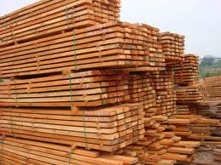
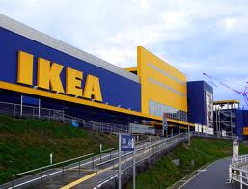
Industry Types – what are they called?
Inputs
Outputs
Production
Process

Slide 9
Added Value
Added value is the difference between the price of the finished product and the cost of the inputs/raw materials.
Formula: Sale price – cost of materials

Slide 10
Example: iPhone4
COMPONENT | COST PRICE ($)
Applications processor | 25.05
Memory | 27.30
Radio Frequency | 25.00
Power Management | 3.93
Connectivity | 10.35
Interface & Sensors | 10.13
Display/Camera | 49.25
Battery | 5.80
Other | 30.70
TOTAL | 187.51
Selling price in 2010:
$599.99
1. Added Value = ?
Added Value = $412.45
Notes:
411.49

Slide 11
Adding Value
The £412.48 figure is NOT profit – why not?
Part of this £412.48 will be used to pay the wages of the employees and the business overheads
Profit figure will actually be lower than the value added figure – remember profit is the difference between the selling price and ALL costs of production

Slide 12
How do…
…add value?
Notes:
Buy products from a producer or wholesaler – sell it at a higher price to customers that it has paid for it – the difference in price is the added value. The retailer is adding value because it is providing a service

Slide 13
How do businesses add value?
Turn raw materials into a product
Provide excellent customer service
Offer product features and benefits
Offer convenience
Build a brand

Slide 14
How do businesses increase added value?
Purchase cheaper raw materials
Improving efficiency of production
Raising the price of the product
Create a USP
Provide a better quality of customer service
Offer an upmarket brand image
Satisfy new customer trends

Slide 15
Tasks
Use the lesson slides to fill in any gaps on pages 1 and 2 of the Intro to Ops/Added Value workbook
Complete questions 1, 2, 4 & 6

Slide 16
Plenary
Without looking at your notes, complete the Added Value worksheet at the back of your booklet.

