Slide 1
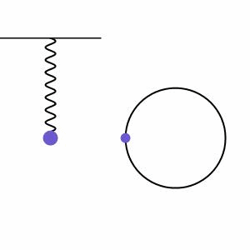
Simple Harmonic Motion
From my learning today I will be able to:
Key: | Describe the principles of simple harmonic motion C
Boost: | Calculate phase difference and acceleration for simple harmonic systems- B
Aspire: | Derive expressions from circular motion– A/A*

Slide 2
Oscillations (definitions)
An oscillation is a repeated motion about a fixed point.
Time = 1 period
Time = 0 period
Time = 5T / 8
Time = 3T / 8
Time = 3T / 4
Time = 7T / 8
Time = T / 8
Time = T / 4
Time = T / 2
equilibrium position
Notes:
2

Slide 3
amplitude, A
displacement, x
Frequency, f = 1 / T
Angular frequency, ω
ω = 2π f
ω = 2π / T
x = 0
x = + A
x = 0
x = - A
x = 0
equilibrium position

Slide 4
amplitude, A
displacement, x
Frequency, f = 1 / T
Angular frequency, ω
ω = 2π f
ω = 2π / T

Slide 5
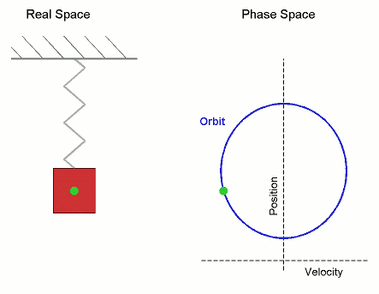
The pattern of SHM motion
The pattern of SHM is the same as the side view of an object moving at a constant speed around a circular path
The amplitude =radius of the circle.
+ A
The object moves quickest as it passes through the central equilibrium position.
- A
The time period of the oscillation is equal to the time taken for the object to complete the circular path.
Notes:
5

Slide 7
An object is undergoing simple harmonic motion (SHM) if;
The acceleration of the object is directly proportional to its displacement from its equilibrium position.
The acceleration is always directed towards the equilibrium position.

Slide 8
Lets look at point 1:
The acceleration of the object is directly proportional to its displacement from its equilibrium position.
$$a∝x$$

Slide 9
Lets look at point 2:
The acceleration is always directed towards the equilibrium position
$$a∝−x$$

Slide 10
Acceleration variation of SHM
a
The constant k is equal to (2πf )² or ω² or (2π/T)²
Therefore:
a = - (2πf )² x (given on data sheet)
or
a = - ω² x
or
a = - (2π/T)² x
+ ω² x
x
- A
+ A
- ω² x
gradient = - ω² or - (2πf )²
Notes:
10

Slide 11
Question
A body oscillating with SHM has a period of 1.5s and amplitude of 5cm. Calculate its frequency and maximum acceleration.
(a) f = 1 / T
= 1 / 1.5s
frequency = 0.67 Hz
(b) a = - (2πf )² x
maximum acceleration is when x = A (the amplitude)
a = - (2πf )² A
= - (2π x 0.6667Hz)² x 0.005m
maximum acceleration = 0.88 ms⁻²
Notes:
11

Slide 12
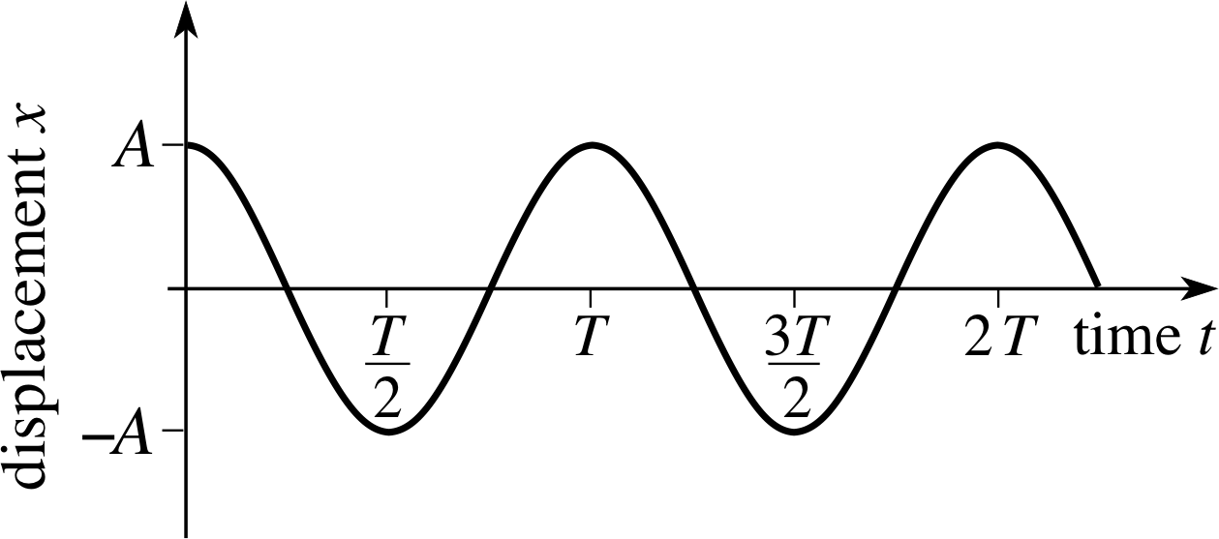
Amplitude - maximum displacement from centre point (If there’s no friction, the amplitude is constant. This is known as free oscillation.)
$$T=\frac{1}{f}$$
$$ω=\frac{2π}{T}$$
Equilibrium - the centre point
Period (T) - time for one complete oscillation (s)
Frequency (f) - number of oscillations per second (Hz)

Slide 13
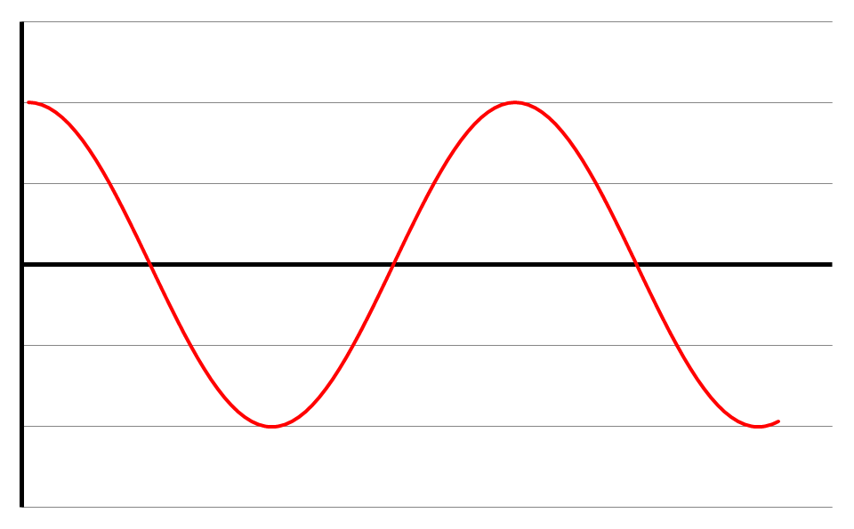
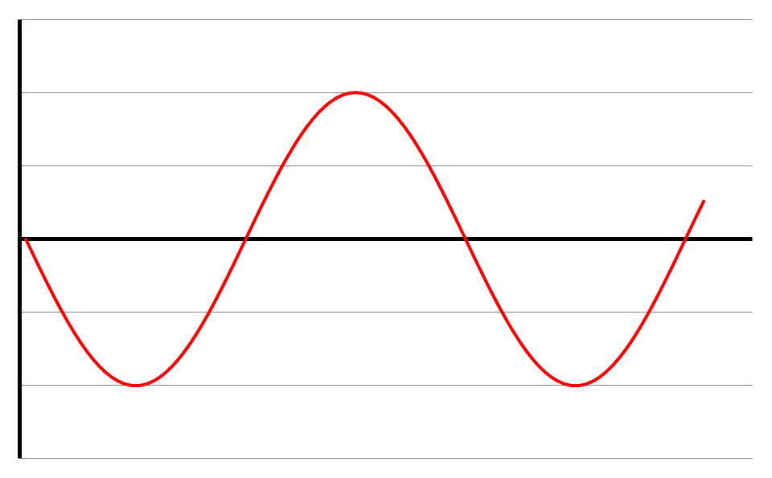
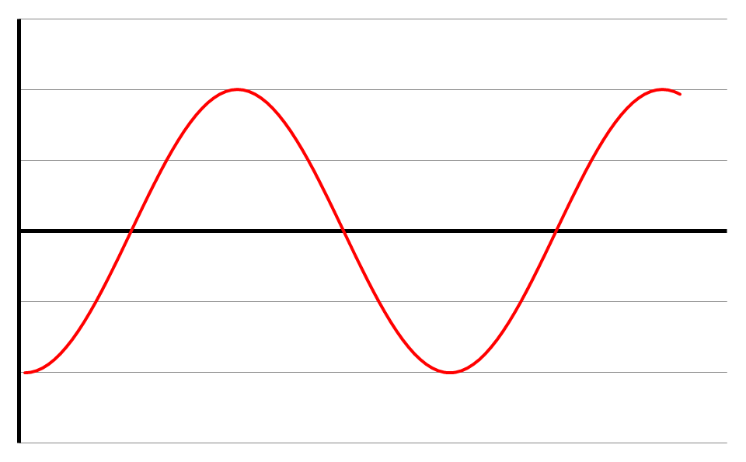
Consider a pendulum (because it’s easy to think about) ...
Displacement
Move it across to one side and let it go.
Time
Velocity
Velocity is given by the gradient of the displacement – time graph.
Velocity is zero at maximum displacement.
Velocity is maximum at zero displacement (when gradient is steepest).
Time
Acceleration is given by the gradient of the velocity – time graph.
Acceleration is greatest when velocity is zero (when displacement is greatest).
Acceleration is zero when displacement is zero.
Acceleration
Time

Slide 14
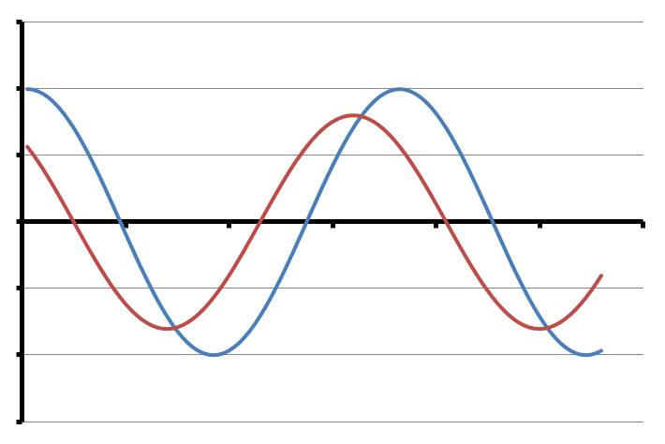
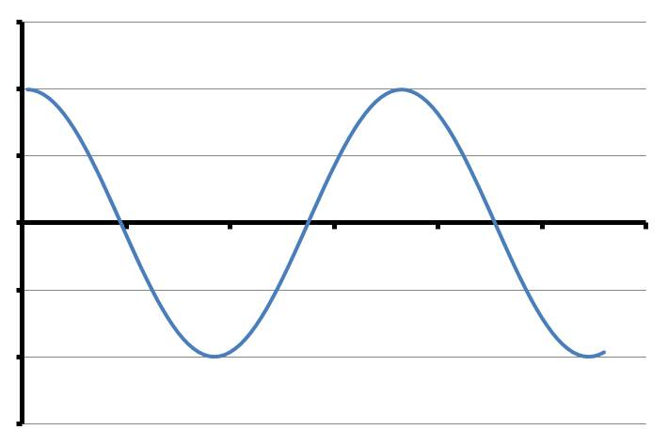
Phase
Displacement
Say we have 2 pendulums of identical length oscillating at the same time. Since they have the same length, their periods will be the same.
Δt
Time
Let’s say the other pendulum’s oscillating slightly ahead of the first one, and the time difference is Δt. We say they are oscillating out of phase.
Their phase difference is a fraction of a cycle equal to Δt / T.
Phase difference is usually quoted in radians. This is calculated by:
phase difference = 2π Δt / T

Slide 15
In the context of oscillations explain the meaning of the following: (a) equilibrium; (b) displacement; (c) amplitude; (d) time period; (e) frequency; (f) angular frequency and (g) phase difference.

Slide 22
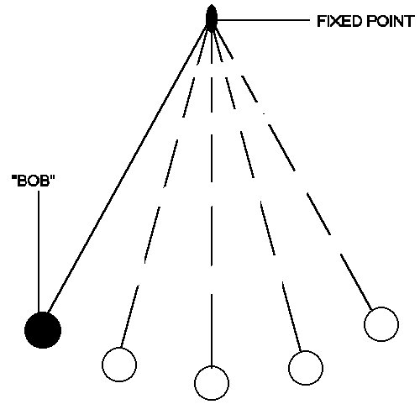
Simple Harmonic Motion II
At each of the points, describe the objects
Displacement
Velocity
Acceleration
1
3
2
From my learning today I will be able to:
Key: | Describe the principles of simple harmonic motion C
Boost: | Calculate phase difference and acceleration for simple harmonic systems- B
Aspire: | Derive expressions from circular motion– A/A*

Slide 23
1
3
2

Slide 24
From the displacement & acceleration graphs, acceleration is always in the opposite direction to the displacement.
SHM is defined as oscillating motion where the acceleration is:
proportional to the displacement;
in the opposite direction to the displacement.
It can be shown that:
a = - (2πf)² x where f = frequency
x = displacement
Another thing to bear in mind is that T does not depend on A.
It can also be shown (see p39) that:
x = A cos(2πft) where A = amplitude
t = time since oscillations began
Note - 2πft must be in radians – get your calculator in
the right mode!
The inevitable questions:
P37, qu1-4
P39, qu1-4
And, since this would be a good place to include it:
v = ± 2πf √(A² – x²) (See p44 for proof)

