Slide 1
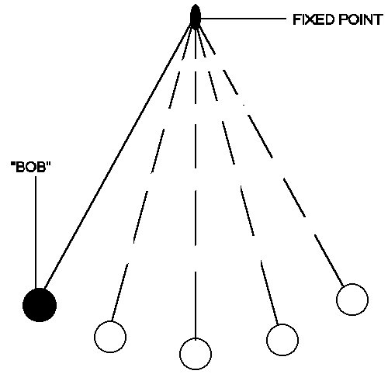
Simple Harmonic Motion II
At each of the points, describe the objects
Displacement
Velocity
Acceleration
1
3
2
From my learning today I will be able to:
Key: | Describe the principles of simple harmonic motion C
Boost: | Calculate phase difference and acceleration for simple harmonic systems- B
Aspire: | Derive expressions from circular motion– A/A*

Slide 2
1
3
2

Slide 3
Acceleration variation of SHM
a
The constant k is equal to (2πf )² or ω² or (2π/T)²
Therefore:
a = - (2πf )² x (given on data sheet)
or
a = - ω² x
or
a = - (2π/T)² x
+ ω² x
x
- A
+ A
- ω² x
gradient = - ω² or - (2πf )²
Notes:
3

Slide 4
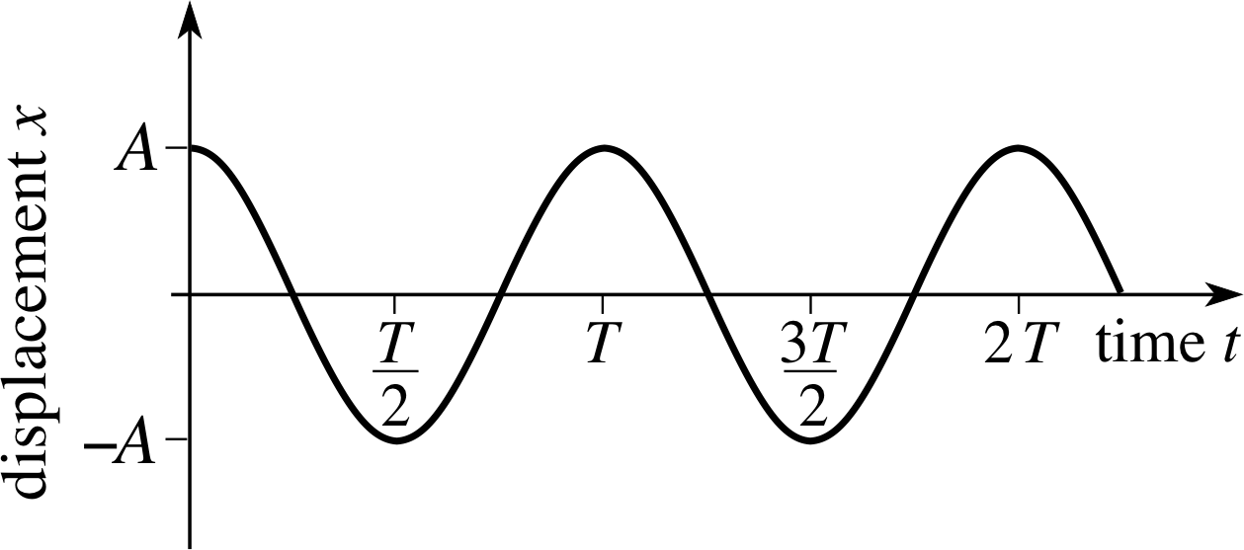
Amplitude - maximum displacement from centre point (If there’s no friction, the amplitude is constant. This is known as free oscillation.)
$$T=\frac{1}{f}$$
$$ω=\frac{2π}{T}$$
Equilibrium - the centre point
Period (T) - time for one complete oscillation (s)
Frequency (f) - number of oscillations per second (Hz)

Slide 5
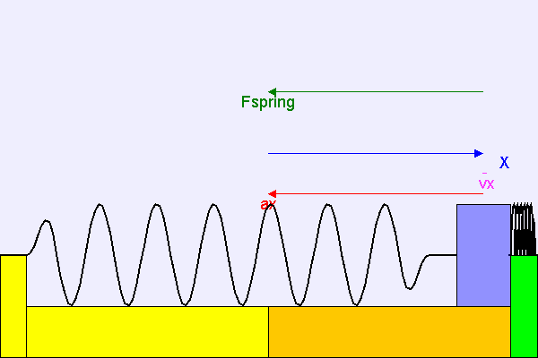
Variation of x, v and a with time
The acceleration, ax depends on the resultant force, Fspring on the mass.
Note that the acceleration ax is always in the opposite direction to the displacement, X.
Notes:
5

Slide 6
SHM time graphs
+ A
x
x
v
a
time
v
T/4 T/2 3T/4 T 5T/4 3T/2
a
- A
x = A cos (2π f t)
v = - 2π f A sin (2π f t)
v_{max} = ± 2π f A
a = - (2π f )² A cos (2π f t)
a_{max} = ± (2π f )² A
Note: The velocity curve is the gradient of the displacement curve
and the acceleration curve is the gradient of the velocity curve.
Notes:
6

Slide 7
SHM summary table
Displacement | Velocity | Acceleration
+ A | 0 | - (2π f )² A
0 | ± 2π f A | 0
- A | 0 | + (2π f )² A
A ?
B ?
C ?
D?
E ?
E ?
Notes:
7

Slide 8
SHM graph question
The graph below shows how the acceleration, a of an object undergoing SHM varies with time. Using the same time axis show how the displacement, x and velocity, v vary in time.
a
x
a
v
v
time
T/4 T/2 3T/4 T 5T/4 3T/2
x
acceleration is proportional to minus displacement
velocity is the gradient of displacement
Notes:
8

Slide 9
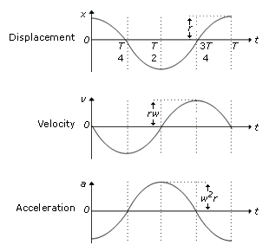
Consider a pendulum (because it’s easy to think about)
Move it across to one side and let it go.
Velocity is given by the gradient of the displacement – time graph.
Velocity is zero at maximum displacement.
Velocity is maximum at zero displacement (when gradient is steepest).
Acceleration is given by the gradient of the velocity – time graph.
Acceleration is greatest when velocity is zero (when displacement is greatest).
Acceleration is zero when displacement is zero.

Slide 11
An object is undergoing simple harmonic motion (SHM) if;
The acceleration of the object is directly proportional to its displacement from its equilibrium position.
The acceleration is always directed towards the equilibrium position.

Slide 17
From the displacement & acceleration graphs, acceleration is always in the opposite direction to the displacement.
SHM is defined as oscillating motion where the acceleration is:
proportional to the displacement;
in the opposite direction to the displacement.
It can be shown that:
a = - (2πf)² x where f = frequency
x = displacement
Another thing to bear in mind is that T does not depend on A.
It can also be shown (see p39) that:
x = A cos(2πft) where A = amplitude
t = time since oscillations began
Note - 2πft must be in radians – get your calculator in
the right mode!
The inevitable questions:
P37, qu1-4
P39, qu1-4
And, since this would be a good place to include it:
v = ± 2πf √(A² – x²) (See p44 for proof)

