Slide 1
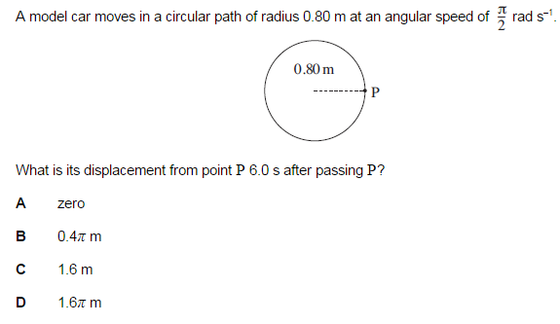
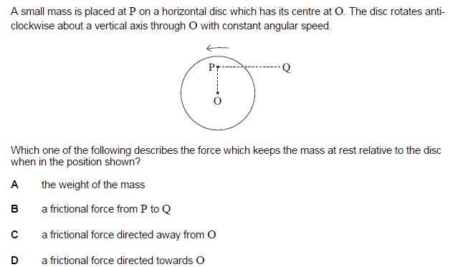
HINT: What is Displacement?
What is angular speed?

Slide 2
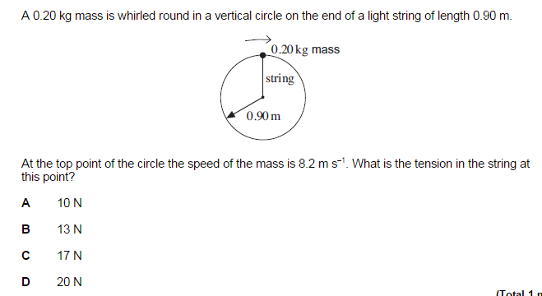
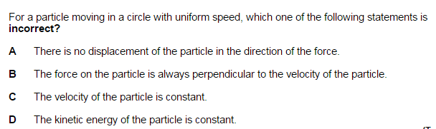

Slide 3
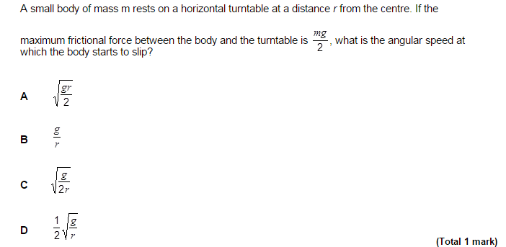
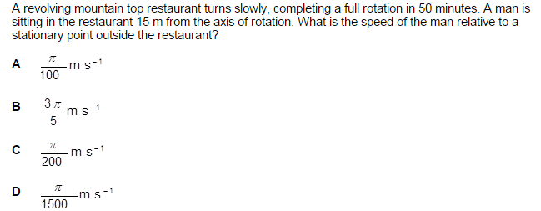

Slide 4
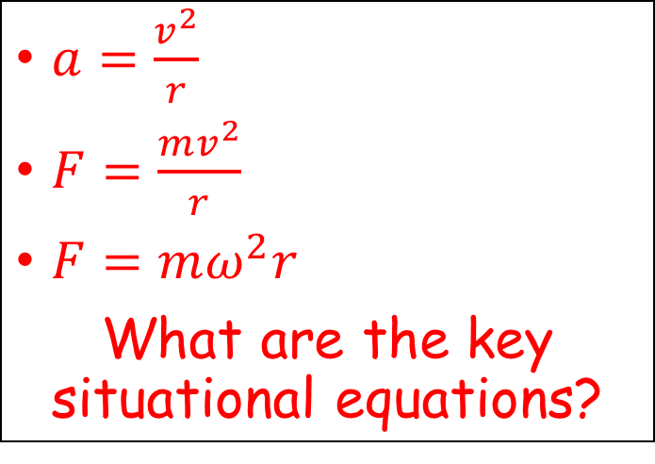
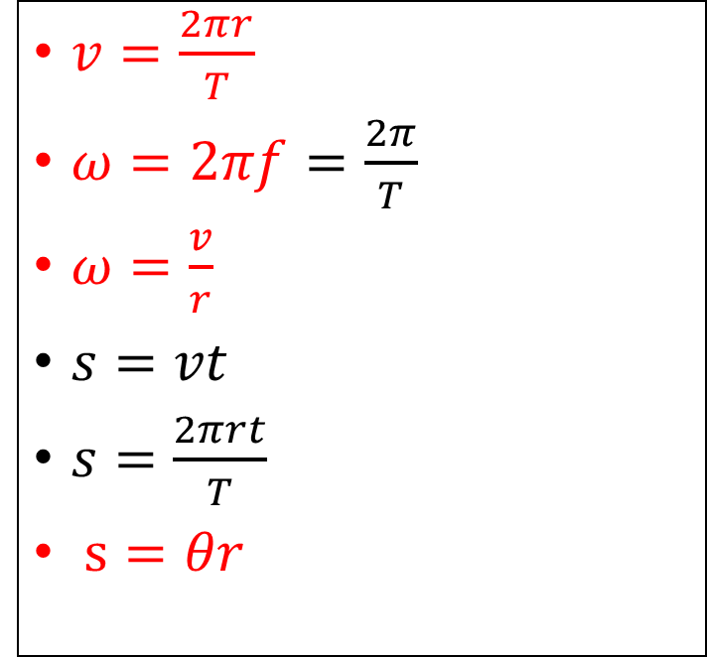
Remind ourselves of our equations
$v=\frac{2πr}{T}$
$ω=2πf=\frac{2π}{T}$
$ω=\frac{v}{r}$
$s=vt$
$s=\frac{2πrt}{T}$
$s=θr$
Motion in a circle
$a=\frac{v^{2}}{r}$
$F=\frac{mv^{2}}{r}$
$F=mω^{2}r$
What are the key situational equations?
Centripetal force

Slide 5
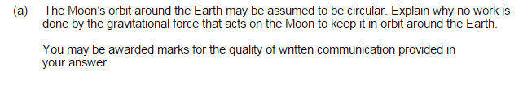
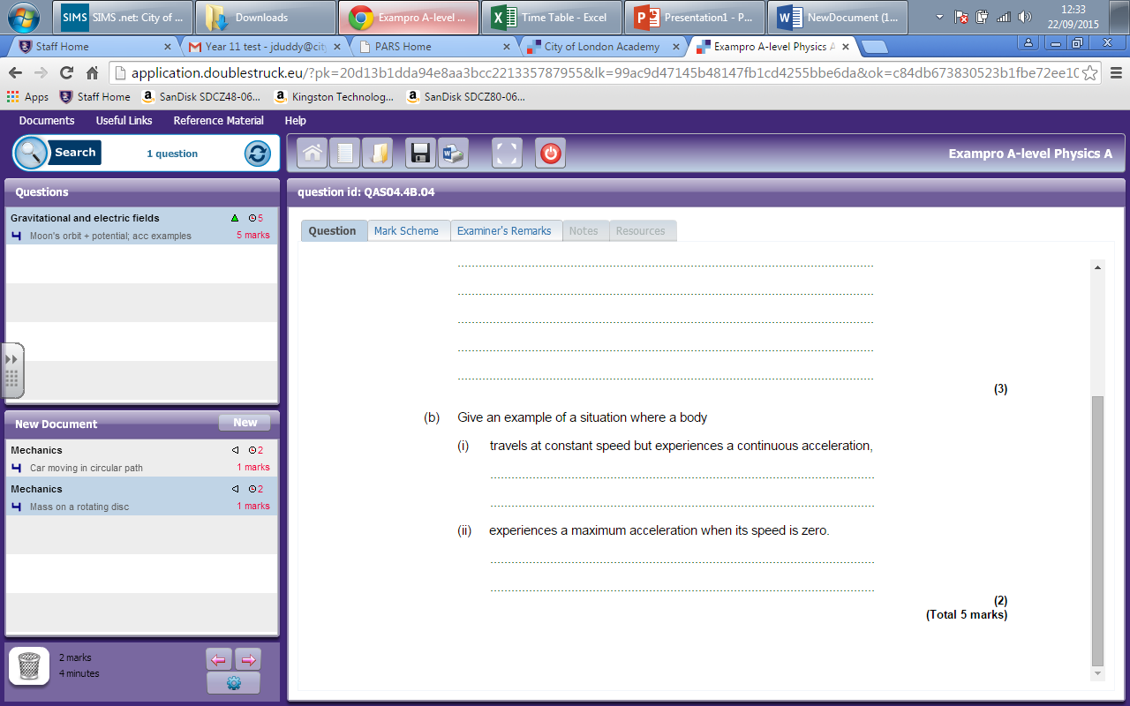

Slide 6
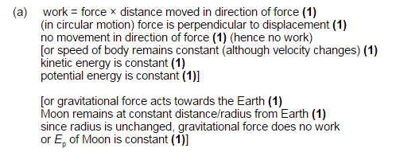

Slide 7
