Slide 1
What is Simple Harmonic Motion?
Objectives
Be able to describe features of SHM.

Slide 2
SHM Terminology
Oscillations wobbling about a centre point
Equilibrium the centre point
Amplitude (A) maximum displacement from centre point
(If there’s no friction, the amplitude is constant.
This is known as free oscillation.)
Period (T) time for one complete oscillation (s)
Frequency (f) number of oscillations per second (Hz)
T and f are related as follows:
T = 1 / f

Slide 3
SHM - displacement, velocity & acceleration
Objectives
Describe how displacement, velocity and acceleration are related in SHM.

Slide 4
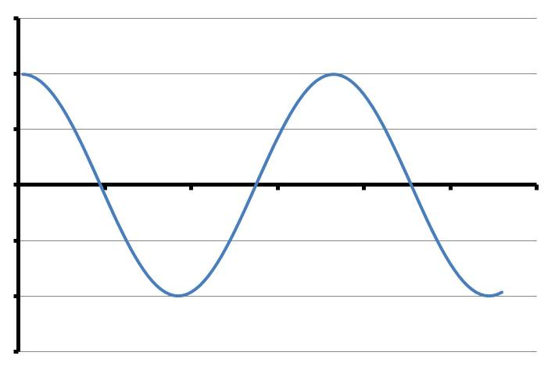
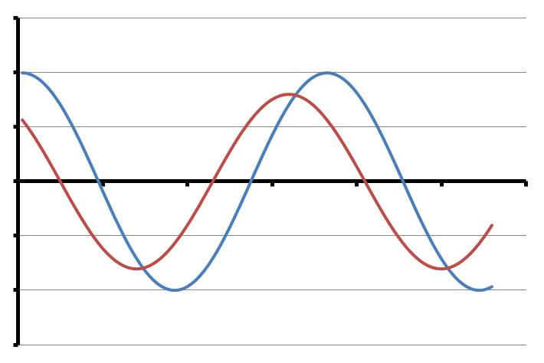
Phase
Displacement
Say we have 2 pendulums of identical length oscillating at the same time. Since they have the same length, their periods will be the same.
Δt
We can plot a displacement-time graph for one of the pendulums.
Time
Let’s say the other pendulum’s oscillating slightly ahead of the first one, and the time difference is Δt. We say they are oscillating out of phase.
Their phase difference is a fraction of a cycle equal to Δt / T.
Phase difference is usually quoted in radians. This is calculated by:
phase difference = 2π Δt / T

Slide 5
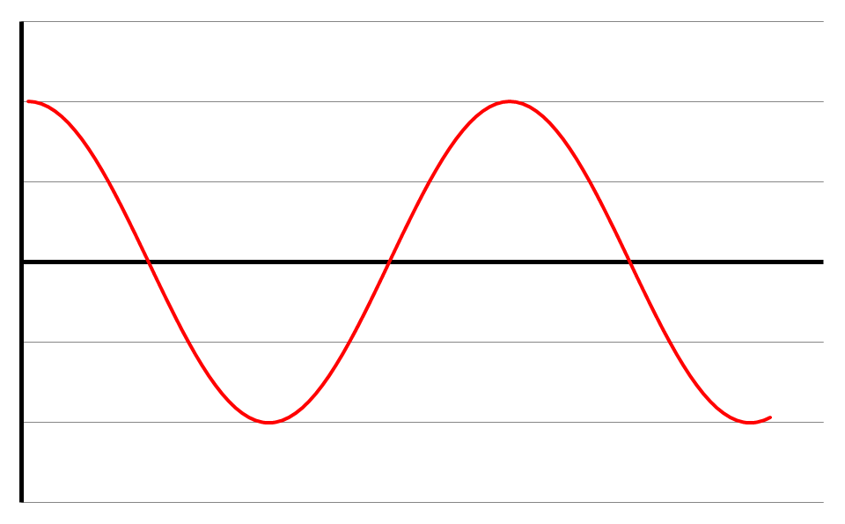
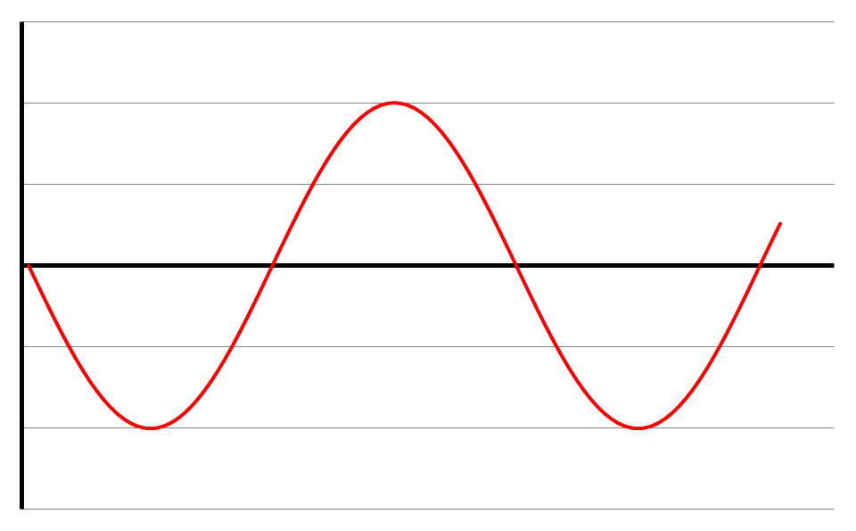
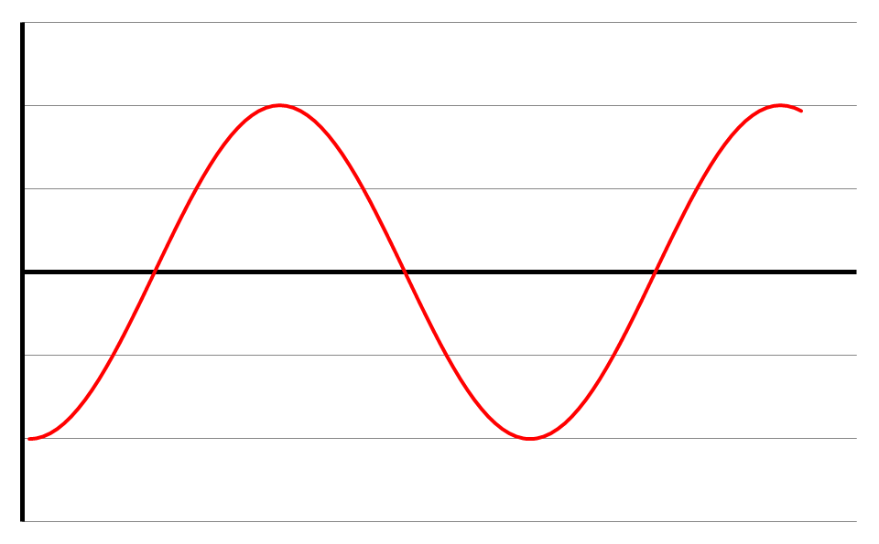
Consider a pendulum (because it’s easy to think about) ...
Displacement
Move it across to one side and let it go.
Time
Velocity
Velocity is given by the gradient of the displacement – time graph.
Velocity is zero at maximum displacement.
Velocity is maximum at zero displacement (when gradient is steepest).
Time
Acceleration
Acceleration is given by the gradient of the velocity – time graph.
Acceleration is greatest when velocity is zero (when displacement is greatest).
Acceleration is zero when displacement is zero.
Time

Slide 6
Still considering that pendulum...
From the displacement & acceleration graphs, acceleration is always in the opposite direction to the displacement.
SHM is defined as oscillating motion where the acceleration is:
proportional to the displacement;
in the opposite direction to the displacement.
It can be shown that:
a = - (2πf)² x where f = frequency
x = displacement
Another thing to bear in mind is that T does not depend on A.
It can also be shown (see p39) that:
x = A cos(2πft) where A = amplitude
t = time since oscillations began
Note - 2πft must be in radians – get your calculator in
the right mode!
The inevitable questions:
P37, qu1-4
P39, qu1-4
And, since this would be a good place to include it:
v = ± 2πf √(A² – x²) (See p44 for proof)

Slide 7
Applications of SHM
Objectives
What do the periods of pendulums and of mass-spring systems depend on?

Slide 9
Worked Example
A baby of mass 8.0kg is tied to a bit of elastic hung from a doorway. This is intended to be fun for the child, as it can bounce about. The elastic has a stiffness of 12Nm⁻¹.
What is the period of the baby’s bounces?
What will the period be if the child eats a 1.0kg meal and is suspended from two identical pieces of elastic?
a. Using standard notation:
m = 8.0kg
k = 120Nm⁻¹
T = 2π √ (m / k)
= 1.6s
m = 9.0kg
k = 240Nm⁻¹
T = 2π √ (m / k)
= 1.2s

Slide 10
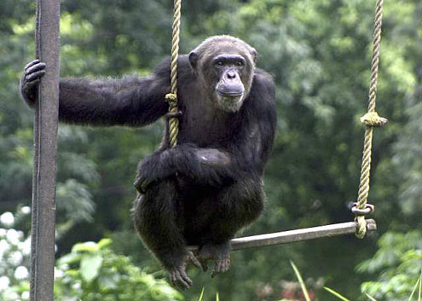
Worked Example
Charlie swings on a very long swing. It is so long, it takes 3.0s to swing from one side to the other. How long is this swing? (g = 9.8Nkg⁻¹)
What will the period be if Cheryl gets on the swing with Charlie?
Using standard notation:
T = 6s
T = 2π √ (l / g)
l = T²g / 4π²
= 8.9m
Questions
P43 – qu 1-6
P51 – qu 3
P39 – qu 1-4

Slide 11
Verifying pendulum SHM equation
Objective
Verify that T = 2π √ (l/g) holds true for a simple pendulum.

Slide 12
T = 2π √ (l/g)
What do you need to know?
How will you find out T?
How will you find out l?
How many lengths will you use?
How will you check the relationship?

Slide 13
T = 2π √ (l/g)
How many lengths?
You’ll need to try at least 5 different lengths up to 1m.
Finding T
Use a reasonable amplitude. Time 10 oscillations.
Finding l
Measure accurately from the top of the string to the centre of the bob.
Checking the relationship
Plot a graph of T² against l.
What should the intercept and gradient be?

Slide 14
Verifying mass-spring SHM equation
Objective
Verify that T = 2π √ (m / k) holds true for a mass-spring system.

Slide 15
T = 2π √ (m / k)
How will you go about it?
What do you need to know?
How will you find out T?
How will you find out m?
How will you find out k?
How many masses will you use?
How will you check the relationship?

Slide 16
T = 2π √ (m / k)
How many masses?
You’ll need to try a range of at least 5 different masses. Be careful that you don’t stretch the spring past its elastic limit. You also need to keep an eye on the loops at the top and bottom of the spring.
Finding T
Use a reasonable amplitude. Time 10 oscillations.
Finding m
Pan balance.
Finding k
Measure the initial length of the spring. Hang at least 5 different masses on the spring and calculate the extension. Use the balance to get an accurate measure of the masses used. Use g = 9.8Nkg⁻¹ to determine the weights of the masses.
Draw a force-extension graph. k will be the gradient.
Checking the relationship
Plot a graph. What against what?
What should the gradient and intercept be?

Slide 17
How to do questions
Give yourself some space.
Write down what you know. Use standard units.
Draw a picture.
Is there anything you can work out straight away using your common sense?
Sit back and think - what do you have to find out? What do you need to know in order to find it out?
Do not go through your book looking for a magic formula to give you the answer.
Work with symbols for as long as you can. Then plug in the numbers at the end.
25 April 2016

Slide 18
Energy and SHM
Objectives
Explain how KE and PE vary with time and with displacement.
Explain the effect of damping on oscillations.

Slide 19
Energy and SHM
If there’s no friction, we get free oscillation. BUT if frictional forces are acting, the amplitude decreases.
Assuming no friction for a moment, the energy is constantly changing between kinetic and potential.
BUT the total energy remains constant. Why?
Where are the maximum and minimum values of KE and PE in these situations:
a simple pendulum; a mass-spring system?
We can draw energy-displacement graphs for KE and for PE.
PE curve is a parabola (see p45).
KE curve is also a parabola (p45).
Adding the two curves together gives a straight line – the total energy.
energy
Total energy
PE
KE
displacement

Slide 20
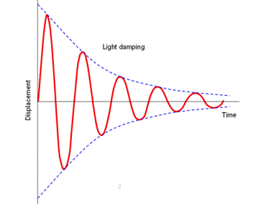
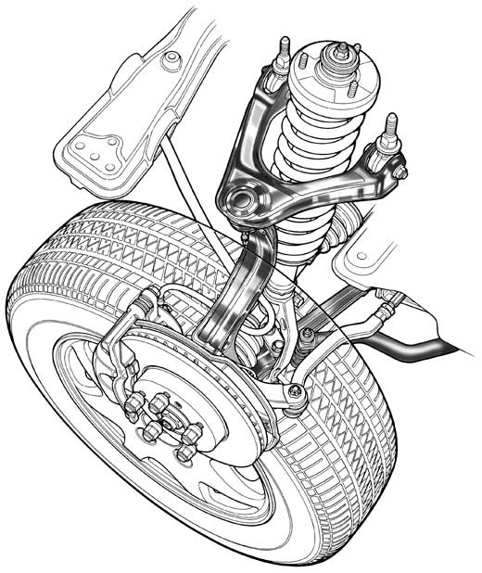
Energy and SHM - ctd
Oscillations die away due to dissipative forces. When this happens, the system is said to be damped. There are three types of damping:
displacement
Critical damping
Object returns to equilibrium in shortest possible time and does not overshoot (see p45).
Light damping
time
Heavy damping
Damping is so strong that object takes a long time to return to equilibrium, and oscillation does not happen (see p45).
T stays the same.
Amplitude decreases by the same fraction each cycle
A car suspension system includes a spring and damper. The damper provides almost critical damping so that oscillation dies away quickly after going over a bump (see p46 for more).

Slide 21
SHM energy questions
P46 – qu 1-4

Slide 22
Forced oscillations and resonance
Objectives
Explain the difference between free and forced vibrations.
Explain the circumstances required for resonance to occur.

Slide 23
Imagine a SHM oscillator – swing, ruler on the edge of a desk or a mass bouncing on a spring.
Natural frequency - frequency at which it vibrates when no force is applied.
Let’s go for the swing.
Periodic force - regular pushes at the right times to make it swing higher.
When a periodic force is applied, a system undergoes forced oscillation.
IF applied frequency = natural frequency:
amplitude of oscillations becomes very big (the lighter the damping, the greater A becomes);
phase difference between displacement & periodic force changes to π/2;
periodic force is now in phase with velocity.
When this situation occurs, the system is said to be resonating.
Video
If damping is light: applied freq of periodic force = natural freq of system
If damping is heavier: resonant freq is slightly lower than natural freq
Factors affecting resonance:
when oscillating mass increases, natural frequency decreases;
when springs are weaker, natural frequency decreases;
damping limits oscillations.

Slide 24
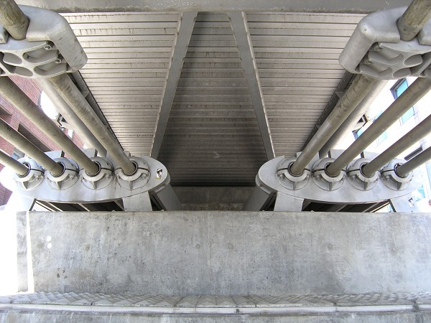
In 1940, a periodic force due to a 40 mph wind set up resonance in a bridge across Tacoma Narrows in the US.
Tacoma Narrows Bridge
Resonance qu’s
P49 – qu 1b, 2-4
In 2000, the Millennium Bridge swayed when people walked across it. It was later fitted with dampers to overcome the problem.

Slide 25
SHM questions
A U-tube manometer is half-filled with water. The liquid levels are displaced so that one side is higher than the other. The water is then left free to oscillate from side to side. The tube has a cross section area of 1cm² and the initial displacement is 0.1 m from the rest position, which is 0.5 m above the middle of the bottom of the tube. The total length of tube filled with water is 1.1 m. g = 10 N kg^{–1}
Using the relationship: pressure = density x g x depth, calculate the pressure at the bottom of the tube due to each of the unbalanced columns of water and hence the resultant force acting. g = 10 m s^{–2}
How will the force vary as the levels move towards their rest positions?
Show that the restoring force is proportional to the displacement and hence that the resultant motion is simple harmonic.
Explain why the period remains constant as the oscillations die away due to friction.
How will the motion differ if mercury is used instead of water, with a density 13.6 times greater?

Slide 26
Archimedes’ principle states that the upthrust acting on a body immersed partly or wholly in a fluid is equal to the weight of fluid displaced. A cylindrical fishing float is 15 cm long, with an average cross section of 3 cm². It is made of polystyrene and has negligible mass. A lead weight of 30 g is attached to the bottom of the float using a thin nylon monofilament line. g = 10 N kg^{–1}
Assuming the weight and line to be of negligible volume, calculate how far the float will sink into the water?
A fish pulls on the baited hook further down the line and pulls the float down a further 3 cm before letting go. Calculate the resultant force on the float as the fish lets go.
Show that the restoring force is proportional to the distance that the float is pulled below its rest level.
If the float is lifted slightly by the angler and dropped, show that the force is again proportional to the distance above the rest position.

Slide 27
1.
Resultant force
2. Force is proportional to displacement.
3.
i.e. F is proportional to x.
4. The term equivalent to the ‘spring constant’ and the mass remain the same so the frequency is unchanged.
5. The restoring force will be greater due to the larger pressure difference, caused by the greater density and hence proportionately greater effective spring constant. The mass to be moved will also be greater in proportion to the density. As a result the two effectively cancel and the time period is unchanged, if we consider the motion to be pure SHM.
6. The up thrust must support 30 g, so the up thrust is 0.3 N.
The float sinks until 0.3 N of water is displaced. Length of float submerged = h.
7. Additional volume displaced = 0.03 m  3  10–4 m2 = 9  10–6 m3
up thrust = Vg = 9  10–6 m3  1000 kg m–3  10 N kg–1 = 0.09 N
8. F = density  area  g  additional length submerged, therefore the force is proportional t o the additional length submerged.
9. Lifting the float involves the same calculation, with the decrease in up thrust being calculated, which is then the resultant force downwards.

