Slide 1
Lenz and Faraday
K – define the terms magnetic flux density and magnetic flux linkage
B – apply Faraday’s law to wires and coils
A – apply Lenz’s law to induction

Slide 2
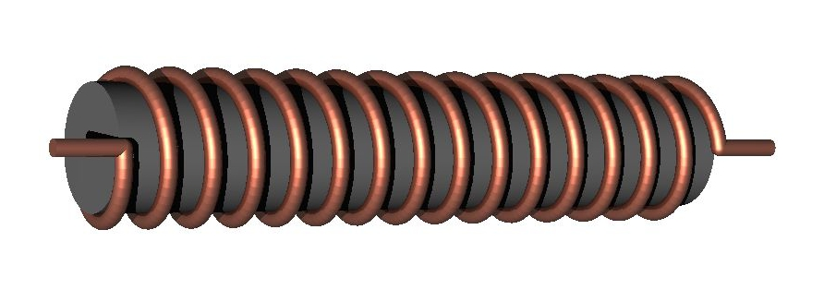
What happens when an electric current flows through a coil?

Slide 3
What will happen when a bar magnet is pushed into a coil connected to an ammeter?
The lines of flux cutting across the coils of wire induce a current in the solenoid
The current in the solenoid must produce a magnetic field
Why must the pole of the field in the solenoid oppose the pole of the incoming magnet?

Slide 4
Lenz’s Law

Slide 5
Lenz’s law states that the direction of the induced current is always such as to oppose the change that causes the current
What conservation law is this?
What happens when the magnet leaves the solenoid?

Slide 6
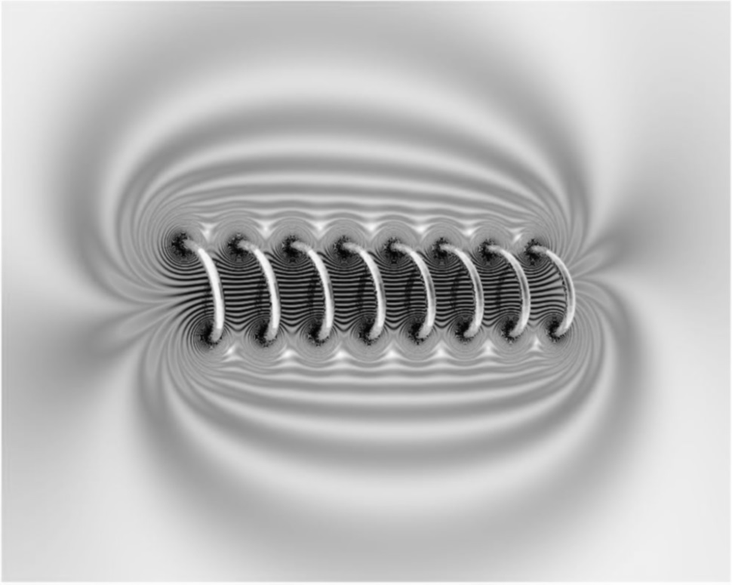
When you push a magnet into a coil of wire it creates a current in the wire
This current in turn creates a magnetic field (The coil becomes a solenoid)
The direction of this magnetic field opposes the movement of the magnet that created it

Slide 7
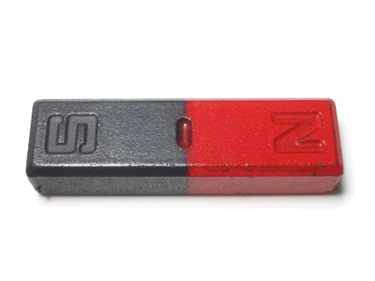
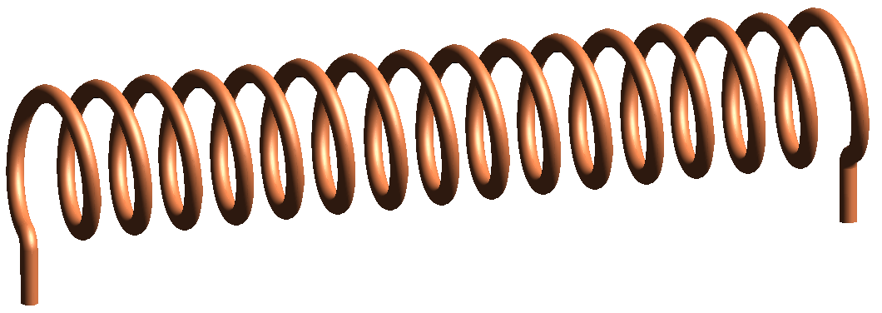
Look at the magnet and decide which pole is going into the coil (or out)
3) Use Lenz's right hand grip rule to work out if the current is going to go clockwise or anticlockwise when viewed from the magnet
4) Finally look at the coil direction of the wire and work out which way the current will flow. Remember this is the direction of positive conventional current (not the negative electrons!)
2) Imagine the coil is like a bar magnet and orientate the poles to resist the movement

Slide 8
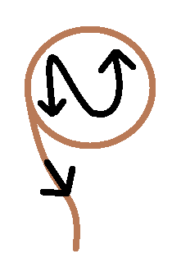
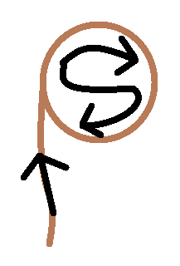
3) Imagine looking at the end of the coil of wire with either an N (North) or S (South) written in it. The letter represents the current direction in the wire.
S
N
If the magnet is removed, the polarity reverses creating a south pole, so current flow reverses

Slide 9
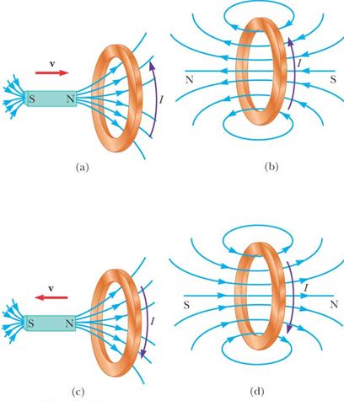

Slide 10
Magnetic Flux
Magnetic flux density B can be thought of as the strength of a magnetic field
If you multiply this by a known area A of a field the you get the Magnetic Flux

Slide 11
Magnetic Flux Units
Magnetic flux density B is measured in Teslas T
Magnetic flux (BA) is measured in Webers (Wb) equal to Tm²

Slide 12
Magnetic Flux linkage
If you use a coil of N turns then the flux linkage is given by:
In general if the angle between the magnetic field and the face of the coil is θ the you have:

Slide 13
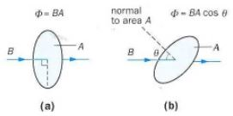
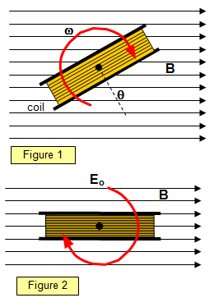

Slide 14
More about flux linkage
Flux linkage through a coil with N turns = N Φ = BAN
When the magnetic field is perpendicular to the coil face the flux linkage = N Φ = BAN
When the coil is turned through 180⁰ the flux linkage = -BAN
When the magnetic field is parallel to the coil then the flux linkage =0 as no field lines pass through the coil area
In general = N Φ = BANcosθ

Slide 15
Consider:

Slide 16
Calculating emf
When a wire is pushed through a magnetic field then a current is induced in the wire
A current carrying wire in a magnetic field experiences a force (F=BIl)
This force opposes the force pushing the wire through the field so work is done on the wire to keep it moving

Slide 17
Faraday’s Law of electromagnetic induction

Slide 18
Faraday’s Law of electromagnetic induction
“The induced emf in a circuit is equal to the rate of change of flux linkage through the circuit”

Slide 19
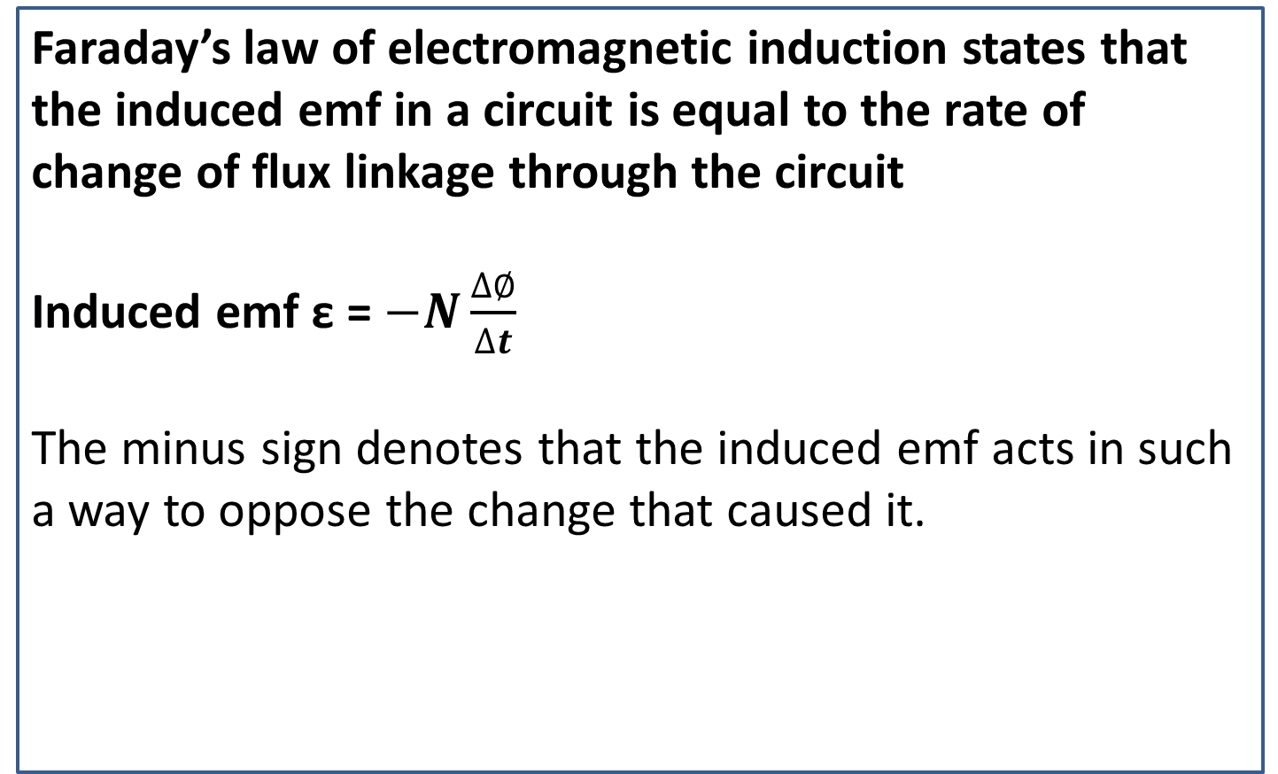
Faraday’s law of electromagnetic induction states that the induced emf in a circuit is equal to the rate of change of flux linkage through the circuit
Induced emf ε = $−N\frac{∆∅}{∆t}$
The minus sign denotes that the induced emf acts in such a way to oppose the change that caused it.

Slide 20
Using velocity v
In some examples you may be told the velocity of a coil entering a magnetic field or, conversely, the velocity of a magnet entering a coil of wire:

Slide 21
Flux linkage is calculated for N coils:
emf is calculated in several ways:

Slide 22
Summary
When a magnet is inserted into a coil it induces an emf and hence a current flows
This current creates a magnetic field that opposes the movement of the magnet that created it
To work out the direction of the current flow invisage the letter N or S at the end of the solenoid and follow the ends of the letters to trace out the current direction
Magnetic flux is calculated using:

