Slide 1
Electrostatics
Vid

Slide 2
Origin of Charge
Charge is an intrinsic property of matter
Two types:
  Positive Charge: Protons
  Negative Charge: electrons
  Opposites Attract! (likes repel)
Charge on an electron = e = 1.60 x 10⁻¹⁹ C
Remember q = N x e ?
Unit = Coulomb
Notes:
Start by asking if electric force is so large, why don’t we ever feel it?
Copper and wood both made of atoms, both have positive and negative charges, but are electrically very different. Why?

Slide 3
Charge conservation
Charge cannot be created or destroyed just transferred!
Like:
  Energy
  Momentum
  Mass (most of the time)
  Some other “nice” quantum quantities
“charging” is really just “moving” charge

Slide 4
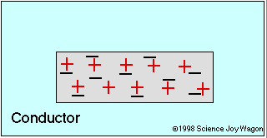
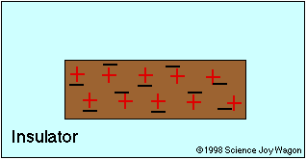
Conductors and Insulators
Q: How do electrons behave in a perfect conductor?
A:
Q: How do electrons behave in a perfect insulator?
A:
Most things are in between perfect conductor / insulator
Notes:
Copper and wood both made of atoms, both have positive and negative charges, but are electrically very different. Why?

Slide 5
Electroscope
Conduction
  Charged rod is brought near scope
  Charged rod touches scope transferring some charge
  Scope is left w/ same charge as rod
Induction
  Charged rod is brought near scope
  Scope is briefly grounded allowing charge to flow on (or off) scope
  Scope is left w/ opposite charge as rod
Notes:
Do the demo first, then show the visualization. Comment on how electroscope works. It’s like VandeGraaff and hair standing on end.

Slide 6
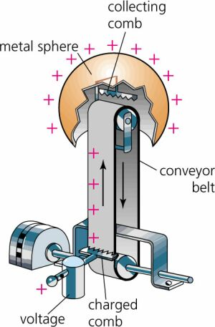
Van de Graff
Video

Slide 7
Quick Quiz: Induced Dipole
An uncharged conducting sphere is hung next to a charged sphere. What happens when the uncharged sphere is released?
1) Nothing
2) Attracted to charged sphere.
3) Repelled from charged sphere.

Slide 8
Quick Quiz: Induced Dipole
An uncharged conducting sphere is hung next to a charged sphere. What happens when the uncharged sphere is released?
1) Nothing
2) attracted to charged sphere.
3) Repelled from charged sphere.

Slide 9
Quick Quiz: Induced Dipole
An uncharged conducting sphere is hung next to a charged sphere. What happens when the uncharged sphere is released?
1) Negative charge attract+ repels -

Slide 10
Quick Quiz: Induced Dipole
An uncharged conducting sphere is hung next to a charged sphere. What happens when the uncharged sphere is released?
1) Negative charge attract+ repels -
2) Since + is closer, attractive force is strongest

Slide 11
Quick Quiz: Induced Dipole
An uncharged conducting sphere is hung between a charged sphere and a grounded sphere and held midway between the two. What happens when the uncharged sphere is released?
An uncharged conducting sphere is hung between a charged sphere and a grounded sphere and held midway between the two. What happens when the uncharged sphere is released?
1) Negative charge attract+ repels –
2) Since + is closer, attractive force is strongest

Slide 12
Electrostatics Lesson2
Coulombs law

Slide 13
Objectives
You will be able to:
Deduce the direction of force on a charged particle
Calculate the magnitude of that force
Explain each part of Coulombs law

Slide 14
EXERCISES using Coulomb’s law

Slide 15
Equal and opposite forces
Pip 20.10, 20.11

Slide 16
Coulomb’s Law
Example
Magnitude of the force between charges q₁ and q₂ separated a distance r:
F = k q₁q₂/r² k = 9x10⁹ Nm²/C²
Force on electron in Hydrogen atom
Q_{p}=1.6x10⁻¹⁹ C
Q_{e} = -1.6x10⁻¹⁹ C
+
-
r = 1x10⁻¹⁰ m
Notes:
Calculate force on electron due to proton
Comment “larger charges = larger force” Smaller separation = larger force

Slide 17
Quick Quiz: Coulomb’s Law
What is the direction of the force on the proton due to the electron?
  (1) Left (2) Right (3) Zero
What is the magnitude of the force on the proton due to the electron?
Example
q_{p}=1.6x10⁻¹⁹ C
q_{e} = -1.6x10⁻¹⁹ C
F
  F= _______ N
+
-
r = 1x10⁻¹⁰ m

Slide 18
Quick Quiz: Coulomb’s Law
What is the direction of the force on the proton due to the electron?
  (1) Left (2) Right (3) Zero
What is the magnitude of the force on the proton due to the electron?
Example
q_{p}=1.6x10⁻¹⁹ C
q_{e} = -1.6x10⁻¹⁹ C
F
  F= -2.3x10⁻⁸ N
+
-
r = 1x10⁻¹⁰ m

Slide 19
Quick Quiz
A positive and negative charge with equal magnitude are connected by a rigid rod, and placed near a large negative charge. What is the net force on the two connected charges?
1) Left 2) Zero 3) Right
-
+
-

Slide 20
Quick Quiz
A positive and negative charge with equal magnitude are connected by a rigid rod, and placed near a large negative charge. What is the net force on the two connected charges?
1) Left 2) Zero 3) Right
Positive charge is attracted (force to left)
Negative charge is repelled (force to right)
Positive charge is closer so force to left is larger.
-
+
-

Slide 21
Quick Quiz: Induced Dipole
An uncharged conducting sphere is hung next to a charged sphere. What happens when the uncharged sphere is released?
1) Nothing
2) Attracted to charged sphere.
3) Repelled from charged sphere.

Slide 22
Quick Quiz: Induced Dipole
An uncharged conducting sphere is hung next to a charged sphere. What happens when the uncharged sphere is released?
1) Nothing
2) attracted to charged sphere.
3) Repelled from charged sphere.

Slide 23
Quick Quiz: Induced Dipole
An uncharged conducting sphere is hung next to a charged sphere. What happens when the uncharged sphere is released?
1) Negative charge attract+ repels -

Slide 24
Quick Quiz: Induced Dipole
An uncharged conducting sphere is hung next to a charged sphere. What happens when the uncharged sphere is released?
1) Negative charge attract+ repels -
2) Since + is closer, attractive force is strongest

Slide 25
Quick Quiz: Induced Dipole
An uncharged conducting sphere is hung between a charged sphere and a grounded sphere and held midway between the two. What happens when the uncharged sphere is released?
An uncharged conducting sphere is hung between a charged sphere and a grounded sphere and held midway between the two. What happens when the uncharged sphere is released?
1) Negative charge attract+ repels –
2) Since + is closer, attractive force is strongest

Slide 26
Closer look at k
k = 1/ (4πε₀) = 9.0 × 10⁹ N m² C⁻²
F= q₁q₂/ (4πε₀ r²)
ε₀= permittivity of free space
permittivity relates to a material's ability to transmit (or "permit") an electric field.
1/4π r² geometric term

