Slide 1
CW | Gravitational Potential | 02/10/2018
Assume g = 9.8 N kg⁻¹ near the surface of the Earth.
1) Climbing a vertical rope is difficult. You have to lift your full body weight with your arms. If your mass is 60 kg and you climb 2.0 m, by how much do you increase your gravitational potential energy?
2) A block of bricks is raised vertically to a bricklayer at the top of a wall using a pulley system. If the block of bricks has a mass of 24 kg, what is its weight? It is raised 3.0 m. Calculate its increase in gravitational potential energy when it reaches the top of the wall.
From my learning today I will be able to:
Key: | Calculate Potential (C)
Boost: | Draw and interpret equipotential lines (B)
Aspire: | Suggest the amount of energy needed to escape fields (A/A*)

Slide 2
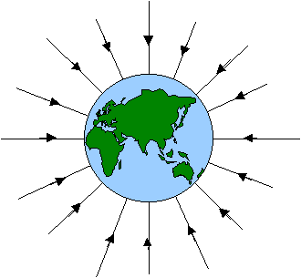
Work is done when a force moves an object some distance in the direction of the force.
This work done is stored as gravitational potential energy in the object.
Work done = gravitational potential energy = mgh
Why is this wrong?
The further you raise the object, the more work you do and the greater the change in gpe. GPE INCREASES WITH DISTANCE!!
But
If the object is far enough away from the planet, then the gravitational force on it is negligible – it is no longer in the gravitational field. GPE IS ZERO AT INFINITY!!
Next: gravitational potential

Slide 3
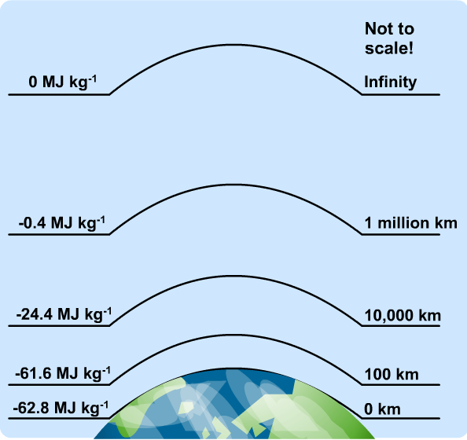
The gravitational potential (V) is the energy of an object due to its position in a field.
As you move towards the object then you lose energy (i.e. you would need to exert energy to move away from the object and hence gain potential energy) so all potential energy values will be negative values

Slide 4
The gravitational potential (V) at a point in a field, is the work done (W) per kilogram of mass (m) to move it from infinity to that point.
V = W
m
The gravitational potential is the gravitational potential energy per unit mass (1kg mass).
Notes:
The gravitational potential at infinity is ZERO.
All other points will have negative potential values.
Gravitational potential is measured in joules per kilogram (J kg⁻¹).
Gravitational potential is a SCALAR quantity

Slide 5
Questions
(a) What work would be needed to remove the astronaut completely from the Earth’s gravitational field?
(b) If this work came from a conversion of initial kinetic energy (the astronaut is projected from the Earth’s surface), what would be the astronaut’s initial speed?

Slide 6
(a) ΔV = (6.26 – 0) x 10 ⁷ Jkg⁻¹ = 6.26 x 10 ⁷ Jkg⁻¹
ΔW = m x ΔV
= 80 kg x 6.26 x 10 ⁷ Jkg⁻¹
Work = 5.01 x 10 ⁹ J = 5 010 MJ
(b) ½ m v ² = ΔW = 5.01 x 10 ⁹ J
v² = (2 x 5.01 x 10 ⁹ J) / 80 kg
v² = (10.02 x 10 ⁹ J) / 80 kg
v² = 1.25 x 10 ⁸
speed, v = 1.12 x 10⁴ ms⁻¹ (11 kms⁻¹)
This is called the escape speed.

Slide 7
A rocket has a mass of 200kg on a planet with a gravitational potential of -50MJkg⁻¹ at its surface.
a. Calculate the work done needed for the rocket to escape the planet’s gravity.
b. Calculate the work done when the rocket moves from gravitational potential V₁ to gravitational potential V₂ (where V₁=-30MJkg⁻¹, V₂= -20MJkg⁻¹)
a. Work done = m x V
Work done = 200 x -50 = -10,000 MJ
The rocket’s GPE must increase from -10,000 MJ to zero
b. Work done = m x ΔV
Work done = 200 (-10) = -2000 MJ

Slide 8
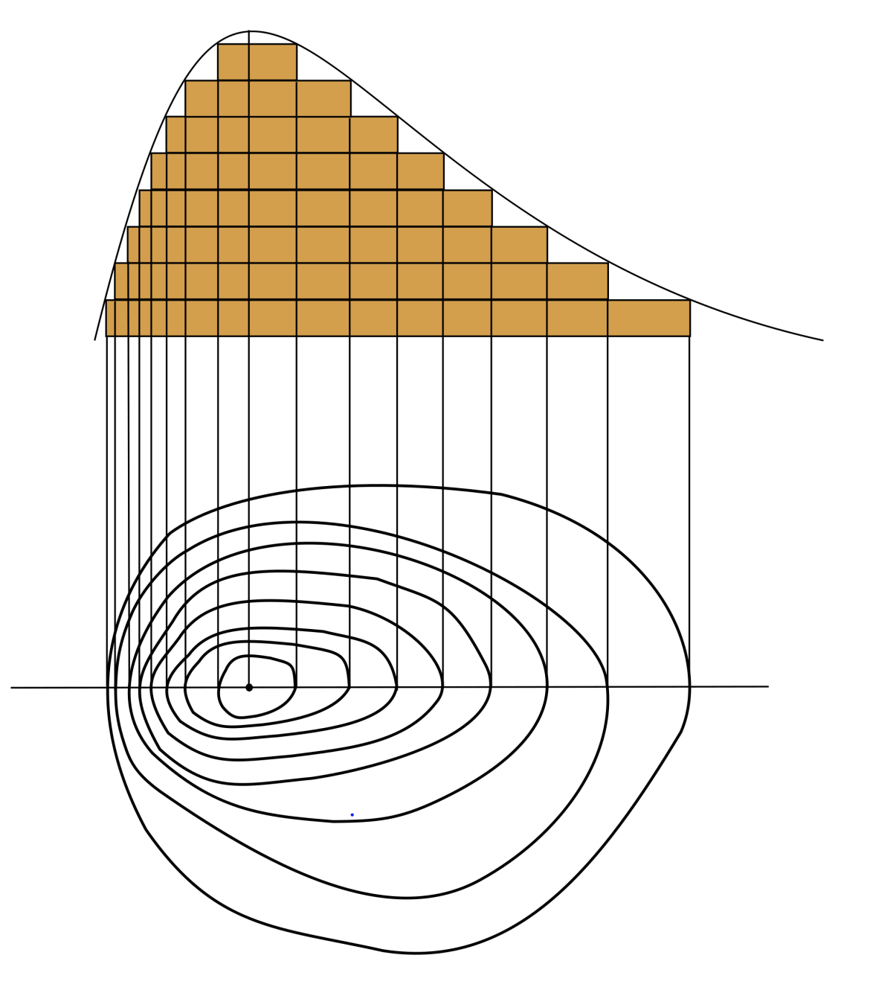
Equipotentials
On a map there are contour lines that show all of the places that have the same height (and hence the same gravitational potential) – without friction it would take no energy to move along these lines

Slide 9
If you draw equipotentials showing uniform, regular changes (steps) in potential i.e. an equipotential every 10MJkg-1, you will notice that the space between them increases as you move away from the Earth.
This shows that the potential changes more rapidly for changes in height near the Earth than for changes of height a long distance away from the Earth.
In fact, it can be shown that:
Potential gradient = gravitational field strength, g.
Potential gradient at a point in a field is the change of potential per metre at that point

Slide 10
Equipotentials
Equipotentials join points of equal potential. They are very simple in the cases of uniform fields (close to the surface of the Earth) and radial fields (for point and spherical masses):
49.0 J/kg
39.2 J/kg
29.4 J/kg
19.6 J/kg
9.8 J/kg
Notes:
Need to add something about potential gradient.

Slide 11
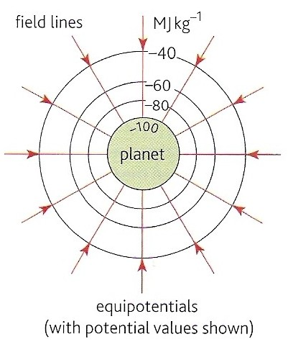
Gravitational equipotentials
These are surfaces that join up points of equal potential.
  No work is done by gravitational force when a mass is moved along an equipotential surface.
  Equipotentials are always perpendicular to field lines.
  Examples include: contour lines on maps, sea level, the floor of a room, the bench top surface.

Slide 12
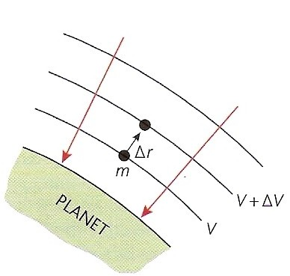
Potential Gradients
The potential gradient at a point in a field is change of potential per metre at that point
At the surface of planet Earth this is 9.8 J kg⁻¹ m⁻¹
Note: Gravitational Field Strength is simply the negative of the potential gradient

Slide 13
Gravitational potential difference (ΔV ) and Work (W)
When a mass, m is moved through a gravitational potential difference of ΔV the work done ΔW is given by:
ΔW = m x ΔV

