Slide 1
Gravitational Fields

Slide 2
Newton’s Law of Universal Gravitation
What causes you to have weight?
What affects the size of the Earth’s pull on you? Why would you weigh a different amount on the Moon?
If the Earth is pulling down on you, then what else must be occurring, by Newton’s 3rd Law?
What happens to the strength of the pull of the Earth as you go further away from it?
All your answers are stuck together in Newton’s law of universal gravitation.

Slide 3
F = Gm₁m₂/r²
G is known as the “universal gravitational constant” (NOT to be confused with “little” g).
What is the unit of G?
G = 6.67 × 10⁻¹¹ N m² kg⁻²
So, every massive object in the universe attracts every other massive object.
The formula applies to point masses but spherical masses can be treated as though they were point masses with all their mass concentrated at their centre.
The force is always attractive.

Slide 4
Worked Example
I have a mass of 80kg. When I am standing on the Earth, what is the force exerted on me by:
The Sun;
The Earth.
G = 6.67 x 10⁻¹¹ N m² kg⁻², mass of the Earth = 6.0 × 10²⁴ kg,
radius of the Earth = 6.4 × 10⁶ m, mass of the Sun = 2.0 × 10³⁰ kg,
average distance from the Earth to the Sun = 1.5 x 10¹¹ m.
a F = 6.67 x 10⁻¹¹ x 80 x 2.0 × 10³⁰ / (1.5 x 10¹¹ )²
= 0.47 N
b What will we use for r?
F = 6.67 x 10⁻¹¹ x 80 x 6.0 x 10²⁴ / (6.4 × 10⁶ )²
= 780 N

Slide 5
S me questi ns
P61 – qu 1-4

Slide 6
Gravitational Field Strength
Objective
Be able to draw and interpret gravitational field diagrams.

Slide 7
You lift a book by touching it and applying a force.
The Earth applies a force to the book without touching it. How?
The book is in the Earth’s gravitational field.
We can define the field due to a body as the region of space surrounding it where other bodies will feel a force due to it.
How far do gravitational fields reach?
(Infinite, but it’s an inverse square law.)
We can’t see this field, but we can model it using field lines. In a field line diagram, the direction of the field line shows the direction of the force of attraction that would be felt by a small mass placed there. The relative density of field lines on the diagram is an indication of the strength of the field.
So, for a spherical object, such as a planet, the field pattern would look like this:
Close to the surface of the Earth, the field lines look like this:
Radial field
Uniform field

Slide 8
Radial field - the field lines become more spread out as the distance from the Earth increases, indicating the diminishing strength of the field. Note that the field is really 3-dimensional.
Uniform field – field lines are parallel and equidistant indicating that the field is constant.
Is the Earth’s gravitational field radial or uniform?
A couple of important points to note:
Field lines do not start or stop in empty space (even though, on diagrams, they have to stop somewhere). They end on a mass and extend back all the way to infinity.
Field lines never cross. (If they did, then an object placed at the point where they crossed would feel forces in more than one direction.)

Slide 9
Your pull on the Earth is the same as the Earth’s pull on you, but your gravitational field is far, far weaker then the Earth’s.
We define field strength at a point in a body’s field as the gravitational force exerted on an object placed at that point, per kg of the object’s mass.
In other words, it is just the number of newtons of attractive force acting per kg of the object’s mass. We can write this as:
g = F/m
g has units N/kg.
It’s worth noting that acceleration due to gravity has the same symbol, but a different unit:
a = F/m
= mg/m
= g
And something else worth noting:
The gravitational field strength at a point in a field does not depend on the mass placed there – it is a property of the field. So, two objects of different mass placed at the same point in the field will experience the same field strength, but will feel different gravitational forces.
Some questions:
P55 – qu 2, 4.

Slide 10
Verify Gravitational Field Strength is Proportional to r²
Objective
Use data from Apollo 11 mission to verify the relationship between gravitational field strength and distance.

Slide 11
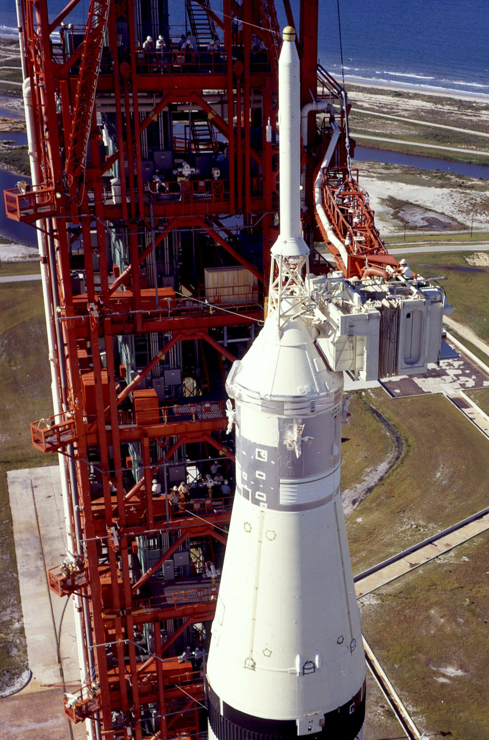
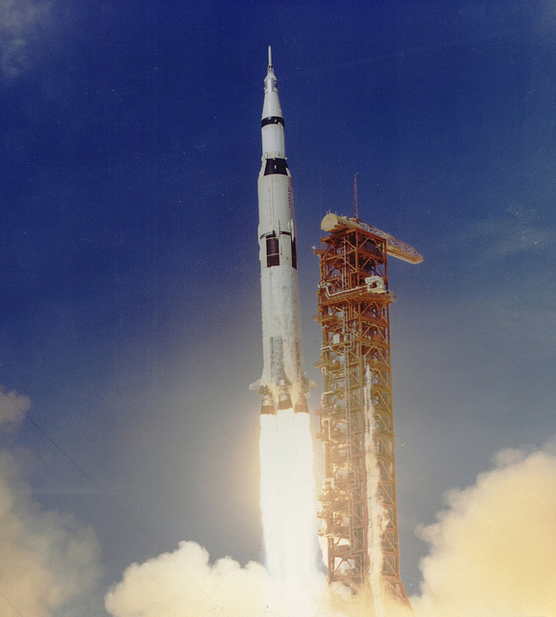
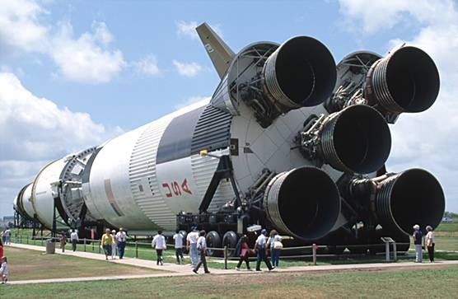
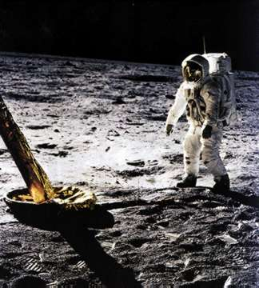
Apollo 11
Apollo 11 data

Slide 12
This 1/r² graph business.
You wanted to prove that a was proportional to 1/r².
In other words, you’re trying to show that a = k x 1/r².
The way to do this is with a graph.
If you’re trying to prove a relationship, you must end up with a straight line graph.
In order to get a straight tine, you need to compare the thing you’re trying to prove with the straight line formula.
y = mx + c
a = k x 1/r²
In this case, a will go on the y axis.
The slope, m, when calculated, will be equal to the constant of proportionality.
To make your line straight and prove the given relationship, you’ll have to plot 1/r² on the x axis.

Slide 13
Gravitational Field Strength in a Radial Field
Objective
Be able to calculate gravitational field strength in any position in a radial field.

Slide 14
In previous weight calculations, we’ve used g = 9.8 N/kg. This is fine for objects on the Earth’s surface, but what about at a distance from the Earth? What about other planets or stars?
F = Gm₁m₂/r²
If we’re talking about a small mass, m, and a planet of mass M, we would rewrite the equation as:
F = GMm/r²
But we also know that F = mg.
You need to be careful to sort out your ms here!
mg = GMm/r² OR
g = GM/r²
Is there a problem here, if we dig a hole to the centre of the Earth?
Return

Slide 15
Data required: G = 6.67 × 10⁻¹¹ N m² kg⁻², mass of the Earth = 6.0 × 10²⁴ kg,
radius of the Earth = 6.4 × 10⁶ m.
Treating the Earth as a perfect sphere, show that the field strength at the Earth’s surface is around 9.8 N kg⁻¹.
What is the strength of the gravitational field due to you at a distance equal to the radius of the Earth?
Assume the Earth has an average density ρ. Rewrite the expression g = GM/r² to include ρ. (The volume of a sphere is given by V = (4/3) pr³.) Now, assume that the Moon has the same average density as the Earth. On the surface of the Moon, the gravitational field strength is about 1.6 N kg⁻¹. Use this to estimate the radius of the Moon.
In fact the radius of the Moon is 1.7 × 10⁶ m. In view of your answer to question 4, what does this suggest about the average density of the Moon compared with that of the Earth?

Slide 16
Hang on a minute:
We have 3 formulae so far. Make sure you know when to use them.
F = Gm₁m₂/r²
g = GM/r²
g = F/m

Slide 17
Orbits
Objective
Know how period and speed are related to radius of a circular orbit.
Know what a geosynchronous orbit is.

Slide 18
Throwing a ball

Slide 19
Throwing it faster

Slide 20
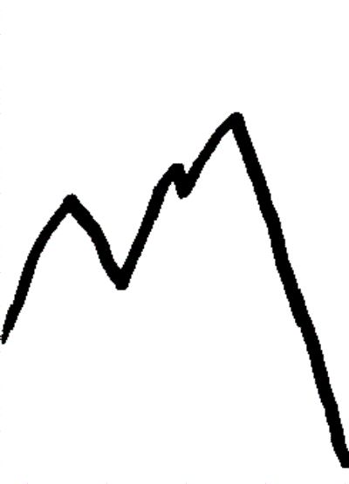
Big mountain, big gun, very fast

Slide 21
Newton’s Cannon

Slide 22
Let’s say we have a planet orbiting a star.
It remains in orbit due to centripetal force = mv²/r
From Newton’s law, we know that gravitational force = Gm₁m₂/r²
Equating these expressions, we have: GMm/r² = mv²/r
(M = mass of star and m = mass of planet.)
But v is distance travelled in one orbit (2πr) divided by period: v = 2πr/T
Plugging this into the previous equation, and cancelling m on both sides gives:
GM/r² = 4π²r/T²
Rearranging again gives: T² = (4π²/GM) r³
This shows that the further away a planet is, the longer its period of orbit (but in a non-linear way).
Although this law was originally discovered for the motion of planets, it works equally well for all satellite motion. We just need to think about what M is in the constant (4π²/GM).

Slide 23
Geostationary satellites are predominantly used for communications. Satellite TV companies use geostationary satellites to cover a constant area on the Earth’s surface – hence you point your satellite dish receiver in the direction of the geostationary satellite.
3 geostationary satellites placed into orbit 120 degrees apart above the equator would be able to cover the entire Earth (except for very near the poles).
Because geostationary satellites have to be launched so high (other satellites orbit as low as a few hundred km), the energy and costs required for launching a satellite into geostationary orbit are high.

Slide 24
Use Kepler’s third law, T² ∝ r³, to answer this question.
Two Earth satellites, A and B, orbit at radii of 7.0 × 10⁶ m and 2.8 × 10⁷ m respectively.
Which satellite has the longer period of orbit?
What is the ratio of orbital radii for the two satellites?
What, therefore, is the ratio of the cubes of the orbital radii?
What, therefore, is the ratio of the squares of the orbital periods?
Finally therefore, what is the ratio of the satellites’ orbital periods?
The radius of a geostationary orbit is 42 200 km. Use this fact together with the constancy of R³ / T² to estimate the height above the Earth’s surface of a satellite whose circular orbit is completed in 90 minutes. How many times a day would such a satellite orbit the Earth?
90 minutes is a typical orbital period for a military reconnaissance satellite, and 100 minutes for a civilian Earth observation satellite. Can you suggest a reason for this difference?

Slide 25
Gravitational Potential Energy
Objectives
Explain the changes in GPE which occur as an object moves in a non-uniform field

Slide 26
Work is done when a force moves an object.
If there’s no friction, the work is stored as the energy of the object which was moved.
Change in GPE = mgh

Slide 27
A bit of revision
Assume g = 9.8 N kg⁻¹ near the surface of the Earth.
1) Climbing a vertical rope is difficult. You have to lift your full body weight with your arms. If your mass is 60 kg and you climb 2.0 m, by how much do you increase your gravitational potential energy?
2) A block of bricks is raised vertically to a bricklayer at the top of a wall using a pulley system. If the block of bricks has a mass of 24 kg, what is its weight? It is raised 3.0 m. Calculate its increase in gravitational potential energy when it reaches the top of the wall.
3) Travelling in a mountainous area, a bus of mass 3 tonnes reaches the edge of a steep valley. There is a 1 km vertical drop to reach the valley below, but 20 km of road to get there. What gravitational potential energy will the bus lose in making its descent to the valley bottom?
4) Assuming the bus in question 3 does not change its cruising speed on the way down, where does the gravitational potential energy go? Why is there a risk of brake failure in this situation?

Slide 28
That’s all for GPE in a uniform field.
This next bit is only to help understanding.
We can calculate GPE of a mass m at a point distance r from a mass M by:
GPE = –GMm/r
Note:
This is not change in GPE.
At infinite distance, GPE is zero. As you move closer to M, GPE becomes more negative.
GPE ∝ 1/r (not 1/r²)

Slide 29
In order to get an expression involving energy which is independent of the mass placed in a field, we have come up with the notion of gravitational potential, V.
There are a couple of ways of thinking about this:
1 Gravitational potential at a point in a field is the energy per unit mass.
Gravitational potential is the work done per unit mass in moving a small object from infinity to that point.
What is the unit of V?
By looking at 2, we can see that V = W/m.
If we move a mass from a place at one potential to another, we have to do work.
The equation can be rewritten as:
ΔW = mΔV
It can also be shown that the potential at a point is given by:
V = -GM / r
Questions
P58 qu1,2

Slide 30
Data required:
G = 6.67 × 10-11 N m² kg⁻²
mass of the Earth = 6.0 × 10²⁴ kg
radius of the Earth = 6.4 × 10⁶ m
gravitational field strength close to the surface of the Earth is 9.8 N kg⁻¹
What is the gravitational potential energy of a 60 kg student on the surface of the Earth? What then, is the minimum energy that would be required to get this student completely out of the Earth’s gravitational field?
What is the potential you experience at the surface of the Earth? How would the answer be different if your friend who weighs more than you worked it out?
What is the potential at a height of 36 000 km from the Earth’s surface? This is the height of a geostationary orbit. What is the potential difference between the surface of the Earth, and geostationary orbit height?
So, what minimum energy is required to launch a 150 kg satellite into geostationary orbit? Why is the actual value a lot more?
5) What is the potential difference between the top and bottom of an office block on the surface of the Earth that has a height of 50 m? (Hint – this close to the surface of the Earth, the field is roughly uniform, so you can use simple equations for change in GPE or change in potential).

Slide 31
1) GPE = -GMm/r = (- 6.67 x 10⁻¹¹ x 6.0 x 10²⁴ x 60) / 6.4 x 10⁶ = - 3.8 x 10⁹ J
To get the student away from the Earth’s field completely will require taking him to infinity where his GPE will be zero. Thus we need to give him at least 3.8 x 10⁹ J.
2) V = -GM/r = (-6.67 x 10⁻¹¹ x 6.0 x 10²⁴) / 6.4 x 10⁶ = - 6.3 x 10⁷ J kg⁻¹ or - 63 MJ kg⁻¹
The answer is the same for everyone – potential is a property of the field and all objects at the same point in the field are subject to the same potential.
3) V = -GM/r = (-6.67x10⁻¹¹ x 6.0x10²⁴) / (6.4x10⁶ + 3.6x10⁷) = -9.4x10⁶ J kg-1 or
-9.4 MJ kg⁻¹
The potential difference is then - 9.4 – (- 63) = 53 MJ kg-1 (or 5.3 x 10⁷ J kg-1).
Note that this potential difference is positive; indicating that to get to geostationary height, a large amount of energy would be required. There is no problem with potential differences being positive, but absolute values of potential themselves must always be negative.

Slide 32
4) Well, we now know that the potential difference between the Earth’s surface and the geostationary orbit height is + 5.3 x 107 J kg-1. In other words, for each kg of mass lifted from Earth to geostationary orbit, 5.3 x 107 J of energy is required. Therefore, for a satellite of mass 150 kg, energy required = 150 x 5.3 x 107= 8.0 x 109 J or (or 8.0 GJ).
Much more energy is required because there is drag with the Earth’s atmosphere to overcome on the way up, and also the rocket itself (and its fuel) have mass that needs to be lifted into orbit too! The answer we’ve arrived at is only the energy required to lift the satellite against the gravitational pull of the Earth.
5) For a uniform field, change in potential = gh = 9.8 x 50 = 490 J kg-1
For a 60 kg student, the energy required to climb to the top of the building is then 60 x 490 = 2.94 x 104 = 2.9 x 104 J or 29 kJ. For information, that’s about 7 kcal where a kcal is what is referred to as a ‘calorie’ on diet adverts. A chocolate bar is typically 200 calories or more! Students can rest assured that they use up more energy than this in climbing to the top of the building because their bodies are not 100 % efficient, and they warm up.

Slide 33
Gravitational Potential
Objectives
Explain how gravitational potential changes with distance from a massive object.
Review gravity topic.

Slide 34
In order to get an expression involving energy which is independent of the mass placed in a field, we have come up with the notion of gravitational potential, V.
There are a couple of ways of thinking about this:
1 Gravitational potential at a point in a field is the energy per unit mass.
Gravitational potential is the work done per unit mass in moving a small object from infinity to that point.
What is the unit of V?
By looking at 2, we can see that V = W/m.
If we move a mass from a place at one potential to another, we have to do work.
The equation can be rewritten as:
ΔW = mΔV
It can also be shown that the potential at a point is given by:
V = -GM / r

Slide 35
Equipotentials
Equipotentials join points of equal potential. They are very simple in the cases of uniform fields (close to the surface of the Earth) and radial fields (for point and spherical masses):
49.0 J/kg
39.2 J/kg
29.4 J/kg
19.6 J/kg
9.8 J/kg
Notes:
Need to add something about potential gradient.

Slide 36
25 April 2016
S me questi ns
P58 – qu 3-4

Slide 37
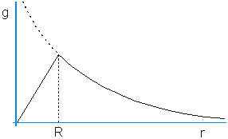
As we move further from Earth, gravitational field strength, g, becomes less.
Remember what was discussed about g for distances less than the Earth’s radius?
Slide 87
We can plot a graph of g as we move further from the Earth’s centre.
Note – it is an inverse-square graph.

Slide 38
If we use V = -GM/r to calculate V at the Earth’s surface, we come up with a figure for V of -63 MJ kg⁻¹.
What does this mean?
It means that 63 MJ of work needs to be done in order to move 1kg from the Earth’s surface to infinity.
We can figure out the work done to move a 1kg mass to infinity from a point in a field by working out the area under a g-r graph.
How does this work out?
Check it using the graph on p64. Bear in mind that you should get a value of 63 MJ kg⁻¹.
Why is the figure positive, rather than negative?

Slide 39
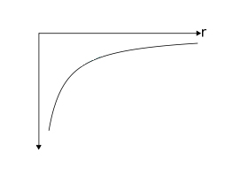
Another sort of graph which can be useful is V against r.
Note – it is a 1/r curve, not an inverse-square.
Questions:
P65 – qu 1-4
V

Slide 40
Revision questions:
P69 – qu 2a ii, b i
3a, b i & ii, c
6a, b
8

