Slide 1
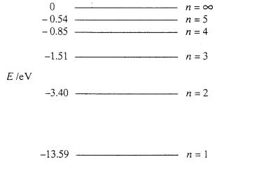
CW | Electric Potential | 02/11/2016
From my learning today I will be able to:
Key: | Calculate Potential (C)
Boost: | Draw and interpret equipotential lines (B)
Aspire: | Suggest the amount of energy needed to escape fields (A/A*)

Slide 2

Electrical potential (V ) For Radial
The electrical potential of a point within an electric
field is equal to the work that must be done per
coulomb of POSITIVE charge in bringing the charge
from infinity to the point.
Notes:
The electrical potential at infinity is ZERO.
Points around positive charges usually (but not always) have positive potentials and vice-versa.
Electrical potential is measured in joules per coulomb (J C⁻¹) or more commonly volts (V) where 1V equals 1 JC⁻¹.
Electrical potential is a SCALAR quantity

Slide 3


What's the potential at a point 2m from a +3C charge?
What's the potential halfway between these?
It cancels to produce zero potential. So moving from infinity to this point would take no energy because the work done by B attracting a positive charge will be equal but opposite to the work done on the charge by A, repelling it.

Slide 4
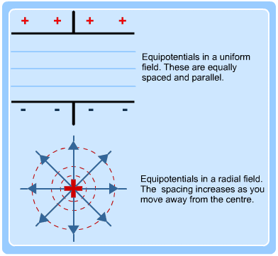
Equipotentials

Slide 5
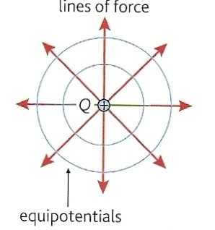
Electrical equipotentials
These are surfaces that join up points of equal potential.
  No work is done by electrical force when a charge is moved along an equipotential surface.
  Equipotentials are always perpendicular to field lines.

Slide 6
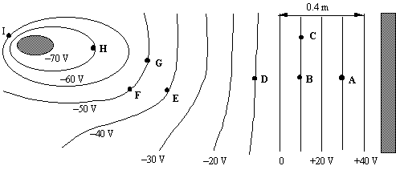

Slide 7
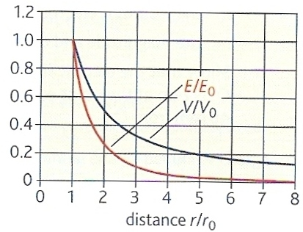
Variation of E and V about a positive charged sphere of charge Q and radius r_{o}
E = Q i
4πε_{o} r ²
V = Q i
4πε_{o} r

Slide 8
Electrical potential difference (ΔV )
When a charge, Q is moved through an electrical potential difference of ΔV the work done ΔW is given by:
ΔW = Q x ΔV

Slide 9
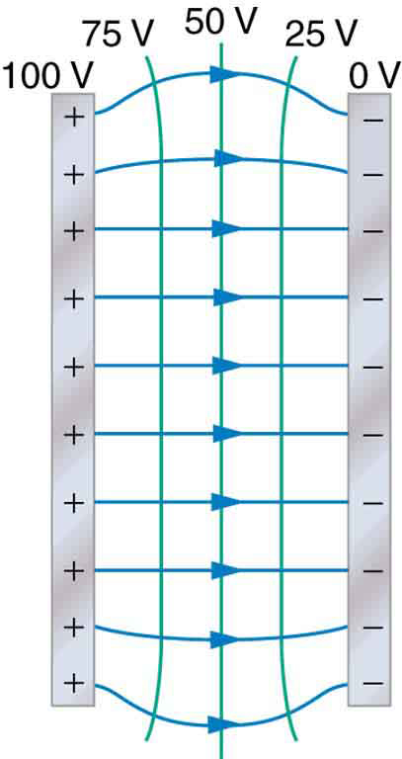

Slide 10
Question 1
Calculate the work required to move a charge 40 mC between two electrodes of potential difference 5 kV.
ΔW = Q x ΔV
= (40 x 10 ⁻³ C) x (5 x 10 ³ V)
Work = 200 J

Slide 11
Question 2
Calculate the work required to move an electron of charge 1.6 x 10 ⁻¹⁹ C between two electrodes of potential difference 1V.
ΔW = Q x ΔV
= (1.6 x 10 ⁻¹⁹ C ) x (1 V)
Work = 1.6 x 10 ⁻¹⁹ J
= 1 electron-volt !!

Slide 12
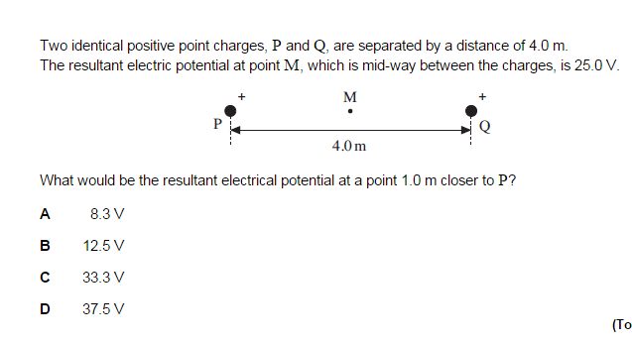
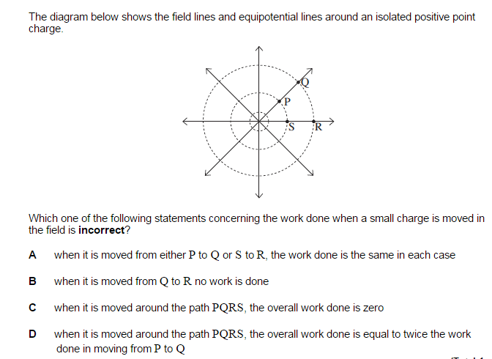

Slide 13
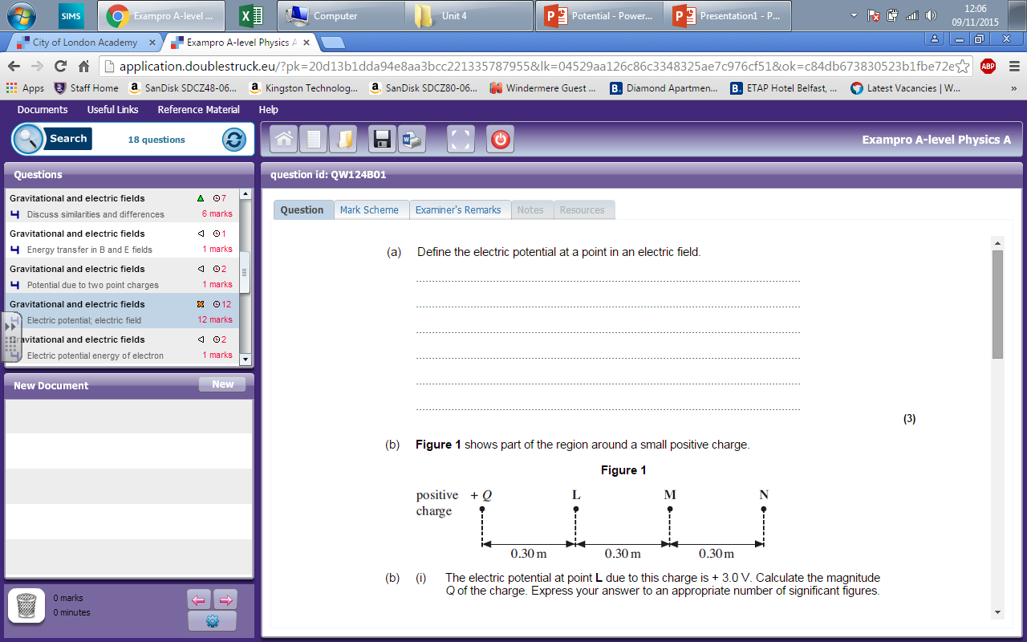
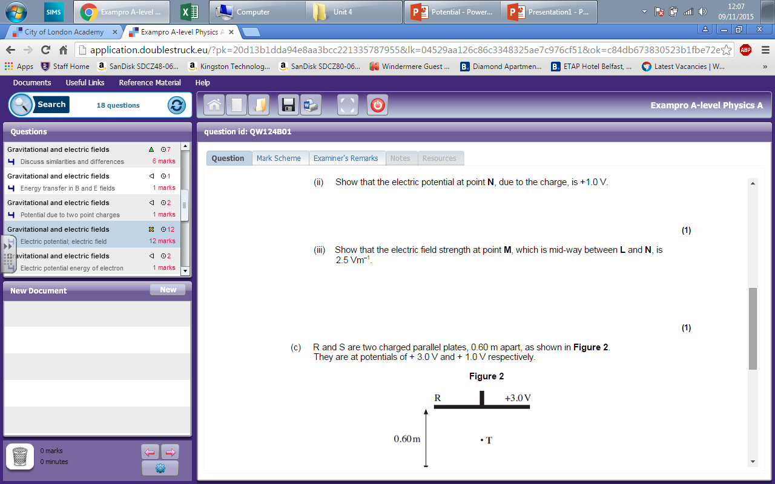
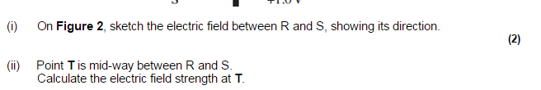

Slide 14
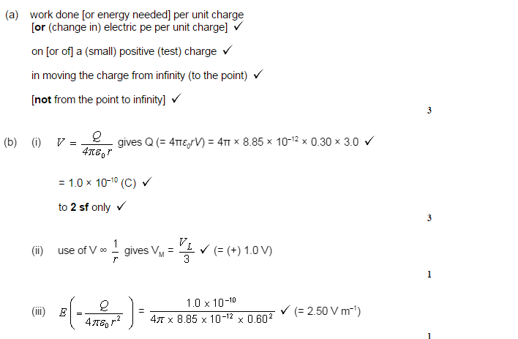
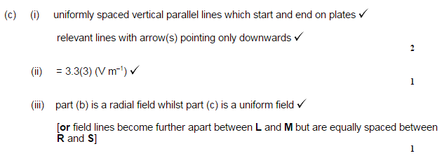

Slide 15
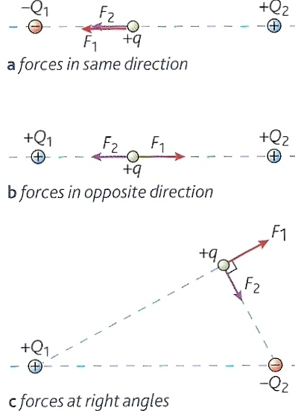
Calculate the resultant force, electric field strength and electrical potential experienced by test charge + q of magnitude 2pC in the situations shown opposite.
Both Q₁ & Q₂ have a charge of magnitude of 4μC
In situations (a) and (b) q is 3cm from Q₁ and 4cm from Q₂
In situation (c) q is 4cm from Q₁ and 3cm from Q₂
Remember that both force and electric field strength are vectors but that electrical potential is a scalar.

Slide 16
Combining fields answers
(a) F₁ = 8.0 x 10 ⁻⁵ N LEFT
F₂ = 4.5 x 10 ⁻⁵ N LEFT
ΣF = 12.5 x 10 ⁻⁵ N LEFT
E₁ = 4.0 x 10 ⁷ NC⁻¹ LEFT
E₂ = 2.25 x 10 ⁷ NC⁻¹ LEFT
ΣE = 6.25 x 10 ⁷ NC⁻¹ LEFT
V₁ = - 1.2 x 10 ⁶ V
V₂ = + 0.9 x 10 ⁶ V
ΣV = - 0.3 x 10 ⁶ V
(b) F₁ = 8.0 x 10 ⁻⁵ N RIGHT
F₂ = 4.5 x 10 ⁻⁵ N LEFT
ΣF = 3.5 x 10 ⁻⁵ N RIGHT
E₁ = 4.0 x 10 ⁷ NC⁻¹ RIGHT
E₂ = 2.25 x 10 ⁷ NC⁻¹ LEFT
ΣE = 1.75 x 10 ⁷ NC⁻¹ RIGHT
V₁ = + 1.2 x 10 ⁶ V
V₂ = + 0.9 x 10 ⁶ V
ΣV = + 2.1 x 10 ⁶ V
(c) F₁ = 4.5 x 10 ⁻⁵ N
UPWARDS TO THE RIGHT
F₂ = 8.0 x 10 ⁻⁵ N
DOWNWARDS TO THE RIGHT
ΣF = 9.17 x 10 ⁻⁵ N
RIGHTWARDS
E₁ = 2.25 x 10⁷ NC⁻¹
UPWARDS TO THE RIGHT
E₂ = 4.0 x 10⁷ NC⁻¹
DOWNWARDS TO THE RIGHT ΣE = 4.59 x 10 ⁷ NC⁻¹
RIGHTWARDS
V₁ = + 0.9 x 10 ⁶ V
V₂ = - 1.2 x 10 ⁶ V
ΣV = - 0.3 x 10 ⁶ V

