Slide 1
Induction
K – describe what happens to the moving conductor in the B-field
B – apply Fleming’s right hand rule
A – explain how a current is induced to flow in the wire

Slide 2
When a moving charge moves it produces a magnetic field.
Similarly when a conductor moves in a magnetic field it causes a current to flow in the conductor. This is called induction. This can also happen if you have a conductor with a magnetic field moving across it.
The condition for induction is that the conductor must cut across the lines of flux.

Slide 3
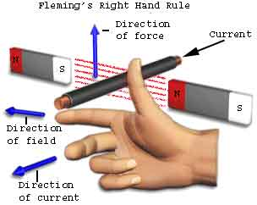
The direction of the current can be determined using Fleming’s right hand rule.

Slide 4
Task
Explain what happens to this conductor as it is moved across this magnetic field.

Slide 5
Answers
current moves upwards
Conductor cuts across lines of flux
Potential difference induced at the ends of the conductor
Current flows
Electrons move down

