Slide 1
23/04/2019
Transformers
In a generator current is induced in the coil.
What does this current create around the coil?
What effect does this magnetic field have? (remember the motor rule)
What is the logical consequence of this?

Slide 2
K – calculate the p.d. and current in primary and secondary coils
B – explain how a transformer works
A – explain the formation and effect of eddy currents

Slide 3
A transformer is used to changes the peak value of an alternating potential difference
Made from two coils which share the same iron core
All the magnetic flux produced by the primary coil passes through the secondary coil

Slide 4
Transformer rules
All transformers consist of two coils of wire that are wrapped around an Iron core
Transformers only work with AC Potential Difference
As the P.D. oscillates it induces a changing magnetic field in the primary coil
This magnetic field also cuts the secondary coil so an emf is induced in the secondary coil

Slide 5
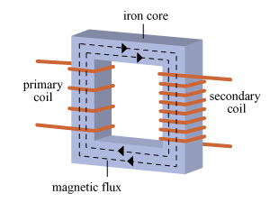
How does the transformer work?
Alternating current in the primary coil
Produces a constantly changing magnetic field
Inside the core
Made of soft iron
The magnetic flux passes through the secondary coil
This induces an emf in the coil
Which drives an alternating current in the secondary coil

Slide 6
Transformer Mathematics
The induced emf in the primary coil opposes the P.D. applied to the primary coil V_{P}
Faraday’s Law states that the induced emf in the secondary coil is the same as the flux linkage in the secondary coil

Slide 7
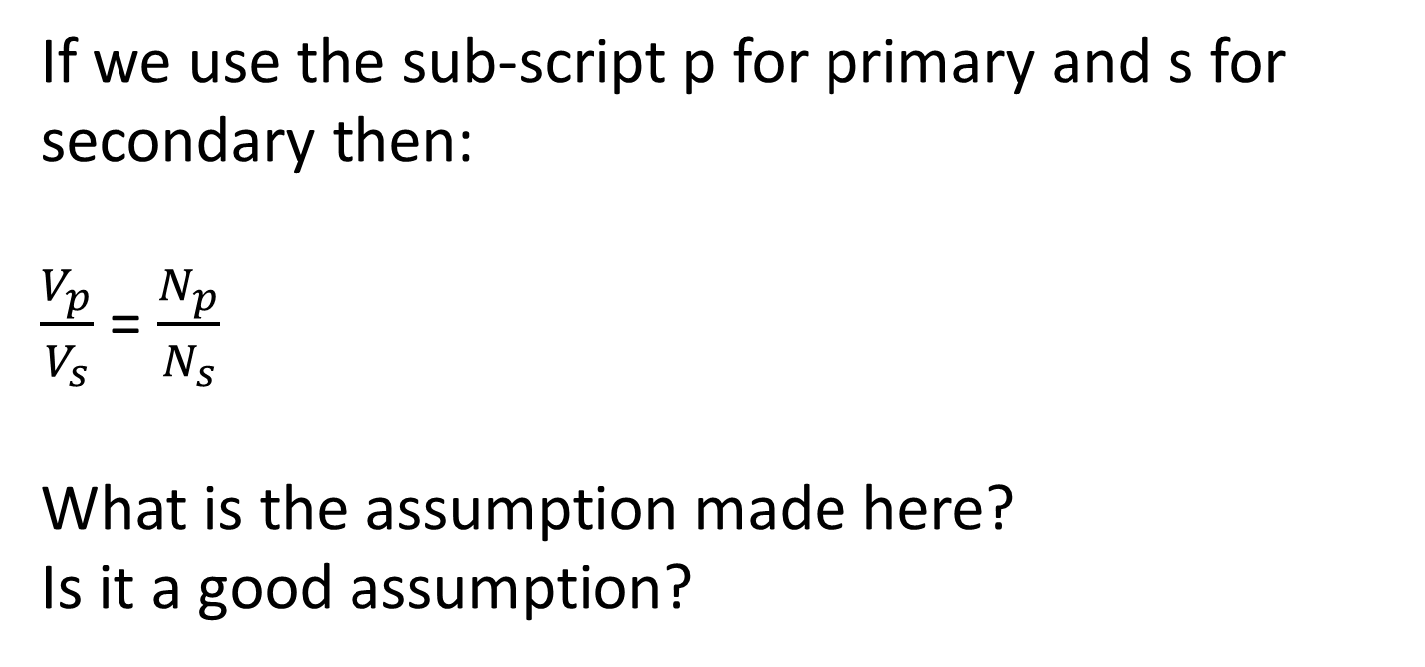
If we use the sub-script p for primary and s for secondary then:
$\frac{V_{p}}{V_{s}}$ = $\frac{N_{p}}{N_{s}}$
What is the assumption made here?
Is it a good assumption?

Slide 8
Calculating efficiency
When there is no current being drawn from the secondary coil (circuit is disconnected) the back emf in the primary coil acts against the p.d. in primary coil so there is very little current in the primary coil.
This explains why a phone charger that is left plugged into the mains with nothing attached to it charge draws very little current – important exam style question!
The efficiency is often given as a percentage. The use of superconductors would give even more efficient transformers however a superconductor that works at sufficiently high temperatures are yet to be discovered.
When there is no current being drawn from the secondary coil (circuit is disconnected) the back emf in the primary coil acts against the p.d. in primary coil so there is very little current in the primary coil.

Slide 9
Transformers are nearly 100% efficient.
Where could they lose energy from?
How could you stop them losing energy from these areas?

Slide 10
Transformers are nearly 100% efficient.
Where could they lose energy from?
Core
Windings
How could you stop them losing energy from these areas?

Slide 11
How could you stop them losing energy from these areas?
Windings:
made of wire with low resistance to reduce power wasted due to heating effect

Slide 12
How could you stop them losing energy from these areas?
Core:
Laminated – layers of iron separated by layers of insulator.
Eddy currents are induced in the core because of the magnetic flux in the core. These can heat the core. Laminating reduces this as much as possible and makes sure the magnetic flux is as high as possible.
Core is made of soft iron. This is easily magnetised and demagnetised so as to reduce the heating effect of repeatedly magnetising and demagnetising it.

Slide 13
A transformer can change the p.d. of an AC supply, both up and down
The transformer formula links the current, p.d. and number of turns on the coils:
The efficiency of the transformer is increased by using low resistance wires and a laminated iron core
The National Grid uses transformers to reduce heating in overhead cables by increasing the p.d. and lowering the current

