Slide 1

Gravitational Field Strength
Why do we not fall off the Earth? How would you explain Gravity to a young child?

Slide 2
Gravitational Fields
Everything that has mass creates a gravitational field around it
A test mass placed in this field will be attracted to the original mass by the force of gravity
The test mass will also create a gravitational field that will attract the original mass with an equal and opposite force
In most cases the test mass is very small so it moves towards the original mass along a field line or line of force

Slide 3
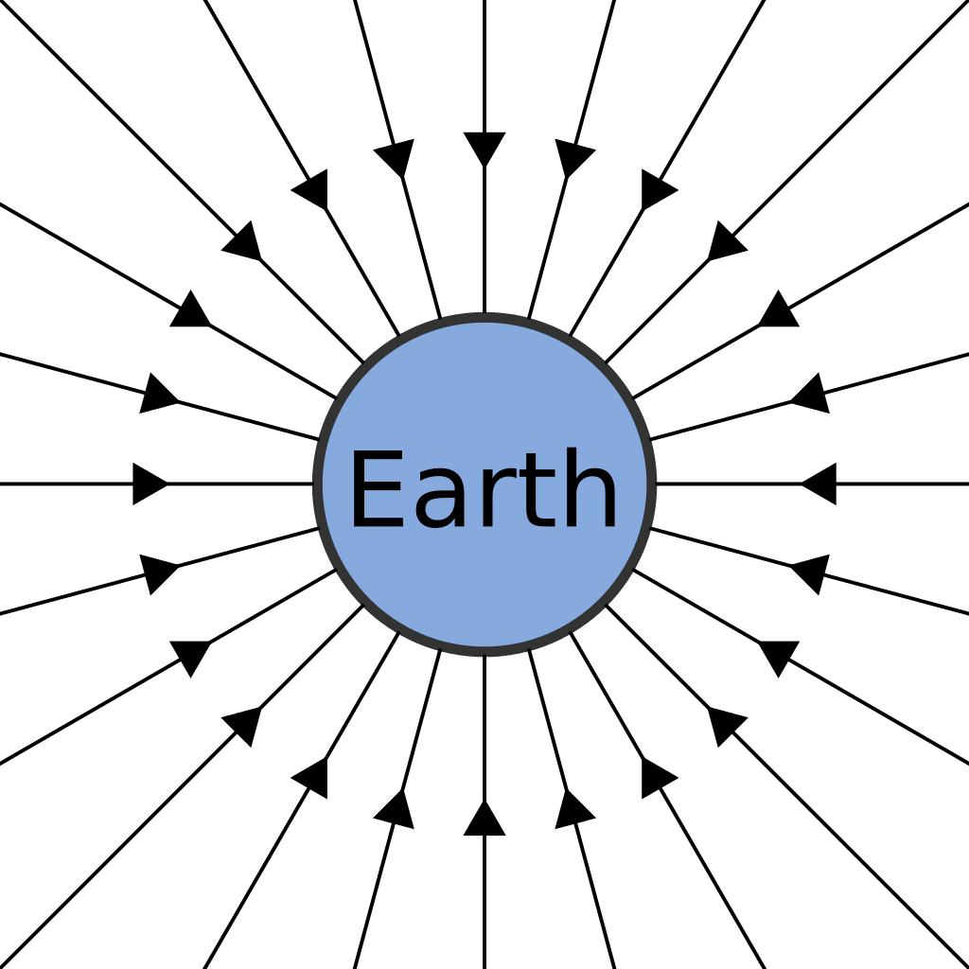
Definitions
“The strength of a gravitational field, g, is the force per unit mass on a small test mass placed in the field”
What are the units of g from the formula above?
N kg⁻¹

Slide 4
Freefall
Mass – How much of something there is measured in kilograms (kg)
Weight – The force felt by an object due to its mass in a gravitational field measured in newtons (N)
In a vacuum or when all other forces are negligible then an object will accelerate obeying Newton’s second law:
On Earth g is 9.8 Nkg⁻¹

Slide 5
Equivalent units
From the formula equating a to g then it is clear that the following are equivalent units:
(N kg⁻¹) and (ms⁻²)
Questions about equivalent units sometimes come up on examinations so remember this one!

Slide 6
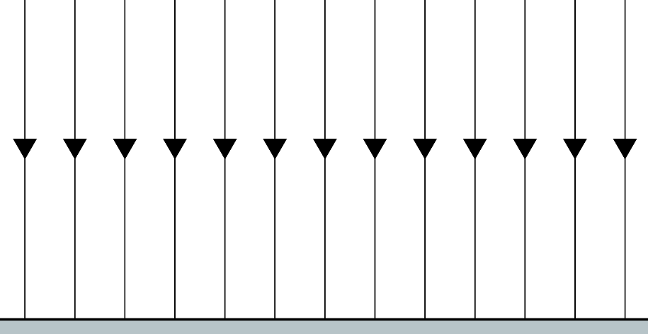
Field Patterns
You can see that for a planet or a point source then the field pattern is radial. Gravity always attracts so the field lines should be labelled pointing towards the centre
What would the field lines look like if you zoomed in to a very small area (e.g. close to the ground)
Uniform Field
Radial Field

Slide 7
Earth’s Gravity
Although it is clear that the gravitational field of planet Earth is radial so long as measurements are taken over heights that are small compared to the radius of the Earth then a uniform field can be assumed
The Earth is not a sphere but an oblate spheroid so the gravitational field strength g varies from place to place.
g = 9.8 N kg⁻¹ is used in all calculations for the surface of the Earth unless specified to a higher accuracy

Slide 8
Summary
Masses create a gravitational field around themselves that attract any test mass placed in that field
Two masses always attract each other with an equal and opposite force
A test mass that is very small compared to the mass attracting it will accelerate along a field line
Planets have radial field patterns however on their surfaces uniform field patterns can be assumed
g is 9.8 N kg⁻¹ on Earth
Objects in freefall accelerate where g = a (ms⁻²)

