Slide 1
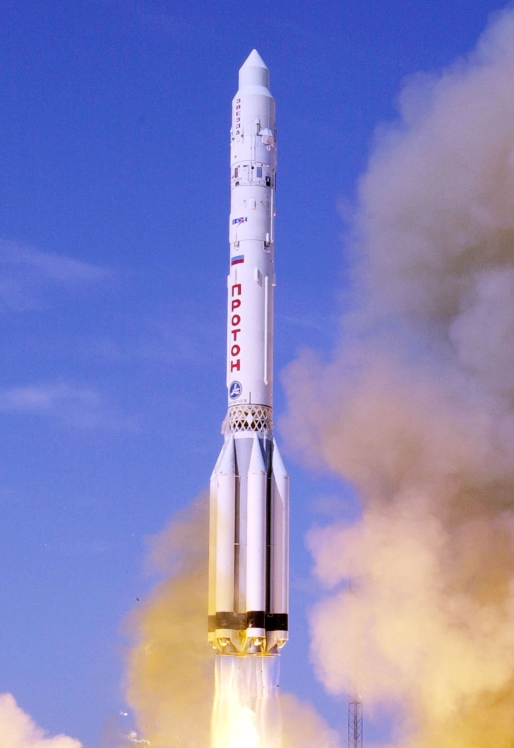
Gravitational Potential
How much energy does it take to escape gravity from a planet?

Slide 2
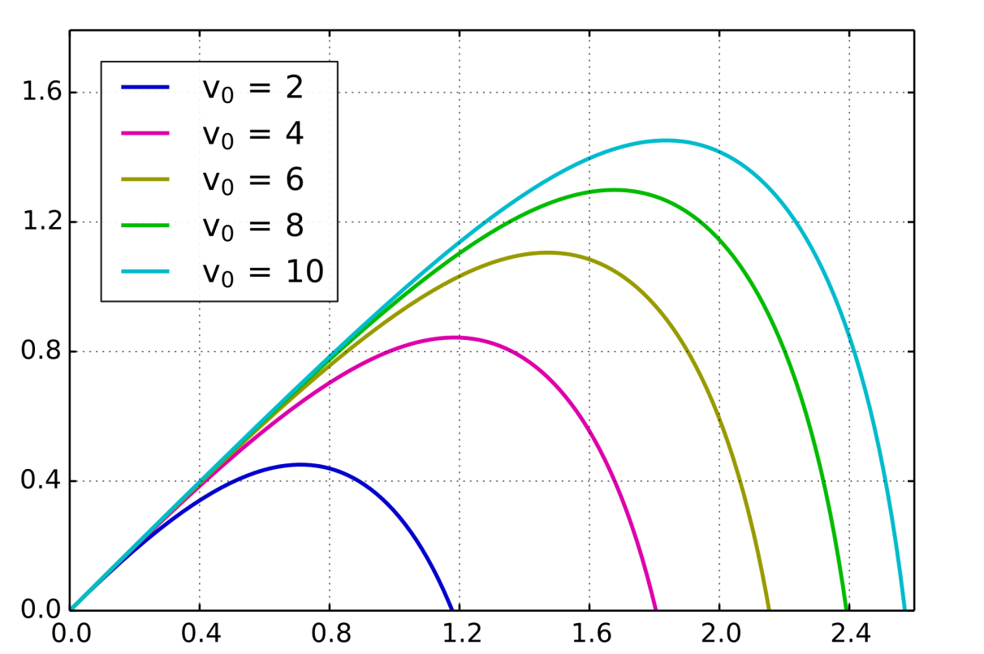
Gravitational Potential
As you move away from a planet then the gravitational field strength gets less – it is a radial field
As an object moves away from a planet then it must do work against the force of gravity
If the object does not possess enough energy then it will eventually be unable to move further away and gravity will pull it back again

Slide 3
Gravitational Potential Energy
The potential energy of an object is set at zero when an object is infinitely distant from an source of gravity
As you move towards the object then you lose energy (i.e. you would need to exert energy to move away from the object and hence gain potential energy) so all potential energy values will be negative values
The Gravitational Potential at a point is the Gravitational Potential Energy per unit mass at that point

Slide 4
Definitions
“The gravitational potential, V, at a point is the work done per unit mass to move a small objet from infinity to that point”
What will the units be for V?
J kg⁻¹

Slide 5
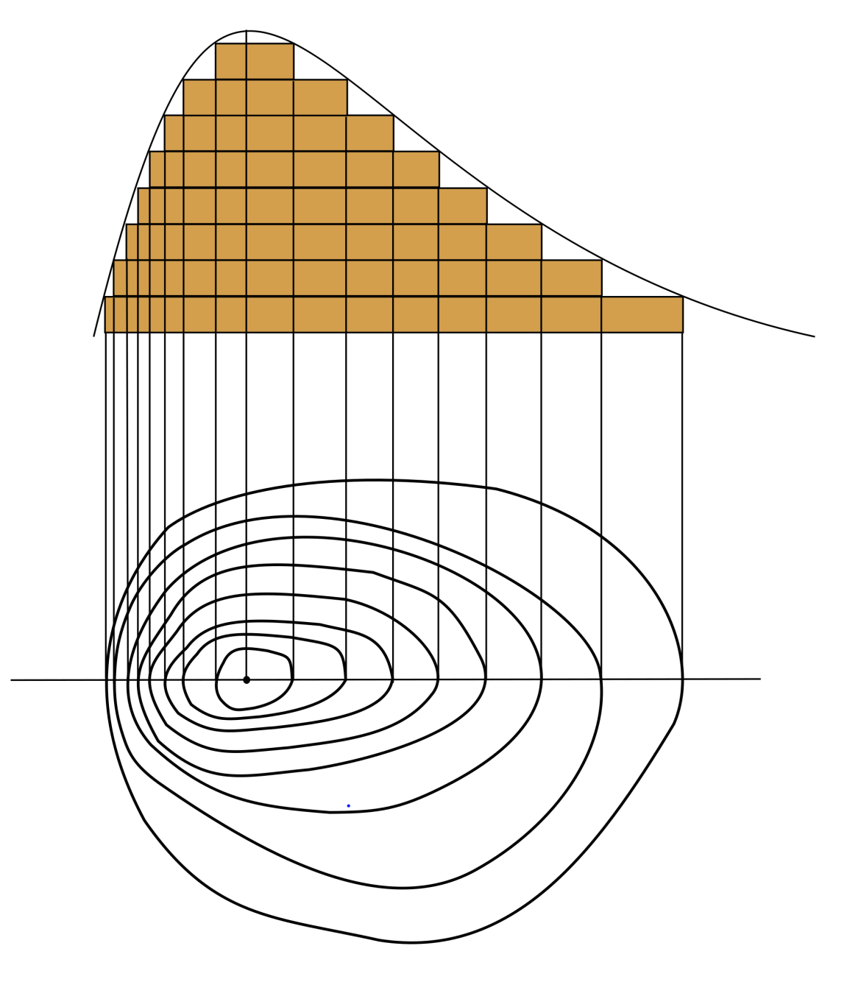
Equipotentials
On a map there are contour lines that show all of the places that have the same height (and hence the same gravitational potential) – without friction it would take no energy to move along these lines

Slide 6
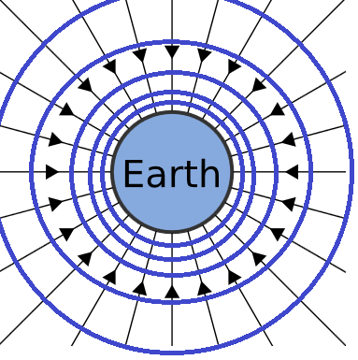
The equipotentials around planet Earth are therefore spheres
Because the gravitational potential gets less with distance these spheres are not evenly spaced

Slide 7
Potential Gradients
The potential gradient at a point in a field is change of potential per metre at that point
At the surface of planet Earth this is 9.8 J kg⁻¹ m⁻¹
Note: Gravitational Field Strength is simply the negative of the potential gradient

Slide 8
Summary
Gravitational field strength gets less with distance from the planet
Gravitational potential energy is zero at infinite distance from a source, hence potential energy is always negative
Equipotentials are points around a mass that have the same gravitational potential
The potential gradient is the change in gravitational potential per meter at that point, in J kg⁻¹ m-1
The gravitational field strength at a point is equal to the negative of the potential gradient at that point

