Slide 1
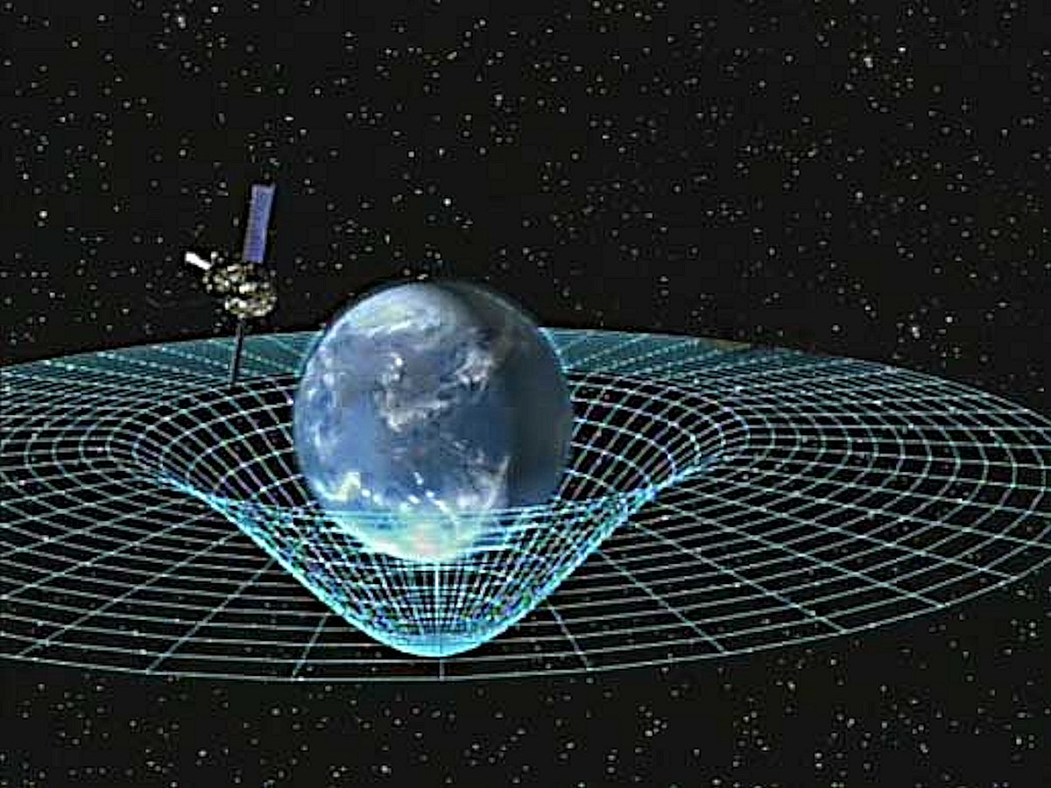
Planetary Fields
How would you describe the Gravitational field around a spherical mass?

Slide 2
Gravitational Field Strength
Newton discovered that the force between two point masses can be modelled as:
If you consider a test mass m placed into a gravitational field of a much larger mass M then you can calculate the gravitational field strength at that point:

Slide 3
Surfaces of planets
Remember that when doing calculations on planets and gravity you are modelling the planet as a point mass
If you are calculating g on the surface of a planet then you simply calculate the gravitational field strength at a distance r from the centre of the planet where r is the radius of the planet
As you go upwards into the atmosphere and beyond then the gravitational field gets strength weaker

Slide 4
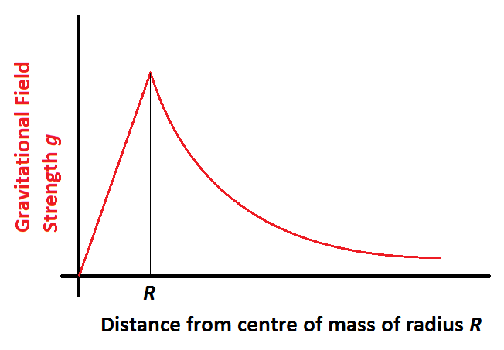
Inside planets and stars
As you move inside a spherical mass only the mass inside the radius contributes to the gravitational field strength. This means that even though the radius r is getting less the mass M is also reducing. The overall effect is that the gravitational field strength reduces linearly to zero at the centre
How does the gravitational field strength vary inside a planet or star as you move towards the centre?

Slide 5
Potential Energy and Escape velocity
Recall that the potential energy of an object is a negative value that represents the energy required to move an object from within a gravitational potential well to infinite distance (zero energy)
What value does this give for the surface of planet Earth?

Slide 6
To remove a mass m from a potential energy well requires work W to be done on it:
The kinetic energy of an object must exceed this value, therefore the escape velocity v can be calculated as:

Slide 7
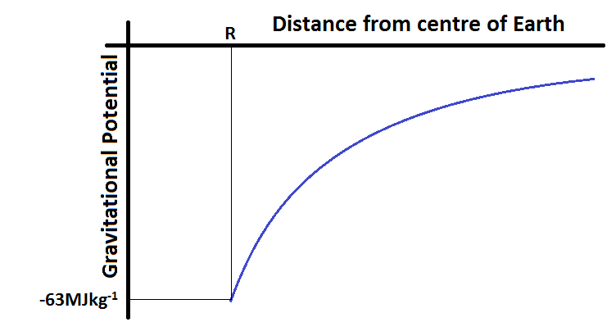
Graphing potential gradients
Note that the graph you have seen for the gravitational field strength is:
The graph for Potential gradients follows a different relationship, what is it?

Slide 8
Summary
You need to be able to plot or sketch graphs to show how the gravitational field strength and the potential gradients vary as you move away from the surface of a planet
You must recall that the graphs follow the relationships 1/r² and –(1/r) respectively
You must be able to calculate the escape velocity from potential energy wells including the Earth and other planets
You should be able to understand and be able to discuss the logistical difficulties associated with rocket launches

