Slide 1
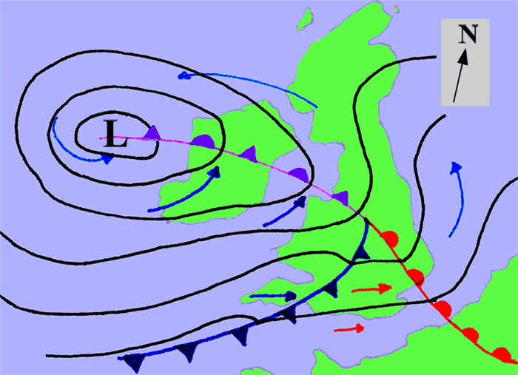
Electric Potential
What do the isobars represent on a meteorological map? What would the analogy be for electrical potential?

Slide 2
Definition
Recalling that the potential energy is zero at infinity from a charge then you can define the electric potential at a point as:
“The work done per unit charge to move a positive test charge from infinity to that position in the electric field”
What would the units be for electric potential?
Joules per Coulomb (JC⁻¹) or Volts (V)

Slide 3
Electric Potential Energy
Recall that the electric potential energy E_{P} of a charged object Q is the work done in moving it from infinity to that point in the field.
Therefore the relationship between Electric Potential V and energy E_{P} is:

Slide 4
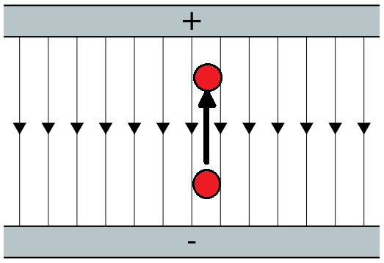
Moving charges
If a charge Q moves in an electric field from one point to another with differing electric potentials E_{P} then the work done W is:

Slide 5
Equipotentials
Equipotentials are positions that have the same potential energy. Think of contours on a map; if you walked around them then no work would be done against gravity.
If you link together positions around a charge that have the same potential energy then no work would need to be done for a test charge to move along those lines.
The force produced on the charge in the field would be always at right angles to the equipotential

Slide 6
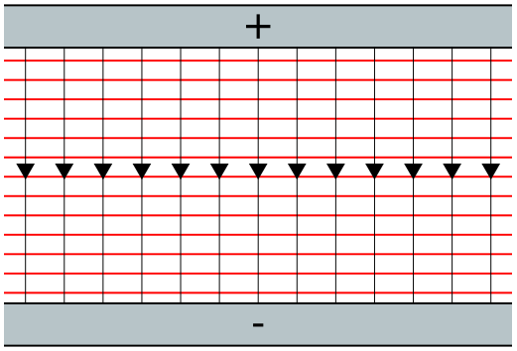
Equipotentials in an electric field between two charged parallel plates

Slide 7
Potential Gradient
Again using the analogy of the contours on a map, the closer they are together then the steeper the ground. This means that the rate of change of potential energy with distance is large.
The potential gradient in an electric field is the same, it is a measure of change of potential energy per unit change of distance
In a uniform field like this example then this is simply:

Slide 8
Electric field strength
In a non-uniform electric field then the electric potential gradient will vary from one place to another, much like different sides of a mountain having different steepness.
The analogy is still the same however you would have to calculate the rate of change of electric potential V with respect to change in displacement x
The negative of this value is called the electric field strength

Slide 9
Summary
The electric potential at any point around a charge is the work done per unit charge in moving a positive test charge to that point
Equipotentials are lines that link together points of the same electric potential, therefore no work is done on a charge moving along them
The force felt by a charge in an electric field is always along the field lines and perpendicular to the equipotentials
The potential gradient at a point in an electric field is the rate of change of electric potential with unit distance

