Slide 1
Coulombs Law
What would the electric field and equipotentials look like around a point charge?

Slide 2
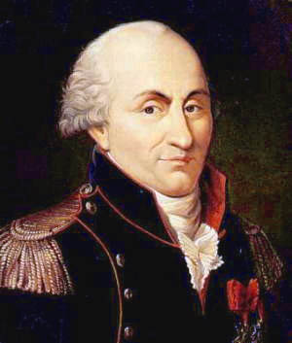
Famous for calculating the relationship between the force between charged particles and the distance between them
Charles-Augustin de Coulomb
1736 - 1806

Slide 3
Coulomb’s Law
Experiments performed by Coulomb showed that the relationship between force F and radial distance r from a point charge Q was:
Given your knowledge of Newton’s law of gravitation, and the differences between that and the properties that govern electric fields, can you write a formula to represent Coulomb’s Law?

Slide 4
Permittivity of Free space and Coulomb’s constant
You can now create a final formula for Coulomb’s law:
You may recall that the permittivity of free space is a constant (epsilon nought) that appeared in electric fields
Coulomb’s constant k can be expressed neatly as a multiple of this constant:

Slide 5
Gravitational vs Electric forces
Given the data, calculate the gravitational force and electric force between an electron and a proton:

Slide 6
Summary
Coulomb’s law is an inverse square law, i.e. the force felt by charges is inversely proportional to their separation
Coulomb’s law work on point charges and calculates the force felt by two charges placed a distance r apart
The value given only works for particles in a vacuum however air has a negligible effect.

