Slide 1
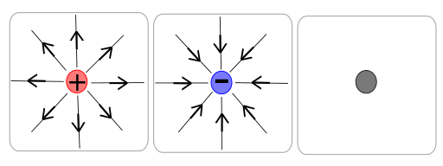
Point Charges
Recall that planets and stars can be considered “Point sources” – why is this the case and can it be extended to include charges?
Only when the size of the objects or particles is very small when compared to the distances between them

Slide 2
Electric Field Strength around a point charge
Recall both Coulomb’s law for a test charge q and also the Electric Field Strength E formula:
Combine these two formulae to create a formula to represent the field strength around a point charge

Slide 3
Vectors and Electric Field Strength
Consider the effect of having two charges Q acting on a test charge q
If the charges are pushing the test charge in the same direction then add the field strengths together
If the charges are working in opposition then subtract the field strengths
If the charges are acting at right angles to each other then use Pythagoras’ Law to add the vectors

Slide 4
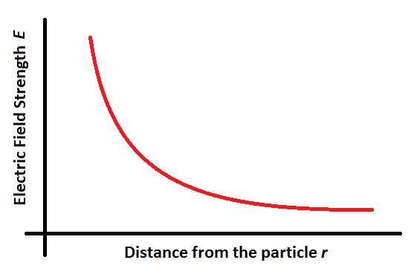
Graphing electric field strength
From the formula for electric field strength it should be clear that the correlation is an inverse square law. You should be able to sketch a graph showing electric field strength against radial distance for a point source

Slide 5
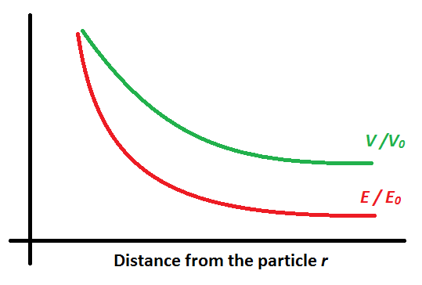
Electric Potential about a point source
What would the formula be for the electric potential V around a point source?
What would the electric potential look like on a graph compared to the field strength graph?
It is less steep due to being 1/r instead of 1/r²

Slide 6
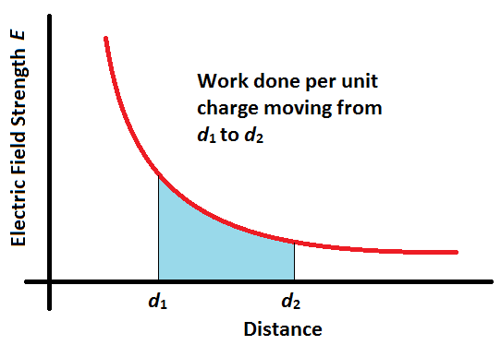
Using the area under a graph
Recall that work done is the product of force and distance
Recall also that the electric field strength at any point in a field is the force per unit charge at that point in the field
Therefore it follows that the area under an electric field strength versus distance graph will represent the work done per unit charge in moving a charge between the two points

Slide 7
Summary
Particles can be considered point sources with all of the charge being associated with their centre
The force on a charged particle in an electric field from a point charge follows coulomb’s law, which is an inverse squared law
The electric field strength from a point charge also follows an inverse square law
The electric potential from a radial field is an inverse law and hence has a lower gradient than the electric field strength
The area under an Electric Field Strength versus Distance graph represents the work done per unit charge in moving from one point to another

