Slide 1
Dielectrics
Why does a statically charged balloon stick to an uncharged wall or window?

Slide 2
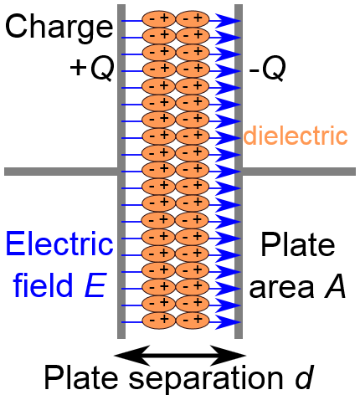
Increasing the capacitance of a capacitor
If you use an insulating material between the charged plates then a charge can be induced in this insulator when the plates become charged
This occurs due to movements in the molecules that make up the dielectric material
If the molecules are polar molecules then the effect is enhanced

Slide 3
Relative permittivity
The insertion of a dielectric is to increase the capacitance of a capacitor
If you take a reading of the capacitance without a dielectric and then with one, the ratio of the two values is the relative permittivity:

Slide 4
Dielectric constant
The relative permittivity is also often referred to as the dielectric constant of a material
Note that charge for a given potential difference can also be used to calculate this value instead of capacitance as they are proportional to each other
Material | Dielectric constant
Paper | 3.7
Quartz | 4.3
Mica | 7
Strontium Titanate | 300

Slide 5
Capacitor design
What design makes the best capacitor?
Large area for the plates (A)
Parallel plates
Plates close together (small distance d)
Dielectric between the plates with a large dielectric constant (ε_{r})

Slide 6
Polarisation and frequency
The dielectric works because the charge on the plates induces a polarising effect on the particles in the dielectric:
Orientation polarisation: Covalent molecules that do not share electrons equally are dipoles that align with the field
Ionic polarisation: Oppositely charged ions align with the field
Electronic polarisation: Electrons in an atom are displaced slightly and the atom then aligns with the field
When in an alternating field the three mechanisms work in different ways. They can only sustain the oscillations up to a certain frequency:
Orientation polarisation decreases first (10⁹ Hz)
Ionic polarisation decreases second (10¹² Hz)
Electronic polarisation decreases last (10¹⁵ Hz)

Slide 7
Summary
A dielectric is a material that is placed between the plates in a capacitor to increase the capacitance
The dielectric constant is the ratio of the capacitance with and without the dielectric, the higher the value the greater the increase in capacitance due to its use
The formula for capacitance links to the best possible design for a capacitor
The use and design of a dielectric must be considered if the capacitor is to be used in alternating fields

