Slide 1
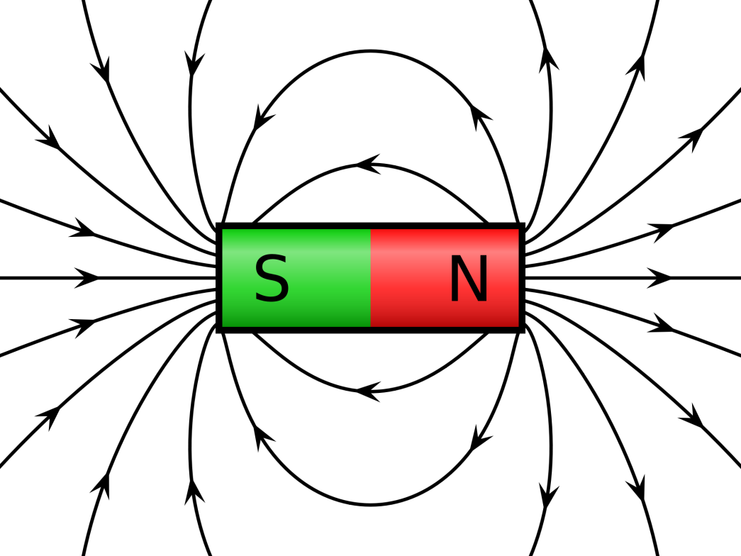
Current carrying conductors in a magnetic field
Is there a link between magnetism and electric charges? Would one effect the other?

Slide 2
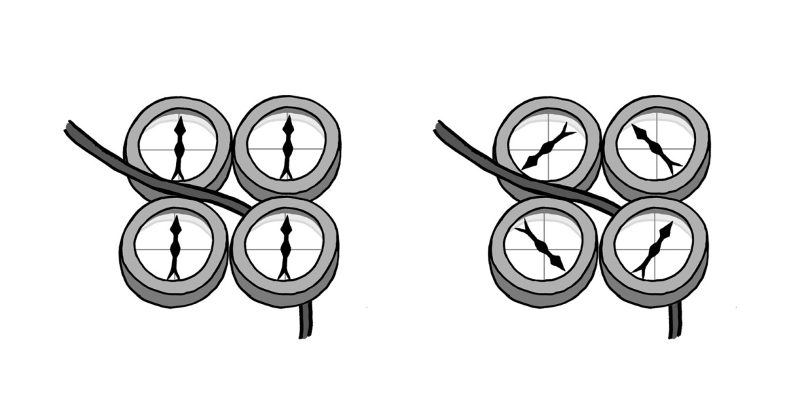
Magnetism and moving currents
The most obvious magnetic field is the one present around planet Earth, caused by the convective motion of the metallic core
As electrons pass through a wire a magnetic field is created around the wire, this can be observed by placing plotting compasses next to a wire with a current flowing

Slide 3
Lines of force
In magnetism, like in electric fields, there are lines of force.
Magnets have “North seeking” and “South seeking” poles, so named by the Pole on planet Earth that they align towards from free to move
If totally free to move the a north pole on a magnet would move along the magnetic field lines

Slide 4
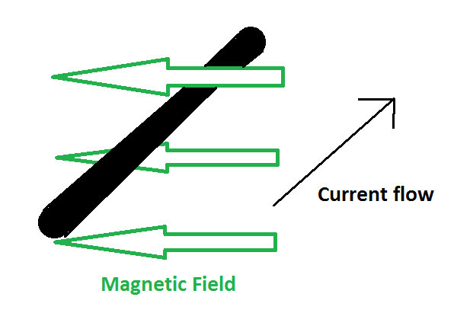
The motor force
If a current carrying wire is placed into magnetic field then it feels a force
This force acts:
  Perpendicular to the magnetic field lines
  Perpendicular to the direction of current flow
What direction(s) can the force be in that is perpendicular to both fields?
Up or down

Slide 5
What effect does varying the angle have on the force?
The force is greatest when the current flow and the magnetic field are perpendicular.
The force is zero when the two are parallel
Increasing the current will increase the force
Increasing the magnetic field strength will increase the force
Increasing the length of wire that is inside the magnetic field will increase the force

Slide 6
Formula and units
If the current flow is at right angles to the magnetic field then then the following formula can be used:

Slide 7
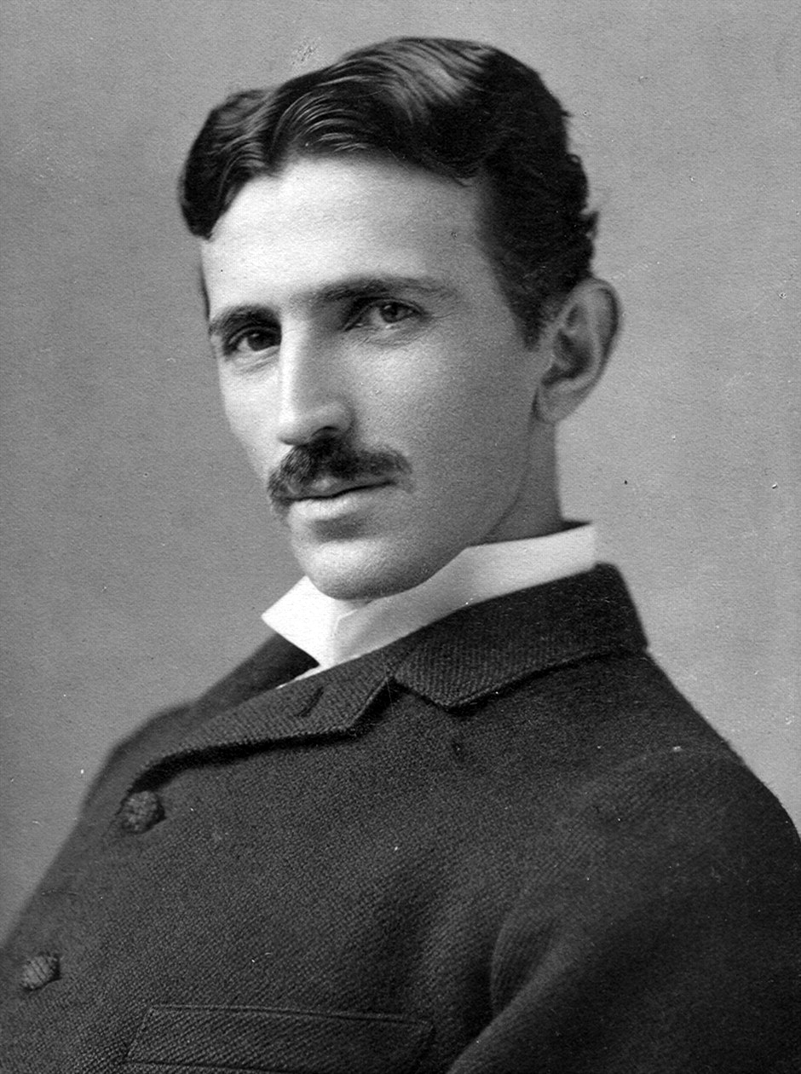
Nikola Tesla
The unit for Flux Density is the Tesla, so named after Nikola Tesla
It is defined as 1 N m⁻¹ A⁻¹
1856 - 1943

Slide 8
Examples of Flux Densities
Position | Flux Density /T
Near a small Bar Magnet | 0.01
Inside a sunspot | 0.15
Near a strong electromagnet | 10
Surface of a Neutron Star | 100,000

Slide 9
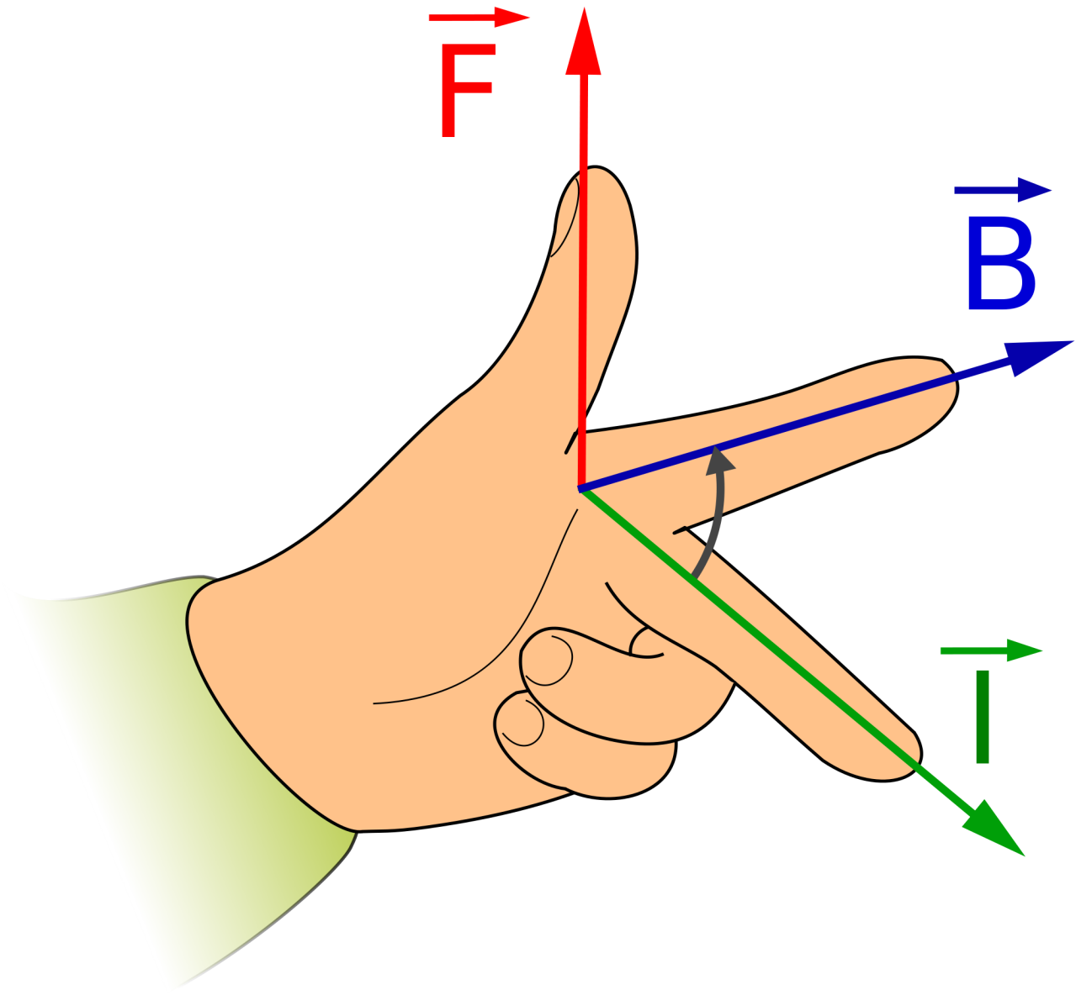
Flemming’s left-hand rule
The direction of the motor force can be worked out by performing the following with your left hand
  First finger (index) points in the direction of the magnetic force (North to South poles)
  Second finger (middle finger) points in the direction of the conventional (positive) current flow (away from your palm)
  Extend your thumb at right angles to both to show the direction of the motor force

Slide 10
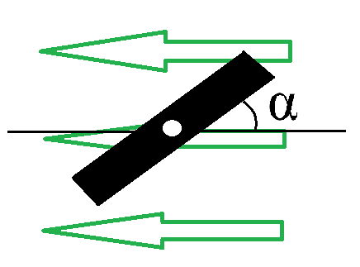
Coils
If a wire is coiled inside a magnetic field then the total length of the wire is the length multiplied by the number of coils n
This extends the formula to:
If the entire coil is within the magnetic field then one end of the coil has the current one way and the other end has the current reversed. This means that either end of the coil feel an opposite motor force. This creates a turning force or torque – the idea behind the electric motor.

Slide 11
Summary
The strength of a magnetic field is called the Flux Density B and is measured in Tesla (T)
Flemming’s left-hand rule shows which direction the motor force will act
The formula for magnetic flux density assumes that the current and magnetic field are perpendicular
A coil of wire in a magnetic field feels a turning force or torque

