Slide 1

Moving charges in a magnetic field
Given your knowledge of the motor force acting on a current carrying wire, what would happen to a charged particle moving through a magnetic field?

Slide 2
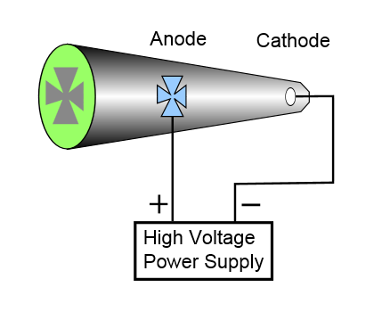
Experimental evidence
Looking at the demonstration which accelerates negative electrons onto a fluorescent screen, whet will bet the effect of bringing a North seeking pole towards the beam?

Slide 3
Motor force acting on particles
The motor force acts on individual particles in exactly the same way as it does on a current carrying wire, this is because it is the electrons in the wire that feel the force
This effect is used in particle accelerators to both steer the particles around the circular path and also to analyse the new particles created as find out their properties

Slide 4
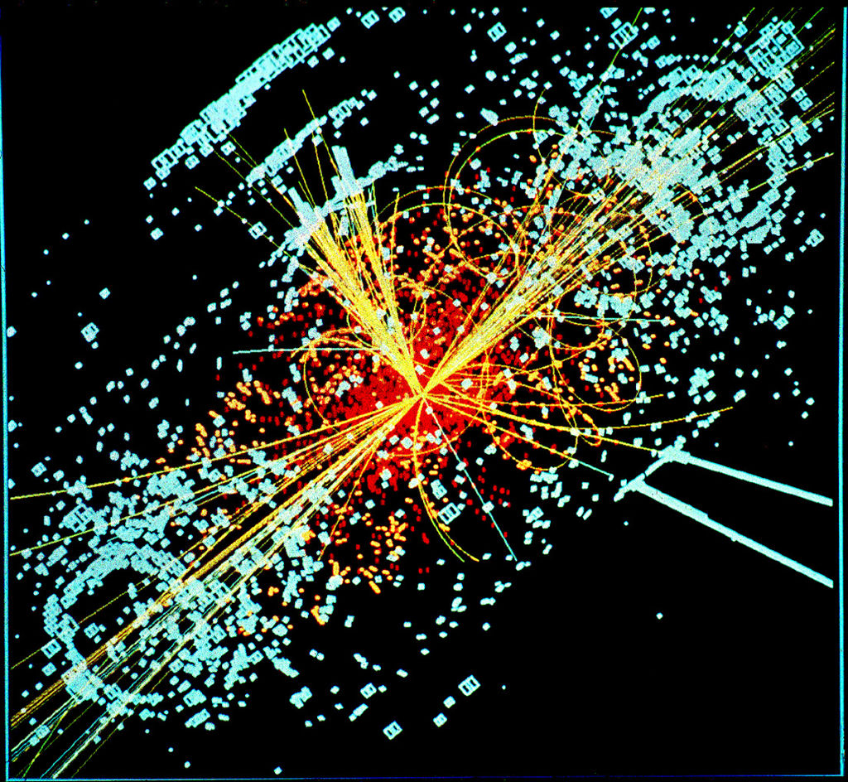

Slide 5
Formula
From the motor force formula we have:
The particle is moving with velocity v through a length L in time t with charge Q
Therefore by substitution we attain:

Slide 6
Direction of velocity
As a particle moves through a magnetic field it is unlikely to be moving perpendicular to the field lines. If it’s velocity vector is at an angle θ to the field lines then the formula becomes:
You are not expected to use this extended formula for A-Level Physics

Slide 7
Summary
Charged particles that are moving in a magnetic field feel a force
This force is greater if:
  The field is stronger
  The move faster
  They have a greater charge
The formula used to calculate this force (assuming the particle is moving perpendicular to the field) is:

